Slide 1
A Nuanced SLE Case: Highlights of Management
Surbhi Patel, MD PGY-2¹, Sanket Shah, DO PGY-4²
Department of Internal Medicine and Geriatrics ¹, OHSU Division of Arthritis and Rheumatic Diseases²
OHSU

Slide 2
Financial Disclosures and Acknowledgements
No financial disclosures to disclose
Thank you Sanket Shah, DO for contributions to the presentation

Slide 3
Case Presentation Overview
Outpatient
Hospitalization
Treatment
Discussion

Slide 4
Case
11/2024: PCP Visit
24 yo M presents w intermittent facial swelling, arthralgias, stiffness
No known past medical history
Father and paternal grandmother with history of Rheumatoid Arthritis
Social history notable for cannabis use. No tobacco or alcohol use. Works at a cannabis dispensary

Slide 5
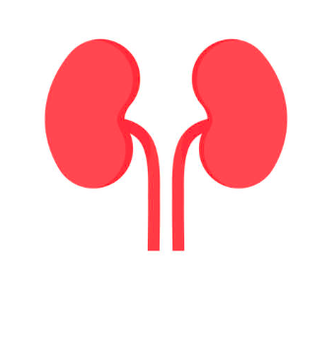
Outpatient Workup
Labs showed elevated CRP, leukopenia with absolute lymphopenia, anemia
ANA 1:1280, multiple strong positive ENA (strong positive anti-dsDNA, RNP, Smith, Smith/RNP, antichromatin)
Urine studies with casts, WBC, RBCs. Protein:Creatinine 4.51g/day
Concern for Lupus Nephritis
Referred to Nephrology for suspected Class 3 vs 4 Lupus Nephritis on 12/20/2024
Initiated on hydroxychloroquine 200mg BID, lisinopril 5mg
Referred to Rheumatology and plan for renal biopsy

Slide 6
12/31/2024: Course Complicated by hospitalization
Developed inattention, impaired coordination, reduced po intake, epigastric pain and malaise→ ED visit
LABS:
CBC - WBC 4.9 with absolute lymphopenia 310, Hgb 8.7, MCV 74, Plt 217
CMP - Na 131, BUN 39 Cr 2.6 (baseline 0.9), Ca 8.2, T Protein 6
low C3 74, low C4 12.5
Haptoglobin elevated 440, positive direct Coombs test
UA +blood, protein, LE, few bacteria, granular casts
UDS +cannabinoids, otherwise negative
Ferritin 808
Tsat 18%
Lipase 372

Slide 7
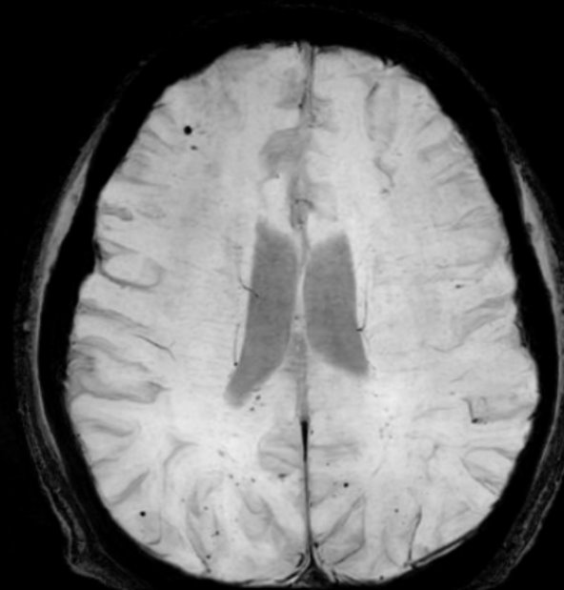
MRI Brain wwo contrast
Evolving innumerable small infarcts predominantly in a parasagittal distribution in the bilateral cerebral hemispheres.
Innumerable microhemorrhages of the supra and infratentorial brain along with sulcal hemosiderin staining in the cerebral hemispheres suggestive of prior small volume subarachnoid hemorrhage.
Suggestion of mild stenosis and irregularity of the bilateral M1 middle cerebral artery segments with no associated abnormal vessel wall enhancement of the proximal anterior and posterior circulation.

Slide 8
Review Of Systems
General: fatigue, weakness, fevers, night sweats, weight loss. ​
Eyes: changes in visual acuity, diplopia, amaurosis, no discharge, tearing or eye pain.​
Ears/Nose/Throat: sore throat, dental pain, hearing loss, ear pain.​
CVS: chest pain, leg swelling, or palpitations.​
Respiratory: pleuritic pain, shortness of breath, cough
Gastrointestinal: abdominal or flank pain, anorexia, nausea or vomiting, dysphagia, change in bowel habits or black or bloody stools or weight loss.​
Musculoskeletal: joint pain, swelling hot/red/swollen joints, myalgias, back pain, dactylitis, fasciitis, enthesitis​
Neurologic: generalized weakness, cognitive impairment ; unilateral disturbance of motor or sensory function. loss of balance or vertigo, numbness, tingling​
Heme/Lymphatic: abnormal bruising, abnormal bleeding or enlarged lymph nodes, history of blood clots
Skin: petechiae, rash, plaques, skin thickening, ulcers, blisters, bruising, Raynauds​

Slide 9
Physical Exam
BP: 132/68, P:65, T:97.7, R:17​
Gen: No acute distress​
Heart: RRR, no LE edema, no JVD​
Pulm: Normal respiratory effort but catches his breath with deep inhalation which causes right-sided chest pain, CTAB, no crackles, wheezes, or rhonchi​
MSK: no synovitis or joint tenderness of b/l DIPs, PIPs, MCPs, wrists, elbows, shoulders, knees, ankles, and MTPs. Full ROM throughout joints of upper and lower extremities​
Skin: no abnormal nodules, plaques, or ulcerations. Over the skin of the shoulders there are scattered ~1mm erythematous nonblanching macules. No oral ulcers or other ulcers​
Neuro: Alert and oriented x4, "Lupus" as reason for admission; CN II-XII grossly normal, 4+/5 strength in b/l upper and 5/5 in lower extremities, sensation normal to light touch, normal but slow gait. Significant latency in responses. Serial sevens able to slowly get to the 50s with one error, ~20 seconds per number​

Slide 10
Outpatient Lab Overview Thus Far
11/6/24​
CBC: WBC 3.3, abs lymphopenia 500, Hgb 10, MCV 80, elevated Plt 500s​
CMP: Normal electrolytes, Cr 0.98 (baseline), Albumin 2.6, T protein 5.3, Calcium 7.9​
CRP 46 mg/L​, Uric acid 6.3​, ESR 11​
A1C 5.7%​
11/20/24​
ANA >1:1280 dense fine speckled​
Anti-dsDNA >300​
Anti-RNP >8.0​
Anti-Smith >8.0​
Smith/RNP >8.0​
Antichromatin >8.0​
UA 4+ protein, 2+ blood, 2+ ketones, 11-30 RBC​
Negative Anti-SCL70, SSA, SSB, ribosomal P, Jo1, Centromere B​, RF 15​
Negative CCP 14​
12/5/24​
Urine Pr: Cr ratio 4.51​
Negative anticardiolipin, negative Beta-2 glycoprotein, negative LA​
Positive direct coombs test​
​
​
​

Slide 11
Labs, continued
12/31/24​
CBC - WBC 4.9 with absolute lymphopenia 310, Hgb 8.7, MCV 74, Plt 217​
CMP - Na 131, BUN 39, Cr 2.6, Ca 8.2, T Protein 6​
C3 74, C4 12.5​
Haptoglobin elevated 440 ​
UA: +blood, protein, LE, few bacteria, granular casts​
UDS +cannabinoids​
Ferritin 808​
Tsat 18%​
Lipase 372​
1/3/25
CBC normal overall WBC but lymphopenia 460, anemia Hgb 7.6, MCV 76, Plt 309
LDH 251​
CRP 36.8​
CMP Na 139, BUN 70, Cr 2.51, calcium 7.7, albumin 2.4​
Haptoglobin 328​
Normal coagulation studies

Slide 12
Additional Labs
12/31/2024
Lumbar Puncture
Clear​​
RBC count: 306​
WBC count: 0​
Glucose: 41​​
Protein 80​
HIV negative​
HAV total ab positive, IgM negative ​
HBsAg, HBsAb negative ​
HCV negative
Quantiferon Gold Indeterminate
Normal aHUS genetic panel
Excessive complement activation with significantly elevated sC5B-9 level of 992​

Slide 13
Labs + Imaging = Concern for CNS Vasculitis
Transferred to OHSU for further management and Rheumatology Consulted

Slide 14
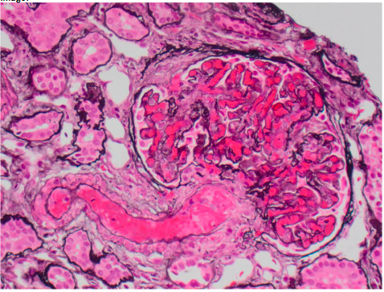
Renal Biopsy
Native kidney biopsy:
Acute thrombotic microangiopathy, with glomerular mesangiolysis, arteriolar fibrin thrombi, and focal dissolution of arteriolar walls
Focal lupus nephritis with features of activity and chronicity, ISN/RPS class III (A/C)
Vascular immune deposits, detected by immunofluorescence microscopy, related to #1
Mild tubular atrophy and interstitial fibrosis
Electron Microscopy showing acute endothelial injury as well as glomerular immune deposits
Notes:
The most prominent finding in this biopsy is an acute thrombotic microangiopathic (TMA), with arteriolar fibrin thrombi and focal dissolution/necrosis of arteriolar walls. In glomeruli, this is manifest as mesangiolysis and ischemic changes. Recent antiphospholipid antibody testing is noted to be negative Rarely, these features of endothelial injury can represent morphologically early findings in vasculitis (plausibly related to a shared pathway of endothelial injury, with unknown relationship to complement abnormalities), although definitive arteritis is not seen. The role of complement potential defects in these and patients with lupus-associated TMA is not known, but may be worthy of investigation in this case.
In addition, there is a more conventional lupus immune complex mediated glomerulonephritis, with IgG and C1q dominant immune complex deposition in glomeruli and extraglomerular vascular deposits. Active lesions involve approximately 35% of glomeruli and include cellular crescents in 10% within additional 13% of glomeruli involved by fibrocellular crescents. Chronic injury involves approximately 13% of glomeruli, and includes 3% global glomerulosclerosis and 10% segmental fibrous scars. There is approximately 10% tubular atrophy and interstitial fibrosis. There is a segmental membranous pattern but this does not appear to meet criteria for an additional diagnosis of membranous lupus nephritis; this will be further evaluated by electron microscopy, and the results reported in an addendum.

Slide 15
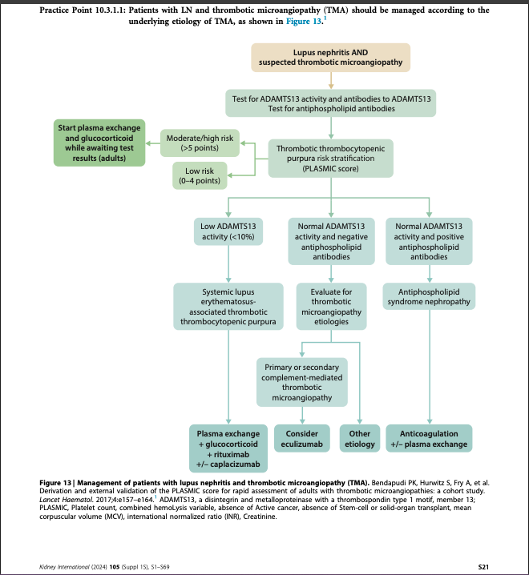
Diagnosed with
Lupus Nephritis + complement-mediated TMA
Normal aHUS genetic panel
Excessive complement activation with significantly elevated sC5B-9 level 992​ ng/mL
low C3, C4

Slide 16
Clinical course
Initiated on 1000mg IV methylprednisolone pulse x 3 days + cyclophosphamide for CNS involvement concerning for neuropsychiatric lupus→ noted to have systemic improvement
Initially planned to start voclosporine however discovery of TMA superimposed on lupus nephritis raised concern that CNS lesions were secondary to limited TMA.
After multidisciplinary conference with Heme-Onc and Nephrology, opted to start belimumab instead due to those extra-renal manifestations.
Started on Eculizumab for complement-mediated TMA​

Slide 17
Patient Course Thus Far
Meningococcal vaccination with Meningococcal conjugate vaccine and Meningococcal group B vaccine. Plan to continue penicillin prophylaxis for the duration of eculizumab treatment to reduce the risk for meningococcal disease​
Significant improvement in his mentation and kidney function with initiation of treatment with Methylprednisolone/prednisone, cyclophosphamide, belimumab, and eculizumab​
Cr improved to 1.6, plan to stop cyclophosphamide and start mycophenolate​
Close to baseline prior to discharge, mild cognitive dysfunction that is slowly improving​
Updated plan to stop eculizumab and start ravulizumab (long-acting complement inhibitor)​

Slide 18
Thrombotic Microangiopathy (TMA)
Triad of microangiopathic hemolytic anemia, thrombocytopenia and ischemic organ injury
Leads to endothelial injury and microvascular thrombi formation
Primary: ADAMTS13-deficiency, complement-mediated TMA (atypical HUS), Shiga-toxin-associated TMA
Secondary: Autoimmune-Associated, Pregnancy-associated TMA, Infection-Associated, Transplant-Associated, Cancer-Associated
Genest, et al, 2022

Slide 19
TMA in SLE
Immune-complex deposition and complement activation are implicated⁸
24% incidence of TMA development in patients with SLE¹⁰
TMA is an independent prognostic factor resulting in higher mortality and higher risk of developing End Stage Renal Disease¹¹
Treatment options include:
Immunosuppression
Plasma exchange, double filtration plasmapheresis
Eculizumab for complement-mediated TMA
Belimumab
Rituximab

Slide 20
Guidance for Management of TMA in SLE
Early recognition is key; co-management with Hematology is recommended²
Thus far, there have been a few case series,^{1,2,3,5,6} recommendations from the KDIGO 2024 Guidelines, and a 2013 systematic review⁹ to recommend management with eculizumab for TMA in SLE for adjunctive therapy
Data on eculizumab has been extrapolated after treatment in aHUS groups and APS^{3,5}
Duration of treatment has also varied based on clinical response⁶
Next Steps: complete randomized control trial to determine minimal treatment duration, evaluate role of eculizumab in refractory lupus nephritis with TMA
Notes:
aHUS: atypical Hemolytic Uremic Syndrome
APS: anti-phospholipid syndrome

Slide 21
Conclusions
Complement-mediated thrombotic microangiopathy (TMA) in lupus, particularly in the context of lupus nephritis (LN) is a severe and challenging condition to manage ​
Complement-mediated TMA should be suspected in LN patients with TMA features, such as thrombocytopenia, microangiopathic hemolytic anemia, and acute kidney injury, especially when ADAMTS13 activity is >10% and antiphospholipid antibodies are negative.
The Kidney Disease: Improving Global Outcomes (KDIGO) 2024 guidelines recommend the use of eculizumab, a complement inhibitor, as the primary treatment for complement-mediated TMA in LN.
The optimal dose and duration of eculizumab therapy remain controversial. Regular monitoring of hematologic and renal parameters is essential to guide treatment adjustments.

Slide 22
References
Cao M, Leite BN, Ferreiro T, et al. Eculizumab modifies outcomes in adults with atypical hemolytic uremic syndrome with acute kidney injury. Am J Nephrol. 2018;48:225–233.
Cavero T, Rabasco C, Lopez A, et al. Eculizumab in secondary atypical haemolytic uraemic syndrome. Nephrol Dial Transplant. 2017;32:466– 474.
de Holanda MI, Porto LC, Wagner T, et al. Use of eculizumab in a systemic lupus erythemathosus patient presenting thrombotic microangiopathy and heterozygous deletion in CFHR1-CFHR3. A case report and systematic review. Clin Rheumatol. 2017;36:2859–2867.
Genest DS, Patriquin CJ, Licht C, John R, Reich HN. Renal Thrombotic Microangiopathy: A Review. Am J Kidney Dis. 2023 May;81(5):591-605. doi: 10.1053/j.ajkd.2022.10.014. Epub 2022 Dec 10. PMID: 36509342.
Kello N, Khoury LE, Marder G, et al. Secondary thrombotic microangiopathy in systemic lupus erythematosus and antiphospholipid syndrome, the role of complement and use of eculizumab: case series and review of literature. Semin Arthritis Rheum. 2019;49:74–83.
Lupus Nephritis (2024), Kidney Disease: Improving Global Outcomes (KDIGO) Lupus Nephritis Work Group. KDIGO 2024 Clinical Practice Guideline for the Management of Lupus Nephritis. Kidney Int. 2024;105(1S):S1–S69. PMID: 38182286
Li QY, Yu F, Zhou FD, Zhao MH. Plasmapheresis Is Associated With Better Renal Outcomes in Lupus Nephritis Patients With Thrombotic Microangiopathy: A Case Series Study. Medicine (Baltimore). 2016 May;95(18):e3595. doi: 10.1097/MD.0000000000003595. PMID: 27149490; PMCID: PMC4863807.
Song D, Wu LH, Wang FM, Yang XW, Zhu D, Chen M, Yu F, Liu G, Zhao MH. The spectrum of renal thrombotic microangiopathy in lupus nephritis. Arthritis Res Ther. 2013 Jan 15;15(1):R12. doi: 10.1186/ar4142. PMID: 23320601; PMCID: PMC3672792.
Wright RD, Bannerman F, Beresford MW, Oni L. A systematic review of the role of eculizumab in systemic lupus erythematosus-associated thrombotic microangiopathy. BMC Nephrol. 2020 Jun 30;21(1):245. doi: 10.1186/s12882-020-01888-5. PMID: 32605540; PMCID: PMC7329551.
Yue C, Su J, Gao R, Wen Y, Li C, Chen G, Zhang X, Li X. Characteristics and Outcomes of Patients with Systemic Lupus Erythematosus-associated Thrombotic Microangiopathy, and Their Acquired ADAMTS13 Inhibitor Profiles. J Rheumatol. 2018 Nov;45(11):1549-1556. doi: 10.3899/jrheum.170811. Epub 2018 Jul 15. PMID: 30008460.
Zhang Y, Jiang N, Chen Z, Duan X, Shi X, Li H, Jiang Z, Wang Y, Wang Y, Zhao J, Wang Q, Tian X, Li M, Zeng X. Clinical features and prognostic factors of systemic lupus erythematosus related thrombotic microangiopathy: A retrospective study based on Chinese SLE Treatment and Research Group (CSTAR) registry. Chin Med J (Engl). 2024 Dec 31;138(5):613–5. doi: 10.1097/CM9.0000000000003388. Epub ahead of print. PMID: 39787386; PMCID: PMC11882265.

Slide 23
Questions?

