Slide 1
Lupus Nephritis: A Nephrologist’s Perspective
Rupali Avasare, MD
Associate Professor of Medicine
Division of Nephrology and Hypertension
Oregon Health & Sciences University

Slide 2
Overview
Kidney Biopsy
Evolution of classification system
Indications for diagnostic biopsy
Indications for surveillance biopsy
Nephritis treatment
New therapeutic strategies from KDIGO and ACR guidelines
Managing co-existent disease
Thrombotic microangiopathy
Chronic kidney disease

Slide 3
ISN/RPS Classification

Slide 4
Purpose of classification systems in renal disease
Management implications
Prognostic value
Interobserver concordance

Slide 5
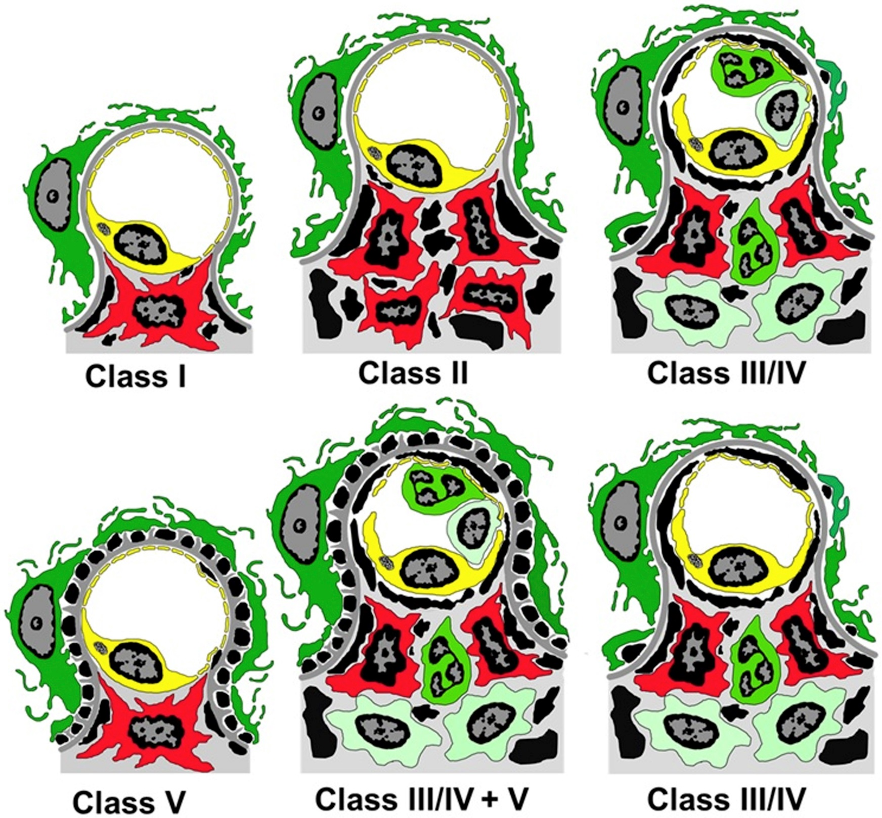
Figure 2
RED: Mesangial Cell
YELLOW: Endothelial cell
GREEN: Podocyte
Fluorescent GREEN: Neutrophil
Light GREEN: Leukocyte
BLACK: Deposits
Bajema et al. Kidney International April 2018
Notes:
Drawings depicting the ultrastructural features of a single glomerular capillary affected by lupus glomerulonephritis: class I with mesangial immune deposits (black) but no mesangial cell (red) hypercellularity or influx of leukocytes; class II with mesangial immune deposits and mesangial cell hypercellularity but no influx of leukocytes; class III/IV (upper right) with mesangial and capillary influx of leukocytes; class III/IV (lower right) with subendothelial capillary wall immune deposits that can be seen by LM and mesangial but no capillary influx of leukocytes (dark green neutrophils and light green monocytes/macrophages); class III/IV + V with an influx of leukocytes and numerous subepithelial immune deposits in addition to subendothelial deposits; and class V with numerous subepithelial immune deposits but no influx of leukocytes (podocyte = outer green cell, endothelial cell = yellow cell, mesangial cell = red cell, neutrophil = green cell with segmented nucleus, monocyte/macrophage = light green cell). LM, light microscopy.

Slide 6
Deposits
Podocyte
Mesangial
Subepithelial (btw podocyte & GBM)
Capillary
Lumen
Subendothelial (btw GBM & endothelium)
Mesangial cell
Courtesy of
Nicole Andeen, MD

Slide 8
Pros and cons of the 2003 ISN/RPS classification
Pros | Cons
Low inter- and intra-observer variability | Prognostic Significance of III vs. IV lesions
Prognostic Significance of proliferative (III,IV) versus non-proliferative (I,II,V) lesions | Prognostic Significance of class IV subclassification (Global vs. Segmental lesions)
 | Absence of Tubular Lesions
 | Absence of Vascular Lesions
TMA found in 18% of cases, independent RF for ESRD and lower response to initial treatment
P.N. Furness, N. Taub. Interobserver reproducibility and application of the ISN/RPS classification of lupus nephritis – a UK-wide study Am J SurgPathol, 30 (2006), pp. 1030–1035.
H. Yokoyama, T. Wada, A. Hara, et al. The outcome and a new ISN/RPS 2003 classification of lupus nephritis in Japanese Kidney Int, 66 (2004), pp. 2382–2388
C. Grootscholten, I.M. Bajema, S. Florquin, et al.Interobserver agreement of scoring of histopathological characteristics and classification of lupus nephritis. Nephrol Dial Transplant, 23 (2008), pp. 223–230

Slide 9
Phase 1 Venture to improve scoring criteria
“proposed 2 important alterations in the classification system, namely to abandon the segmental and global designations in class IV, and to replace the A, C, and A/C designations of classes III and IV by use of modified NIH lupus nephritis activity and chronicity scoring indices.”
Bajema et al. Kidney International April 2018

Slide 10
Activity and Chronicity Scoring
Bajema et al. Kidney International April 2018

Slide 11
Additional findings, not reported in the score (but are important):

Slide 12
Renal Biopsy

Slide 13
Biopsy
Initial/diagnostic biopsy:
proteinuria > 500 mg/day and/or renal insufficiency without clear non-lupus cause, active urine sediment
Subsequent biopsy:
protocol biopsies
For-cause biopsy
Biopsy during flare
Biopsy non-responders

Slide 14
Reasons for diagnostic biopsy
Not all lupus nephritis is treated with immunomodulatory therapy
Class II LN: conservative anti-proteinuric therapy
Class V LN: conservative anti-proteinuric therapy for subnephrotic-range proteinuria (KDIGO 2024)
Poor correlation of lab parameters (hematuria, degree of proteinuria) to lupus class
Other diseases
Thrombotic microangiopathy (TMA) – 15 - 30% of biopsies
Lupus podocytopathy
Insterstitial lupus nephritis
Non-lupus GN (ex: IgA) – 5%
Zhao et al. Arthritis Res ther 15: R12, 2013
Truong et al. Hum Pathol. 2001 Oct; 32(10):1125-35.
KDIGO Glomerulonephritis Guidelines, 2024

Slide 15
Reasons for subsequent biopsy: Lupus Evolves
Transition from proliferative LN to non-proliferative: 25%
Transition from non-proliferative to proliferative: 58%
in one series of pts with repeat biopsy management was altered in 87% of cases
Soriano ER et al. Lupus Sci Med. 2014

Slide 16
Protocol biopsy
Inflammation on 6-month post treatment biopsy was predictive for doubling of serum creatinine
Presence of subendothelial deposits on 1-year post treatment biopsy was predictive of worse renal outcomes
On the other hand….
Clinical parameters do not correlate with histologic parameters. repeat renal biopsies showed active lesions in 30% of patients with complete clinical remission and 60% of patients with partial clinical remission, the histological changes were not predictive of renal outcome at 10 years of follow-up.
Hill GS, Nochy D, et al. Kidney international. 2001;59(1):304–316.
Askenazi D, Kamdar A, et al. Pediatr Nephrol. 2007;22:981–986.
Malvar A, Rovin B et al. NDT

Slide 17
Rovin B et al. Rheum Dis Clin North Am. 2014 Aug; 40(3): 537–ix.

Slide 18
Treatment of Lupus Nephritis

Slide 19
Induction Phase Therapy for Class III or IV LN (OLD)
Multiple options
Standard, NIH protocol IV CTX
0.75-1.0 g/m² IV q4 weeks for 6 doses
Eurolupus IV CTX
500 mg IV q2 weeks for 6 doses
MMF
2000-3000 mg/day for 6 months
All should be given alongside standard steroid regimen
3 days pulse (7 mg/kg) followed by PO steroids at 1 mg/kg/day (not exceeding 60 mg) for 8 weeks, then taper

Slide 20
Induction Phase Therapy for Class III or IV LN (OLD)
Multiple options
Standard, NIH protocol IV CTX (High dose IVC CRR: 22-24%)
0.75-1.0 g/m² IV q4 weeks for 6 doses
Eurolupus IV CTX (Low dose IVC CRR: 25%)
500 mg IV q2 weeks for 6 doses
MMF (MMF CRR= 21%)
2000-3000 mg/day for 6 months
All should be given alongside standard steroid regimen
3 days pulse (7 mg/kg) followed by PO steroids at 1 mg/kg/day (not exceeding 60 mg) for 8 weeks, then taper
D Wofsy, B Diamond, F Houssiau. Arthritis Rheumatology May 2016

Slide 21
Lupus Nephritis: Voclosporin (potent CNI); Phase 2 Study

Slide 22
ARORA 1: Voclosporin (potent CNI); Phase 3 Study
RCT, placebo-controlled, Phase 3 trial (Lancet 2021): 27 countries, SLE + LN III, IV and or V on biopsy within 2 years of enrollment.
All received MMF and rapidly tapered low-dose oral steroids
Primary outcome: complete renal response at 52 weeks (UPCR < 0.5mgmg, stable renal function (< 20% decline in eGFR), no rescue meds, and <10mg/day prednisone.
Result: 73 [41%] of 179 patients in VOCLOSPORIN group vs 40 [23%] of 178 patients; odds ratio 2·65; 95% CI 1·64–4·27; p<0·0001 achieved primary outcome.

Slide 23
BLISS-LN: Belimumab (anti-BAFF)
RCT, placebo-controlled, phase 3 (NEJM 2020). 21 countries, active lupus nephritis on biopsy.
Primary outcome: primary efficacy renal response (UPCR < 0.7, stable kidney function (eGFR < 20% rise), no rescue therapy. Secondary end point complete renal response (UPCR < 0.5, eGFR no worse than 10%, no rescue therapy.
All got MMF or CTX/Aza
Primary outcome: 43% vs. 32%; odds ratio, 1.6; 95% confidence interval [CI], 1.0 to 2.3; P=0.03
Secondary outcome: 30% vs. 20%; odds ratio, 1.7; 95% CI, 1.1 to 2.7; P=0.02

Slide 25
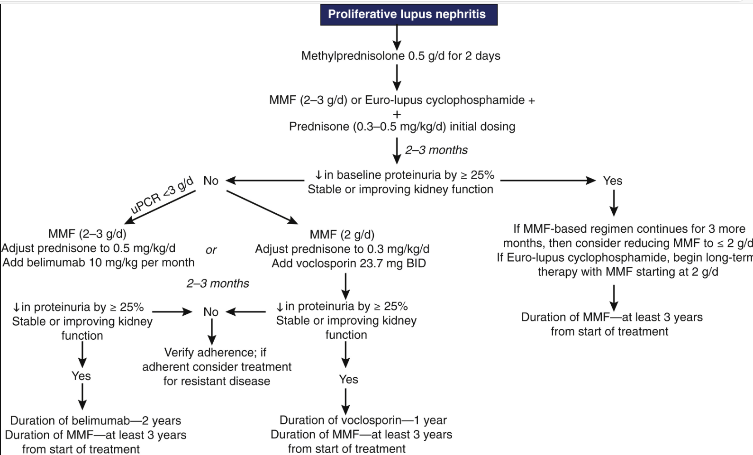
Mejia-Vilet, Juan M. et al. Kidney International, 2022

Slide 26
Just out! REGENCY: Obinituzumab for lupus nephritis

Slide 27
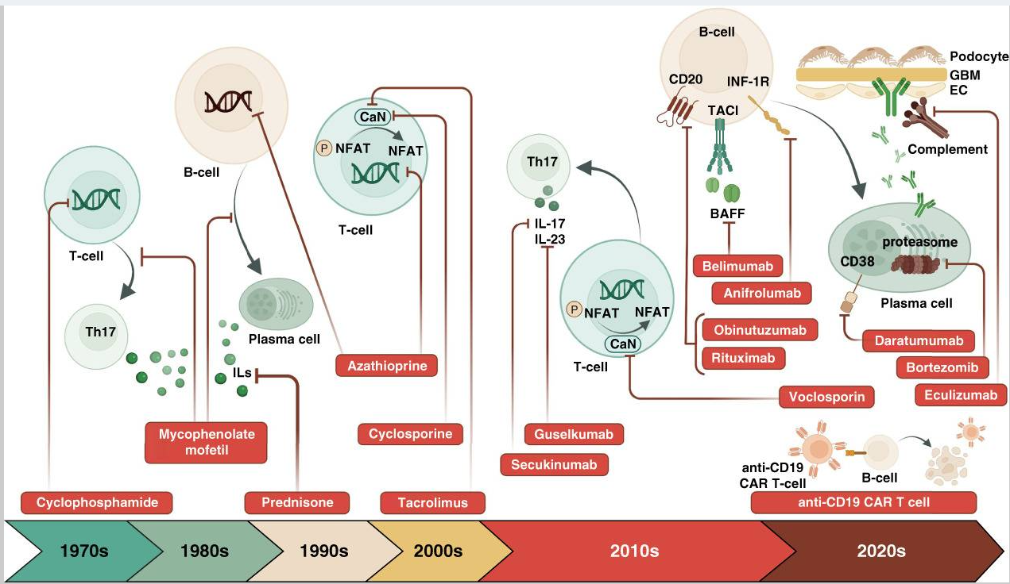

Slide 28
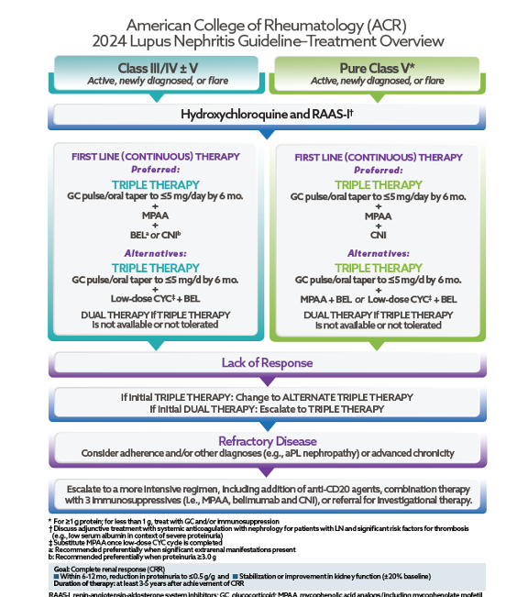

Slide 29
Induction Phase Therapy for Class III or IV LN
KDIGO 2024 GN Guidelines

Slide 30
Induction Therapy for Class III or IV LN
KDIGO 2024 GN Guidelines

Slide 31
KDIGO recommended steroid regimen

Slide 32
KDIGO 2024 GN Guidelines – Many more options for induction therapy
KDIGO 2021 GN Guidelines

Slide 33
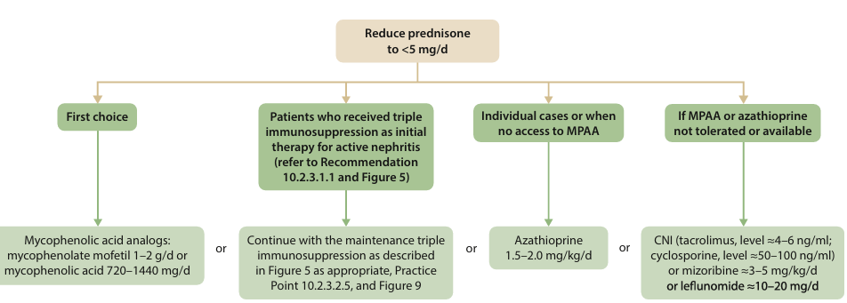
Maintenance Phase Therapy for Class III or IV LN
KDIGO 2024 GN Guidelines

Slide 34
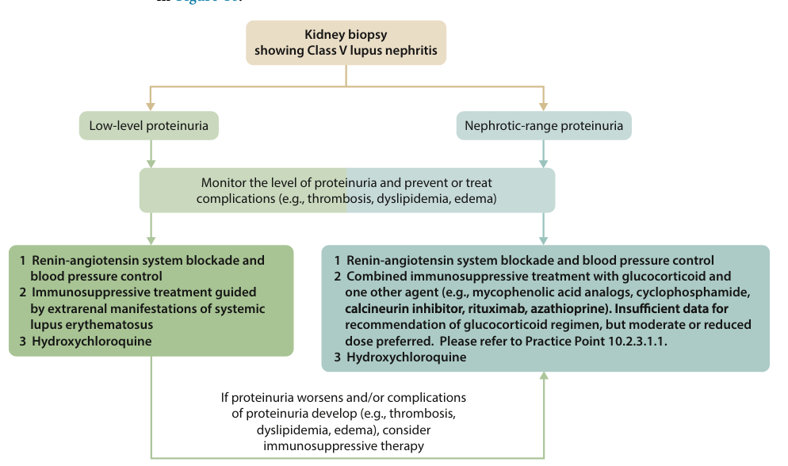
Therapy for Class V LN
KDIGO 2024 GN Guidelines

Slide 35
What is renal remission?
KDIGO 2021 GN Guidelines

Slide 36
Supporting the whole patient

Slide 37
KDIGO versus ACR guidelines
Paradigm of induction vs. maintenance therapy
Incorporation of biopsy information into management decisions
Acknowledging some patients do OK with MMF + steroids alone

Slide 38
Lupus Nephritis ++
--TMA
--All chronic disease

Slide 39
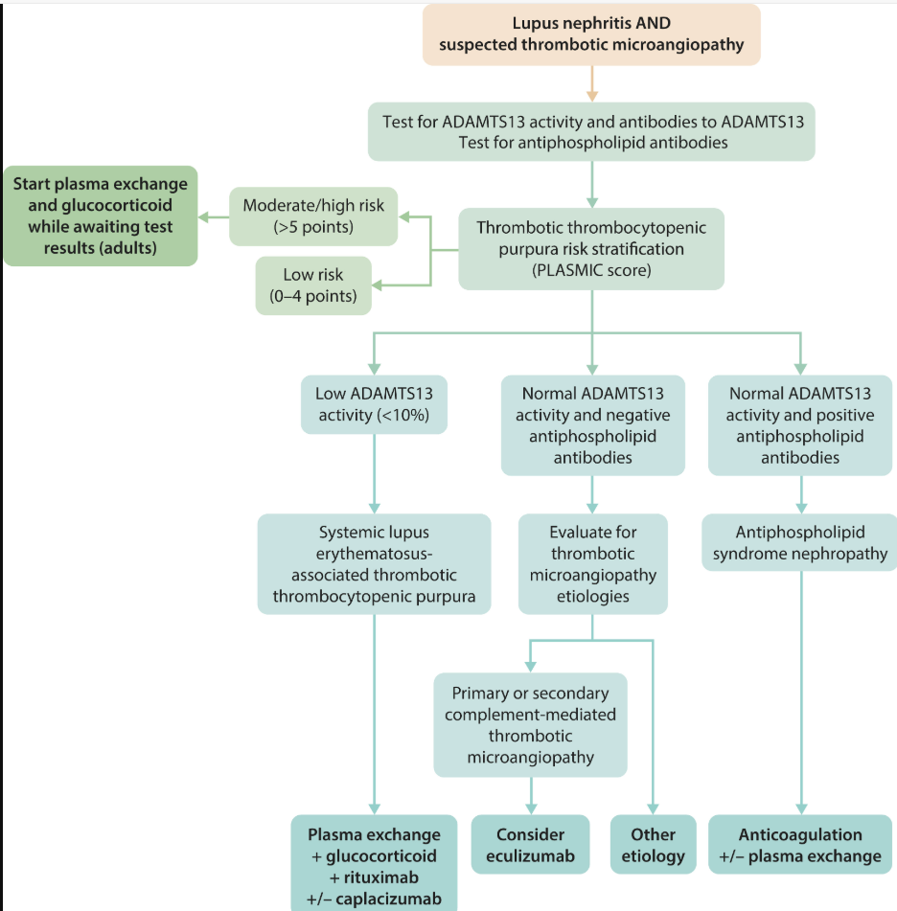

Slide 40
Kidney biopsy comes back with lupus class III (c) – ALL CHRONIC!
ACE-I or ARB
Sodium-glucose transporter 2 inhibitors (SGLT2i; IE dapagliflozin or empagliflozin)
Mineralocorticoid receptor antagonist (IE, spironolactone)
Endothelin receptor antagonists (IE, sparsentan or atrasentan)?
GLP-1 agonists (IE, semaglutide)?

Slide 41
Questions?

