Slide 1
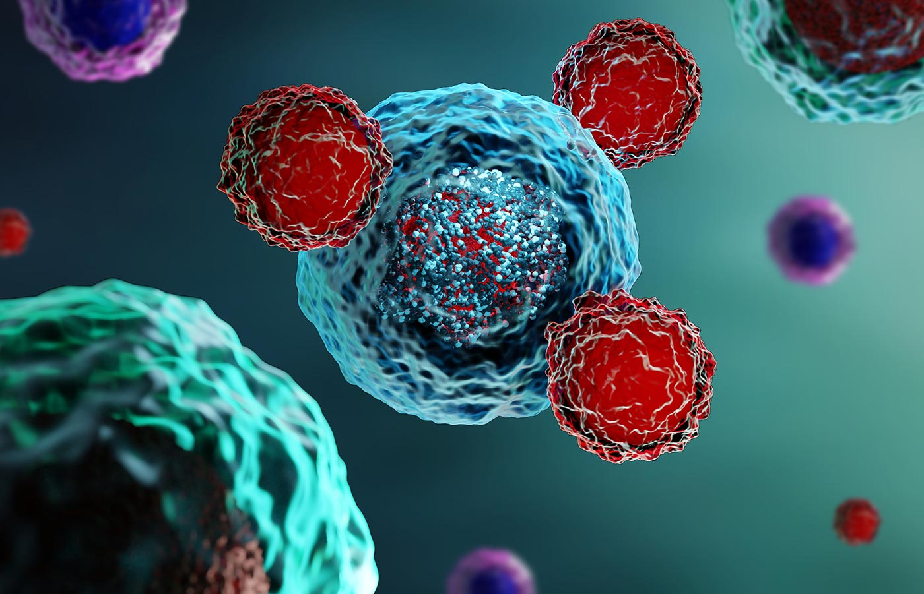
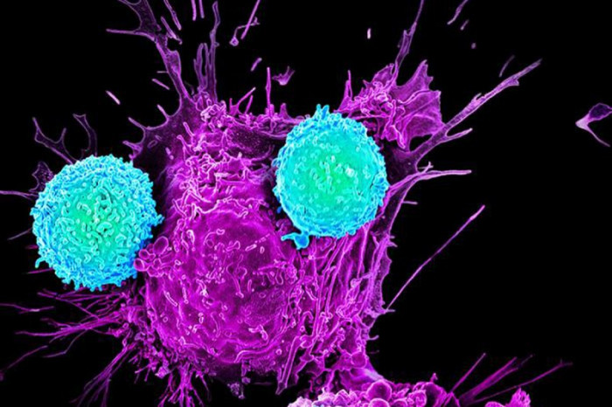
CAR T-cell Therapy for Rheumatologists
Richard T Maziarz, MD
Professor of Medicine
Oregon Health & Science University
April 26, 2025

Slide 2
Disclosures
Research Funding: Novartis, Kite/Gilead, OrcaBio,
Consultancy: Novartis, Artiva Bio, OriCell,
DSMB: Vor Pharma, Century Rx, MarchBio
Steering Committee member: BMT CTN
Executive Board (VP): American Society of Transplantation & Cell Therapy

Slide 3
Outline
1. Introduction
2. Biology
4. Clinical data
5. Experience in rheumatologic disorders

Slide 4
CELLS ARE DRUGS*
Autologous HCT- PBSC are used to enhance Hematopoietic Recovery after high-dose chemoradiotherapy
Allogeneic HCT - Allogeneic stem cells are used to enhance hematopoietic recovery after high-dose chemoradiotherapy and critical to the intervention, donor derived, adoptively transferred mature lymphocytes are used to establish a graft versus malignancy effect
Immune effector cells/ CAR–T – Graft engineered autologous (? allogeneic) T cells targeting surface B-cell antigens that activate the cytotoxic capacity of the ex vivo manufactured, reintroduced T-cell products
*Regulated by FDA- exempt or non-exempt (e.g. more than minimally manipulated; heterologous use)

Slide 5
What is CAR-T?
CAR T therapy - chimeric antigen receptor (CAR) genetically modified T cells - designed to recognize Tumor specific antigens (TSA) → in vivo activation and proliferation → significant and durable malignant cell immunity
CAR T cells : “living drug” –can persist for long periods of time
CAR T cells - generally autologous product from patient’s own blood cells, although universal donor “off the shelf” CAR T cells emerging

Slide 6
Approved Diagnoses for CAR-T
CAR T-cell therapies currently approved by FDA- All for hematologic malignancies
Major target: two well characterized cell surface antigens on B cells- CD19 or BCMA
B-ALL
Large B-cell lymphoma – includes DLBCL, NOS
High grade B-cell lymphoma
Primary mediastinal large B-cell lymphoma
Follicular lymphoma
Low grade NHL->DLBCL
Mantle cell lymphoma
Multiple myeloma
CLL

Slide 7
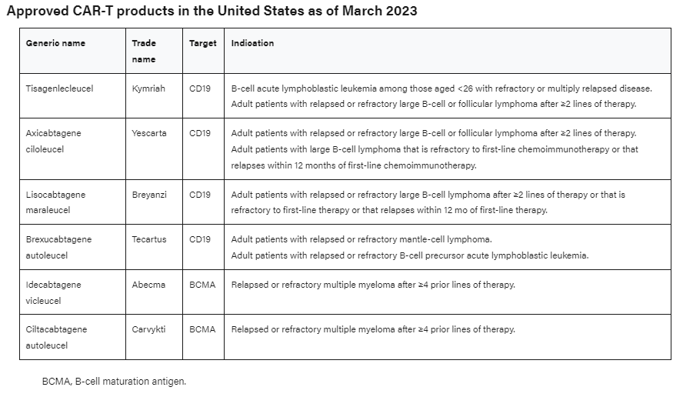
Commercial CAR-T Products

Slide 8
The near horizon…
Obecabtagene autoleucel (obe-cel) for R/R ALL
  Unique biology: “Fast off” binding; fractionated administration
  FDA approved Nov 2024
FDA approved T cell therapies (non CAR T)- 2024
Afamitresgene autoleucel – MAGE-A4 targeted, HLA restricted engineered T cell therapy for unresectable/ relapsed synovial cell sarcoma
Lifileucel for B-raf resistant/wild type, checkpoint inhibitor resistant metastatic melanoma

Slide 9
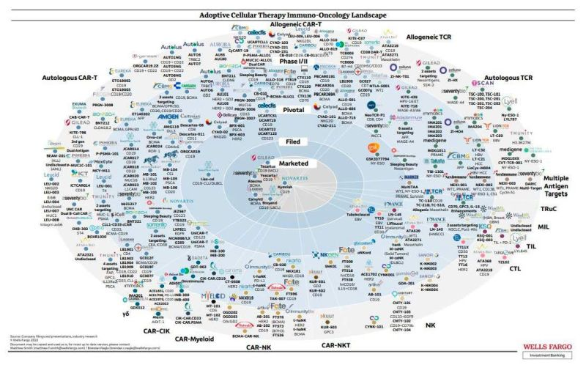
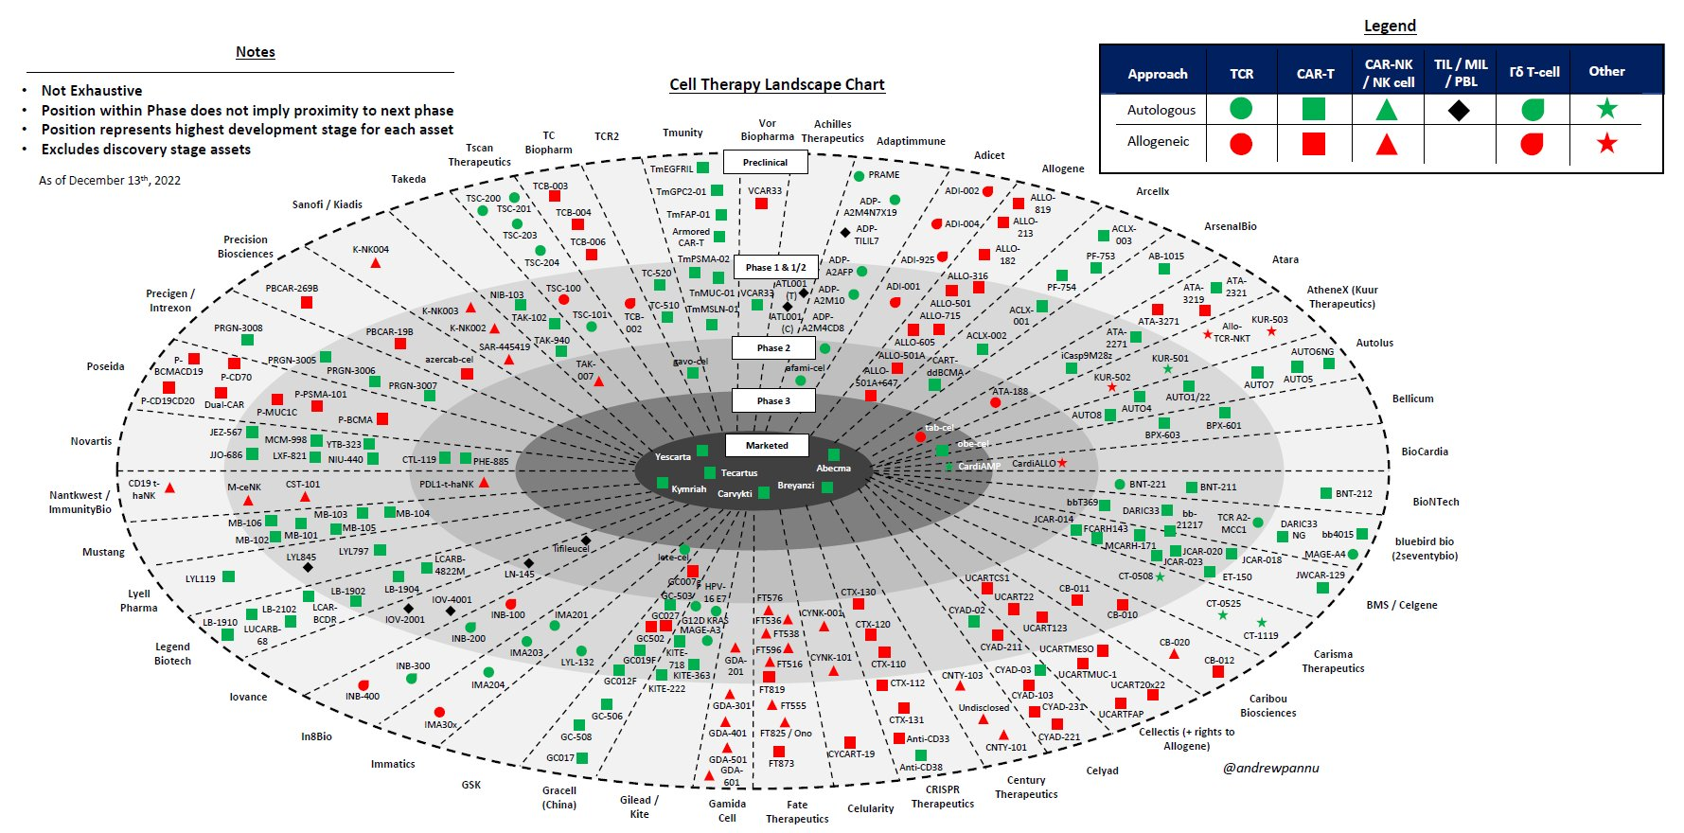
Cell Therapy Landscape: 2022-2023 View
Futures:
Allogeneic therapies
Overcoming TME
Controlling cell expansion & persistence
Increased solid tumor efficacy
In vivo CAR delivery
Reduced toxicity & side effect profile
Alternative cell types and constructs

Slide 10
U.S. CAR T-Cell procedures
A fraction of world wide use: Estimated at ~ 35000 commercial Rx since 2017
“To date, Kite has treated > 19,500 patients with its CAR-T therapies.”
Pharmavoice, Feb 20, 2024
Notes:
Slide 10: CAR T-cell indications by year demonstrates an increase in the overall utilization of this therapy consistent with commercial approval of the products. There is a more distinctive increase among recipients with large B-cell lymphoma with over 1200 patients treated for this indication being reported in 2021. All new indications on recent approved CAR T cells are also expanding in utilization since 2020.

Slide 11
OHSU Adult HCT & Cell RX activity
2018: 233 17
2019: 234 18
2020: 216 27
2021: 230 43
2022: 236 68
2023: 250 91
2024: 232 105*
2025: 264# 140#
*9 clinical trial; 10 TIL
#annualized

Slide 12

CAR T-Cell Therapy: Underlying Principles
Leukapheresis
Manufacturing
Infusion
Activity
Collect patient’s white blood cells
Isolate and activate T-cells
Engineer T-cells with CAR gene
Expand CAR T-cells
Infuse same patient with CAR T-cells
Targeting element
(eg, CD19, BCMA,
CD20)
CD19
Tumor cell
Spacer
Transmembrane domain
Viral vector with
CAR
DNA
Costimulatory domains (eg,
CD28 or 4-1BB)
CAR-engineered
T-cell
CD3𝛇 (essential signaling domain)
Median manufacturing time: 17-28 days
Patients undergo lymphodepleting (and possibly salvage/bridging) therapy
Majors. EHA 2018. Abstr PS1156. Lim. Cell. 2017;168:724. Sadelain. Nat Rev Cancer. 2003;3:35.
Brentjens. Nat Med. 2003;9:279. Park. ASH 2015. Abstr 682. Axicabtagene ciloleucel PI. Tisagenlecleucel PI.

Slide 13
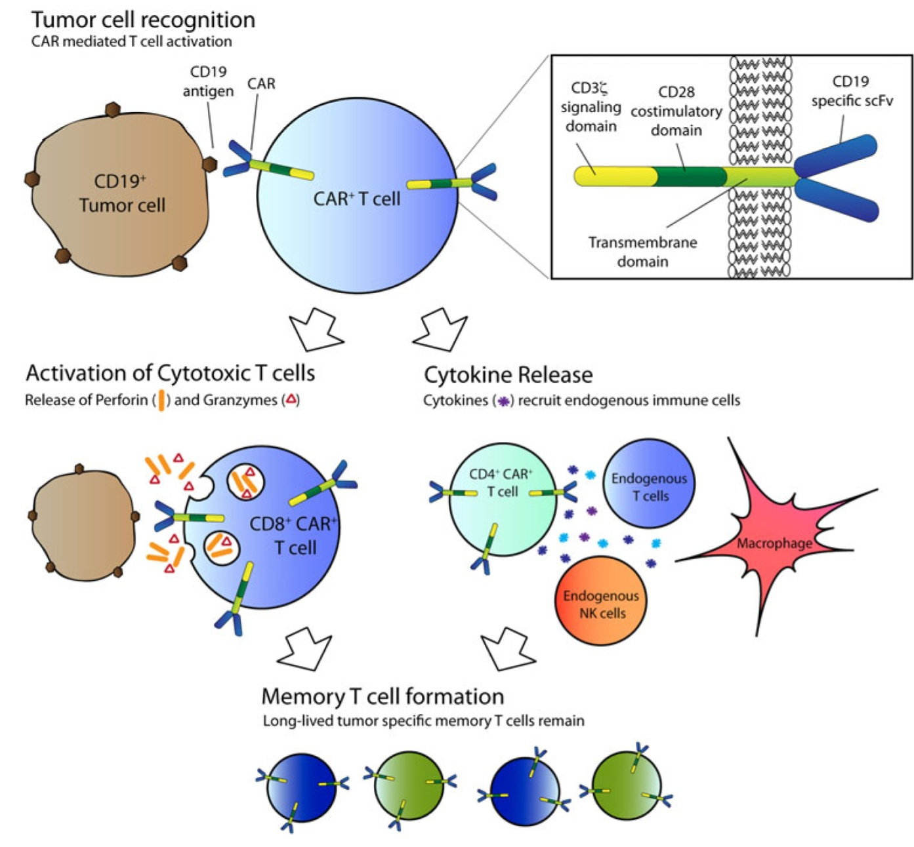
How Do CAR-T Cells Kill?
Davila ML, et al. Int J Hematol. 2014;99:361

Slide 14
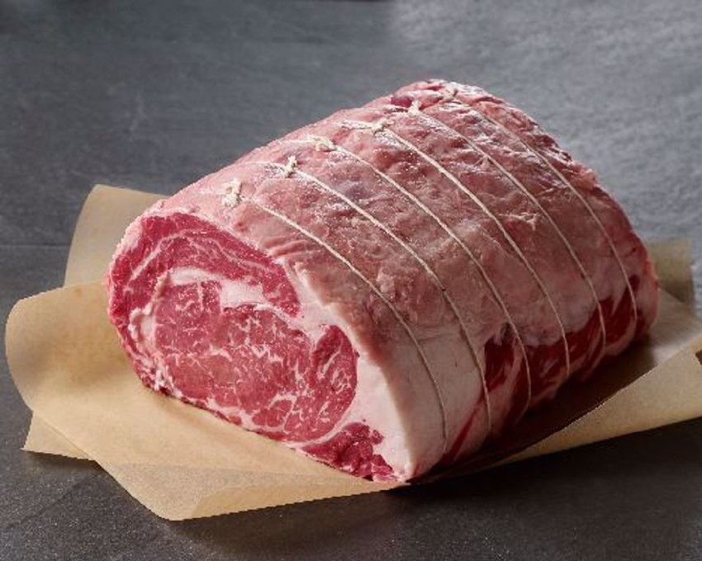
ALL: What is the clinical burden of acute leukemia?
Imagine:
  90 kg individual → TBW ~60 L = 60kg
  Extracellular Water ~ 20 L
  Intravascular space ~ 6L
Basic biology tells us that 1 x 10⁹ cells = 1 cm³ = 1 ml = 1 gm
Therefore→ Peripheral Blasts = 100K; BM = 100% blasts; 90 kg pt
Tumor burden = 100,000 x 1,000,000 x 6L (blood volume) + adult BM vol (4.8% x 90) = 6 x 10¹¹ + 4.32 kg (1 x 10¹² cells) = 4.92 kg of leukemia cells
Total body leukemia burden → 12 lbs

Slide 15
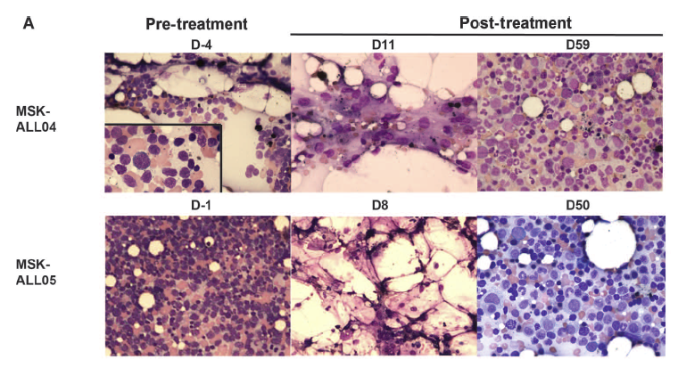
The Power of CAR T
Rapid ALL elimination and recovery of normal bone marrow after CD19-28z CAR T cell therapy
Sci Transl Med. 2013 Mar 20;5(177):177ra38
Notes:
15

Slide 16
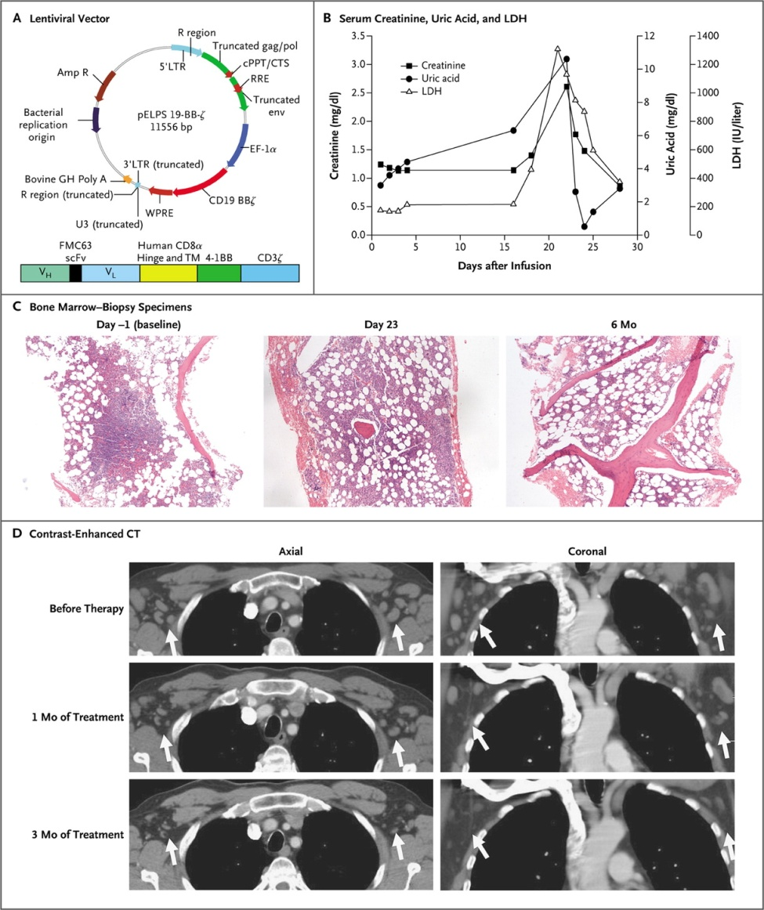

Porter DL et al. N Engl J Med 2011;365:725-733.
Clinical Response in the Patient.
First 2 patients: Refractory CLL
Still alive and in CR, >10 yrs after single application
Decade-long leukaemia remissions with persistence of CD4 ⁺ CAR T cells, Melenhorst et al, Nature. 2022 Feb;602(7897):503-509

Slide 17
OHSU PT: Relapsed, Refractory DLBCL- post auto HCT
Treatments work across time & space
Baseline Day 30 Day 90

Slide 18
Lymphodepletion for autologous therapy
Generation of long-term T-lymphoid cell lines with specific cytotoxic reactivity for a syngeneic murine lymphoma, Eberlein, JNCI, 1982
  Murine tumor model: Autologous T cells / TCGF + CTX vx CTX alone: 53% vs 0% cure
Cyclophosphamide-facilitated adoptive immunotherapy of an established tumor depends on elimination of tumor induced suppressor cells. North, J Exp Med 1982
Phase I study of the adoptive immunotherapy of human cancer with lectin activated autologous mononuclear cells, Mazumder, CA, 1984
  PHA Activated T cells administered to refractory CA pts→ no tumor regression
A new approach to the adoptive immunotherapy of cancer with tumor infiltrating lymphocytes. Rosenberg, Science, 1986
  Murine model: TIL alone, CTX alone→0 benefit; Synergy seen with both, amplified by IL2. Triplet therapy -→100% mice cured of liver and 50% of lung mets: MC38 colorectal ca

Slide 19
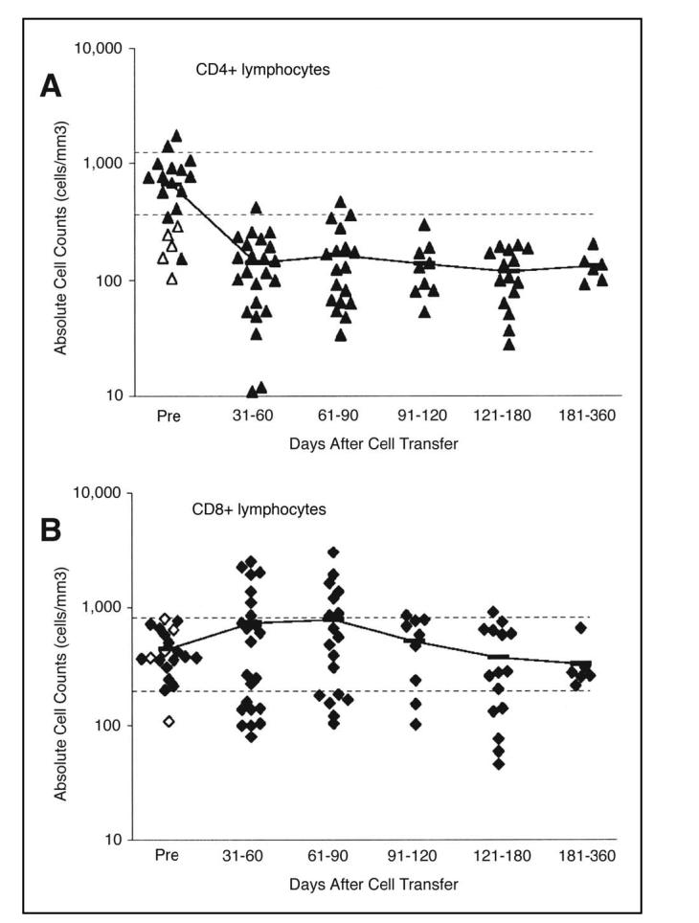
Adoptive Cell Transfer
Therapy Following Non-Myeloablative
but Lymphodepleting
Chemotherapy for the Treatment of
Patients With Refractory
Metastatic Melanoma, Dudley, JCO 2005
LDC:
CTX 60 mg/kg x 2
Flu 25 mg/M2 x 5
Cells next day from last dose of flu

Slide 20
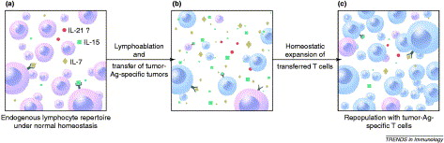
Removal of consumptive cytokine ‘sink’ by lymphoablation
Notes:
Under normal homeostasis, a smaller quantity of cytokines [IL-7 (yellow), IL-15 (green) and possibly IL-21 (red)] are available owing to consumption by the endogenous lymphocyte population. (b) After lymphodepletion preconditioning by chemotherapy or irradiation, the consumptive cellular cytokine ‘sinks’ are removed, enabling the adoptively transferred T cells a less competitive environment and greater access to IL-7, IL-15 and IL-21. (c) This is followed by preferential homeostatic expansion and re-population of the peripheral lymphoid compartments with the adoptively transferred, tumor-reactive T cells.

Slide 21
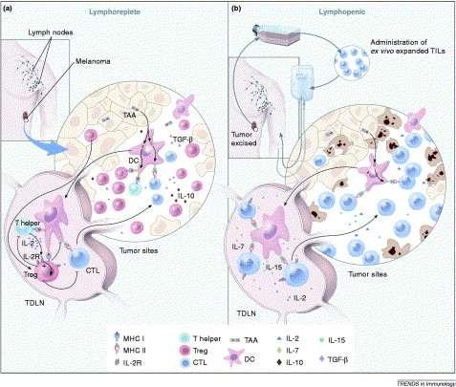
Removal of the inhibitory effect of Treg cells and activation of DCs by lymphoablation.
Notes:
Under normal homeostasis, Treg cells (red) in the tumor draining lymph node (TDLN), might exert inhibitory effects on the transferred tumor-specific T cells (blue). In addition, Treg cells might prevent CD4⁺ Th cells (green) from providing supportive cytokines, such as IL-2 (blue). DCs (pink) in the tumor, which cross-present tumor-associated antigens (TAAs), might induce tolerance in the absence of inflammation and in the presence of immunosuppressive cytokines, such as IL-10 (brown) and TGF-β (purple). The net outcome of these inhibitory factors could abrogate an effective antitumor response. (b) After the induction of lymphopenia, ex vivo expanded tumor-reactive TILs are adoptively transferred (blue). This preconditioning before cell transfer effectively eliminates Treg cells and other cytokine-competing cells, thus removing inhibition and freeing supportive cytokines, such as IL-2, IL-7 (yellow) and IL-15 (green). The ablative conditioning might also activate DCs that are capable of cross-presenting TAAs in the presence of danger signals. The effect of ablation is a ‘permissive’ and activating environment that augments tumor-specific T cell-induced tumor destruction.

Slide 22
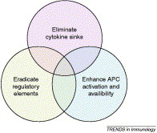
An interactive model for the mechanisms underlying the impact of lymphodepletion on adoptively transferred T cells
Notes:
Elimination of cytokine sinks: lymphoablation, either by chemotherapy or irradiation, reduces the consumptive cytokine ‘sinks’ created by the endogenous lymphocyte repertoire, thus enabling the transferred T cells a less competitive access to homeostatic cytokines, such as IL-7 and IL-15. (ii) Eradication of regulatory elements: Treg cells, such as the CD4⁺CD25⁺ cells, that would otherwise exert an inhibitory effect on the transferred T cells are diminished in number and function after lymphoablation. (iii) Enhancement of APC activation and availability: lymphoablation, either by irradiation or chemotherapy, can induce tumor apoptosis and necrosis, resulting in uptake and presentation of tumor antigens by APCs. Furthermore, there is some evidence that suggests that after lymphodepletion, APCs become activated, thus enhancing stimulation of the adoptively transferred T cells.

Slide 23
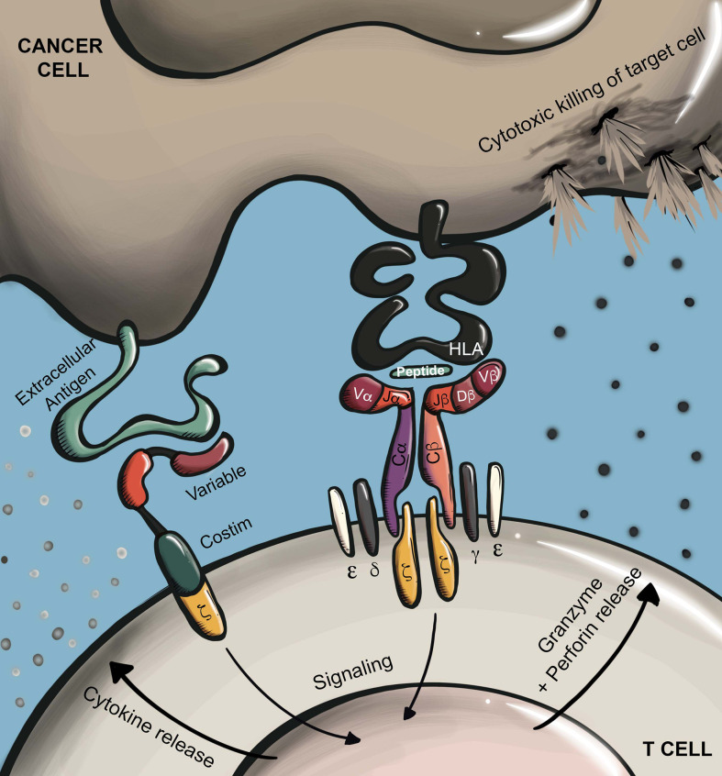
A little bit of science……..
TCR vs CAR target cell recognition
Shafer, Front Immunol, 2022

Slide 24
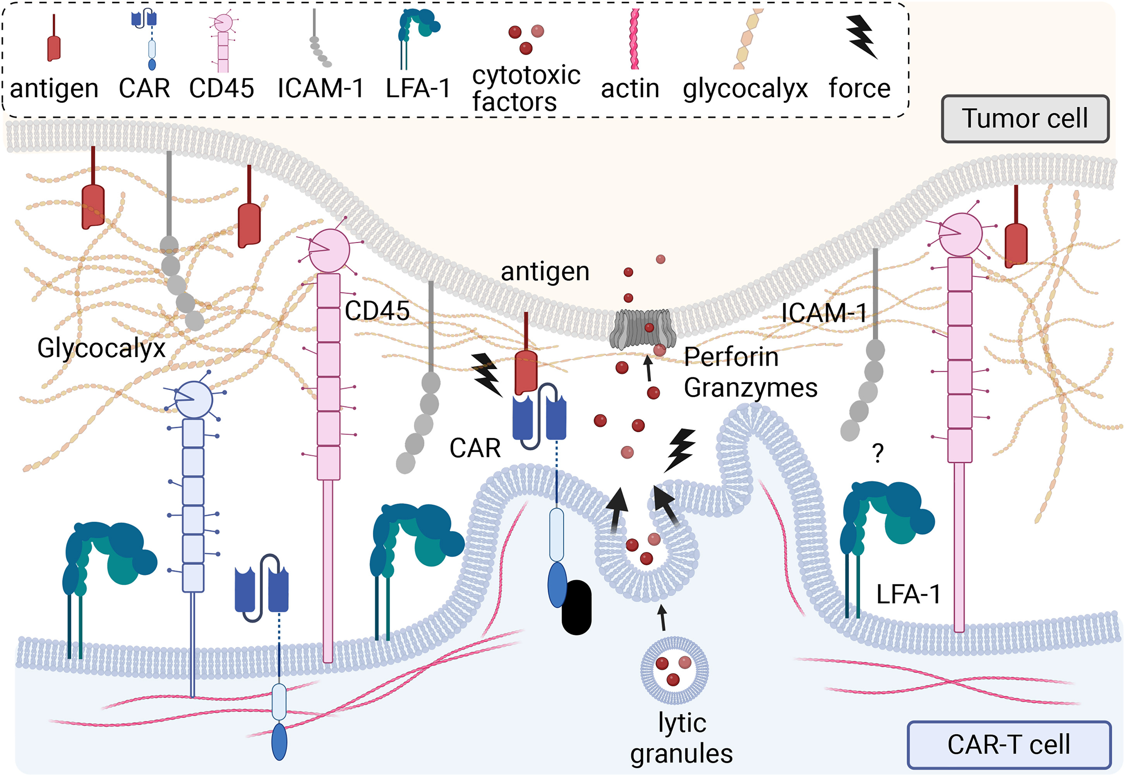
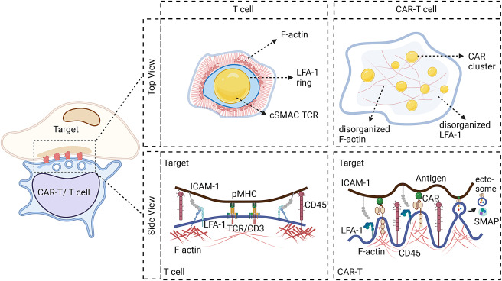
Immunologic synapse: CAR vs TCR
TCR Requires < 50 target HLA: peptide complexes; scFV requires ~5000 target molecules/ cell surface
Xiong et al, 2024

Slide 25
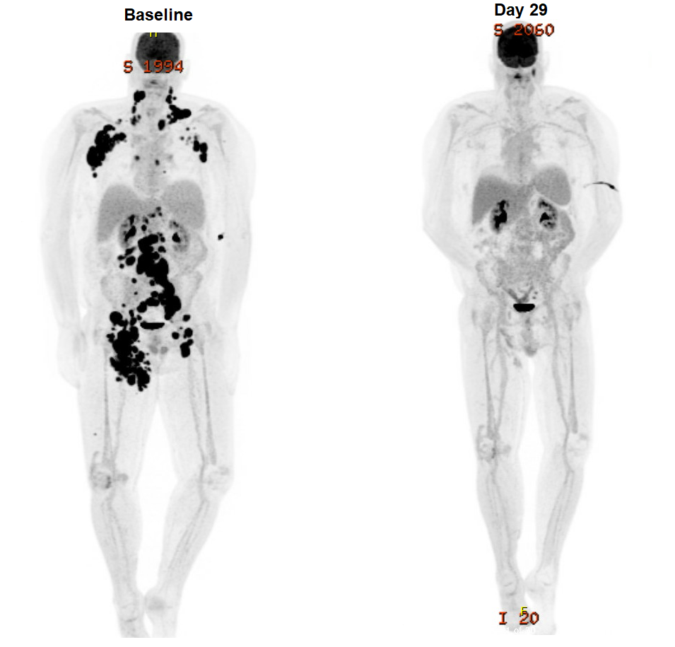
CAR T-Cell therapy: a saga of success & failure
ALL- pediatric & adult
Non-Hodgkin Lymphoma
Myeloma
Myeloid Malignancy
Proliferation (CD28) vs Persistence (4-1BB)
  5 yr data emerging: Zuma 1 vs Juliet
Relapse: intrinsic resistance, immune signature, PDL1 overexpression, antigen loss, antigen gain (trogocytosis), TBD???
(Focus of 1/2 ASH 2024 Special Session)

Slide 26
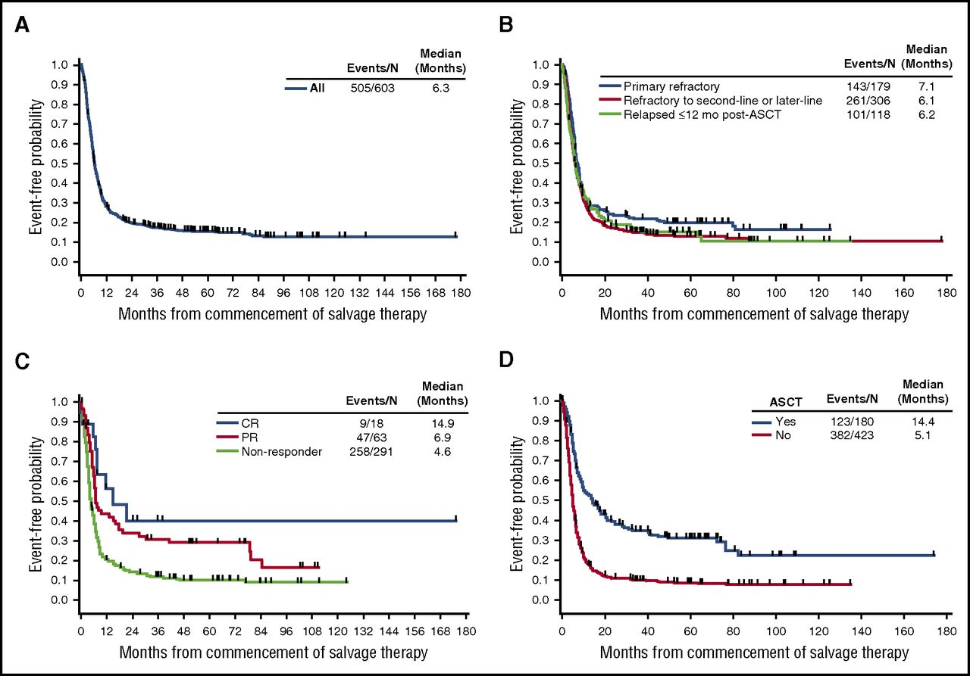
Large cell lymphoma, relapsed/refractory
SCHOLAR 1 retrospective, Crump et al, 2017
N = 603
OS @ 2 yr 20%
Overall survival from commencement of salvage therapy. Shown for the (A) overall population, (B) refractory subgroups, (C) tumor response, and (D) post-refractory transplantation status (Kaplan-Meier).

Slide 27
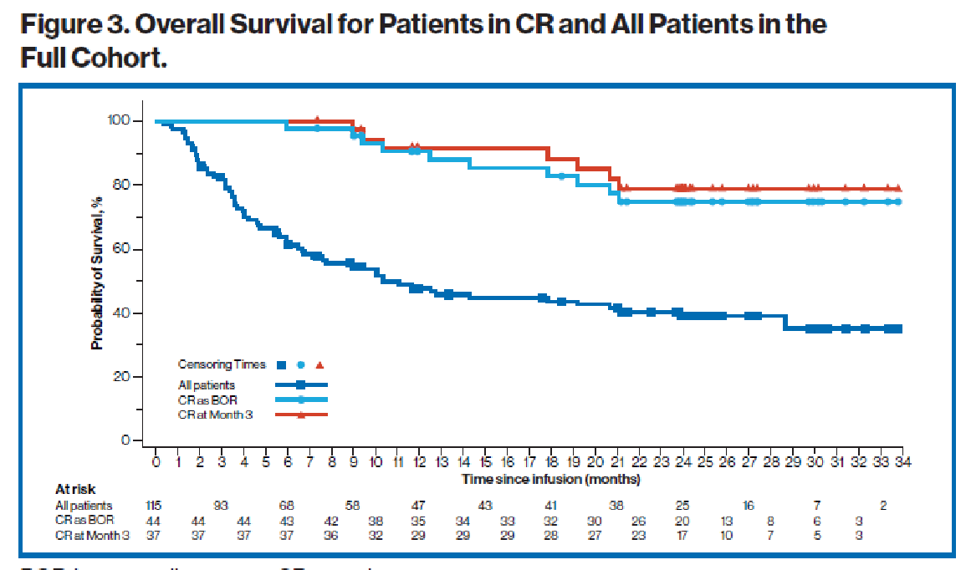
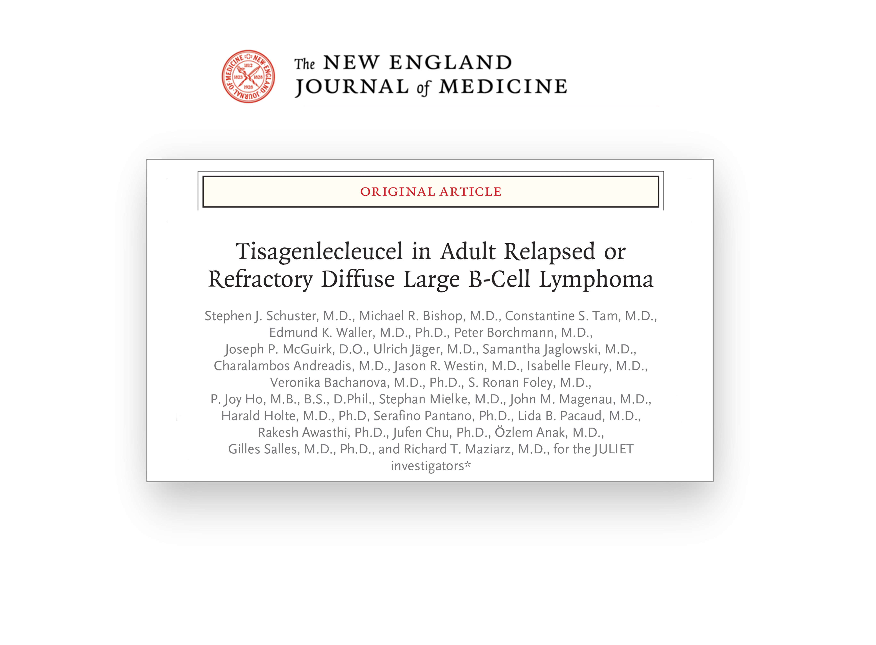
JULIET: Median Overall Survival
Median OS not reached (95% CI, 21 months-NE) in patients in CR
No patients proceeded to allogeneic SCT or auto-SCT while in remission
5 Year data demonstrate sustained benefit: OS @ ~30%; >50% for pts with response, Maziarz et al, Under Review
11
Auto-SCT, autologous stem cell transplant; CI, confidence interval; CR, complete response; NE, not evaluable; OS, overall survival; SCT, stem cell transplant. Median OS in CR patients: not reached (95% CI, 21 months-NE).

Slide 28
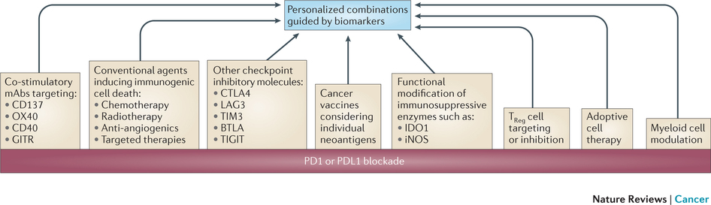
How to improve on outcomes?
Potential trial candidates
There is an internal message: WORK IS NOT DONE
CAR T still does not cure all!!!!!

Slide 29
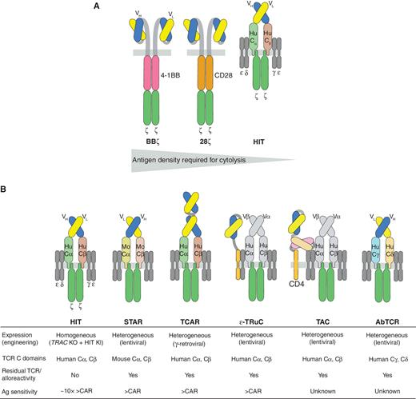

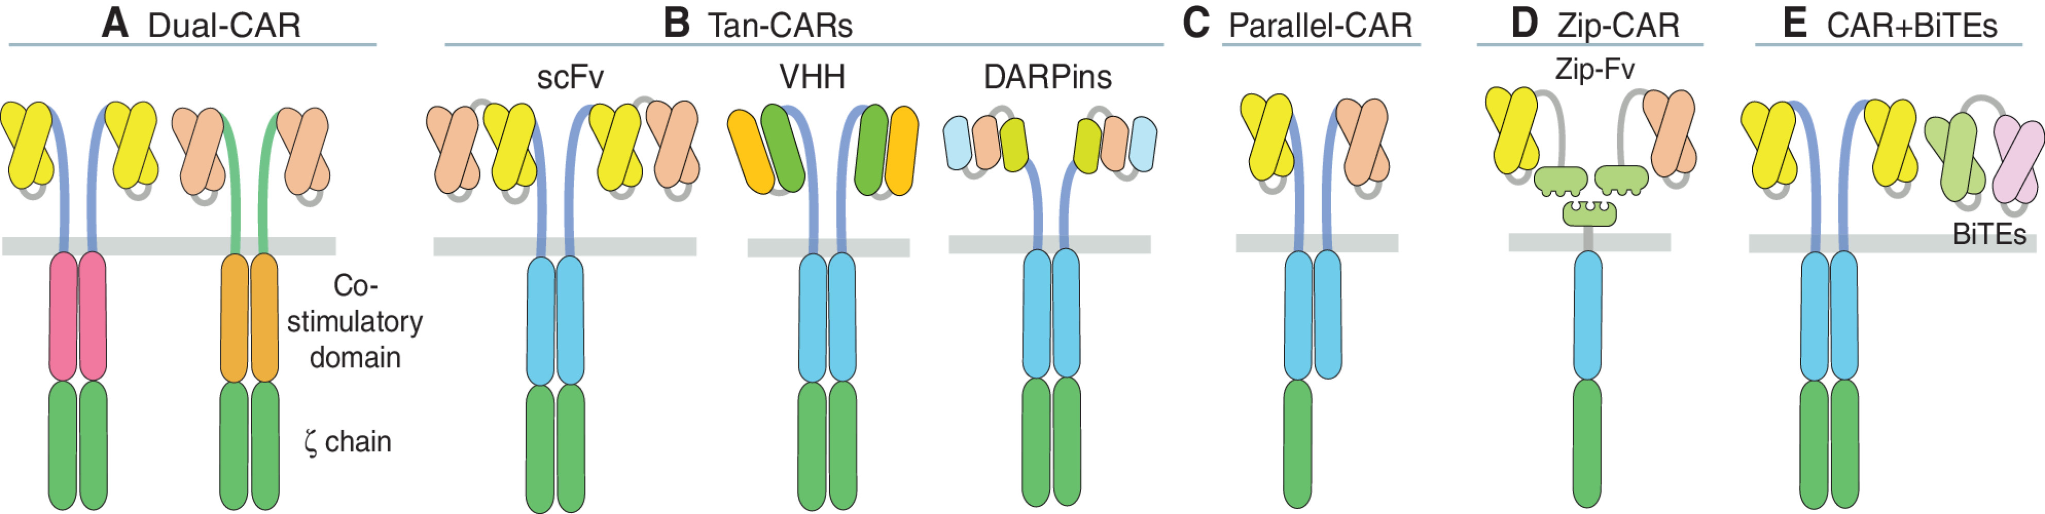
Constructs: multiple designs & approaches- CAR T

Slide 30
Predictors of Response
Summary: Variables and Unknowns
Preparative regimen
Disease type and burden
Immune environment
Production
Dosing
Lymphocyte populations
Strategy
Outcome Event-Free Survival
Costimulatory domain
Timing and availability
Competence
Persistence
Target
Pers. Comm., Platzbecker, MD

Slide 31
Adverse Events of Special Interest
CRS and Neurological Events after CAR-T Cells
Brudno JN, Kochenderfer JN. Blood. 2016;127(26):3321-3330.

Slide 32
Toxicity: CAR T cells
No significant acute infusional toxicity
Tumor lysis syndrome
Cytokine Release Syndrome (CRS)
Neurologic toxicity
B cell aplasia and hypogammaglobulinemia in responding patients (toxicity or efficacy?)
  Supported with intravenous immunoglobulin (IVIG)
  No excessive or frequent infections

Slide 33
Cytokine Release Syndrome after CAR T Cell Therapy
Correlates with CAR T activation and expansion resulting in immune activation.
Clinical syndrome:
  Onset 1-14 days after infusion, duration 1-10 days
  Fevers in all patients (up to 105ºF/ 41ºC)
  Myalgias, arthralgias, anorexia, nausea, diarrhea
  Capillary leak, hypotension, hypoxia
  May be self-limited or require anti-cytokine intervention
  CRS-related mortality low but possible
Biochemical changes
  Marked increase in IL6
  Dramatic elevations in ferritin (MAS/HLH), CRP

Slide 34
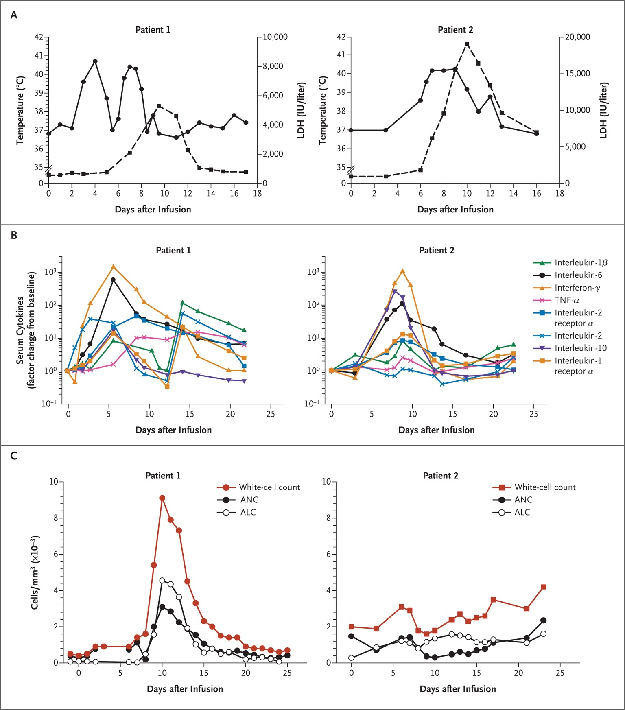

Clinical Responses to CTL019 Infusion in Two Children with Relapsed, Chemotherapy-Refractory Acute Lymphoblastic Leukemia (ALL).
April 2012
Pt #1: IL-6 3 Log
Grupp SA et al. N Engl J Med 2013;368:1509-1518
Notes:
Rachel Weinstein
Colton w Zoe and XXX
Austin Schuetz, 9 mo out
Nick Wilkins ? 1 yrs out

Slide 35
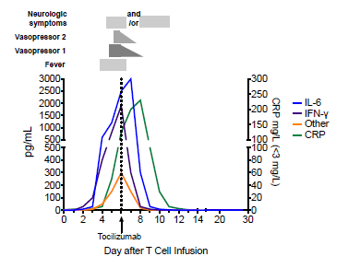
Rapid reduction in cytokine levels after a single dose of Tocilizumab
Lee, Grupp. Blood. 2014

Slide 36
ASTCT CRS Consensus Grading, Lee et al, BBMT 2019
CRS Parameter | Grade 1 | Grade 2 | Grade 3 | Grade 4
Fever† | Temperature ≥38°C | Temperature ≥38°C | Temperature ≥38°C | Temperature ≥38°C
With either:
Hypotension | None | Not requiring vasopressors | Requiring one vasopressor with or without vasopressin | Requiring multiple vasopressors (excluding vasopressin)
And/or‡
Hypoxia | None | Requiring low-flow nasal cannula^ or blow-by | Requiring high-flow nasal cannula^, facemask, non-rebreather mask, or Venturi mask | Requiring positive pressure (eg: CPAP, BiPAP, intubation and mechanical ventilation)
Low-flow nasal cannula is defined as oxygen delivered at ≤ 6 liters/minute.
Low flow also includes blow-by oxygen delivery, sometimes used in pediatrics.
High-flow nasal cannula is defined as oxygen delivered at > 6 liters/minute.

Slide 37
Grading and Management of CRS
Grading System | Grade 1 | Grade 2 | Grade 3 | Grade 4
ASTCT CRS Consensus Grading, adapted from Lee et al, BBMT, 2019 | Temperature ≥38°C No hypotension No hypoxia | Temperature ≥38°C with hypotension not requiring vasopressors and/or hypoxia requiring low-flow nasal cannula (≤6L/minute) | Temperature ≥38°C with hypotension requiring vasopressors ± vasopressin and/or hypoxia requiring high flow nasal cannula (>6L/minute), facemask, nonrebreather mask, or Venturi mask | Temperature ≥38°C with hypotension requiring vasopressors (excluding vasopressin) and/or hypoxia requiring positive pressure (e.g. CPAP, BiPAP, intubation and mechanical ventilation)
CRS Management Guidelines, adapted from Reagan et al, JCO, 2021 | Supportive care Rule out infection Consider tocilizumab if fever is refractory to above measures for >3 days | Supportive care per grade 1 Initiate cardiac telemetry and pulse oximetry IV fluid for hypotension Tocilizumab up to 3 doses/day Initiate dexamethasone 10 mg q12 hr if no response to tocilizumab | Per grade 2 Assess cardiac function using ECG, consider ICU transfer Dexamethasone 10 mg q6 hr Increase dexamethasone to 20 mg q6 hr if no response in 48 hr | Per grade 3 Transfer to ICU Methylprednisolone 1g/day IV If no response, consider alternate immunosuppressant (e.g. anakinra, ATG, cyclophosphamide)

Slide 38
Definition of Immune Effector Cell-Associated Neurological Events
ICANS as “a disorder characterized by a pathologic process involving the central nervous system following any immune therapy that results in the activation or engagement of endogenous or infused T cells and/or other immune effector cells. Symptoms or signs can be progressive and may include aphasia, altered level of consciousness, impairment of cognitive skills, motor weakness, seizures, and cerebral edema.”
Lee DW, et al. Biol Blood Marrow Transplant. 2018. [Epub ahead of print].

Slide 39
ASBMT Immune effector Cell-Associated Neurotoxicity Syndrome (ICANS) Consensus Grading for Adults
Neurotoxicity Domain | Grade 1 | Grade 2 | Grade 3 | Grade 4
ICE Score^ | 7-9 | 3-6 | 0-2 | 0 (patient is unarousable and unable to perform ICE)
Depressed level of consciousness❖ | Awakens spontaneously | Awakens to voice | Awakens only to tactile stimulus | Patient is unarousable or requires vigorous or repetitive tactile stimuli to arouse. Stupor or coma
Seizure | N/A | N/A | Any clinical seizure focal or generalized that resolves rapidly; or Non-convulsive seizures on EEG that resolve with intervention | Life-threatening prolonged seizure (>5 min); or Repetitive clinical or electrical seizures without return to baseline in between.
Motor findings§ | N/A | N/A | N/A | Deep focal motor weakness such as hemiparesis or paraparesis
Raised ICP / Cerebral edema | N/A | N/A | Focal/local edema on neuroimaging# | Diffuse cerebral edema on neuroimaging; Decerebrate or decorticate posturing; or Cranial nerve VI palsy; or Papilledema; or Cushing's triad

Slide 40



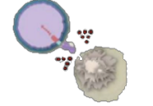


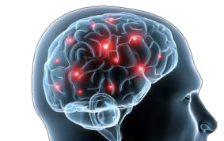















CAR-T Toxicities
CAR T cell infusion
CRS Typical time to onset: 2-3 days
Neurotoxicity Typical time to onset: 4-10 days
Cytokine Release Syndrome
Cytokine release
CAR T cell expansion
Tumor cell death
Days
0 7
14
28
CRS
Adverse Events > Day 30
Infections
Cytopenias
B cell aplasia
Neurological Toxicity
ICANS/Neurotoxicity
HLH
*Immune Effector Cell-Associated Neurotoxicity Syndrome (ICANS)

Slide 41


Neurologic Symptoms and Relationship between ICANS and CRS
Cerebrovascular accident 1%
Leukoencephalopathy 4%
ICANS 7%
CRS 35%
Tremors 23%
Depressed level of consciousness 25%
CRS & ICANS 64%
Hallucinations 3%
Cerebral edema
Hemiparesis/ paraparesis/
Dysphasia 11%
1%
Aphasia
20%
other motor deficit 8%
Seizure 4%
CIDR data unpublished

Slide 42
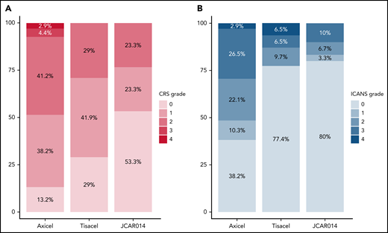
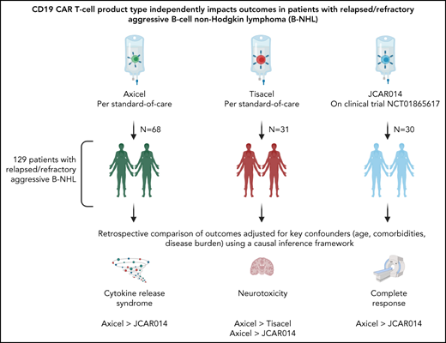
Not all CAR T-cell products are created equal
Different products can mean different results,
Gauthier & Maziarz, Blood, 2022

Slide 43
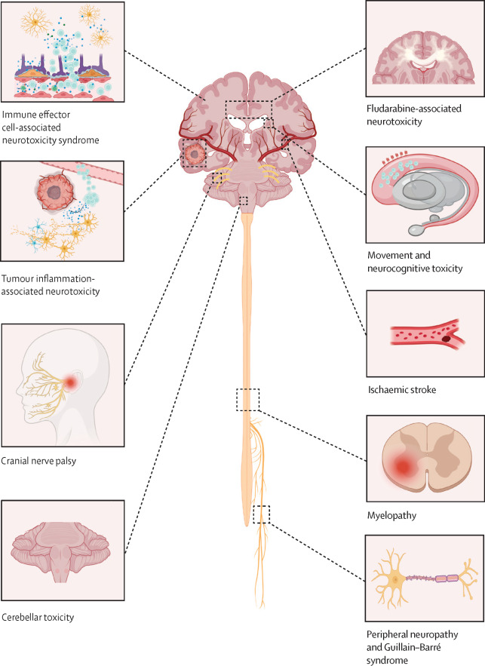
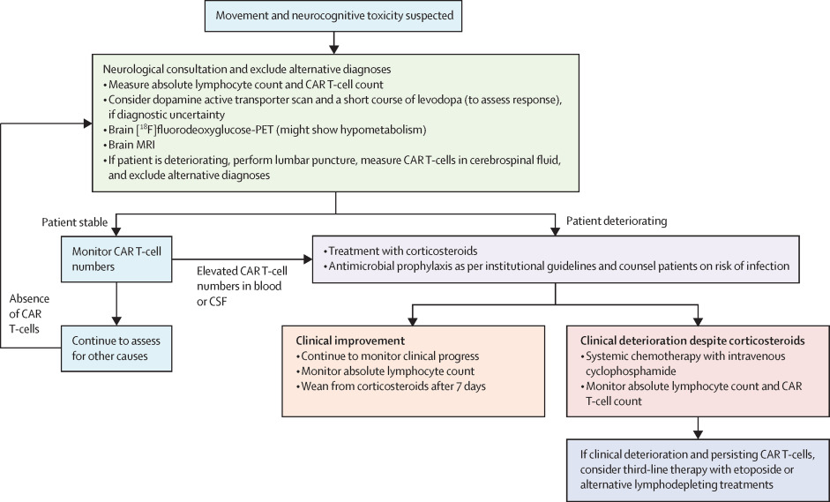
CAR T-cell therapy associated neurotoxicity, Graham et al, Lancet Onc. 2025
Management of Movement/Neurocognitive Toxicity

Slide 44
Cytokine Release Syndrome (CRS)
Can we impact clinical outcome with patient selection?
Some centers may choose to limit treatment to lower burden disease subjects

Slide 45
Predictors of CAR-T Mediated CRS- composite scores
The EASIX score
(creatinine × LDH)/platelets
EASIX-Endothelial Activation and Stress Index
A biomarker score- thought to be a surrogate marker of endothelial activation.
Associated with complement levels in allo-SCT recipients
Predictive of transplant-related toxicities and outcomes

Slide 46
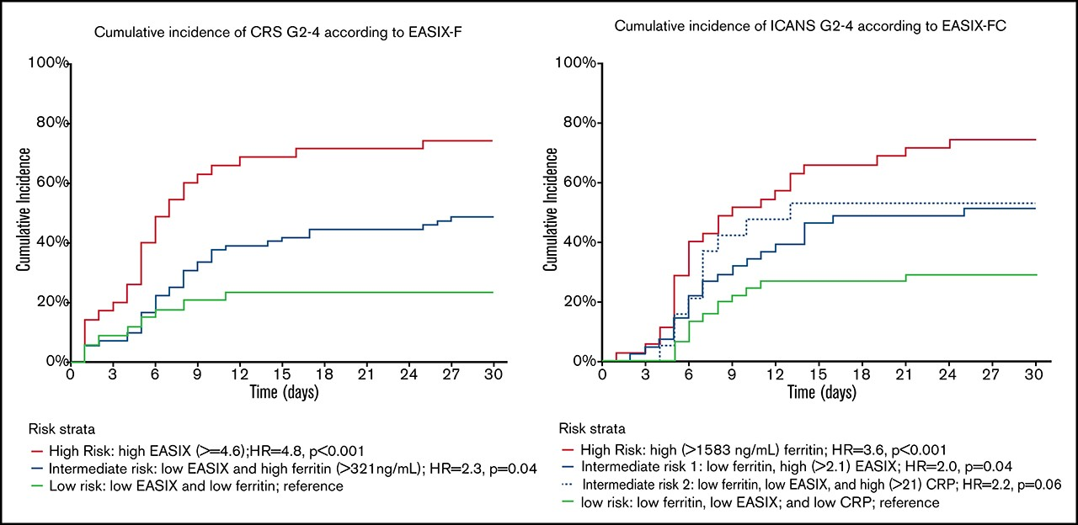
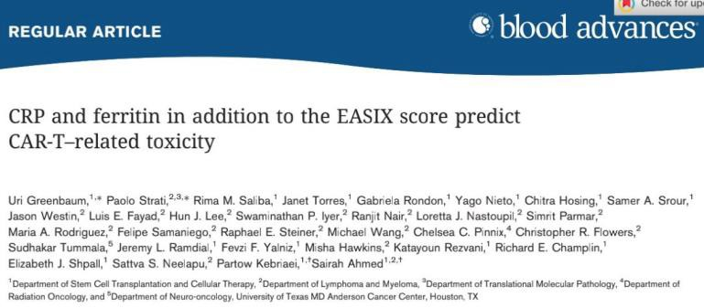
Predictors of CAR-T Mediated CRS- composite scores
CRS ICANS
The MD Anderson experience
  Pre-LD EASIX with ferritin helps define 3 risk groups for CRS grades 2-4
  Pre-LD EASIX with CRP and ferritin helps define 3 risk groups for ICANS grades 2-4

Slide 47
National CAR-T Landscape- 2020
Clintrials.Gov- ~1000 trials planned, ongoing, completed
Disease targets:
  Lymphoma- NHL and HD; MM; Neuroblastoma; ALL; CLL; Mesothelioma; Ovarian ca; Pancreatic ca; AML; Glioblastoma; Prostate ca; Germ Cell HCC: MUC 1+ Lung CA & triple (-) Breast Ca; Colorectal Ca; H/N Ca; SLE
  Targets include Her2/Neu, mesothelin, EGFRvIII, GD2 ganglioside
  CD19/CD22 bispecific CAR-T (generated by bicistronic insertion)
  CD19/CD20 bispecific CAR-T
  Multi-CAR T trials
  CAR-T with checkpoint inhibitors

Slide 48
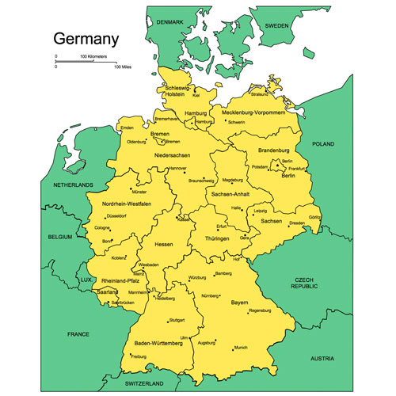
Rheumatologic Illnesses
Where & when did the “fuss” begin??
Erlangen

Slide 49
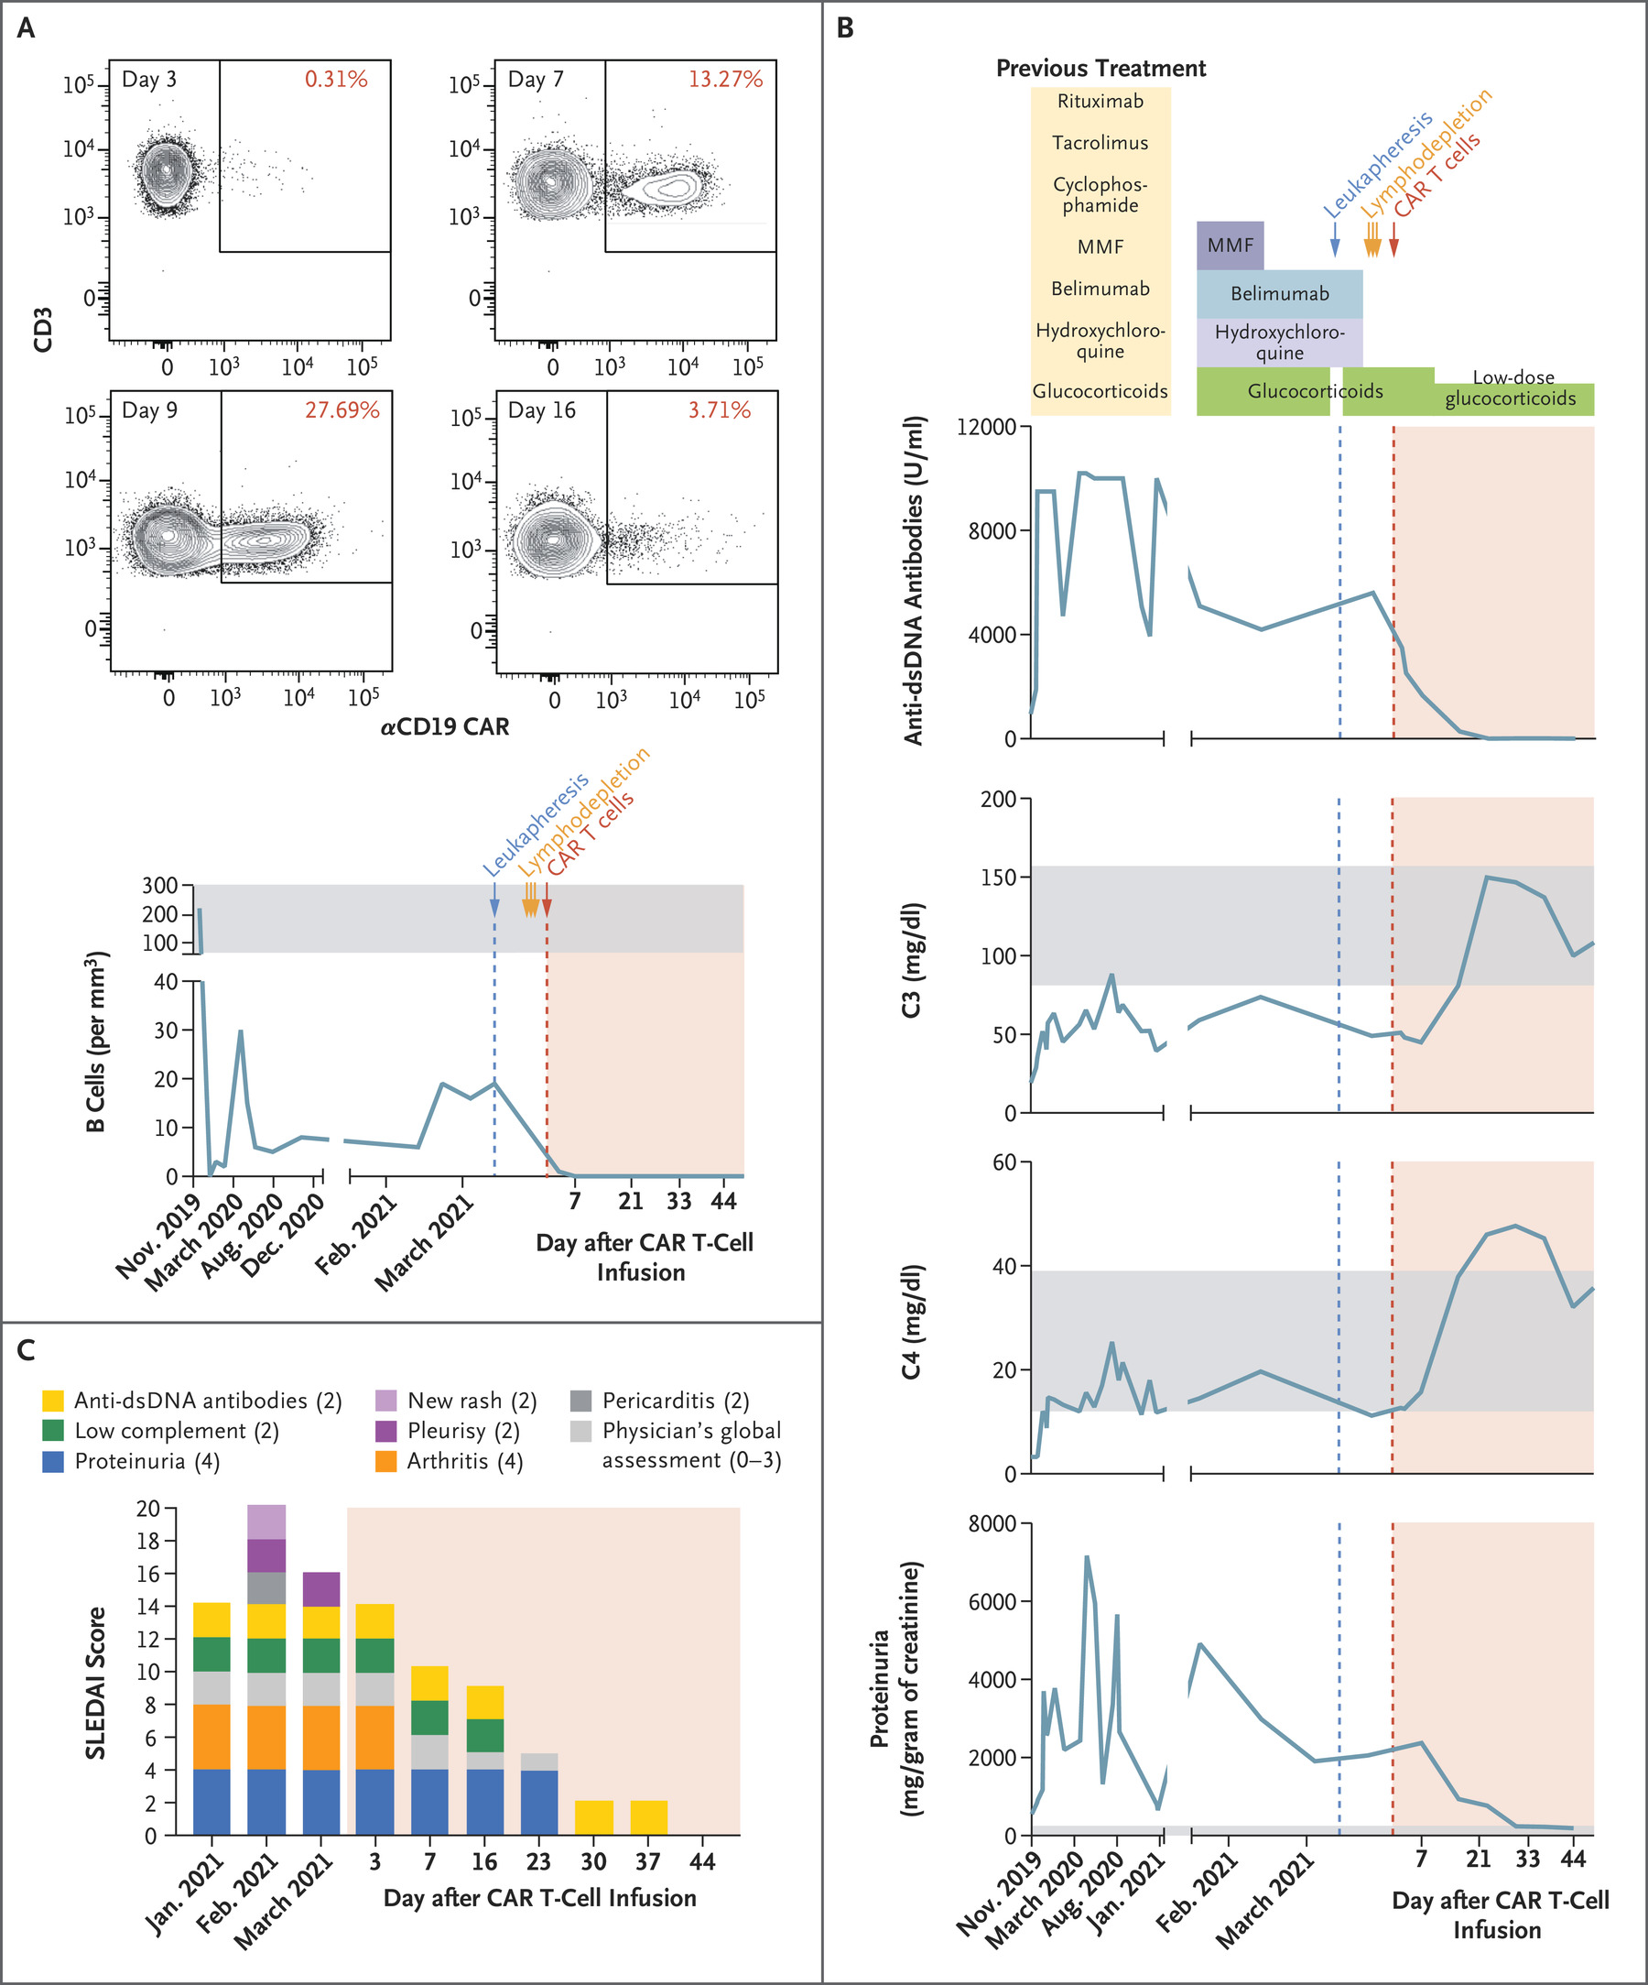
CD19-Targeted CAR T Cells in Refractory Systemic Lupus Erythematosus, Mougiakakos et al, Letter: NEJM, 2021

Slide 50
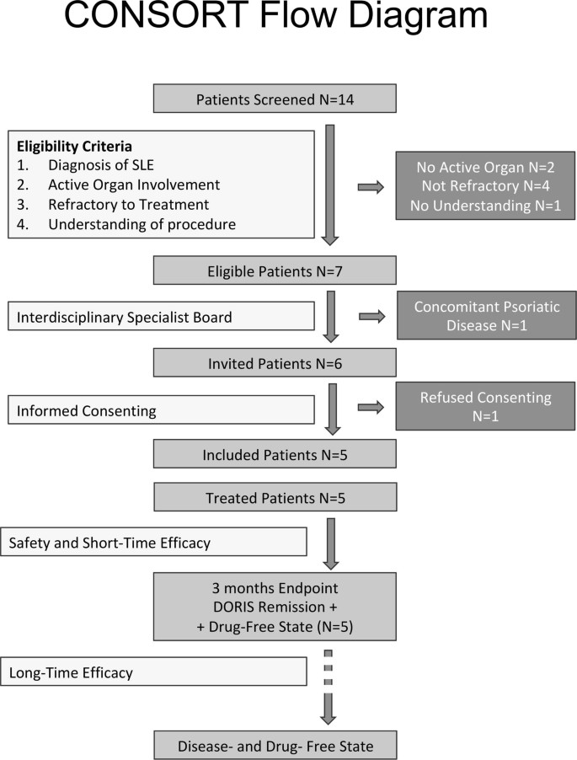
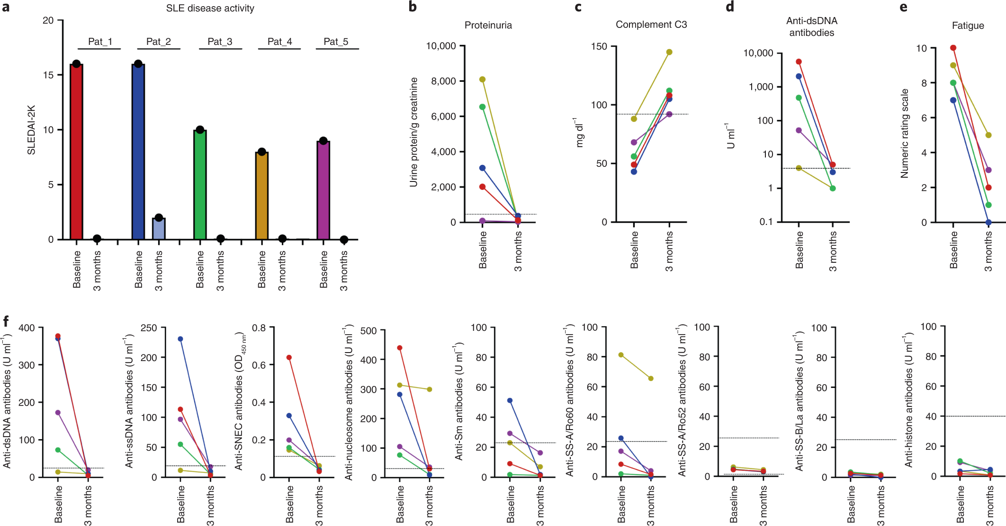
Anti-CD19 CAR T cell therapy for refractory SLE, Mackensen et al, Nat Med, 2022

Slide 51
ASH 2023: Abst #220- CD19-Targeted CAR-T Cells in Refractory Systemic Autoimmune Diseases: A Monocentric Experience from the First Fifteen Patients, Mueller et al.
Background: CD19 CAR T cells target autoreactive B cells that trigger autoimmune diseases (AID) including systemic lupus erythematosus (SLE), idiopahtic inflammatory myositis (IIM) and systemic sclerosis (SSc).
Aim: To test whether CD19 CAR T cells achieve a deeper reset of B cells, eradicate autoimmunity, and achieve lasting drug-free remission in autoantibody-dependent AID.
Methods: Treatment-refractory SLE, IIM and SSc eligible→signs of active organ involvement, failure of multiple immunomodulatory therapies, and serious or immediately life-threatening disease.
Autologous CD19 CAR T cells MB-CART19.1 (Miltenyi prodigy platform). Leukapheresis on day -13; LDC with flu 25 mg/m2 D-5 to -3 and CTX 1000 mg/m2/on D-3. D1: patients 1x10e6 CAR T cells / kg body weight.

Slide 52
ASH 2023: Abst #220- CD19-Targeted CAR-T Cells in Refractory Systemic Autoimmune Diseases: A Monocentric Experience from the First Fifteen Patients, Mueller et al.
Results: 15 patients : 8 SLE, 4 SSc, and 3 IIM (Med age = 36); 15./15 with autoabs; at least 2 organ involvement
Median disease duration before CAR T was 4 years [1-20], median f/u post CAR T 12 months [2-28]. Median # prior RX= 5 [2-14
No Immune meds except max pred 10 mg qd
CAR T cell expansion with peak day 8.6 ± 0.8.
Clearance of host CD19+ B cells: mean of 5.9 ± 2.2 days
8 SLE pts → CR at 3 mo; ongoing SLE Disease Activity Index (SLEDAI) of 0.
3/3 IIM pts→ major improvement and normalization of CK at 3 mos; ongoing response.
4 SSc patients, 3 patients with >3 months → decreased sx by EULAR AI by -4.3 [-4.3; -3.6].
All 15 patients entirely stopped immunosuppressive drugs.
CRS 11/15; 10 Gr1; 1 gr 2. 6/156 → toci. ICANS 1/15, Gr 1 (vertigo sx)
Five SLE patients at 14-24 months in CR, with B cell recovery seen. Total B cell numbers gradually increased to a median of 230 cells/µl at month 12; mostly naïve phenotype. The early drop of CD19+CD27+ memory B cells increased again at month 12 indicating maturation of the B cells emerging after CAR T treatment.

Slide 53
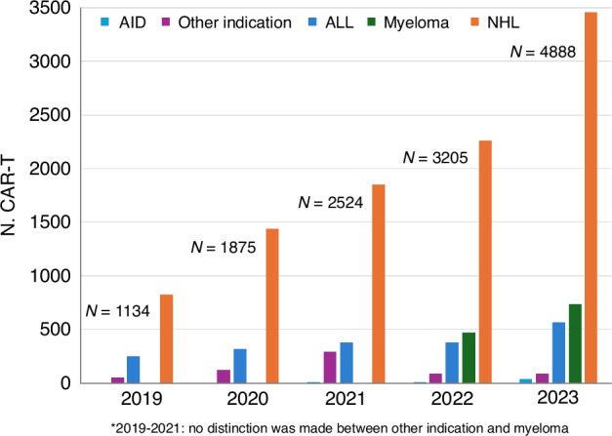
EBMT: Increase in the number of patients receiving CAR-T therapy by main indication from 2019 to 2023, Passweg et al, BMT, Feb 2025

Slide 54
OHSU experience
Treated subjects
  M. Gravis (5)
  Myositis (2 + 1 in planning)
  Lupus nephritis (1 in planning)
Available & planned IEC studies
  Lupus nephritis
  Myesthenia gravis
  Systemic involvement of SLE
  Multiple sclerosis
  Scleroderma
  Multiple rheum disorders including RA

Slide 55

Immune Effector Cell Therapy: the work continues & the work evolves
OHSU – research trials in CAR T, CAR M, NK, TIL, TCR transfer, solid tumor, autoimmune (MS, MG, SLE, myositis, vasculitis)

