Slide 1

Pain in Axial Spondyloarthritis
Mohamad Bittar, MD, MS
Assistant Professor of Medicine
Oregon Health & Science University
Portland, OR

Slide 2

Disclosures
None

Slide 3
Outline
Epidemiology
Pain phenotypes
Measuring pain
Associated factors
Treatment approach

Slide 4
Spondyloarthritis
Axial
Peripheral
Ankylosing Spondylitis
Non-radiographic axSpA
Psoriatic arthritis
Enteropathic arthritis
Reactive arthritis
Undifferentiated

Slide 5
Clinical manifestations of axial spondyloarthritis
IBP/Sacroiliitis/spondylitis (hallmark of axSpA – most patients)
Peripheral arthritis (30% of axSpA)
Enthesitis (up to 35% of axSpA)
Dactylitis (6% of axSpA)
Pain is present in >95% of the cases
de Winter JJ, et al. Arthritis Res Ther. 2016 Sep 1;18(1):196.

Slide 6
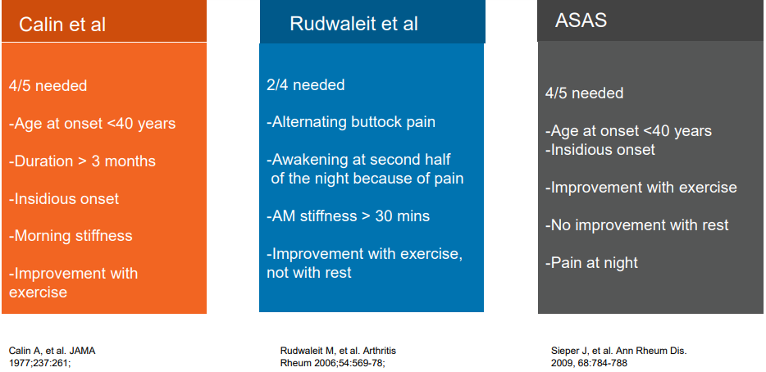
Inflammatory back pain
ONLY 15% of IBP patients have axSpA

Slide 7
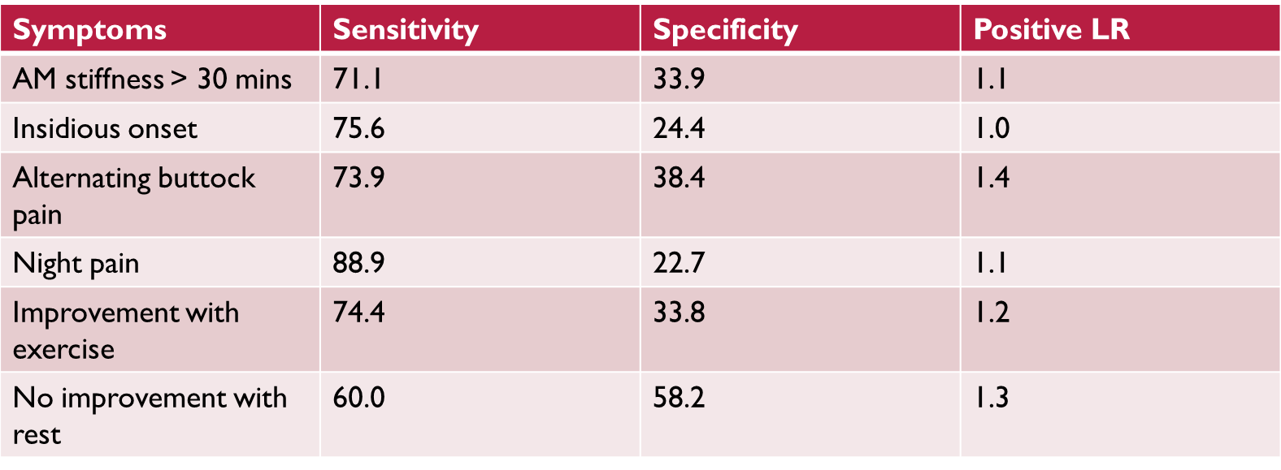
Inflammatory back pain
Poddubnyy D, et al. RMD Open. 2018 Dec 5;4(2):e000825
Notes:
Blinded vs diagnosing rheumatologist: IBP (diagnostic test) was assessed in each centre by an independent (blinded) rheumatologist; a second (unblinded) rheumatologist made the diagnosis (axSpA or no-axSpA), which served as reference standard.
Per Authors: “In summary, rheumatologists must be aware that their global judgement on IBP might be influenced by knowledge of other SpA parameters. Rheumatologists must also be aware that many patients referred to them for a diagnostic workup of axSpA will have IBP because IBP effectively operates in primary care as a selection criterion for referral. Although the specificity of IBP (and the resulting LR+) is low in the rheumatology setting, a small diagnostic gain remains.”

Slide 8
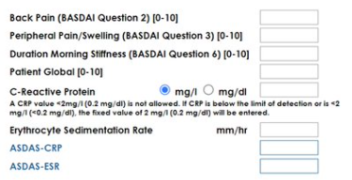

Remission in axSpA?
ASAS-PR: a value of 2 (on a 0 to 10 scale) or less should be present in each of the following domains: patient global, pain, function (BASFI), and inflammation (mean of BASDAI questions 5 and 6).
ASDAS-ID: ASDAS score <1.3

Slide 9
Remission in axSpA?
Certolizumab pegol trials:
24% achieved partial remission (ASAS-PR) at 24 weeks
32.1% achieved inactive disease (ASDAS-ID) at 4 years
Golimumab trials:
23% achieved ASAS-PR at 24 weeks
34% achieved ASAS-PR at 5 years
Ixekizumab trials:
27% achieved ASAS-PR at 52 weeks
22% achieved ASDAS-ID at 52 weeks
Upadacitinib trials:
39% achieved ASAS-PR at 1 year
34% achieved ASDAS-ID at 1 year
> 60% of patients do not achieve partial remission or inactive disease
Landewe R et al, Ann Rheum Dis. 2014
van der Heijde D et al, Rheumatology. 2017
Inman RD et al, Arthritis Rheum. 2008
Deodhar A et al, Arthritis Rheumatol. 2022
Dougados M et al, Ann Rheum Dis. 2020

Slide 10
Disease activity scores
> 60% of patients do not achieve partial remission or inactive disease
MRI scores: such as the Spondyloarthritis Research Consortium of Canada (SPARCC) have very weak or no correlation with clinical disease activity scores (r = 0.18 – 0.31)
MacKay JW et al, Clin Rheumatol. 2015
Non-inflammatory pain component?

Slide 11
Central sensitization in axSpA
Dutch study: 45% of axSpA participants (n=178) had a high probability of central sensitization based on central sensitization inventory (CSI)
Turkish study: 46.6% of axSpA participants (n=116) had central sensitization based on CSI
Prevalence of fibromyalgia in axSpA is thought to range between 16 and 30% in different studies
Pain: associated with heightened disease burden, worse quality of life, disability, absenteeism from work, increased medical costs and economic burden (direct and indirect costs).
Kieskamp SC, et al. Semin Arthritis Rheum. 2022
Sas S et al. J Rheum Dis. 2023
Son et al. J Clin Rheumatol. 2022

Slide 12
What is Pain?
Revised International Association for the Study of Pain (IASP) definition of Pain (2020):
“An unpleasant sensory and emotional experience associated with, or resembling that associated with, actual or potential tissue damage.”
- a personal experience that is influenced by biological, psychological, and social factors.
- individuals learn the concept of pain through their life experiences
- pain may have adverse effects on function and social and psychological well-being.
Raja SN, et al. Pain. 2020

Slide 13
Pain phenotypes
Nociceptive
Neuropathic
Nociplasic

Slide 14
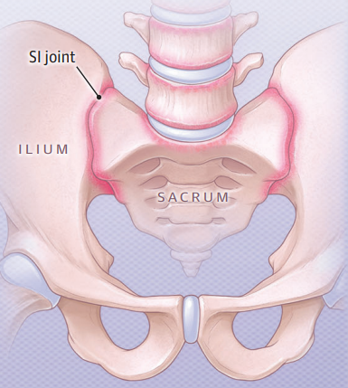

Nociceptive pain
“Pain that arises from actual or threatened damage to non-neural tissue and is due to the activation of nociceptors.”
Examples: Sacroiliitis, peripheral joint inflammation
Bittar M, Deodhar A. JAMA. 2025

Slide 15
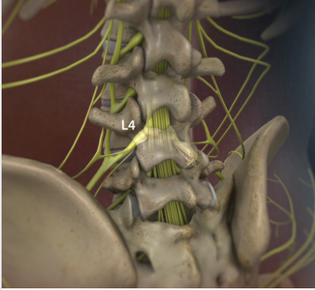
Neuropathic pain
“Pain caused by a lesion or disease of the somatosensory nervous system.”
Central neuropathic pain
Peripheral neuropathic pain
Examples: radiculopathy, carpal tunnel syndrome
https://www.hopkinsmedicine.org/

Slide 16

Nociplastic pain
International Association for the Study of Pain (IASP) definition: “pain that arises from altered nociception despite no clear evidence of actual or threatened tissue damage causing the activation of peripheral nociceptors, or evidence for disease or lesion of the somatosensory system causing the pain”
Examples: fibromyalgia, functional abdominal pain syndrome
Key mechanisms: central and peripheral sensitization
Kosek E, et al. Pain. 2021
https://www.hopkinsmedicine.org/

Slide 17
Central mechanisms
Central sensitization: a neurophysiologic mechanism that reflects an exaggerated central nervous system neural signaling which elicits pain hypersensitivity
Enhanced ascending pain facilitation and inefficient descending pain inhibition
Kwon M, et al. Pain Pract. 2014.

Slide 18
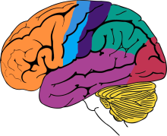
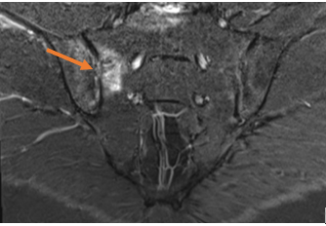
Central mechanisms
Bottom Up
Ascending facilitatory pathways
Stimulated by peripheral inputs
May resolve (or improve) with
controlling peripheral input

Slide 19
Central mechanisms
Top Down
Descending inhibitory pathways
Does not resolve with controlling peripheral input
Affected by genetics and psychosocial factors

Slide 20
Measuring pain
Largely experimental
Pain scores and questionnaires
Quantitative sensory testing
Neuroimaging

Slide 21
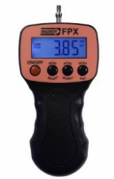
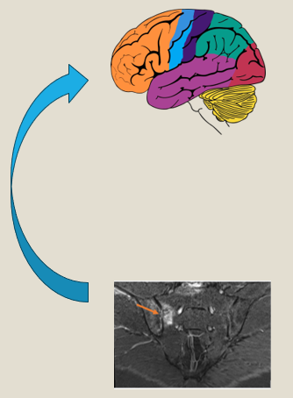
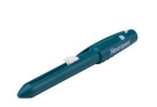
Quantitative sensory testing
Pain pressure thresholds (PPT)
Articular and non-articular sites
Lower pain thresholds = higher pain sensitivity
Low PPTs at extraarticular sites: dysregulation of CNS pain mechanisms
Low PPTs at articular sites: peripheral sensitization
Temporal summation (TS)
- Repetitive taps at a non-articular site (trapezius muscle)
- Higher TS indicative of higher levels of ascending pain facilitation (bottom up)

Slide 22
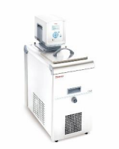
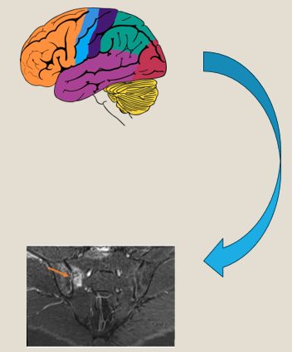
Quantitative sensory testing
Conditioned pain modulation
assessed using a painful conditioning stimulus to
activate the descending inhibitory pain pathways
and a test stimulus to assess pain sensitivity.
Low CPM is considered indicative of abnormalities in descending
pain inhibition (top down)

Slide 23
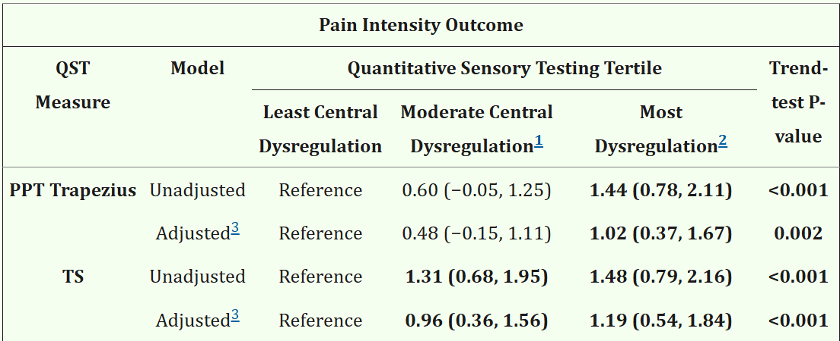
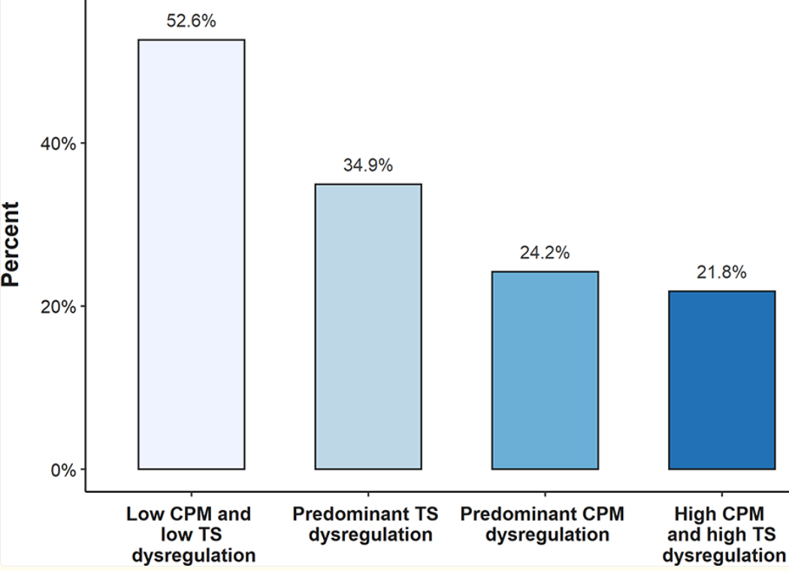
QSTs in Rheumatic Diseases
In RA: central pain (QSTs) was correlated with pain intensity scores, and that was independent of inflammatory activity.
QSTs can predict treatment responses (EULAR treatment responses)
Heisler AC, et al. Arthritis Care Res (Hoboken). 2020.
Heisler AC, et al. Arthritis Rheumatol. 2020

Slide 24
QSTs in axSpA
201 patients; 63% male, 64% radiographic axSpA, mean ASDAS score 2.1±1.0
underwent QST, including PPT, TS and CPM. Also completed central sensitization inventory (CSI) questionnaires
Patients with CSI≥40 had significantly lower PPTs and higher TS than CSI<40 (p<0.004).
In multivariable linear regression, sex, fatigue, anxiety and depression were independently associated with CSI
No stratification by the presence or absence of objective signs of inflammation
van der Kraan YM, et al. RMD Open. 2024.
Notes:
This study did not stratify by the presence or absence of objective signs of inflammation and did not study correlations with neuroimaging.

Slide 25
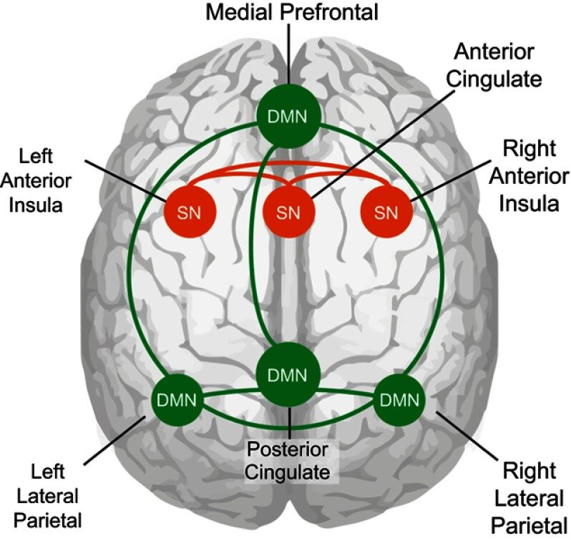
Neuroimaging
Structural: gray matter volume
Functional: activity and connectivity
Default mode network: active when external
stimulation is absent. Plays a role in self-reflection,
planning, social cognition, and emotional
regulation
Salience network: associated with external
stimuli. Evaluates the stimulus and coordinates
response with other brain regions
van Ettinger-Veenstra H, et al. J Pain Res. 2019.

Slide 26
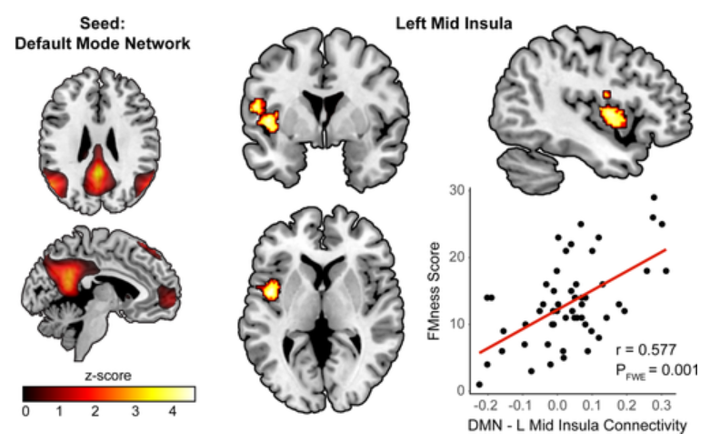
Neuroimaging
In RA: the DMN-insula connectivity was significantly associated with nociplastic pain scores
54 patients, mean age (54.9 ± 11.41 years), 41 women. Mean fibromyalgianess (Fmness) score 13.20 ± 6.21 (range 1–29)
Derived from the ACR FM survey criteria and found that it predicted pain and disability in RA
The altered connectivity between the DMN and anterior insula was observed in studies of fibromyalgia, osteoarthritis, and chronic back pain
Basu N, et al. Arthritis Rheumatol. 2018.
Napadow V, et al. Arthritis Rheum. 2010.
Loggia ML, et al. Pain. 2013.
Baliki MN, et al. PLoS One. 2014.

Slide 27
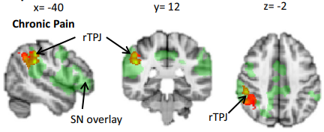
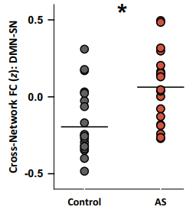
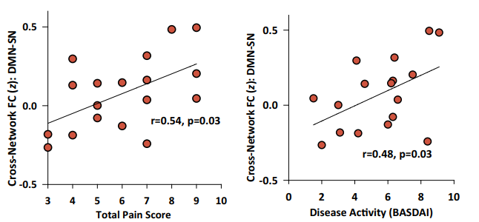
Neuroimaging
In axSpA (AS) study (n=20 patients vs 20 controls): the connectivity between the DMN and salience network was altered. Correlated with pain and disease symptoms
Hemington KS et al., Brain Structure Function, 2016.

Slide 28
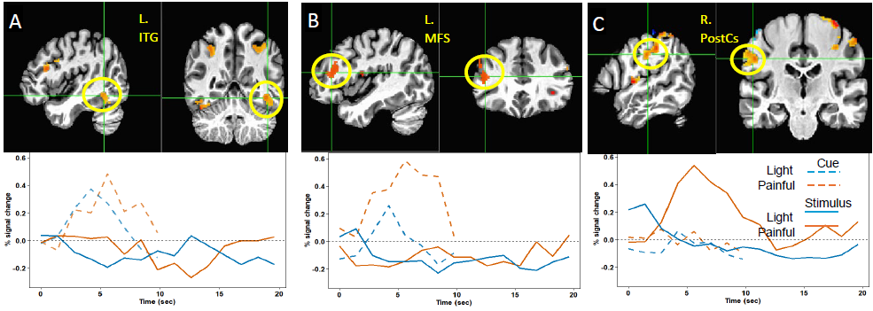
Task fMRI
Unpublished data. Bittar et al.

Slide 29
Neuroimaging
In patients with chronic low back pain (non-inflammatory), gray matter thickness was decreased in the prefrontal cortex and somatosensory cortex when compared to controls
Gray matter volume increased after effective treatment (spine surgery or facet joint block)
This was also seen in osteoarthritis studies
In axSpA (AS) study (n=17 patients): gray matter cortical thinning in the primary somatosensory cortex, insula, and anterior cingulate cortex.
This cortical thinning was correlated with higher painDETECT scores, which is a tool to identify neuropathic pains.
Seminowicz DA, et al. J Neurosci. 2011
Wu Q, et al. Arthritis Rheum. 2013
Notes:
The authors did not study correlations with nociplastic pain scores or objective pain measures such as quantitative sensory testing

Slide 30

Can we predict who will develop nociplasic pain?
A step towards precision medicine

Slide 31
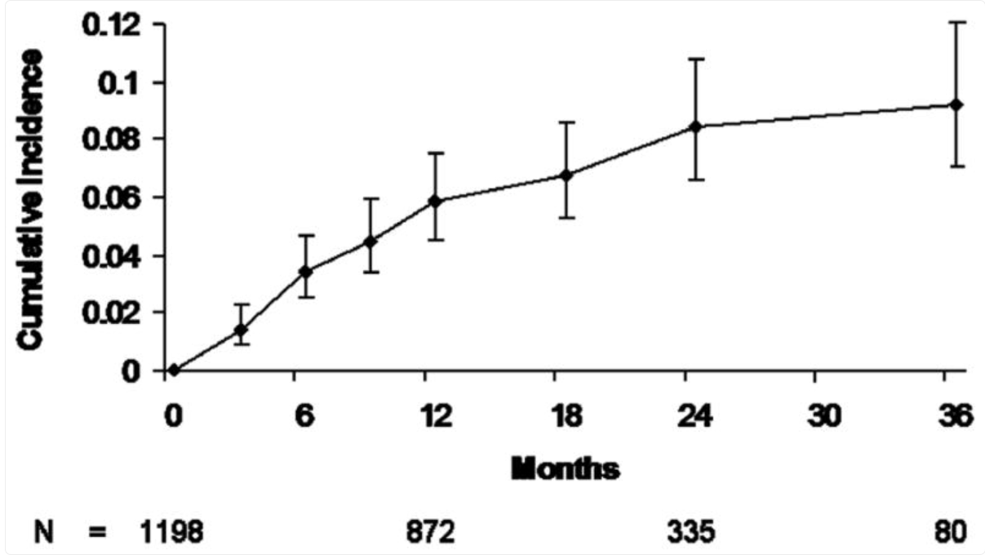
Disease duration and Chronic pain
After inflammatory arthritis diagnosis,
Incidence of developing chronic pain is
Highest within the first 2 years
- Associated factors: pain severity and
Poor mental health
Global delay in axSpA diagnosis ~6.7 years on average.
In axSpA, high levels of disease activity was associated with the development of chronic pain. Starting TNFi lowered the incidence of fibromyalgia.
Lower pain tolerance associated with longer symptom duration
Early diagnosis and treatment of axSpA might be protective?
Lee YC et al. Ann Rheum Dis, 2013
Provan SA et al., Rheumatology (Oxford), 2021
Zhao SS, et al. Rheumatology (Oxford). 2021

Slide 32
Psychosocial factors
“Vicious cycle”
Mental health, disease activity, and chronic pain are inter-related
Anxiety and depression associated with higher disease activity scores and worse pain scores
Sleep disturbances and chronic pain, bi-directional relationship
Qualitative concept elicitation interviews with 15 axSpA patients: 60% had pain that worsened sleep disturbance and sleep disturbance that further aggravated pain
In RA, poor sleep was found to predict pain despite DMARD treatment
Raymond K, et al. Qual Life Res. 2024.
Lee YC et al. Arthritis Rheumatol, 2018.

Slide 33
Sex differences
Female axSpA patients have: higher disease activity scores, worse quality of life, higher prevalence of chronic pain/fibromyalgia, longer diagnostic delays
Sex hormones can influence pain transmission. Testosterone can increase pain thresholds. Pain sensation fluctuates with hormonal changes, especially in women during the menstrual cycle
Estrogens increase cell-mediated and humoral immune response and production of IL-1, IL-6 and TNF-α
Women: greater number of pain receptors and a different expression of the opioid receptors
Body composition (subcutaneous fat) and immune modulation
Pain coping strategies
Rusman T, et al. Rheumatology (Oxford). 2020.
Neuenschwander R, et al. Arthritis Res Ther. 2020.

Slide 34
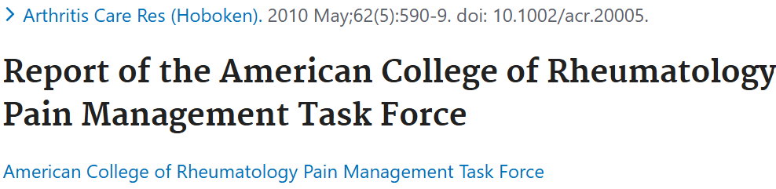
How do rheumatologists approach pain in rheumatic diseases?
A survey by the American College of Rheumatology Pain Management Task force
Most do not characterize themselves as “pain physicians” and are uncomfortable treating pain
Many did not receive training in pain evaluation and management
Main focus is to treat and control inflammation

Slide 35
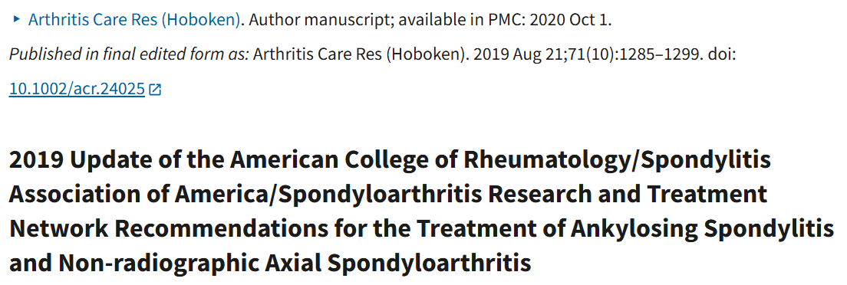
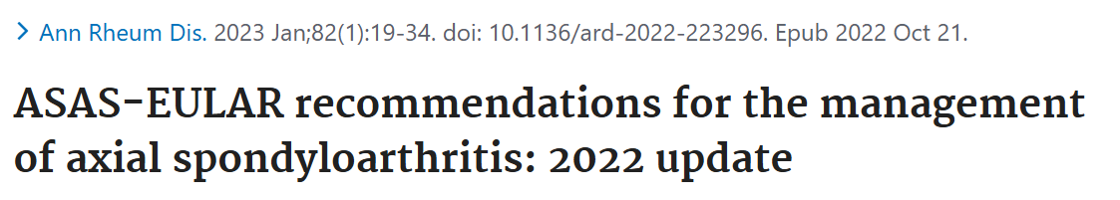
AxSpA treatment algorithms

Slide 36
Management approach
Bottom up pathways
Anti-inflammatory medications to target nociceptive component
(NSAIDs, biologics, targeted synthetic DMARDs)
Gabapentinoids*
Pregabalin efficacious in painful chronic pancreatitis
Responders hypersensitive to electric tetanic stimulation
of the pancreatic area
QST (electrical pain detection ratio) was predictive of response
Sensitivity 87.5%, specificity 80.0%
-Anti-inflammatory
-Gabapentinoids*
Olesen SS, et al. PLoS One. 2013.
*studies on non-rheumatic diseases

Slide 37
Management approach
Top Down pathways
Tricyclic Antidepressants (TCAs)*
Serotonin Norepinephrine Reuptake Inhibitors (SNRIs)*
Cognitive behavioral therapy (CBT)*
- Duloxetine efficacious in painful diabetic neuropathy
Baseline CPM was found to be correlated with duloxetine
efficacy (r=0.628, P<.001)
-TCA*
-SNRI*
-CBT*
Yarnitsky D et al. Pain, 2012
*studies on non-rheumatic diseases

Slide 38
Management approach
Body-based therapies (such as exercise and physical therapy)
Localized procedures such as nerve blocks (for example: in radiculopathy cases)
No data on low dose naltrexone, cannabinoids
Avoid opioids

Slide 39
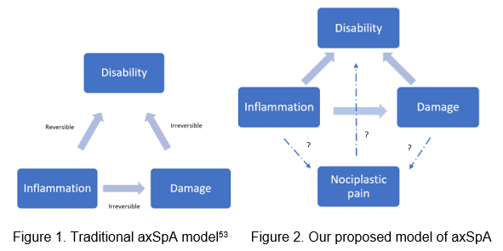
Traditional AxSpA model
Traditional axSpA model
Smolen JS, et al. Ann Rheum Dis. 2018

Slide 40
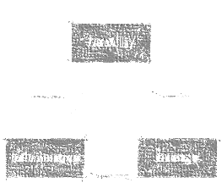
Our proposed AxSpA model
New axSpA model
Bittar, M., and Deodhar, A.

Slide 41



Acknowledgements
Yvonne Lee | Atul Deodhar
Jennifer Barton | Mary Heinricher
Alexander Stevens | Kim Phung Karimzadeh
Issabell Melz | Yuki Harry
Rosy Quinn | Madison Stanaway

Slide 42

Thank you!

