Slide 1
A Conundrum in Coexistence
Manush Sondhi
University of Washington

Slide 2
Chief Complaint
A 52-year-old male presented to PCP with complaints of nasal congestion and rhinorrhea
History of Presenting Illness
Nasal congestion, cough, thick yellow-green nasal discharge, post-nasal drip, and headache since past few months worsened for a week
Worsening intermittent episodes of shortness of breath, wheezing, coughing, chest tightness
Negative for fever, dental problem, drooling, ear discharge, ear pain, mouth sores, nosebleeds, and sore throat
Past Medical History
Hypertension, well-controlled asthma (on Albuterol, Advair, and Trelegy), CAD s/p CABG currently on ticagrelor, past stroke with multiple ischemic infarcts (recovered)
Allergy
Aspirin (developed chest tightness and dyspnea- confirmed by formal aspirin challenge)
Family History
Non-significant
Social History
Never smoked cigarettes, drinks alcohol occasionally, never consumed any recreational drugs

Slide 3
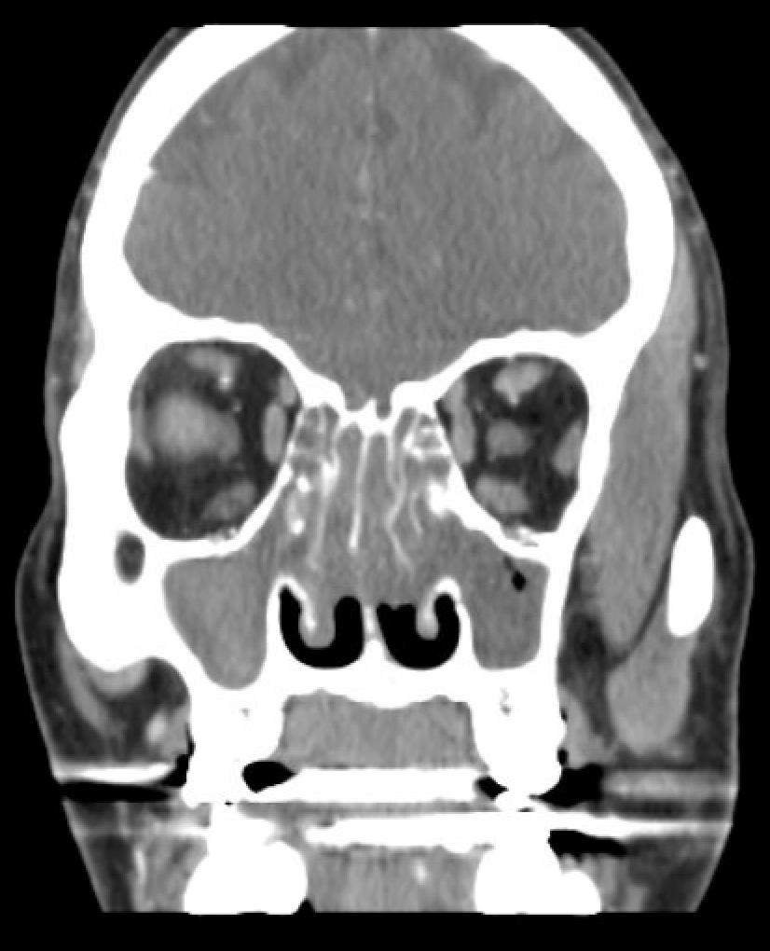
Labs
Hemoglobin 15.7 (12.5-16.3 gm/dl), Hematocrit 48.1 (36.7-47.1%), MCV 91 (82-98 fL), MCH 29.7 (27-31 pg), MCHC 32.6 (29.6-33.8 g/dl),
WBC 9.50 (3.9-12.7 K/ul)
Differential: Gran% 64.4 (38-73%), Lymph% 15.4 (18-48%), Mono% 11.3 (4-15%), Eosinophil count 1300/MicroL (30-350/MicroL), AEC 12.4 (0-0.5 k/ul), Basophil 0.6 (0-1.9%)
Platelets 210k (150-450 K/ul)
CMP- normal
CT sinus
Severe pansinusitis with dense material in the right maxillary sinus and sphenoidal sinuses. Severe mucosal disease with opacification of maxillary sinuses ethmoid cells, sphenoid sinus, and frontal sinus.
CT chest
Diffuse patchy small airway disease with atelectatic changes
Referral to ENT
ENT performed nasal endoscopy that showed bilateral nasal polyposis, confined to the middle meatus – grade 4
Given the invasive nature of the FESS, the patient decided not to go ahead with it.

Slide 4
Treatment course
Referral to Allergy and Immunology
Tryptase 33.4 (<11.5 ng/ml)
Toxocara, Strongyloides serologies as well as stool ova and parasites - Negative
Allergic bronchopulmonary aspergillosis (ABPA) panel - Negative
IgE 1470 IU/ml (Normal < 100)
Spirometry in the office demonstrated mild airway obstruction.
Recommended allergen immunotherapy (AIT) however, the patient refused.
Started on anti-histamines, topical decongestants, and nasal saline rinses.
Referral to HemOnc
Flow cytometry of peripheral blood: No evidence of acute leukemia or NHL. Prominent eosinophilia noted.
Bone marrow biopsy: Consistent with no clonality, normal cytogenetics/FISH, 70% trilineage hematopoietic activity.
Genetic Testing- JAK2 V617F mutation negative; FIP1L1-PDGFRA fusion transcript and PDGFRB- undetectable and BCR/ABL- negative.
Started on hydroxyurea 1000 mg daily.

Slide 5
What is the most likely diagnosis? 1. Hypereosinophilic Syndrome 2. IgG4 related disorder
3. Mastocytosis 4. Lymphoma 5. Sarcoidosis 6. Eosinophilic Granulomatosis with Polyangiitis

Slide 6
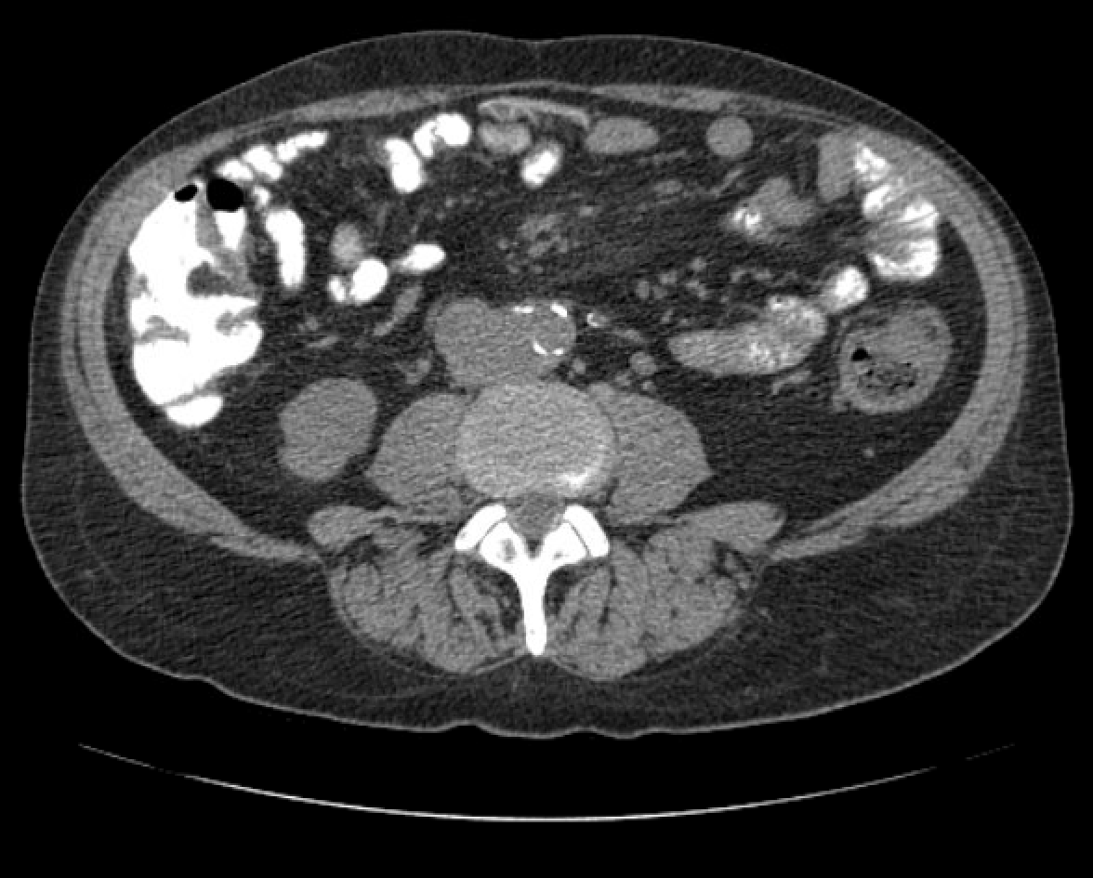
After two years of lost follow-up …
Presented to the clinic with complaints of intermittent dull lower abdominal pain radiating to the lower back for a few months worsened over a few days
Complaints of intermittent diarrhea but no episodes of melena, or hematochezia.
Worsening symptoms of sinusitis.
CT abdomen/pelvis with contrast was ordered that showed:
Periaortic lesion that abuts IVC consistent with large retroperitoneal lymph node along with retroperitoneal mesenteric lymphadenopathy with fat stranding
Referred to Rheumatology for further workup.

Slide 7
Labs
ANA panel - negative
p-ANCA & c-ANCA negative; MPO antibody and GBM negative
C3 complement- 77 (50-180 mg/dl), C4 complement- 14 (11-44 mg/dl)
Celiac Testing- Antigliadin Ab IgG 9 (<20U), Antigliadin Ab IgA 2 (<20 U)
Infectious workup including syphilis, helminthic infections, tuberculosis, and hepatitis B and C virus - negative
Further Course
Due to worsening rhinosinusitis, the patient agreed to get sinus surgery. ENT performed polyp debulking, and a biopsy was taken.

Slide 8
Biopsy results
Acute and chronic lymphoplasmacytic inflammation with storiform fibrosis along with the presence of a few eosinophils and more than 10 IgG4 cells per HPF
Labs
IgG 4180 (650-1600 mg/dl), IgA 82 (40-350 mg/dl), IgM 74 (50-300 mg/dl), IgE 1470 (Normal <100)
IgG 1- 399 (382-929 mg/dl), IgG 2- 232 (242-700 mg/dl), IgG 3- 25 (22-176 mg/dl), IgG4- 2413 (4-86 mg/dl)
Treatment
Started on Prednisone 40 mg for a short interval period and then initiated two 1-gram IV rituximab infusions separated by two weeks every 6 months
Discontinued hydroxyurea
Patient reported improvement in symptoms including abdominal pain and sinus symptoms, following rituximab infusions
Final Diagnosis
Chronic rhinosinusitis with nasal polyps with Asthma and Aspirin Intolerance (Aspirin-Exacerbated Respiratory Disease (AERD)/ Samter's triad) s/p nasal biopsy and laboratory work confirming IgG4 disease

Slide 9
Differential Diagnosis
1. Infectious Causes
Tuberculosis, MAC, HIV, Syphilis: Can lead to retroperitoneal or mesenteric lymphadenopathy with fat stranding, mimicking IgG4-RD radiographically. No risk factors, systemic signs, caseating granulomas, organisms, or infectious infiltrates on biopsy .
Parasitic Infections (Toxocara, Strongyloides): Serologies and stool studies negative.
Allergic Fungal Sinusitis: Negative fungal serologies and ABPA markers.
2. Immune-Mediated/Inflammatory
IgG4-Related Disease
Sarcoidosis: No granulomas or pulmonary/hilar involvement.
Sjogren’s / SLE: No characteristic biopsy features.
Multicentric Castleman Disease: No constitutional symptoms/systemic inflammation.
EGPA: Can have worsening asthma, peripheral eosinophilia, and features of systemic vasculitis, including mononeuritis multiplex, pulmonary infiltrates, and potential cardiac or renal involvement however patient had ANCA negative, no systemic vasculitis or organ damage, and no granulomas on biopsy.

Slide 10
3. Hematologic / Neoplastic
Hematologic Malignancies (Leukemia, Lymphoma): Flow cytometry, bone marrow, and molecular studies negative.
Hypereosinophilic Syndrome: No clonal markers or systemic involvement beyond sinuses.
4. Mast Cell Disorders
Mastocytosis: Elevated tryptase, but no skin lesions/systemic symptoms; BM biopsy negative.
5. Respiratory / Sinopulmonary
Hypereosinophilic Pneumonia: No pulmonary infiltrates or classic respiratory symptoms.
6. Medication-Induced
Ticagrelor-induced hypereosinophilia: No established link, but considered due to evolving symptoms and AERD history.
7. Rare/Genetic Disorders
DOCK8 Deficiency / Hyper-IgE Syndrome: No recurrent infections or syndromic features.

Slide 11
Discussion
IgG4-RD + AERD Coexistence
Coexistence is rare but documented
Only one prior reported case:
61-year-old male with NSAID sensitivity, eye proptosis, nasal symptoms
Diagnosed with both AERD and IgG4-related sinusitis
Nasal polyps are not a typical primary feature of IgG4-RD
Sinonasal involvement in IgG4-RD:
Can present like allergic rhinitis or chronic sinusitis
Histology shows IgG4+ plasma cell infiltration
Literature support:
Ueno et al. – 5 IgG4-RD cases with sinus involvement
Suzuki et al. – 56.5% of IgG4-RD patients had nasal mucosa infiltration

Slide 12
Discussion
Shared Immunopathogenesis
Both AERD and IgG4-RD are Type 2 inflammation-driven
A cytokine-driven immune response involving IL-4, IL-5, and IL-13, characterized by Th2 cells, eosinophils, IgE production, and mucosal barrier dysfunction. Central to diseases like asthma, atopic dermatitis, chronic rhinosinusitis with nasal polyps, and eosinophilic esophagitis.
IL-4 – Promotes B cell class switching to IgE, IL-5 – Drives eosinophil activation and survival, IL-13 – Induces mucus secretion, fibrosis, and airway hyperreactivity
AERD:
↑ IL-5, IL-13 → eosinophilic infiltration, severe nasal polyposis
IL-33 amplifies response, activates mast cells
IgG4-RD:
Th2-driven: ↑ IL-4, IL-10, IL-13 → tissue infiltration by IgG4-positive plasma cells & fibrosis
IL-33 promotes M2 macrophage activation, enhances Th2 response

Slide 13
Discussion
Clinical Evidence of Link
Buchheit et al.:
Found elevated IgG4 in nasal polyp tissue of AERD patients
Engelhart et al.:
Showed increased serum IgG4 in AERD patients
Findings suggest a biological connection
No current evidence that:
AERD is an early sign of IgG4-RD
AERD evolves into IgG4-RD
Important to recognize overlap in persistent AERD with eosinophilia as early intervention can prevent organ damage, halt disease progression and improve long-term outcomes.

