Slide 1
Year in Review
4/26/25
Julianna Desmarais, MD

Slide 2
Disclosures
I have no financial disclosures

Slide 3
Methods
Reviewed journals 2024- 3/2025
Arthritis and Rheumatology
Annals of Rheumatic Diseases
Arthritis Care and Research
NEJM
Lancet
JAMA journals
Practice changing or pivoting understanding
Colleague advice

Slide 4
Overview
Osteoarthritis updates
CAR T
Finally targeted treatment for Sjögren's Syndrome?
BTK inhibitors
RA updates
Lupus Nephritis

Slide 5
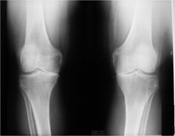
Osteoarthritis Updates
Image Credit: ACR Image Library

Slide 6
Glucagon-Like Peptide-1 (GLP-1) Agonists
GLP-1 agonists were developed to treat diabetes and obesity.
They work through stimulating the pancreas to produce more insulin, reduce glucagon secretion from the liver, slow down stomach emptying, and promote feelings of fullness.
There is interest in these to help with arthritis through weight loss, though another mechanism for symptom improvement may be through anti-inflammatory and anti-degradative properties found in studies with liraglutide^{1,2}
An observational study of patients with diabetes using GLP-1 agonists (including semaglutide, liraglutide and dulaglutide) found lower rates of TKA³
Sci Rep 2022;12:1567-1567
Am J Transl Res 2019;11:4800-4808
Ann Rheum Dis. 2023 Sep;82(9):1218-1226.
Notes:
Liraglutide, a glucagon-like peptide 1 receptor agonist, exerts analgesic, anti-inflammatory and anti-degradative actions in osteoarthritis. Sci Rep 2022;12:1567-1567.
Mei J, Sun J, Wu J, Zheng X. Liraglutide suppresses TNF-α-induced degradation of extracellular matrix in human chondrocytes: a therapeutic implication in osteoarthritis. Am J Transl Res 2019;11:4800-4808.

Slide 7
Once-Weekly Semaglutide in Persons with Obesity and Knee Osteoarthritis
68-week, double-blind, randomized, placebo-controlled international trial
Patients had obesity (BMI ≥30), moderate knee osteoarthritis with at least moderate pain. They were randomly assigned, in a 2:1 ratio, to once-weekly subcutaneous semaglutide (2.4 mg) or placebo
All patients received counseling on physical activity and a reduced-calorie diet
Outcomes:
The primary end points were change in body weight (%) and the change in the WOMAC pain score (on a scale of 0 to 100, with higher scores reflecting worse outcomes) from baseline to week 68.
Main secondary end point was the physical-function score on the 36-Item Short Form Health Survey (SF-36), version 2 (on a scale of 0 to 100, with higher scores indicating greater well-being).
N Engl J Med 2024;391:1573-1583
Notes:
Step 9 study in October 2024

Slide 8
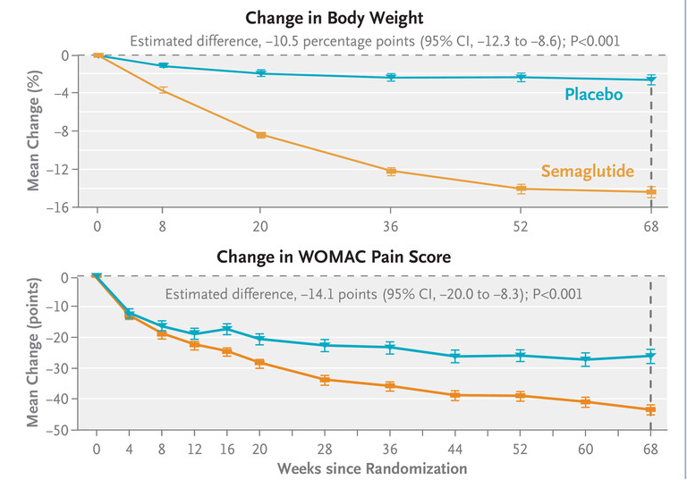
Once-Weekly Semaglutide in Persons with Obesity and Knee Osteoarthritis
Results:
407 patients with mean age of 56 years and mean BMI of 40.3. 81.6% of patients were female.
Mean change in weight from week 0 to 68 was –13.7% in the semaglutide group (271 patients), -3.2% in the placebo group (136 patients)
Mean WOMAC pain score was 70.9 at baseline. After 68 weeks, the mean change in the semaglutide group was –41.7 points, and –27.5 in the placebo group (P<0.001).
SF-36 scores rose by 12 points in the semaglutide group, versus 6.5 points in the placebo group
The incidence of serious adverse events was similar in the two groups
Subgroup analyses indicated a benefit of semaglutide with respect to pain regardless of BMI values at baseline
N Engl J Med 2024;391:1573-1583

Slide 9
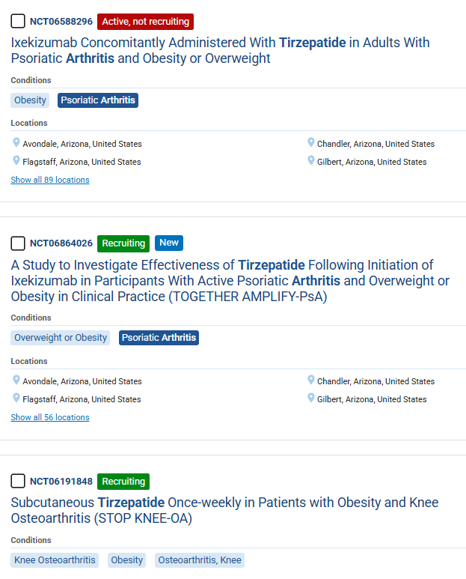

Slide 10
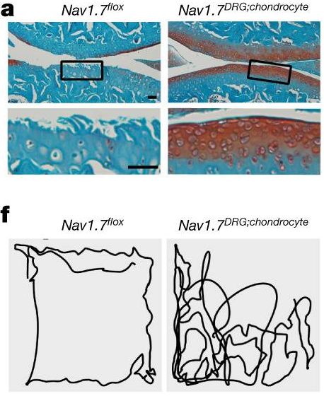
Na_{v}1.7 as a chondrocyte regulator and therapeutic target for osteoarthritis
This group identified Na_{v}1.7 as an OA-associated voltage-gated sodium channel in human chrondrocytes
Through RNA-seq analysis on normal and arthritic cartilage, Na_{v}1.7 as the only significantly upregulated OA-associated VGSC. Human chrondocytes express 350 to 525 channels per cell.
Dorsal root ganglion also express this VGSC as well
Serial genetic ablation of Na_{v}1.7 in multiple mouse models showed that Na_{v}1.7 in the DRG neurons is involved in pain perception, whereas Na_{v}1.7 in chondrocytes regulates OA progression
Generating mice with Na_{v}1.7 knockout in DRG neurons, chondrocytes, or both
Blocking or knocking out Na_{v}1.7 slows the progression of structural joint damage, and reduces OA pain behavior.
Na_{v}1.7 is an OA-associated channel that may be a disease-modifying and pain relief treatment for OA
Nature. 2024 Jan;625(7995):557-565.
Notes:
We assessed the expression profile of VGSCs in human chondrocytes using PCR with reverse transcription (RT–PCR) and found that, SCN2A, SCN3A, SCN4A, SCN8A, SCN9A and SCN11A are expressed in chondrocytes (Extended Data Fig. 1a). In line with this data, analysis of the genes that are differentially regulated between OA cartilage (Kellgren–Lawrence (KL) grade 3–4) and non-arthritic cartilage using our previous RNA-seq dataset22 (GSE168505) with a particular interest in VGSCs, indicated that six VGSCs were expressed in chondrocytes

Slide 11
Chimeric antigen receptor (CAR)–modified T cells
A 2021 case report described CD19 CAR T cells to target B cells in a patient with SLE (N Engl J Med 2021;385:567-569)
In 2022, five patients with lupus treated with CD19 CAR T were published (Nat Med. 2022 Oct;28(10):2124-2132).
Rapid B cell depletion
SLE symptoms resolved, all 5 were able to stop immunosuppression
On B cell recovery a few months later, disease symptoms didn't return
Administration of CAR T cells was well tolerated, with only mild cases of cytokine release syndrome
Notes:
Info about this patient in NEJM- A 20-year-old woman with severe and refractory SLE presented with active lupus nephritis (World Health Organization class IIIA, indicating focal proliferative disease with active lesions), nephrotic syndrome, pericarditis, pleurisy, rash, arthritis, and a history of Libman–Sacks endocarditis
Follow out patients how long? Drug-free remission was maintained during longer follow-up (median (range) of 8 (12) months after CAR T cell administration) and even after the reappearance of B cells

Slide 12
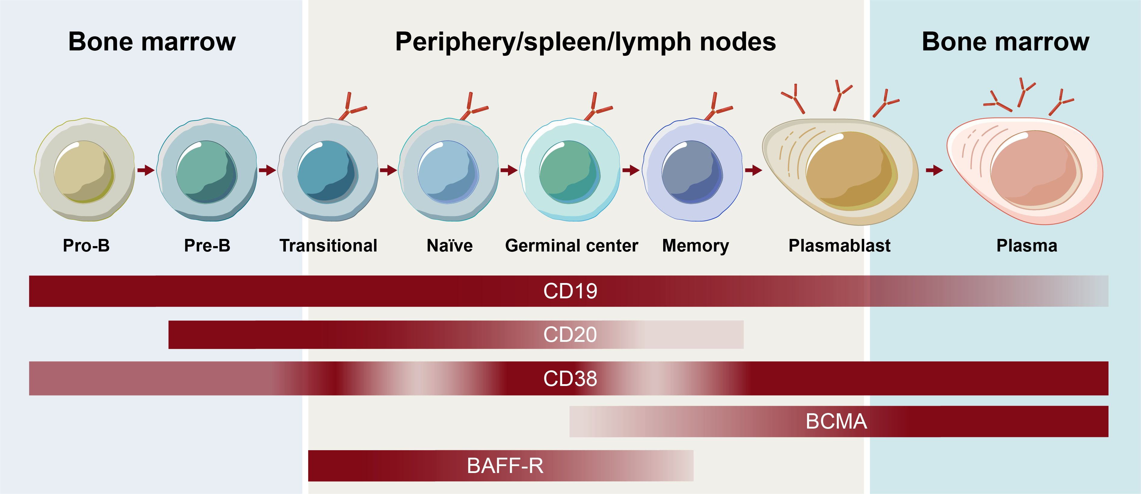
Front Immunol. 2024 Oct 9:15:1454747

Slide 13
CD19 CAR T-Cell Therapy in Autoimmune Disease - A Case Series with Follow-up
15 patients with severe SLE (8 patients), idiopathic inflammatory myositis (3), or systemic sclerosis (4)
Single infusion of CD19 CAR T cells after preconditioning with fludarabine and cyclophosphamide
The median follow-up was 15 months (range, 4 to 29).
The mean (±SD) duration of B-cell aplasia was 112±47 days.
N Engl J Med 2024;390:687-700
Notes:
Panel C shows long-term outcomes in patients with IIM. Scores on the Manual Muscle Test–8 (MMT-8) range from 0 to 150, with lower scores indicating weaker muscles.

Slide 14
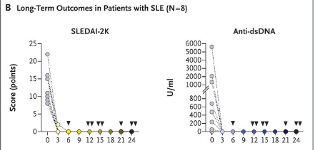
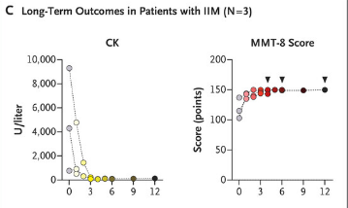
CD19 CAR T-Cell Therapy in Autoimmune Disease - A Case Series with Follow-up
All the patients with:
SLE had DORIS remission
Idiopathic inflammatory myositis had an ACR–EULAR major clinical response
Systemic sclerosis had a decrease in the score on the EUSTAR activity index
Immunosuppressive therapy was completely stopped in all the patients.
Grade 1 cytokine release syndrome occurred in 10 patients. One patient each had grade 2 cytokine release syndrome, grade 1 immune effector cell–associated neurotoxicity syndrome, and pneumonia that resulted in hospitalization.
N Engl J Med 2024;390:687-700
Notes:
Panel C shows long-term outcomes in patients with IIM. Scores on the Manual Muscle Test–8 (MMT-8) range from 0 to 150, with lower scores indicating weaker muscles.

Slide 15
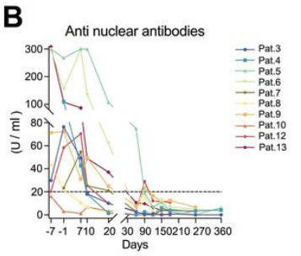
BCMA-CD19 compound CAR (cCAR) T cells for systemic lupus erythematosus: a phase 1 open-label clinical trial
BCMA (B Cell Maturation Agent) is a surface antigen expressed by long-lived plasma cells and is correlated with SLE/lupus nephritis (LN) severity and activity, making it a promising therapeutic target
BCMA-CD19 compound CAR T cells (cCAR) had two independently functioning CARs that target both the B-cell CD19 and the long-lived plasma cell BCMA surface antigens
13 patients treated with severe SLE, mean age 31, 10/13 female
9/13 patients satisfied the DORIS CR criteria and 12 /13 met the LLDAS criteria 3–6 months post-cCAR
Ann Rheum Dis. 2024 Sep 30;83(10):1304-1314.
Notes:
P1 and P2 presented with relapsed/refractory diffuse large B cell lymphoma (DLBCL) comorbid with SLE, and P3–P13 are patients with serum and biopsy confirmed LN. P11 presented with severe bone marrow suppression. Despite performing apheresis twice, T cell counts remained inadequate to dose the patient with 3×106 cCAR cells /kg. Patients were designated to receive 3×106 cCAR cells /kg, however, P11 strongly requested compassionate use cCAR therapy and thus was treated with an initial dose of 1.5×106 cCAR cells /kg.

Slide 16
Allogeneic CD19-targeted CAR-T therapy in patients with severe myositis and systemic sclerosis
Genetically engineered healthy-donor-derived, CD19-targeting CAR-T cells (TyU19) to treat one myositis patient and two scleroderma patients
one dose of 1 × 10⁶/kg CAR-T product
Infused cells persisted for over 3 months, achieving complete B cell depletion within 2 weeks of treatment
No cases of cytokine release syndrome
All three went into deep drug free remission out to 6 months
Cell. 2024 Sep 5;187(18):4890-4904.e9.

Slide 17
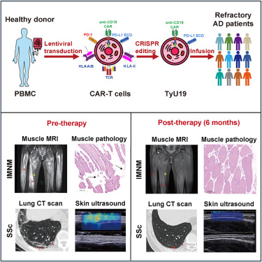
Allogeneic CD19-targeted CAR-T therapy in patients with severe myositis and systemic sclerosis
One scleroderma patient had noted CT chest ILD improvement, the other had myocardial inflammation improve
Protective antibodies to EVB, HSVⅠ, HSVⅡ, and CMV persisted
Cell. 2024 Sep 5;187(18):4890-4904.e9.
Notes:
Woman had myositis, 2 male patinets with scleroderma

Slide 18
CD19-CAR T-cell therapy induces deep tissue depletion of B cells
When B cells are depleted, where are they, and are CD19 CAR T cells more effective than rituximab?
Sequential ultrasound-guided inguinal lymph node biopsies done at baseline and after CD19-CAR T-cell therapy in patients with autoimmune indications, compared with rituximab treated patients who lacked peripheral B cells
5 patients with autoimmune disease before and after CD19-CAR T-cell therapy and from five patients after RTX treatment
Ann Rheum Dis. 2025 Jan;84(1):106-114
Notes:
Which diseases?

Slide 19
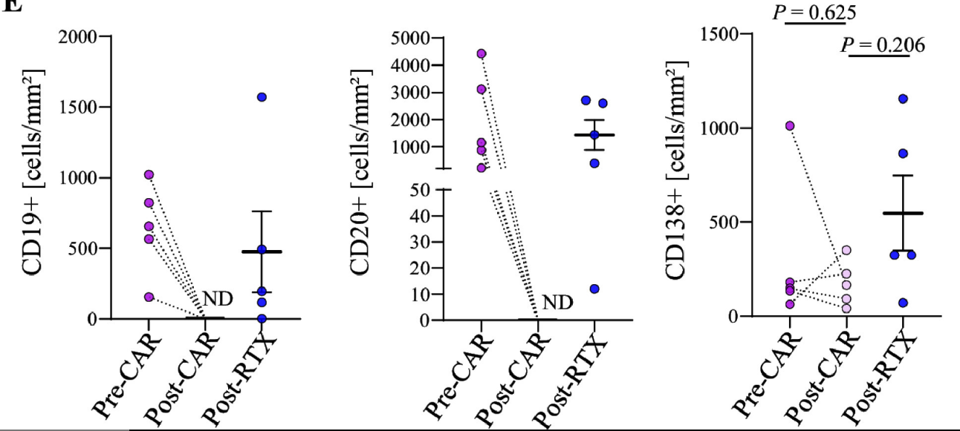
CD19-CAR T cell therapy induces deep tissue depletion of B cells
CD19+ and CD20+ B cells were completely depleted in the lymph nodes after CAR T, but not after RTX
Plasma cells, T cells and macrophages in the lymph nodes remained unchanged
Follicular structures were disrupted, and follicular dendritic cells were depleted in the lymph nodes after CD19-CAR T cell therapy, but not after RTX.
Non-lymphoid organs were completely depleted of B cells in 3 CAR T treated patients (colon, kidney, gallbladder).
This study shows difference in the depth of cell depletion between antibody-based and cell-based therapeutic approaches
Ann Rheum Dis. 2025 Jan;84(1):106-114
Notes:
Objectives
CD19-targeting chimeric antigen receptor (CAR) T-cell therapy can induce long-term drug-free remission in patients with autoimmune diseases (AIDs). The efficacy of CD19-CAR T-cell therapy is presumably based on deep tissue depletion of B cells; however, such effect has not been proven in humans in vivo.
Methods
Sequential ultrasound-guided inguinal lymph node biopsies were performed at baseline and after CD19-CAR T-cell therapy in patients with AIDs. Results were compared with lymph node biopsies from rituximab (RTX)-treated AID patients with absence of peripheral B cells. Conventional and immunohistochemistry staining were performed on lymph node tissue to assess architecture as well the number of B cells, follicular dendritic cells (FDCs), plasma cells, T cells and macrophages.
Results
Sequential lymph node biopsies were analysed from five patients with AID before and after CD19-CAR T-cell therapy and from five patients with AID after RTX treatment. In addition, non-lymphoid organ biopsies (colon, kidney and gallbladder) from three additional patients with AID after CD19-CAR T-cell therapy were analysed. CD19+ and CD20+ B cells were completely depleted in the lymph nodes after CD19-CAR T-cell therapy, but not after RTX treatment. Plasma cells, T cells and macrophages in the lymph nodes remained unchanged. Follicular structures were disrupted and FDCs were depleted in the lymph nodes after CD19-CAR T-cell therapy, but not after RTX. Non-lymphoid organs were completely depleted of B cells.
Discussion
This study demonstrates complete B-cell depletion in secondary lymphoid tissues of patients with AIDs following CD19-CAR T-cell therapy combined with standard lymphodepleting therapy.
CD138, also known as Syndecan-1, is a transmembrane protein marker primarily expressed on the surface of plasma cells and some epithelial cells. It plays a role in cell-cell interactions, adhesion, and migration. CD138 expression is commonly used in diagnostic immunohistochemistry, particularly for identifying and quantifying plasma cells, and can also be a valuable tool in distinguishing carcinomas from mesotheliomas

Slide 20
Can Rheumatoid Arthritis be Prevented?
Atorvastatin (STAPRA¹) and hydroxychloroquine (StopRA²) proved ineffective in preventing the onset of RA
Rituximab (PRAIRI³) delayed RA onset and methotrexate (TREAT EARLIER⁴) improved MRI detected inflammation
Abatacept in individuals at high risk of rheumatoid arthritis (APIPPRA): a randomised, double-blind, multicentre, parallel, placebo-controlled, phase 2b clinical trial (Lancet. 2024 Mar 2;403(10429):838-849)
Abatacept inhibits inflammation and onset of rheumatoid arthritis in individuals at high risk (ARIAA): a randomised, international, multicentre, double-blind, placebo-controlled trial (Lancet. 2024 Mar 2;403(10429):850-859)
RMD Open. 2021 Mar;7(1):e001591
Arthritis Rheumatol. 2022; 74 (suppl 9).
Ann Rheum Dis. 2019 Feb;78(2):179-185.
Lancet. 2022 Jul 23;400(10348):283-294.

Slide 21
APIPPRA
Randomized, double-blind, multicenter, parallel, placebo-controlled, phase 2b clinical trial done in early arthritis clinics (28 in UK and 3 in Netherlands)
Inclusion: age ≥18 years at risk of RA, positive for ACPA and RF (or neg RF but ACPA>3xULN) with inflammatory joint pain without clinical swelling
Exclusion: previous episodes of clinical synovitis and previous use of steroids or DMARDs
Randomized to SQ abatacept or placebo for 12 months, then followed for 12 months
Primary endpoint was the time to development of clinical synovitis in 3+ joints or RA per ACR and EULAR criteria, secondary was DAS28.
Of 213 participants, 110 were randomly assigned to abatacept and 103 to placebo
Lancet. 2024 Mar 2;403(10429):838-849

Slide 22
APIPPRA
Lancet. 2024 Mar 2;403(10429):838-849
Notes:
Between Dec 22, 2014, and Jan 14, 2019, 280 individuals were evaluated for eligibility and, of 213 participants, 110 were randomly assigned to abatacept and 103 to placebo. During the treatment period, seven (6%) of 110 participants in the abatacept group and 30 (29%) of 103 participants in the placebo group met the primary endpoint. At 24 months, 27 (25%) of 110 participants in the abatacept group had progressed to rheumatoid arthritis, compared with 38 (37%) of 103 in the placebo group. The estimated proportion of participants remaining arthritis-free at 12 months was 92·8% (SE 2·6) in the abatacept group and 69·2% (4·7) in the placebo group. Kaplan-Meier arthritis-free survival plots over 24 months favoured abatacept (log-rank test p=0·044). The difference in restricted mean survival time between groups was 53 days (95% CI 28-78; p<0·0001) at 12 months and 99 days (95% CI 38-161; p=0·0016) at 24 months in favour of abatacept. During treatment, abatacept was associated with improvements in pain scores, functional wellbeing, and quality-of-life measurements, as well as low scores of subclinical synovitis by ultrasonography, compared with placebo. However, the effects were not sustained at 24 months. Seven serious adverse events occurred in the abatacept group and 11 in the placebo group, including one death in each group deemed unrelated to treatment.

Slide 23
ARIAA
International, multicenter, double-blind, placebo-controlled trial in 14 locations in Europe (11 in Germany, 2 in Spain, and 1 in the Czech Republic).
Inclusion: Age ≥18 years with ACPA positivity, joint pain (but no swelling), and signs of osteitis, synovitis, or tenosynovitis in hand MRI.
Patients were randomly assigned 1:1 to SQ abatacept or placebo for 6 months followed by a double-blind, drug-free, observation phase for 12 months.
Primary outcome was the proportion of participants with any reduction in inflammatory MRI lesions at 6 months.
139 participants were screened. Of 100 participants, 50 were randomly assigned to abatacept 125 mg and 50 to placebo.
Lancet. 2024 Mar 2;403(10429):850-859
Notes:
Why 49 in each group, not 50?

Slide 24
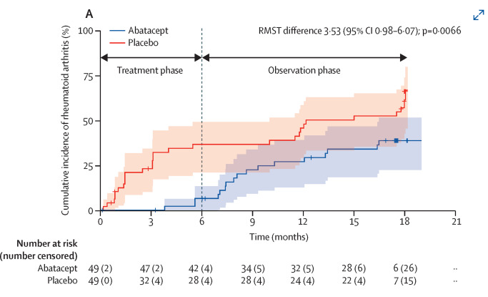
ARIAA
Primary outcome occurred in 28 (57%) of 49 participants in the abatacept group and 15 (31%) of 49 participants in the placebo group.
Rheumatoid arthritis, according to 2010 ACR/EULAR criteria, was diagnosed in 4/49 in the abatacept group and 17/49 participants in the placebo group at 6 months.
The effects of the intervention persisted through a 1-year drug-free observation phase.
Lancet. 2024 Mar 2;403(10429):850-859
Notes:
Final conclusions

Slide 25
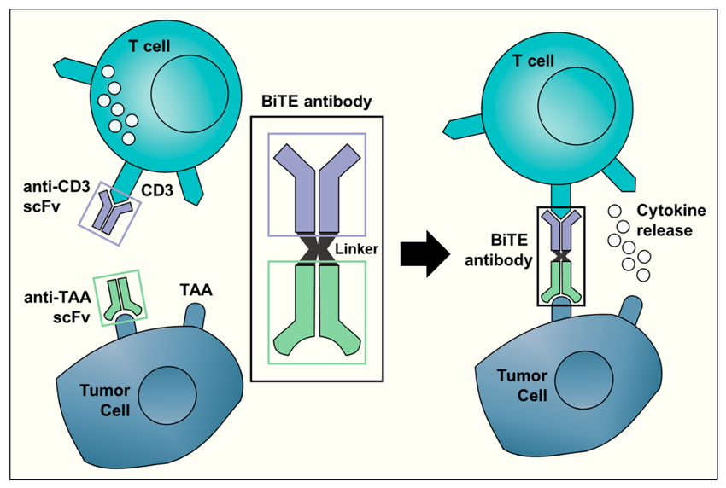
Bispecific T cell engager therapy for refractory rheumatoid arthritis
Bispecific T cell engagers (BiTEs) kill B cells by engaging T cells
Used already in ALL
T cell activation can be used to kill B cells
Blinatumomab—the first BiTE developed
Effective at extremely low concentrations, since T cells are highly sensitive to T-cell-receptor-mediated signaling and a single T cell can engage several B cells
6 patients with multidrug-resistant RA with the CD19xCD3 BiTE blinatumomab under compassionate use
Nat Med. 2024 Jun;30(6):1593-1601.
Cancers (Basel). 2019 Dec 14;11(12):2022.
Notes:
Tackling the immune synapse between B cells and T cells may provide a potential anchor to develop treatments that can target multidrug-resistant RA7. This concept is supported by the effect of abatacept—a CTLA-4-Fc protein—inhibiting T cell activation through interfering with the immune synapse between antigen-presenting cells, including B cells, and T cells8. On the other hand, T cell activation can be used to kill B cells9. This concept has been used to successfully treat resistant acute lymphoblastic leukemia with bispecific T cell engagers (BiTEs) that consist of two separated immunoglobulin single-chain variable fragments (scFv) connected with a flexible linker that creates a short bridge between T cells and B cells

Slide 26
Bispecific T cell engager therapy for refractory rheumatoid arthritis
Patients:
3 male, 3 females with average age of 53 and disease duration of 6 years. Median DAS 28 was 5.1. Median number of treatments for RA was 7.
All 6 patients had received methotrexate, leflunomide, TNFa inhibitors and JAK inhibitors. 5/6 had previously received IL-6 inhibitors and 3/6 have received abatacept and rituximab
Blinatumomab was given inpatient as a continuous infusion over 5 days, then after a 1 week pause was given again as a second 5 day infusion. The last RA drug was stopped 3 weeks before blinatumomab. Baseline methotrexate treatment was continued.
Drug-related adverse events included a subfebrile state (4 patients), elevated C-reactive protein (CRP) (4 patients) and chills (1 patient), all restricted to the first week of therapy.
Nat Med. 2024 Jun;30(6):1593-1601.
Notes:
Tackling the immune synapse between B cells and T cells may provide a potential anchor to develop treatments that can target multidrug-resistant RA7. This concept is supported by the effect of abatacept—a CTLA-4-Fc protein—inhibiting T cell activation through interfering with the immune synapse between antigen-presenting cells, including B cells, and T cells8. On the other hand, T cell activation can be used to kill B cells9. This concept has been used to successfully treat resistant acute lymphoblastic leukemia with bispecific T cell engagers (BiTEs) that consist of two separated immunoglobulin single-chain variable fragments (scFv) connected with a flexible linker that creates a short bridge between T cells and B cells

Slide 27
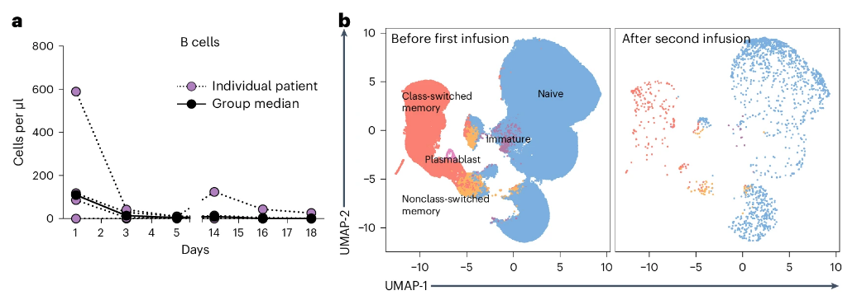
Bispecific T cell engager therapy for refractory rheumatoid arthritis
Infusion of blinatumomab substantially depleted B cells in the peripheral blood. Showing T cell engagement function, blinatumomab induced a rapid and highly dynamic reduction of CD4⁺ and CD8⁺ T cells in the peripheral blood
Nat Med. 2024 Jun;30(6):1593-1601.
Notes:
Tackling the immune synapse between B cells and T cells may provide a potential anchor to develop treatments that can target multidrug-resistant RA7. This concept is supported by the effect of abatacept—a CTLA-4-Fc protein—inhibiting T cell activation through interfering with the immune synapse between antigen-presenting cells, including B cells, and T cells8. On the other hand, T cell activation can be used to kill B cells9. This concept has been used to successfully treat resistant acute lymphoblastic leukemia with bispecific T cell engagers (BiTEs) that consist of two separated immunoglobulin single-chain variable fragments (scFv) connected with a flexible linker that creates a short bridge between T cells and B cells

Slide 28
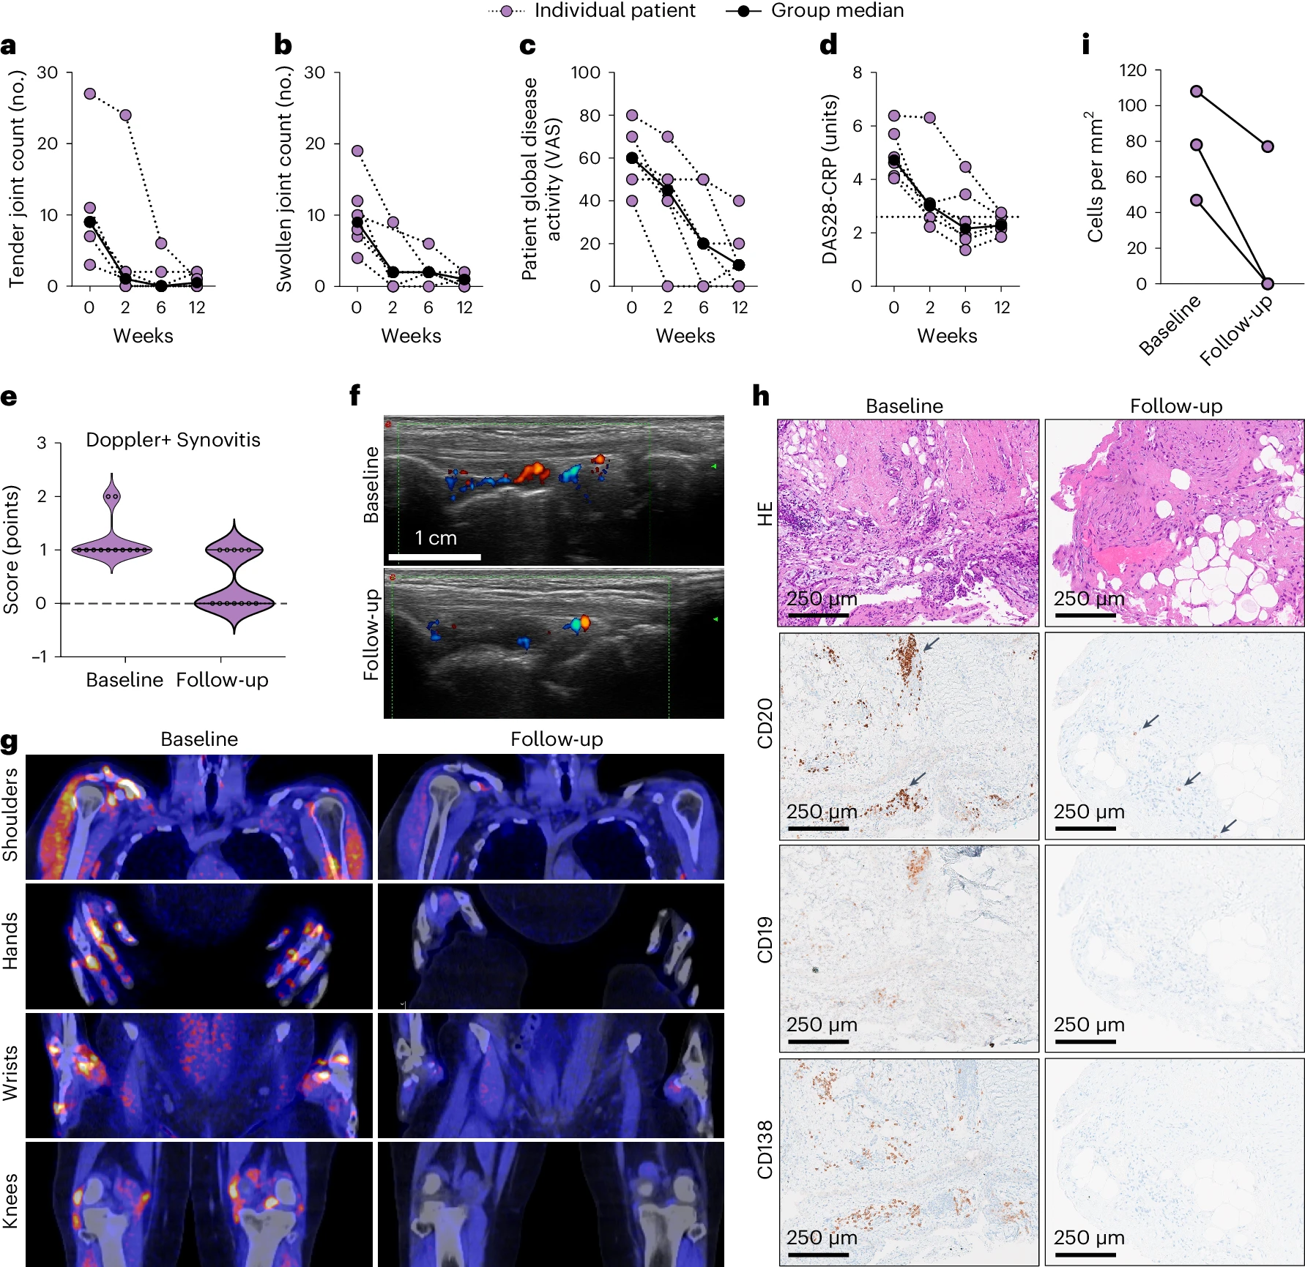
Bispecific T cell engager therapy for refractory rheumatoid arthritis
Nat Med. 2024 Jun;30(6):1593-1601.
Notes:
Effects of blinatumomab on tender joint count (a), swollen joint count (b), patient global disease activity (VAS, 0–100) (c) and DAS28 (d). Dotted horizontal line in d shows cut-off for remission (2.6); n = 6 individual patients. e, Quantification of PD before (baseline) and after (follow-up) therapy with blinatumomab; n = 12 joints from n = 6 individual patients. f, Example of decrease in PD signal in the wrist before and after blinatumomab (patient 5). g, Example of FAPI-PET-CT before and 3 months after therapy with blinatumomab (patient 2). h, Example of immunohistochemistry of synovial tissue of wrist joint biopsies before blinatumomab and 3 months after blinatumomab (patient 6). Staining with hematoxylin eosin (HE) and CD19⁺ B cells, CD20⁺ B cells and CD138⁺ plasmablasts/plasma cells is shown. All pictures were taken at ×200 magnification using the software ndpView (Hamamatsu). i, All five sections of synovial biopsies of patients 1 (proximal interphalangeal joint), 4 and 6 (both wrist joints) were examined for the presence of CD19⁺CD20⁺ B cells before blinatumomab and 3 months after blinatumomab.

Slide 29
Sjögren's Syndrome
Efficacy and safety of remibrutinib, a selective potent oral BTK inhibitor, in Sjögren's syndrome: results from a randomised, double-blind, placebo-controlled phase 2 trial (Ann Rheum Dis. 2024 Feb 15;83(3):360-371.)
Efficacy and safety of telitacicept in primary Sjögren's syndrome: a randomized, double-blind, placebo-controlled, phase 2 trial (Rheumatology (Oxford). 2024 Mar 1;63(3):698-705.)
CD40 ligand antagonist dazodalibep in Sjögren's disease: a randomized, double-blinded, placebo-controlled, phase 2 trial (Nat Med. 2024 Jun;30(6):1583-1592.)
Safety and efficacy of subcutaneous iscalimab (CFZ533) in two distinct populations of patients with Sjögren's disease (TWINSS): week 24 results of a randomised, double-blind, placebo-controlled, phase 2b dose-ranging study (Lancet. 2024 Aug 10;404(10452):540-553.)
Notes:
Telitacicept is a recombinant fusion protein used to treat autoimmune diseases. It is a monoclonal antibody that targets and inhibits two key cytokines involved in B-cell activation and survival: B-lymphocyte stimulator (BLyS) and a proliferation-inducing ligand (APRIL).

Slide 30
RIP Iscalimab

Slide 31
BTK Inhibitors
Efficacy and safety of remibrutinib, a selective potent oral BTK inhibitor, in Sjögren's syndrome: results from a randomised, double-blind, placebo-controlled phase 2 trial (Ann Rheum Dis. 2024 Feb 15;83(3):360-371.)
Efficacy and Safety of Upadacitinib or Elsubrutinib Alone or in Combination for Patients With Systemic Lupus Erythematosus: A Phase 2 Randomized Controlled Trial. (Arthritis Rheumatol. 2024 Oct;76(10):1518-1529.)
Notes:
Explain what a BTK inhibitor is
Bruton’s tyrosine kinase (BTK) plays a crucial role in B-cell receptor signalling, activating Fc receptors for IgG and IgE (FcγR, FcεR) and is expressed by B cells and myeloid cells including macrophages, microglia and mast cells.8–10 Inhibition of BTK has emerged as a potential therapeutic option for selective immune modulation of several diseases based on the mechanistic relevance of autoreactive B cells as pathogenic antigen-presenting cells, a source of autoantibodies, and on the ensuing proinflammatory effector functions of these autoantibodies mediated by FcR signalling
BTK inhibitors work by interfering with the B-cell receptor (BCR) signaling pathway. They do this by binding to and inhibiting the activity of the enzyme Bruton's tyrosine kinase (BTK), which is crucial for B cell growth and survival. By blocking BTK, these inhibitors disrupt the BCR pathway, preventing the abnormal growth and proliferation of B cells, particularly in B-cell malignancies like chronic lymphocytic leukemia (CLL) and mantle cell lymphoma (MCL).

Slide 32
Efficacy and safety of remibrutinib, a selective potent oral BTK inhibitor, in Sjögren's syndrome: results from a randomised, double-blind, placebo-controlled phase 2 trial
Use of remibrutinib in patients with moderate-to-severe SjS in a phase 2 randomized, double-blind trial
moderate-to-severe disease activity (EULAR Sjögren’s Syndrome Disease Activity Index (ESSDAI) (based on weighted score) ≥ 5, EULAR Sjögren’s Syndrome Patient Reported Index (ESSPRI) ≥ 5)
In 73 patients, they used remibrutinib (100 mg) either one (25 patients) or two times a day (24 patients), or placebo (24 patients) for the 24-week study treatment period.
The primary endpoint was change from baseline in ESSDAI at week 24. Key secondary endpoints included change from baseline in ESSDAI over time, change from baseline in ESSPRI over time and safety of remibrutinib in SjS.
Key exploratory endpoints included changes to the salivary flow rate, soluble biomarkers, blood transcriptomic and serum proteomic profiles.
Ann Rheum Dis. 2024 Feb 15;83(3):360-371
Notes:
ESSPRI is a 3-item Patient-Reported Outcome measure of Sjögren's symptom severity (dryness, fatigue, joint/muscle pain). ESSDAI is a 12-domain Clinician-Reported Outcome measure of Sjögren's disease activity. Each domain is rated using pre-defined descriptions for each disease activity level (No/Low/Moderate/High).

Slide 33
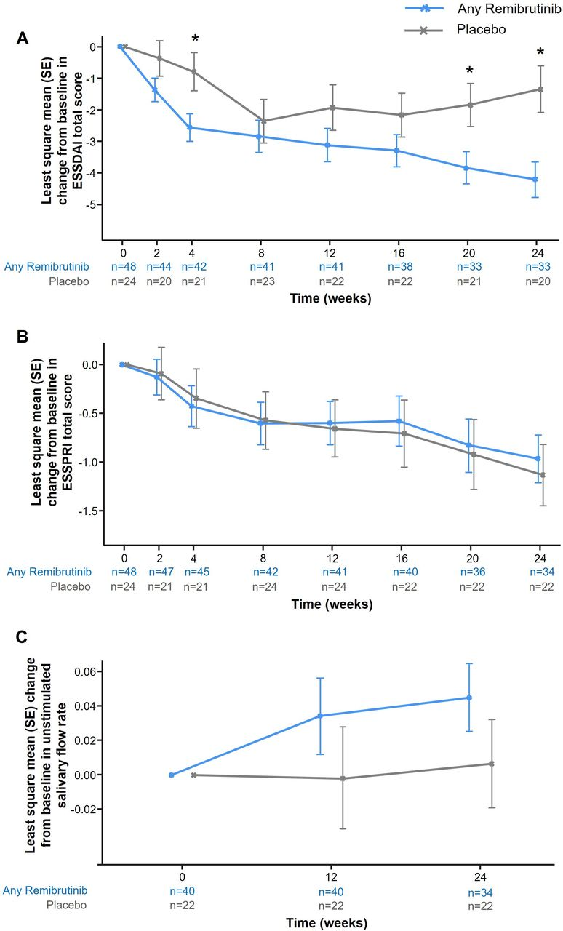
Efficacy and safety of remibrutinib, a selective potent oral BTK inhibitor, in Sjögren's syndrome
Remibrutinib significantly improved ESSDAI score in patients with SjS over 24 weeks compared with placebo (ΔESSDAI −2.86, p=0.003).
No treatment effect was observed in ESSPRI score (ΔESSPRI 0.17, p=0.663).
There was a trend towards improvement of unstimulated salivary flow with remibrutinib compared with placebo over 24 weeks.
Notes:
Bruton’s tyrosine kinase (BTK) plays a crucial role in B-cell receptor signalling, activating Fc receptors for IgG and IgE (FcγR, FcεR) and is expressed by B cells and myeloid cells including macrophages, microglia and mast cells.8–10 Inhibition of BTK has emerged as a potential therapeutic option for selective immune modulation of several diseases based on the mechanistic relevance of autoreactive B cells as pathogenic antigen-presenting cells, a source of autoantibodies, and on the ensuing proinflammatory effector functions of these autoantibodies mediated by FcR signalling

Slide 34
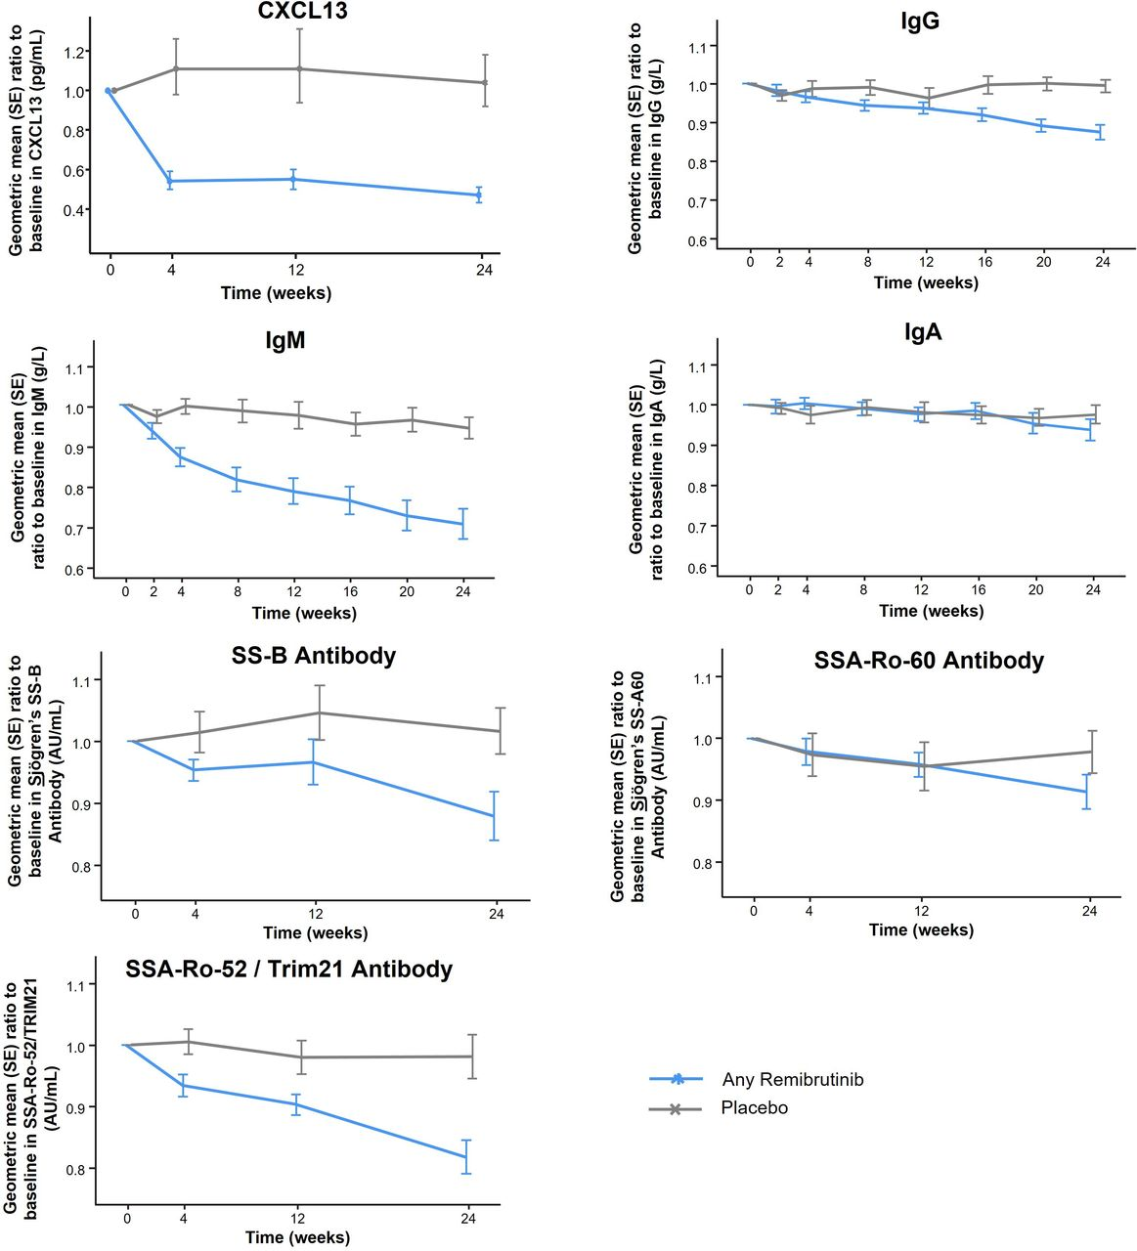
Efficacy and safety of remibrutinib, a selective potent oral BTK inhibitor, in Sjögren's syndrome
Remibrutinib had a favourable safety profile in patients with SjS over 24 wks
AEs were either mild or moderate, with no severe AEs or deaths
Remibrutinib induced significant changes in gene expression in blood, and serum protein abundance compared with placebo.
Notes:
Bruton’s tyrosine kinase (BTK) plays a crucial role in B-cell receptor signalling, activating Fc receptors for IgG and IgE (FcγR, FcεR) and is expressed by B cells and myeloid cells including macrophages, microglia and mast cells.8–10 Inhibition of BTK has emerged as a potential therapeutic option for selective immune modulation of several diseases based on the mechanistic relevance of autoreactive B cells as pathogenic antigen-presenting cells, a source of autoantibodies, and on the ensuing proinflammatory effector functions of these autoantibodies mediated by FcR signalling

Slide 35
Efficacy and Safety of Upadacitinib or Elsubrutinib Alone or in Combination for Patients With Systemic Lupus Erythematosus: A Phase 2 Randomized Controlled Trial.
48-week, phase 2 SLEek study evaluated the efficacy and safety of upadacitinib and elsubrutinib alone or in combination in adults with moderately to severely active SLE
341 patients randomized 1:1:1:1:1 to elsubrutinib 60 mg and upadacitinib 30 mg QD (ABBV-599 high dose), elsubrutinib 60 mg and upadacitinib 15 mg QD, elsubrutinib 60 mg QD, upadacitinib 30 mg QD, or placebo QD.
Primary endpoint was the proportion of patients achieving both SRI-4 and glucocorticoid dose ≤10 mg QD at week 24
Secondary endpoints included the BICLA and LLDAS responses, number of flares, time to first flare, and adverse events
Arthritis Rheumatol. 2024 Oct;76(10):1518-1529.

Slide 36
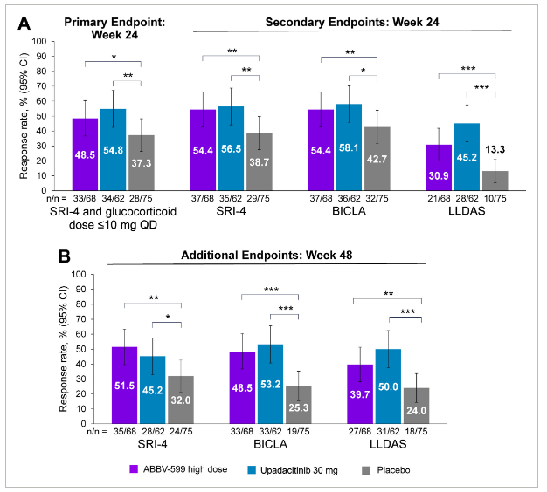
Efficacy and Safety of Upadacitinib or Elsubrutinib Alone or in Combination for Patients With Systemic Lupus Erythematosus: A Phase 2 Randomized Controlled Trial.
The ABBV-599 low dose and elsubrutinib arms were discontinued after a planned interim analysis showed lack of efficacy (no safety concerns).
More patients achieved the primary endpoint with upadacitinib (54.8%; P = 0.028) and ABBV-599 high dose (48.5%; P = 0.081) versus placebo (37.3%).
SRI-4, BICLA, and LLDAS response rates were higher for both upadacitinib and ABBV-599 high dose versus placebo at weeks 24 and 48.
Flares were reduced, and time to first flare through week 48 was substantially delayed with both upadacitinib and ABBV-599 high dose versus placebo.
No new safety signals were observed beyond those previously reported for upadacitinib or elsubrutinib.
Arthritis Rheumatol. 2024 Oct;76(10):1518-1529.

Slide 37
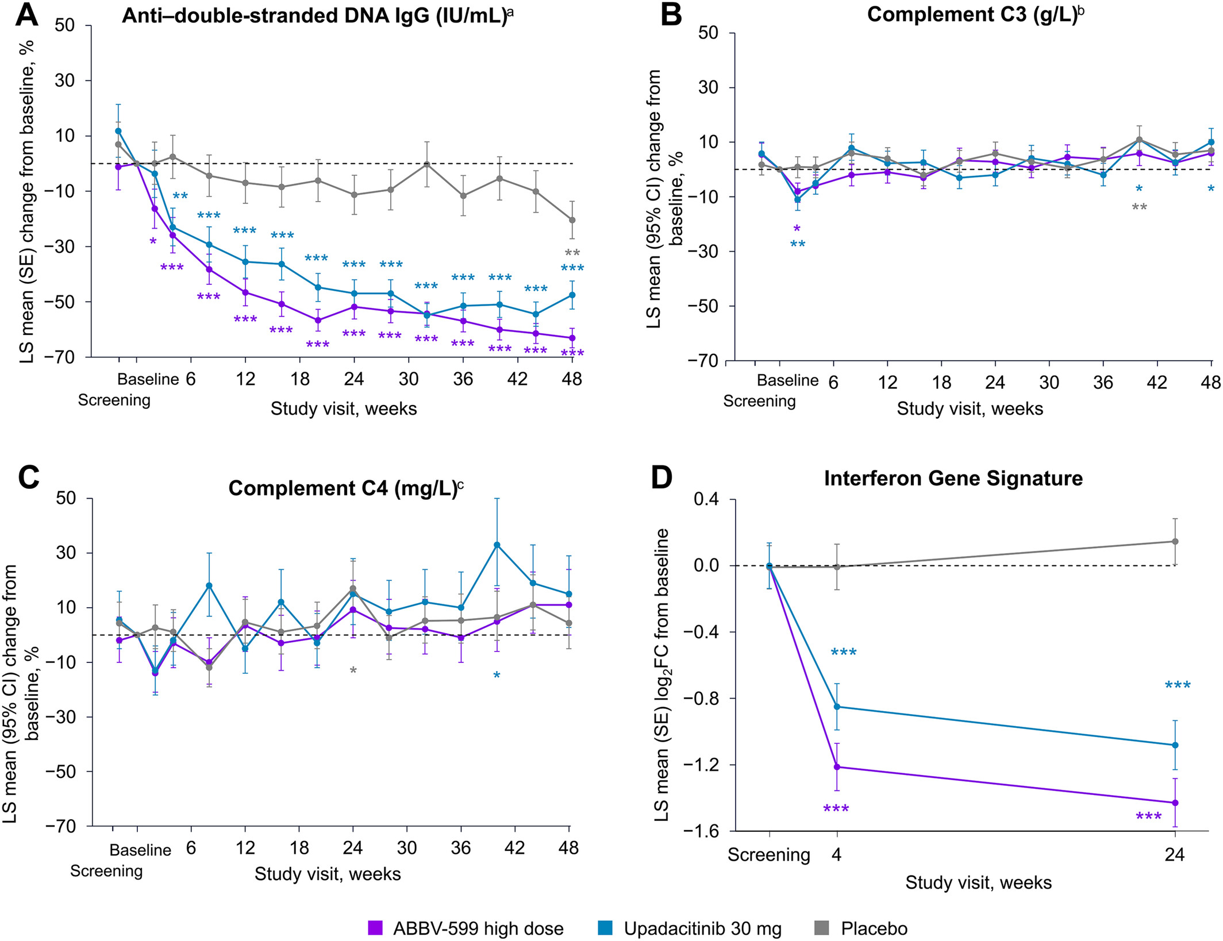
Efficacy and Safety of Upadacitinib or Elsubrutinib Alone or in Combination in SLE
The ABBV-599 high dose and upadacitnib overlapped for almost all outcomes.
The addition of elsubrutinib to upadacitinib did not substantially increase the proportion of treatment responders for any efficacy endpoints compared with patients receiving upadacitinib alone
Using monotherapy with elsubrutinib plus standard of care wasn't efficacious, but neither was low dose upatacitinib plus elsubrutinib
Arthritis Rheumatol. 2024 Oct;76(10):1518-1529.

Slide 38
Lupus Nephritis
Kidney Outcomes and Preservation of Kidney Function With Obinutuzumab in Patients With Lupus Nephritis: A Post Hoc Analysis of the NOBILITY Trial (Arthritis Rheumatol. 2024 Feb;76(2):247-254)
Efficacy and Safety of Obinutuzumab in Active Lupus Nephritis (N Engl J Med. 2025 Feb 7)

Slide 39
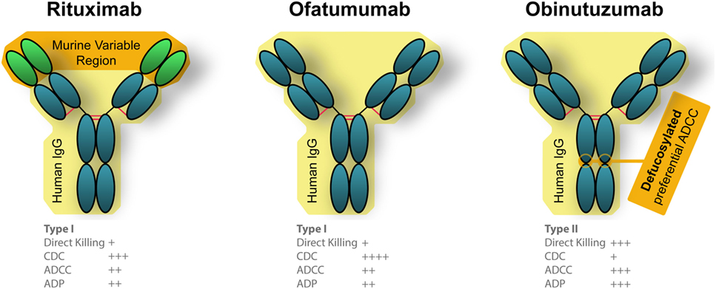
Obinutuzumab
Front Oncol. 2018 Jun 4:8:163.
Notes:
Obinutuzumab is a recombinant, humanized type II anti-CD20 IgG1 monoclonal antibody glycoengineered to enhance antibody-dependent cell-mediated cytotoxicity and phagocytosis. It was approved in 2013 by the US Food and Drug Administration for use in patients with previously untreated chronic lymphocytic leukemia; patients with follicular lymphoma who relapsed after or are refractory to, a rituximab-containing regimen; and patients with previously untreated stage II bulky, III, or IV follicular lymphoma

Slide 40
Kidney Outcomes and Preservation of Kidney Function With Obinutuzumab in Patients With Lupus Nephritis: A Post Hoc Analysis of the NOBILITY Trial
Post hoc analysis of phase II NOBILITY trial (Ann Rheum Dis. 2022 Jan;81(1):100-107)
Patients with LN receiving mycophenolate and corticosteroids randomized to obinutuzumab 1000 mg or placebo on day 1 and weeks 2, 24 and 26, and followed through week 104.
The primary endpoint was complete renal response (CRR) at week 52
A total of 125 patients were randomized and treated. CRR in obinutuzumab at week 52 was 22 (35%) vs 14 (23%) with placebo; and at week 104 was 26 (41%) vs 14 (23%)
This post hoc analysis evaluated:
Time to unfavorable kidney outcome (a composite of treatment failure, doubling of serum creatinine, or death), LN flare, first 30% and 40% declines eGFR from baseline, and chronic eGFR slope during the trial.
Number who achieved complete renal response (CRR) on 7.5 mg or less per day of prednisone
Arthritis Rheumatol. 2024 Feb;76(2):247-254

Slide 41
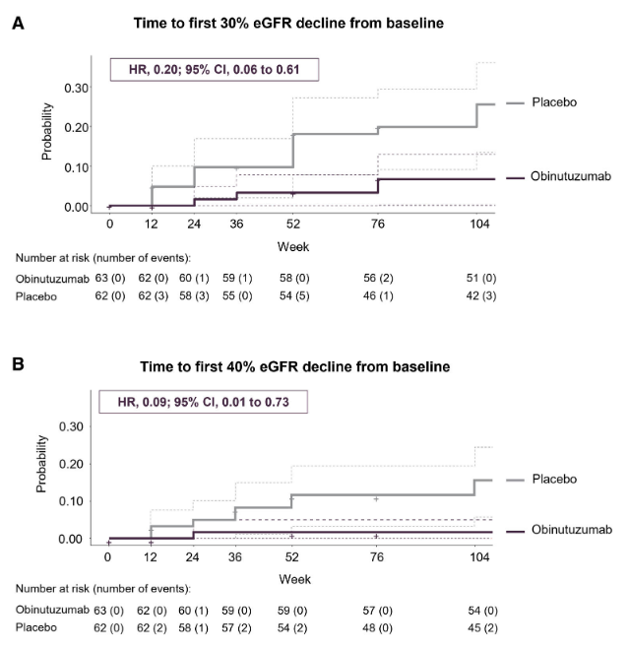
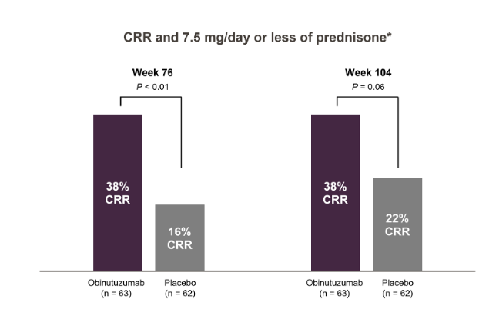
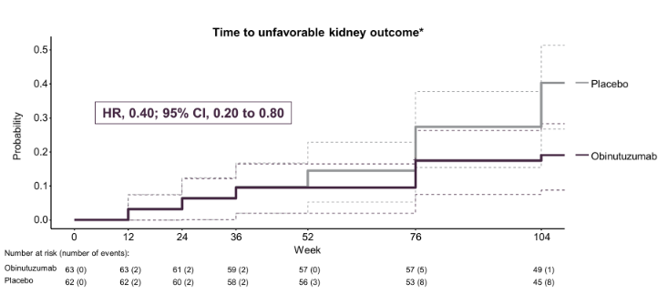
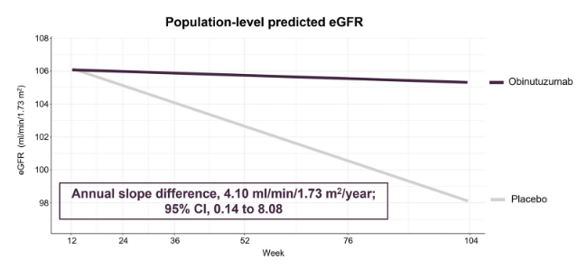
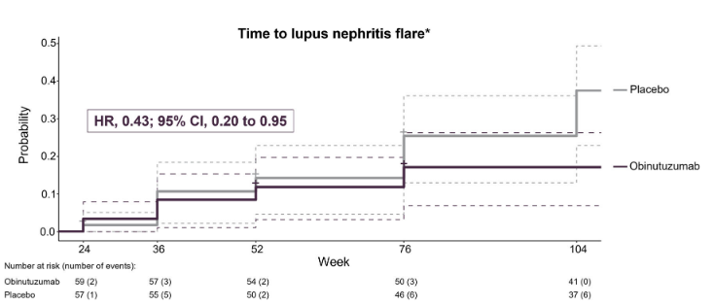
Kidney Outcomes and Preservation of Kidney Function With Obinutuzumab in Patients With Lupus Nephritis: A Post Hoc Analysis of the NOBILITY Trial
Arthritis Rheumatol. 2024 Feb;76(2):247-254

Slide 42
Efficacy and Safety of Obinutuzumab in Active Lupus Nephritis
Phase 3, randomized, controlled trial, adults with biopsy-proven active lupus nephritis were randomized 1:1 to receive obinutuzumab in one of two dose schedules (1000 mg on day 1 and at weeks 2, 24, 26, and 52, with or without a dose at week 50) or placebo
All patients got mycophenolate and PO prednisone at a target dose of 7.5 mg per day by week 12 and 5 mg per day by week 24
Primary end point:
complete renal response at week 76 (P/C<0.5)
estimated glomerular filtration rate of at least 85% of the baseline value
no intercurrent event (rescue therapy, treatment failure, death, or early trial withdrawal)
N Engl J Med. 2025 Feb 7
Notes:
Funded by F. Hoffmann–La Roche; REGENCY ClinicalTrials.gov number, NCT04221477.)

Slide 43
Efficacy and Safety of Obinutuzumab in Active Lupus Nephritis
271 pt randomized, 135 to study drug and 136 to placebo
CRR at week 76 in 46.4% on study drug, 33.1% placebo (P=0.02)
No unexpected safety signals were identified. More serious adverse events, mainly infections and events related to coronavirus disease 2019, occurred with obinutuzumab than with placebo (7 COVID -19 pneumonia, 2 died)
N Engl J Med. 2025 Feb 7
Notes:
Funded by F. Hoffmann–La Roche; REGENCY ClinicalTrials.gov number, NCT04221477.)

Slide 44
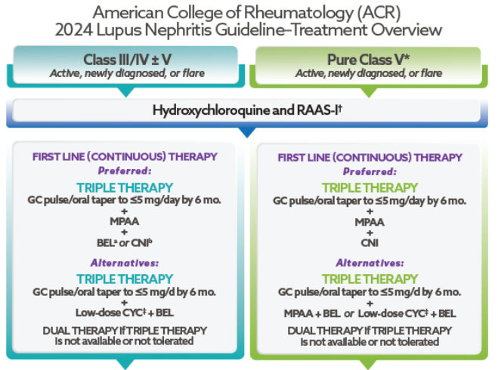
ACR Guidelines for SLE Nephritis

Slide 45
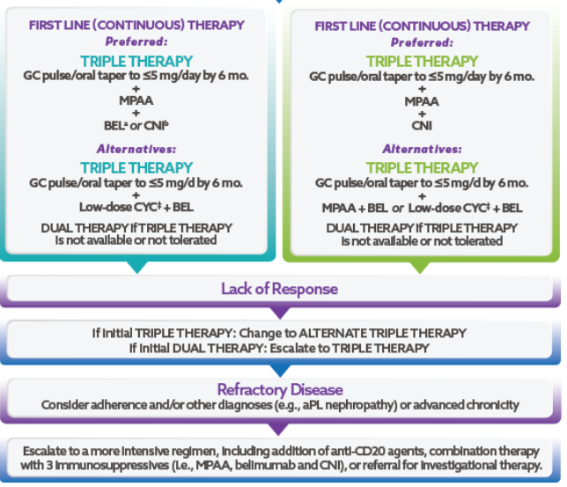
ACR Guidelines for SLE Nephritis

Slide 46
Thank you!

