Slide 1
My Personal and Professional Journeys
James T. Rosenbaum
Legacy Devers Eye Institute
Portland, OR. USA
NWRS
April 26, 2025

Slide 2
Thanks to:
Colleagues and Trainees
Family
Patients
Award Selection Committee

Slide 3
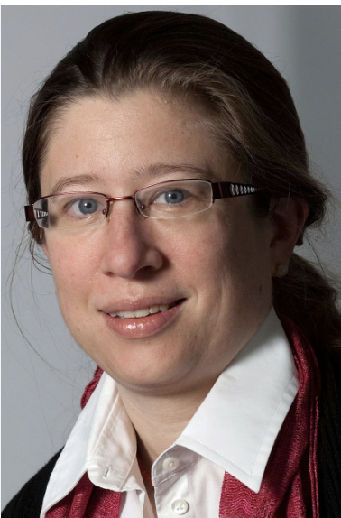
Losses
Mark Asquith
Zili Zhang
Joe Ensign-Lewis with Red Robin
Friederike Mackensen

Slide 4
Part I, Family

Slide 5
1995, Dad’s 80th Birthday, Portland, Oregon

Slide 6
Grandma Rose

Slide 7
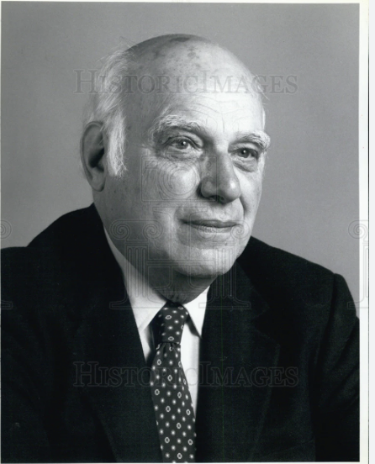
My Dad

Slide 8
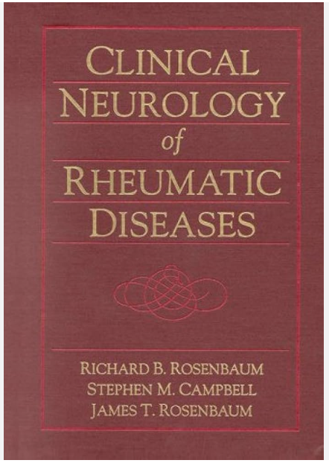
My brother, Rick

Slide 9
My Wife

Slide 10
My older daughter, Lisa

Slide 12
Part II, Professional life How a rheumatologist pretends to be an ophthalmologist and thus epitomizes the imposter syndrome.

Slide 13
Helen Taussig

Slide 14
Outline
The Puzzle
The Microbiome
Bacterial products and inflammation
A solution is proposed…

Slide 15
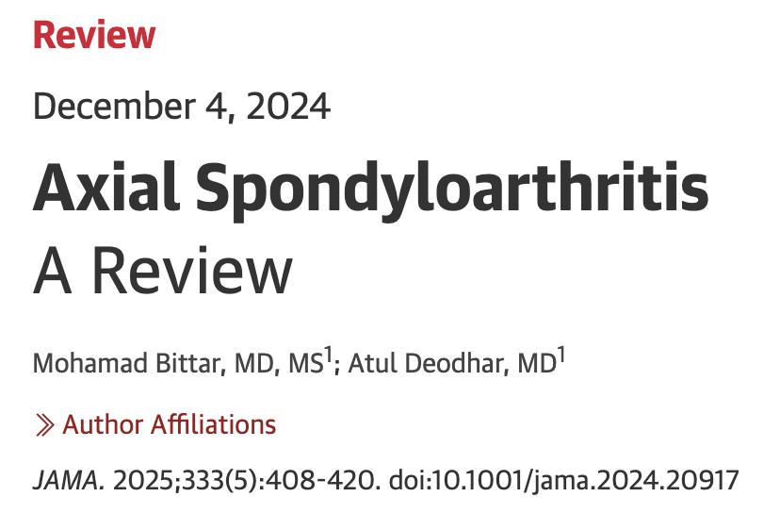

Slide 16
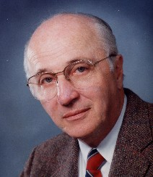
Hugh O. McDevitt
Discoverer of Immune Response Genes (with Baruj Benacerraf)
“this type of genetic control of specific immune responses may play an important role in susceptibility to a variety of diseases in both animals and man” SCIENCE, January, 1972.

Slide 18
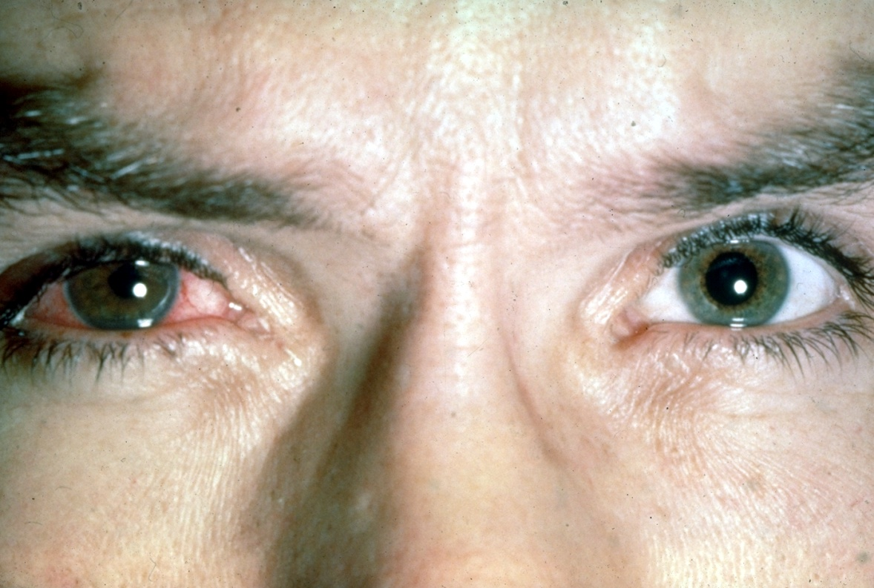
Acute Anterior Uveitis and HL-A 27
Brewerton, DA
Caffrey, M
Nicholls, A
Walters, D
James, DC
Lancet, November, 1973.
Spondyloarthritis is the most common systemic disease associated with uveitis in Europe and North America.

Slide 19
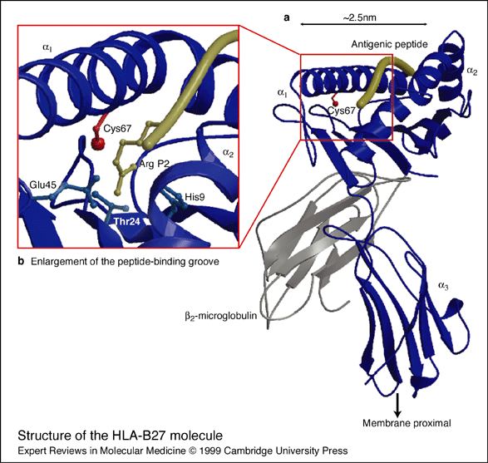
HLA B27 increases the risk of developing ankylosing spondylits about 100 fold
>700 HLA B alleles
>105 HLA B27 subtypes
HLA-B*2706 (southeast Asia)
and HLA-B*2709
(Sardinia)
do not predispose
to disease

Slide 20
Human Leukocyte Antigens (HLA) vs GWAS
HLA types influence susceptibility to more than 100 diseases.
In most genome wide association studies on genetically complex, immune-mediated diseases, HLA alleles are the genes responsible for the highest odds ratio.

Slide 21
Annals of the Rheumatic Diseases, 81:618-21, 2022.
Could HLA predispose to immune-mediated disease by directing an immune response toward a bacterial antigen rather than toward an auto-antigen?

Slide 22
Theories as to why HLA B27 predisposes to disease:
B27 directly affects the immune response as is known to be true of HLA molecules
B27 dimerizes on the cell surface and this activates NK cells
B27 stimulates the unfolded protein response
Taurog, J, The role of HLA-B27 in spondyloarthritis, J Rheumatol, 2010

Slide 23
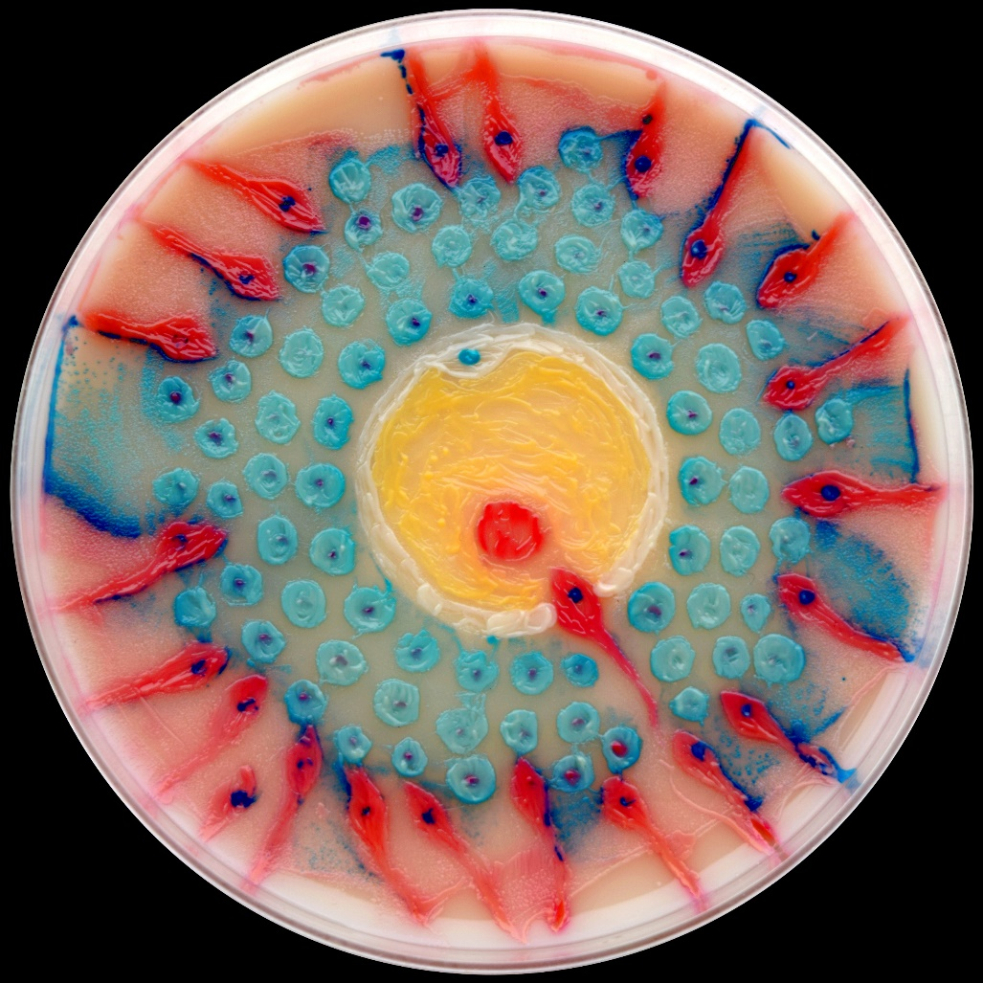
The Concept of the Microbiome
Bacteria in our body outnumber the cells in our body.
99% of all the transcripts expressed in the body are derived from microbes.
Only a fraction of the microbial world that we host is easily cultured.
Without bacteria, no vitamin K and no immune system.

Slide 24
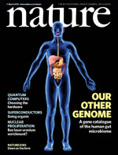
The Human Microbiome Project
Meta Hit Project in Europe
Turnbaugh, P, Ley, R, Hamady, M, Fraser-Liggett, CM, Knight, R, Gordon, J
Nature, 449:804, 2007

Slide 25
Cost for human genome sequencing

Slide 26
Metabolic Syndrome and Altered Gut Microbiota in Mice Lacking Toll-Like Receptor 5
Vijay-Kumar et. al.
April 9, 2010

Slide 28
Some of my best friends are germs
Michael Pollan, New York Times, May 15, 2013

Slide 29
The Economist

Slide 30
Induction of Colonic Regulatory T Cells by Indigenous Clostridium Species
Scanning EM of Clostridium in mouse colon
Koji Atarashi et.al.
January 21, 2011

Slide 31
Helicobacter pylori infection prevents allergic asthma in mouse models through the induction of regulatory T cells
Arnold et.al.
Journal of Clinical
Investigation
121:3088, 2011.

Slide 32
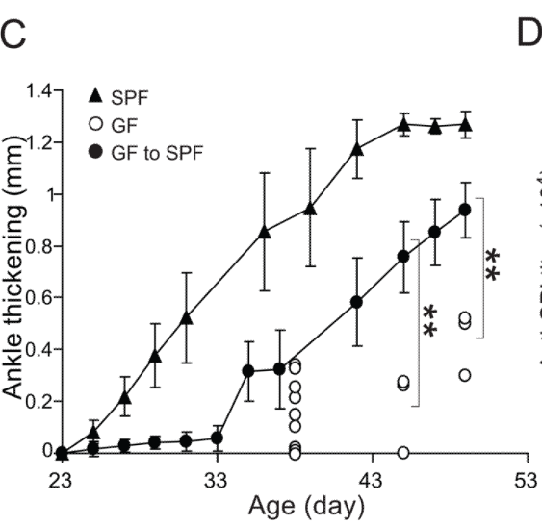
Gut-residing segmented filamentous bacteria drive autoimmune arthritis via T helper 17 cells
Immunity, June 25, 2010

Slide 33
168:928, 2017
Monocolonization with 53 different bacteria shows diversity of immunologic effects
Geva-Zatorsky et. al.
Feb. 23, 2017

Slide 34
Bacterial products and inflammation

Slide 35
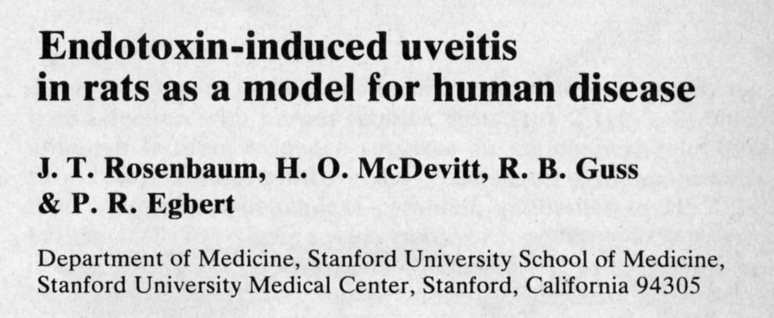
1980

Slide 36
Ankylosing spondylitis is associated with endotoxemia, consistent with increased gut permeability and immune system exposure to microbial antigens
Tejpal Gill

Slide 37
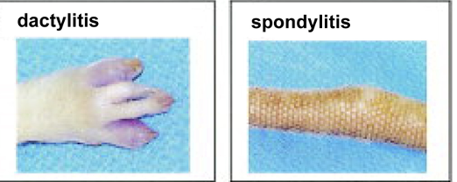
Hypothesis: Time for a gut check. HLA B27 predisposes to ankylosing spondylitis by altering the microbiome
Rosenbaum, JT
Davey, MP
Arthritis & Rheumatism
63:3195, 2011.

Slide 38
Evidence supporting the role of the microbiome in HLA-B27-related diseases
Reactive arthritis is triggered by bacterial infection.
Patients with inflammatory bowel disease develop sacro-iliitis, peripheral arthritis, and uveitis; bacteria are the suspected cause of IBD.
HLA-B27+ germ free rats are protected from developing spondyloarthritis.
Sulfasalazine (sulfapyridine) is effective in preventing attacks of AAU in patients with ankylosing spondylitis.
See Rosenbaum and Davey, A&R, November, 2011.

Slide 39
AC Woods
“Poisons can be isolated from non-pathogenic ferment-producing bacteria which have a definite action upon the uveal tract in the eye.”
“Histologically the eyes showed a round-cell infiltration about the ciliary processes…”
Archives of Ophthalmology
45:451, 1916.

Slide 40
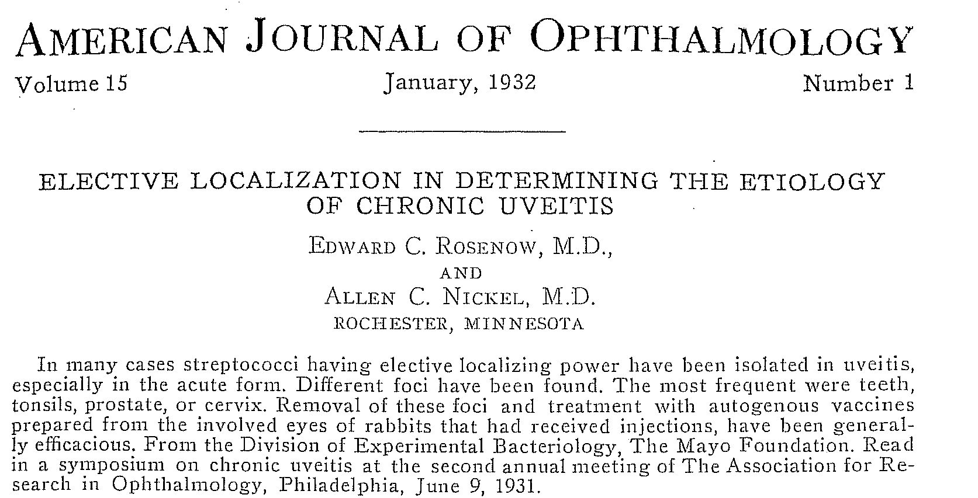

Slide 41
Do HLA molecules shape the microbiome?

Slide 42
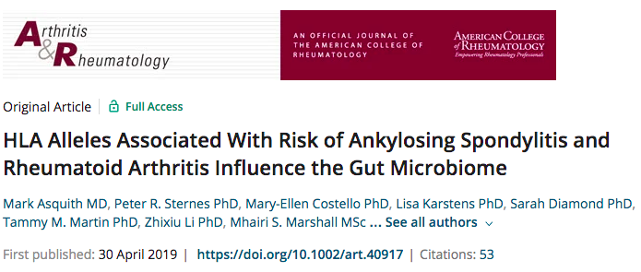

Slide 43
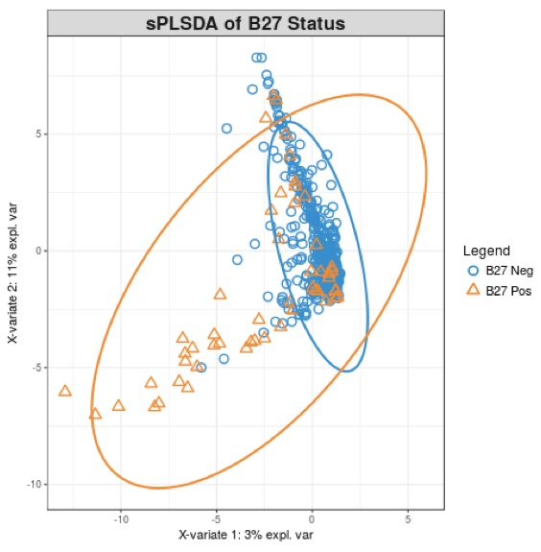
HLA alleles associated with risk of ankylosing spondylitis and rheumatoid arthritis influence the gut microbiome
Arthritis & Rheumatology, 2019
Mark Asquith
Matt Brown
sparse Partial Least Squares Discriminant Analysis
Notes:
Will acknowledge your work along with Costello and Matt Brown

Slide 44
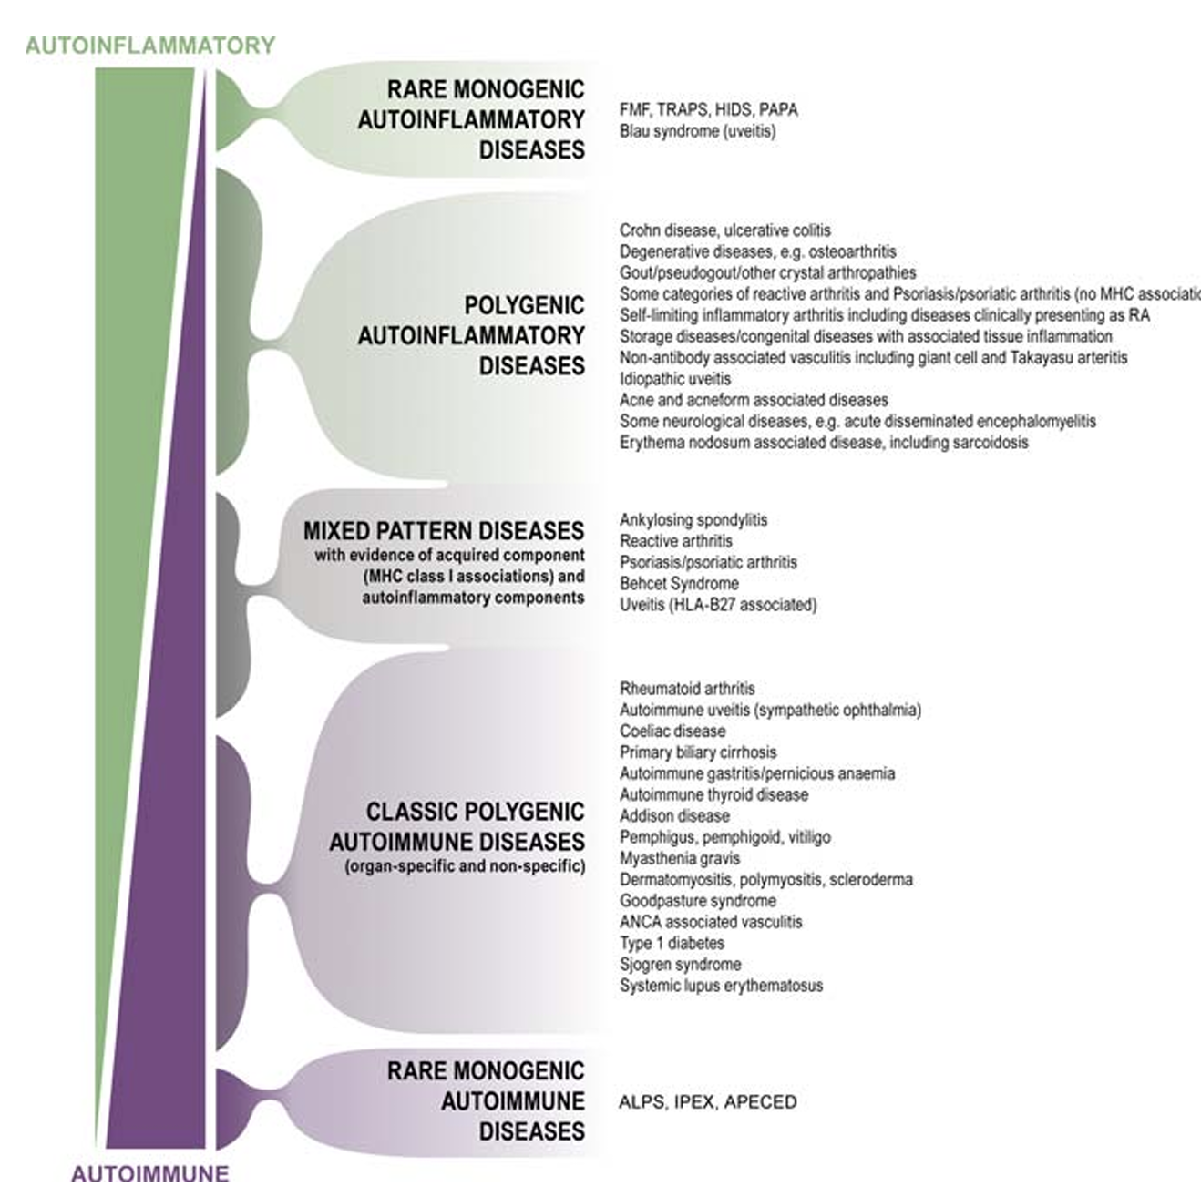
PLoS One, 2006

Slide 45
Theories on the microbiome and the autoimmune response connect…

Slide 46
Rheumatic fever or Guillain-Barre
Rosenbaum and Asquith
Nature Reviews. Rheumatology
December, 2018

Slide 47
Nature, December, 2022
Notes:
Discuss shift in methodology from this paper

Slide 48
Analyzed T cell receptors from blood, synovial fluid, and aqueous humor for B27+ patients with ankylosing spondylitis and/or iritis
Found T cell expansion of a specific TCR expressing TRBV9 in ocular and synovial fluid
Used a yeast peptide library to analyze potential binding sequences to the TCR
Identified both autoantigens such as GPER1 (G protein coupled estrogen receptor 1) (self antigen expressed widely including iris and ciliary body) and YEIH bacterial antigen expressed by multiple Gram-negative bacteria including E. Coli, Klebsiella, Shigella, Yersinia and Salmonella
Britanova, Oct. 2023

Slide 49
Unsolved riddles following the observations of Yang and colleagues:
Which immune response comes first, the one toward the microbe or the one to the auto-antigen?
Why do a minority of HLA B27+ individuals develop spondylitis or uveitis?
For those who are B27- with spondylitis, psoriatic arthritis, or enteropathic arthritis, are the same antigens the target of the immune response?
If the disease is autoimmune, why is the iritis episodic?
My hypothesis: Immune response Dysbiosis Mimicry Disease

Slide 50
Some implications of the microbiome and immunity
Rosenbaum, Martin, Gill, “Seven reasons a uveitis specialist should understand the microbiome”

Slide 51
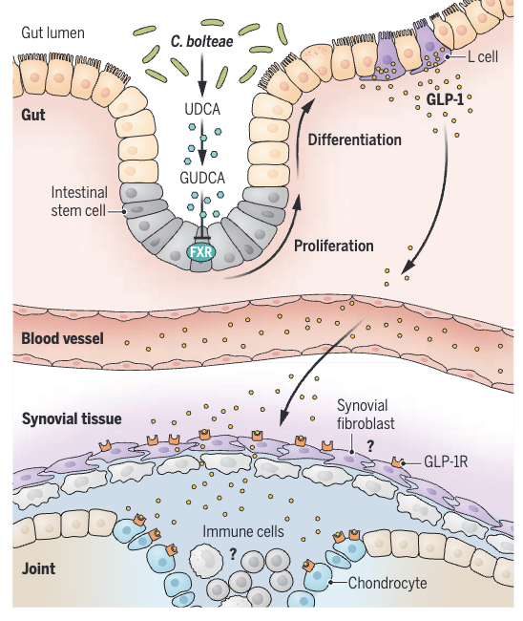
C.=Clostridium
FXR=farnesoid receptor in intestinal stem cells
UCDA=ursodeoxycholic acid
GUDCA=glucoursodeoxy-cholic acid

Slide 52
The Promise of Poop
Fecal transplants offer hope for treating many diseases. But they need to be studied more scientifically, says one of the treatment’s pioneers
August 30, 2013

Slide 53
Conclusion and Future strategy
The pathogenesis of ankylosing spondylitis and/or acute anterior uveitis is likely caused by mimicry involving a B27-presented microbial antigen and self-antigens.
Unsolved questions include: what protects the majority of HLA-B27+ individuals? what triggers disease in a B27- individual? what predisposes to axial v. peripheral joint disease v. uveitis?
Inducing tolerance to peptides identified by Yang et.al. could treat or prevent ankylosing spondylitis, reactive arthritis, and acute anterior uveitis.

Slide 54
Acknowledgements
Joel Taurog
Rob Knight
Russ Van Gelder
Mary Bach
Steve Planck
Mark Asquith
Patrick Stauffer
Matt Brown
Eric Cambronne
Carlene Chun
Aaron Lee
Bob Colbert
Tejpal Gill
Sean Davin
Maxime Breban
Kimberly Ogle
Emma Fale-Olsen

