Slide 1


Pulmonary Hypertension in CTD
Recent Clinical Advances and Emerging Therapies
DATE: April 25th, 2025 PRESENTED BY: JEFF ROBINSON, MD

Slide 2
Disclosures
United Therapeutics - Site-PI for clinical trial
Gossamer Bio - Site-PI for clinical trial
Janssen - Site-PI for clinical trial, Scientific consulting fees
Merck/Acceleron - Site-PI for clinical trial

Slide 3
Outline
PAH in CTD overview
An approach to diagnostics
  New definitions
  Updates in risk stratification
  Diagnostic challenges and considerations within CTD
An approach to treatment
  The current landscape of therapies
New and emerging therapies

Slide 4
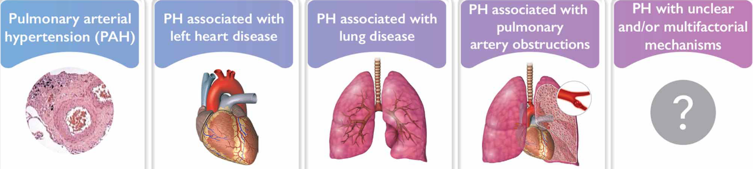
WSPH Classification
1
2
3
4
5
Adapted from: Humbert M, et al. Eur Respir J. 2023:61:2200879
Notes:
These classifications are critically important – they each have very different pathobiologies and therefore very different treatment approaches.

Slide 5
PAH
SSc
SLE
MCTD
SS
PM/DM
LV Disease
SSc
SLE
RA
I
II
PH
ILD/Hypoxia
SSc
SLE
RA
SS
PM/DM
Thrombotic
SLE
SSc
III
IV
Adapted from: Mathai SC. Cardiol Clin 40 (2022) 29–43
Notes:
And this is essentially the outline for what I am hoping to cover today - in diagram form!
*Take them through diagram*

Slide 6

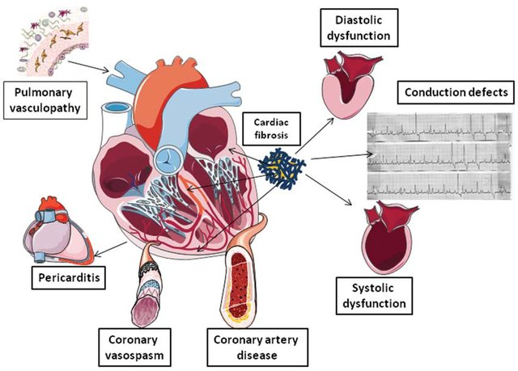
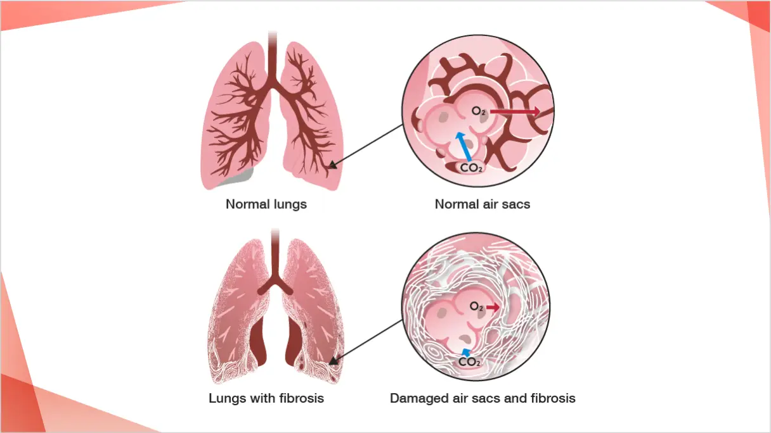
Cardiopulmonary disease in CTD
Pulmonary
Hypertension
Lung fibrosis –
Interstitial Lung Disease
6

Slide 7
PAH
SSc
SLE
MCTD
SS
PM/DM
LV Disease
SSc
SLE
RA
I
II
PH
Lung Disease
SSc
SLE
RA
SS
PM/DM
Thrombotic
SLE
SSc
III
IV
Adapted from: Mathai SC. Cardiol Clin 40 (2022) 29–43
Notes:
First, PAH - this is the area that is probably best understood and studied....

Slide 8
WSPH Classification
1.1 Idiopathic
1.1.1 Non-responders at vasoreactivity testing
1.1.2 Acute responders at vasoreactivity testing
1.2 Heritable
1.3 Associated with drugs and toxins
1.4 Associated with:
1.4.1 Connective tissue disease
1.4.2 HIV infection
1.4.3 Portal hypertension
1.4.4 Congenital heart disease
1.4.5 Schistosomiasis
1.5 PAH with features of venous/capillary (PVOD/PCH) involvement
1.6 Persistent PH of the newborn
1
Systemic sclerosis
Sjogren’s
Systemic lupus erythematosus
Mixed connective tissue disease
Polymyositis/Dermatomyositis
Adapted from: Humbert M, et al. Eur Respir J. 2023:61:2200879

Slide 9
OHSU PAH Population

Slide 10
Rates of PAH in CTD…
SSc
15-27% in symptomatic patients
8-12% in asymptomatic patients
MCTD
23-53% (by echo)
SS
15-23% (by echo)
SLE
0.5-14% (by echo)
PM/DM
16% (by echo)
Notes:
SO how often does this happen in connective tissue disease? It's honestly really hard to sort out and studies are really poor quality -
---- but the bottom line is that pulmonary hypertension happens frequently in this population
-- --- And DEFINITELY happens more than in the regular population, where PAH is a 12/million occurance.

Slide 11
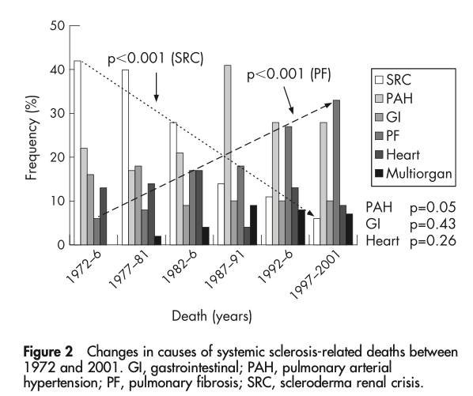
Morbidity in SSc-PAH and ILD
Steen, Medsger. Ann Rheum Dis 2007;66:940–944.
Notes:
And the outcomes when these patients get PH are terrible - though they seem to be improving over time - likely owing to more vigilent screening, as well as our improvements in therapeutics
Here, you see the between PAH and ILD, pulmonary issues are the leading cause of death now in those with systemic sclerosis
Death PAH has declined from the early 90s - perhaps due to our therapies that have emerged since 1995, coupled with screening protocols, which we'll discuss

Slide 12
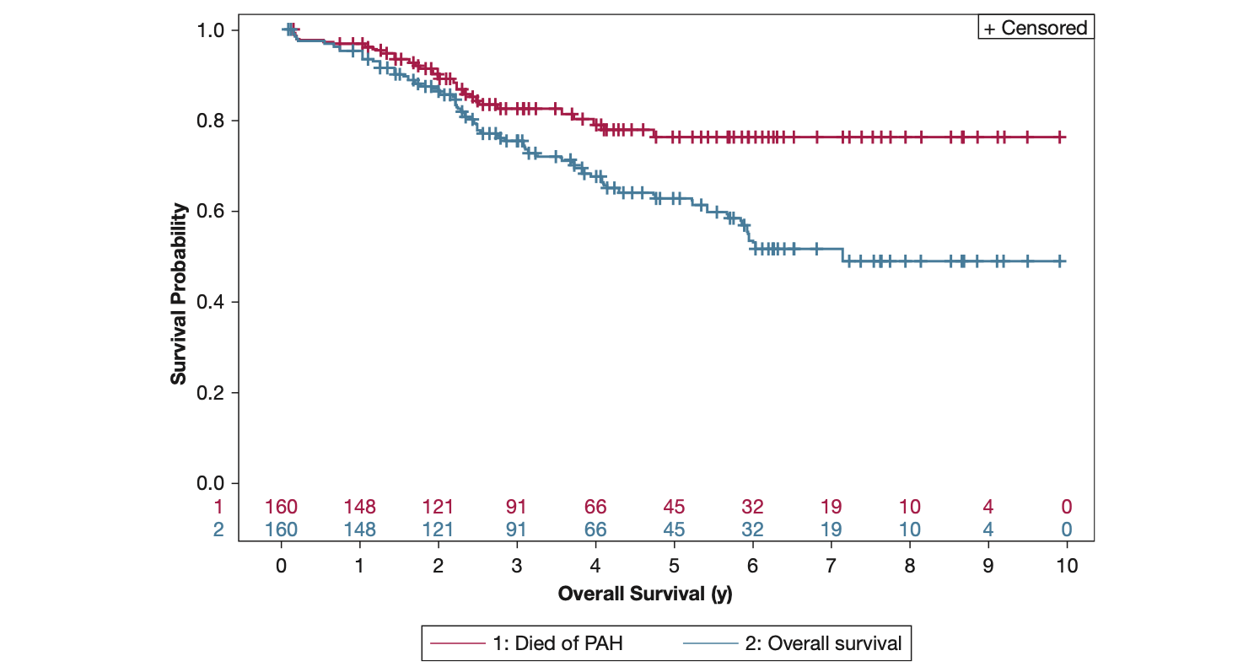
PHAROS Study: Mortality in SSc-PAH
PAH Deaths
Overall Survival
Kolstad KD, et al. CHEST 2018; 154(4):862-871
Notes:
In PHAROS, patients were at expert centers that actively screen for PAH.
1 and 3 year survival rates were 93 and 75% in their cohort – better than our other PAH registries – likely due to earlier disease identification. Far more of these patients were functional class 1 or 2 than other PAH registries.
This survival curve shows that in the first 4 years of diagnosis, the majority of deaths are due to PAH. IN the long run though, other reasons for death were predominant.

Slide 13
PAH Pathobiology
Adapted from: McLaughlin VV, et al. J Am Coll Cardiol. 2015;65:1976-1997.

Slide 14
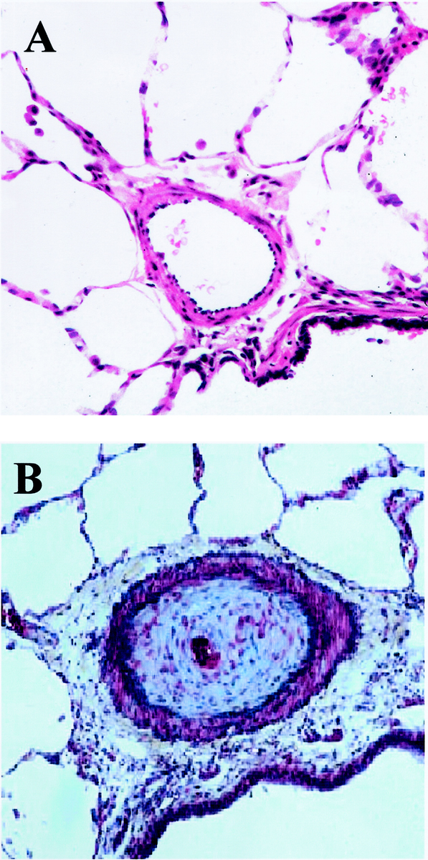

PAH Natural History
Healthy Vasculature
Symptomatic/Decompensating
Declining/Decompensated
Right Heart Dysfunction
Right Heart Failure
CO
PAP
PVR
RAP
Time
Notes:
And due to these progressive vascular changes…

Slide 15
PAH: Symptoms
REVEAL Cohort
(n=2493)
Patients (%)
Dyspnea on exertion
Fatigue
Chest pain
Presyncope/
syncope
Edema
Palpitations
Brown LM, et al. Chest. 2011;140:19-26. 3. McGoon MD, et al. Eur Respir Rev. 2012;21:8-18
Notes:
Symptoms are non-specific

Slide 16
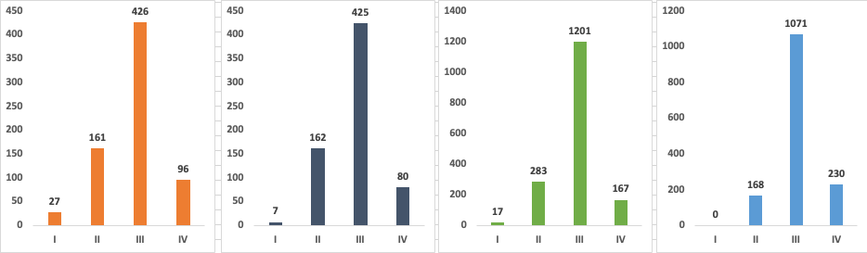
Diagnosis occurs late in disease course
REVEAL Registry
(N = 710)
French National Registry
(N = 674)
SPAHR Registry
(N = 1668)
COMPERA Registry
(N = 1469)
74%
75%
82%
89%
Patients (N)
FC at enrollment
FC at presentation
FC at diagnosis
FC at diagnosis
Farber HW, et al. Chest 2015, 148:1043-54. Humbert M, et al. Am J Respir Cr Care Med. 2006;179:1023-30. Kjellstrom, et al. Swedish Pulmonary Arterial Hypertension Registry Annual Report 2019. Hoeper M, et al. Eur Respir J 2017;50(2):17007-40
Notes:
Often times patients – when first seen in clinic – share that they’ve been complaining of symptoms for over 2 years. When PAH is suspected, the best screening tool we have is echocardiogram.

Slide 17
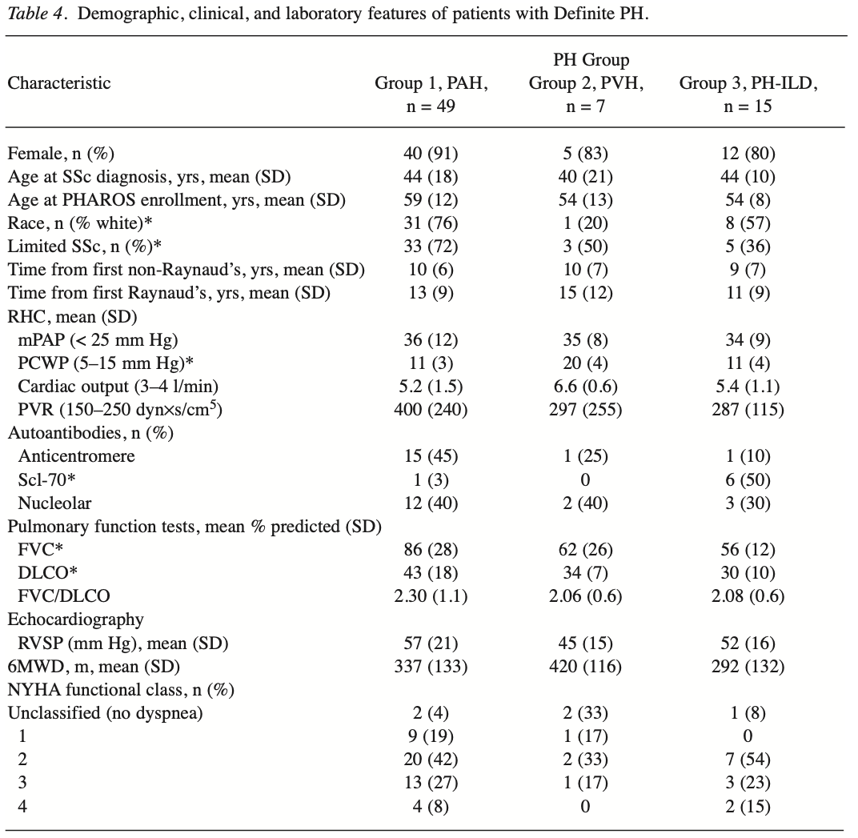
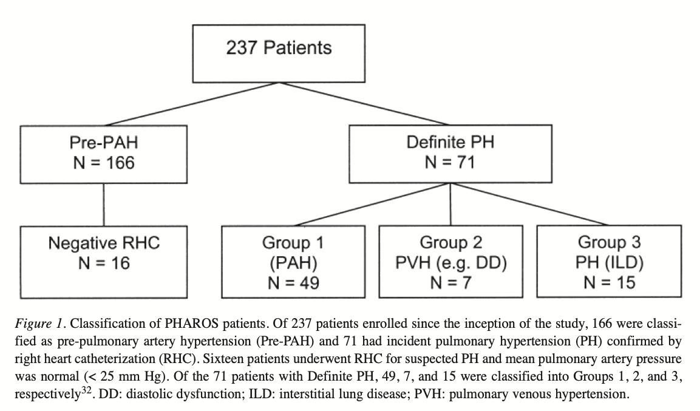
PHAROS Study
Notes:
Who with SSc gets PAH? PHAROS – which I mentioned briefly earlier, was a prospective registry at 19 centers. They enrolled patients at high risk for PAH – they had PFT features of PH with a high FVC/DLCO ratio or echo findings concerning for PAH, and they were followed over time with right heart cath being performed if clinically indicated, and categorized as groups 1, 2, or 3 PH
*click*, they found that a few clinical features were associated with PAH – limited SSc, anticentromere antibodies, normal FVC (indicating no ILD), and elevated RVSP

Slide 18
Screening for SSc-PAH
DETECT
7th WSPH
Step 1:
FVC % / DLCO %
Anticentromere Ab
NT-proBNP
Urate
Right axis deviation
Annual:
Echo
NT-proBNP
If total risk pts > 300
Echocardiogram
Right atrial area
TR velocity
If total risk pts > 35
RHC
Notes:
This is recommended in SSc – less clear if helpful in people with other CTDs that are asymptomatic
DETECT Details: 62 experienced centers throughout north America, Europe and Asia enrolled patients with SSc of >3 years duration since advent of first Non-Raynaud’s symptom – excluding those with an existing PH diagnosis or on PH therapy. Importantly – all patients had a DLCO <60% of predicted, so this population is really enriched for those at risk for PH. All committed to RHC and other testing to allow the construction of a model to predict the presence of PAH.

Slide 19
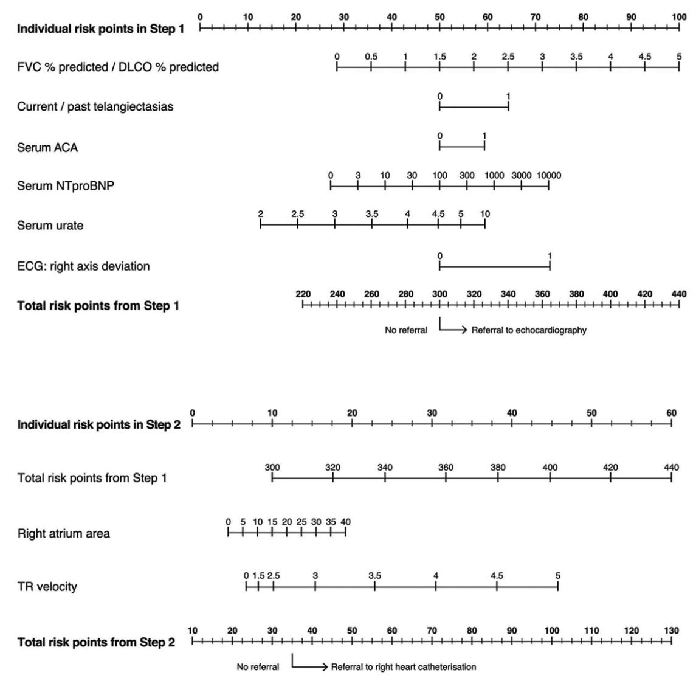
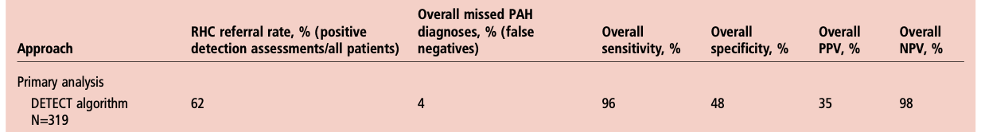
DETECT: Screening for PAH
Coghlan JG, et al. Annals of the Rheumatic Diseases 2014;73:1340-1349.
Notes:
Incident cases of SSc PAH were 19% - quite high.
This method can’t be used with those who have a DLCO > 60%, so we risk missing a lot of earlier disease
This algorithm is not designed to capture PH secondary to left heart disease or underlying lung disease

Slide 20
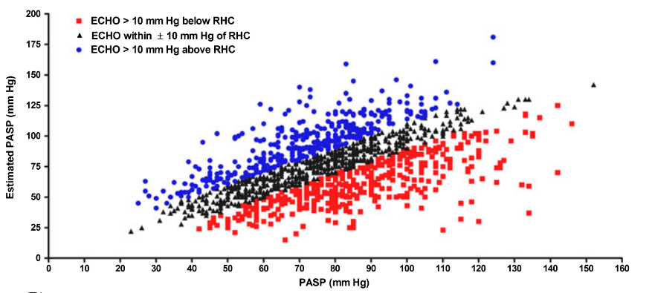
Echocardiographic Screening
Only 50% of echo-derived RVSPs will be within 10 mmHg of RHC RVSP!
Farber HW, et al. Congest Heart Fail. 2011;17:56–63.

Slide 21
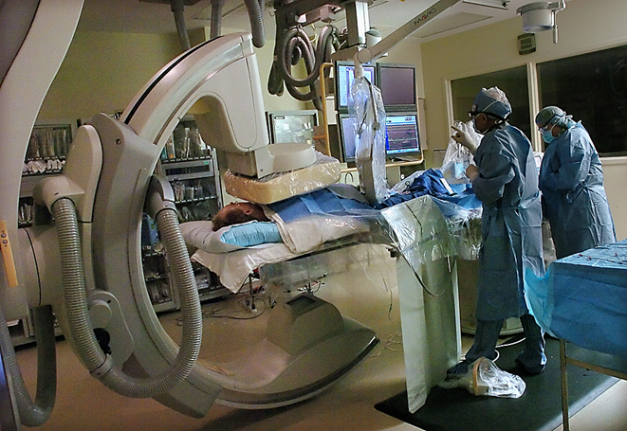
Right heart catheterization
Absolutely necessary prior to treatment of PAH
Use of other provocative maneuvers can be used to clarify phenotype and guide therapies
  iNO (‘vasodilator challenge’)
  Exercise
  Fluid challenge
  Systemic vasodilators

Slide 22
PAH Definitions
2015 ESC/ERS¹
6th WSPH²
2022 ESC/ERS³
mPAP ≥25 mmHg
mPAP >20 mmHg
mPAP >20 mmHg
Hemodynamic definition of PAH:
PAWP ≤15 mmHg
PAWP ≤15 mmHg
PAWP ≤15 mmHg
PVR >3 Wood units
PVR ≥3 Wood units
PVR ≥2 Wood units
ERS=European Respiratory Society. ESC=European Society of Cardiology; PAWP=pulmonary arterial wedge pressure; PVR=pulmonary vascular resistance; WSPH=World Symposium on Pulmonary Hypertension.
1. Galiè N, et al. Eur Respir J. 2015;46:903-975. 2. Simonneau G, et al. Eur Respir J. 2019;24:53. 3. Humbert M, et al. Eur Respir J. 2023:61:2200879.

Slide 23
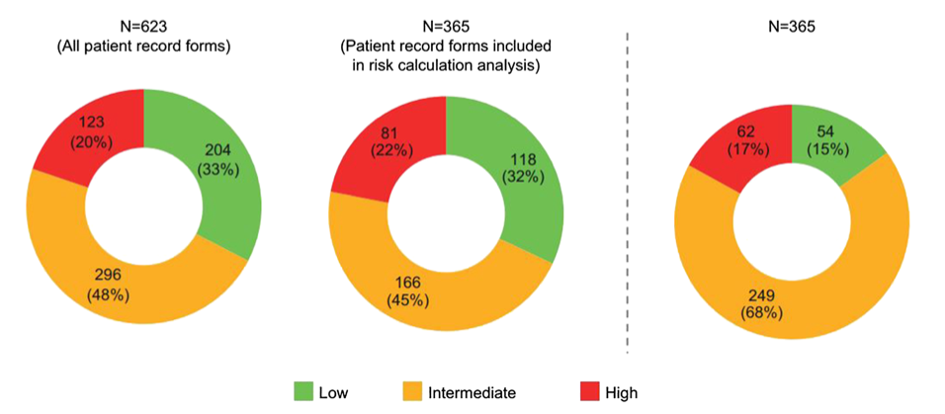
Assessing Risk
Clinical gestalt
Calculated risk
80% of patients deemed low risk by gestalt were in a higher risk category when a calculated risk score was used
Simons JE, et al. Adv Ther (2019) 36:2351–2363
Notes:
Survey of 90 cardiologists and pulmonologists.

Slide 24
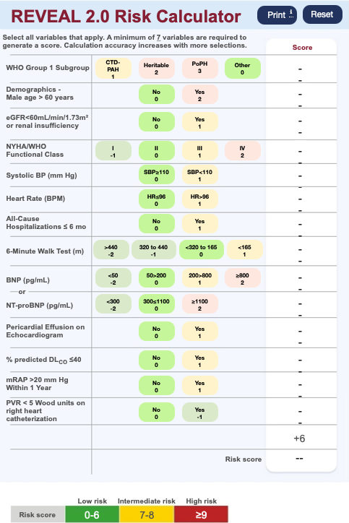
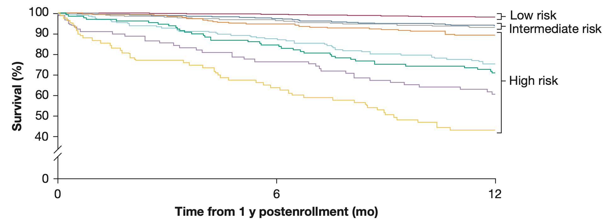
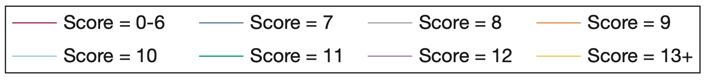
Risk Stratification
Notes:
A multitude of point-of-care risk assessment tools now exist: COMPERA, REVEAL, and the ECS/ERS have all been adopted.

Slide 25
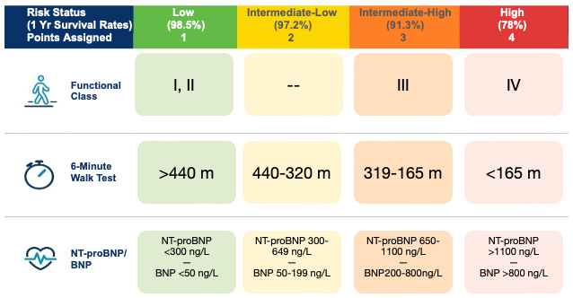
COMPERA 2.0: 4 Strata Risk Assessment

Slide 26
COMPERA 2.0 Risk Assessment
Risk Score
Intermediate
Low
Intermediate
High
Low
High
1yr mortality
0-2%
2-7%
9-19%
≥20%

Slide 27
Goals of PAH Therapy
Symptom relief
Return to ADLs
Improve quality of life
Achieve and maintain a low-risk status
Improve hemodynamics
Delay progression to RV failure
Reduce hospitalization
Improve survival

Slide 28
Evolution of PAH therapies
Treprostinil intravenous
Ambrisentan
Room temperature stable epoprostenol
Treprostinil subcutaneous
Macitentan
Bosentan
Sildenafil
Riociguat
Selexipag
Sotatercept
Epoprostenol
Tadalafil
1995
2001
2002
2004
2005
2007
2009
2010
2013
2014
2015
2022
2024
Iloprost
Treprostinil inhaled
Treprostinil oral
Treprostinil DPI
Notes:
This is the timeline of all these treatments actually becoming available to patients through FDA approval. Epoprostenol (FLOLAN) was the first – which became available in 1995. Note that the molecule was first synthesized in 1976 – it took another 2 decades to study its biologic function, realize its effect on blood vessels, create more stable forms of the molecule that could be used as a medication, test it’s use in laboratory animals – 20 years of work to determine that it’s a useful therapy in PH!

Slide 29
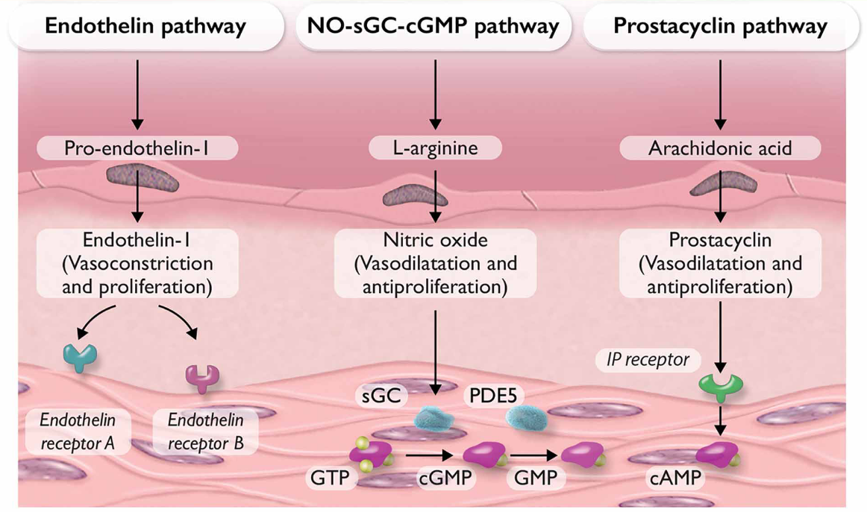
Current PAH Therapies
Humbert M, et al. Eur Respir J. 2023:61:2200879

Slide 30
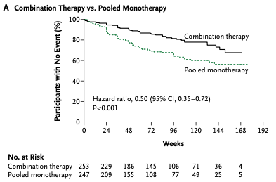
Initial diagnosis treatment strategies
Risk Score
Low
Intermediate
High
Initial PDE5i
+ ERA therapy
When to consider initial monotherapy:
Multiple cardiopulmonary comorbidities
Elderly
Porto-pulmonary hypertension
Notes:
AMBITION endpoint was composite outcome of time to clinical failure: mostly driven by disease worsening and hospitalization.

Slide 31
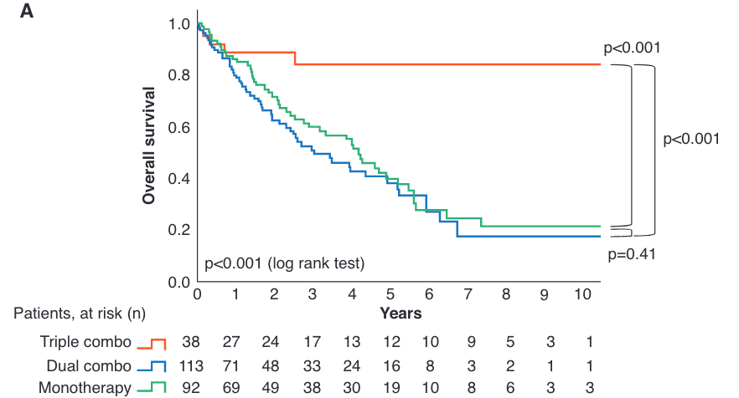
Initial diagnosis treatment strategies
Risk Score
Low
Intermediate
High
High risk: Initial treatment strategy and long-term survival
Initial PDE5i + ERA
And IV/SC PCA
Boucly A, et al. Am J Respir Crit Care Med (2021) 204:842-854
Notes:
At time of initial diagnosis, we utilize the REVEAL 2.0 risk stratification, which includes hemodynamic variables that COMPERA 4 strata doesn’t account for.

Slide 32
Longitudinal treatment strategies
Risk Score
Intermediate
Low
Intermediate
High
Low
High
Add PRA
/ Oral prostacyclin
Add IV/SC PCA and/or evaluate for lung transplant
Continue initial therapy
Notes:
Up front triple oral – negative TRITON study. Only a 26 week trial
These guidelines are great, but not always applicable in the real world. Using IV and subcutaneous therapies requires a stable and safe housing environment, social support, a mixing partner, manual dexterity to mix medication and manipulate the pump. For these and many other reasons, patients will decline the ‘optimal’ therapies that we discuss. These are involved discussions with extensive education and shared decision making.

Slide 33
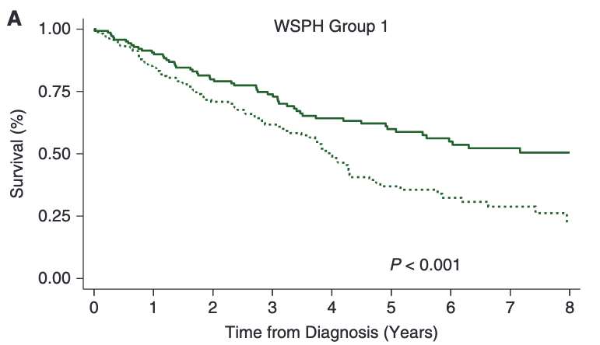
SSc-PAH outcomes are improving…
Diagnosed AFTER 2010
Diagnosed 1999-2010
Hassan, et al. Am J Respir Crit Care Med Vol 207, Iss 3, pp 312–322, Feb 1, 2023

Slide 34
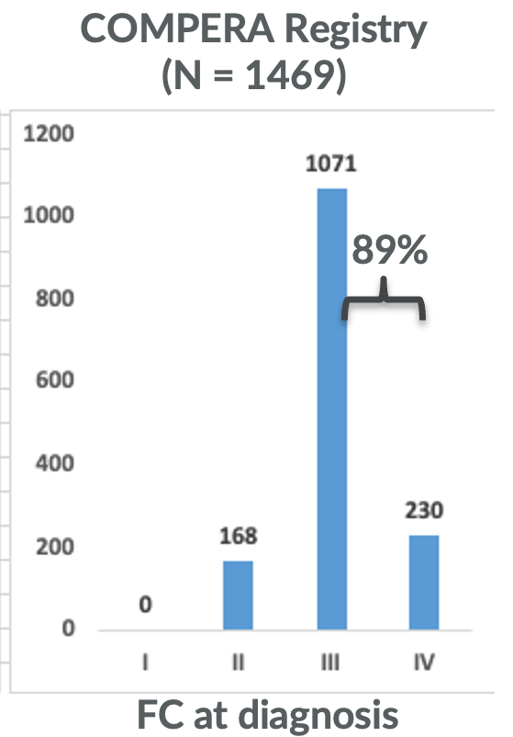
Outcomes
Survival in REVEAL Patients With PAH Matched to NIH Cohort
100
93.3%
77.7%
80
70.4%
67.6%
66.1%
Intermediate
Low
60
Survival (%)
46.2%
2-7%
1 yr mortality
35.0%
31.5%
40
Predicted survival by NIH equation
REVEAL weighted to match NIH cohort
0
0
1
2
3
4
5
6
7
Time From Diagnosis (years)

Slide 35
Emerging ‘4th pathways’

Slide 36
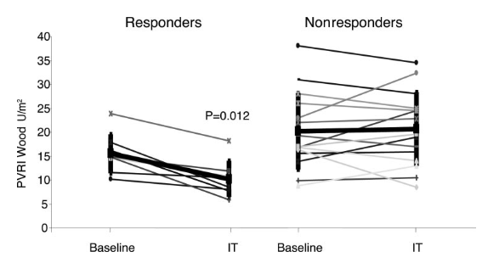
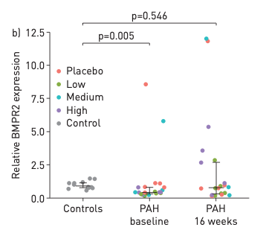
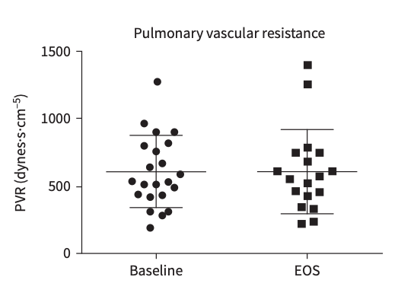
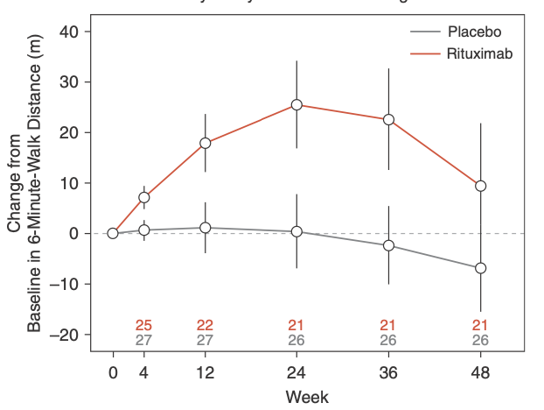
Immunosuppressive therapies?
Cyclophosphamide
Tacrolimus
5/13 SLE Patients
3/8 MCTD Patients
Remaining SLE
MCTD and ALL SSc Pts
Rituximab
Tocilizumab
Notes:
This is a retrospective single center study. These patients were treated initially with mainly prednisone and cyclophosphamide.
Responders are defined as maintaining FC I-II symptoms and not needing pulmonary vasodilator therapies added
In an NIH-sponsored, multicenter, double-blinded, randomized, placebo-controlled, proof-of-concept trial, 57 patients with SSc-PAH on stable-dose standard medical therapy received two infusions of 1,000 mg rituximab or placebo administered 2 weeks apart. The primary outcome measure was the change in 6- minute-walk distance (6MWD) at 24 weeks. Secondary endpoints included safety and invasive hemodynamics.
Tocilizimab:
Phase 2 study with 23 patients – 10 with CTD, others HPAH or IPAH. NO significant change in PVR at 6 months of treatment

Slide 37
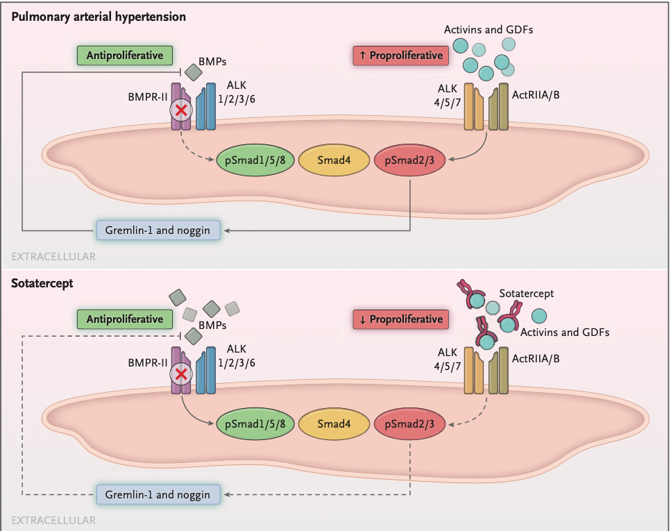
Antiproliferative: Sotatercept
Humbert M, et al. N Engl J Med 2021;384:1204-15.

Slide 38
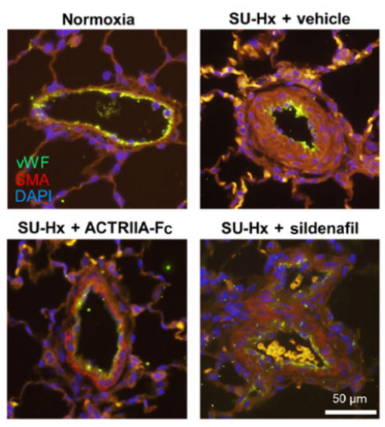
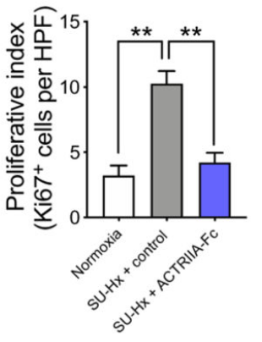
Sotatercept: Preclinical data
Yung LM, et al. Sci Transl Med. 2020 May 13; 12(543).

Slide 39
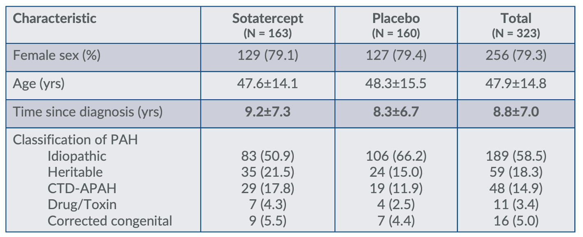
STELLAR: Baseline characteristics
Hoeper MM, et al. N Engl J Med 2023; Apr 20;388(16):1478-1490.
Notes:
STELLAR’s subjects were a high prevalent and heavily treated population.

Slide 40
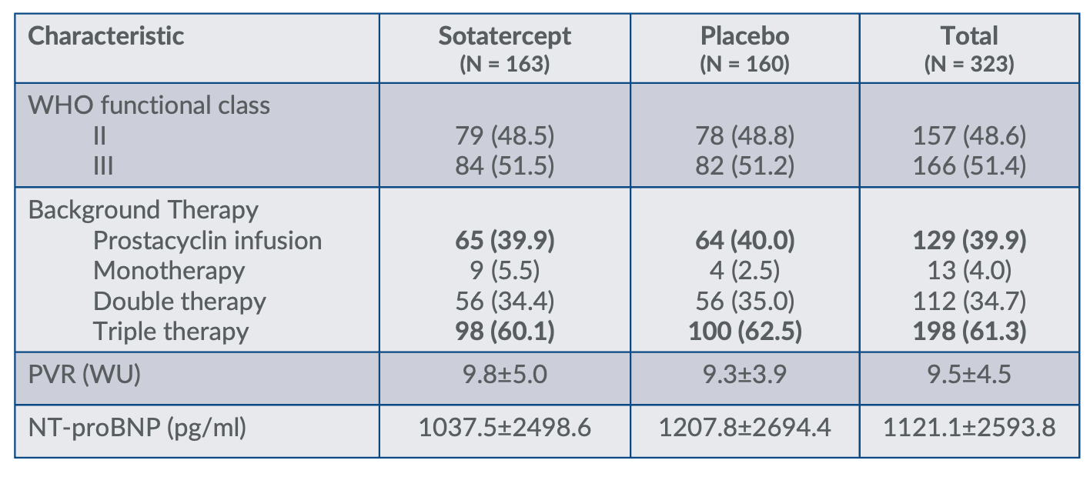
STELLAR: Baseline characteristics
Hoeper MM, et al. N Engl J Med 2023; Apr 20;388(16):1478-1490.

Slide 41
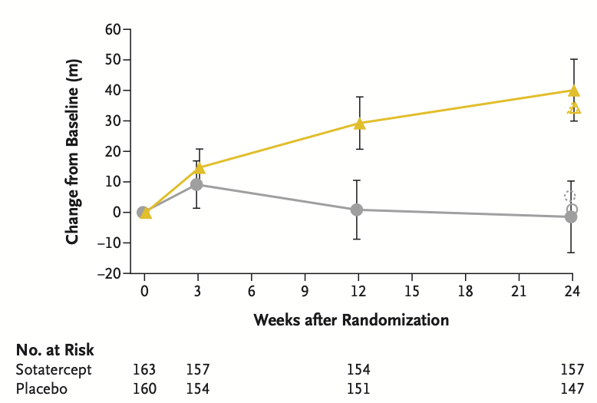


STELLAR: Change in 6MWD though week 24
Hoeper MM, et al. N Engl J Med 2023; Apr 20;388(16):1478-1490.

Slide 42
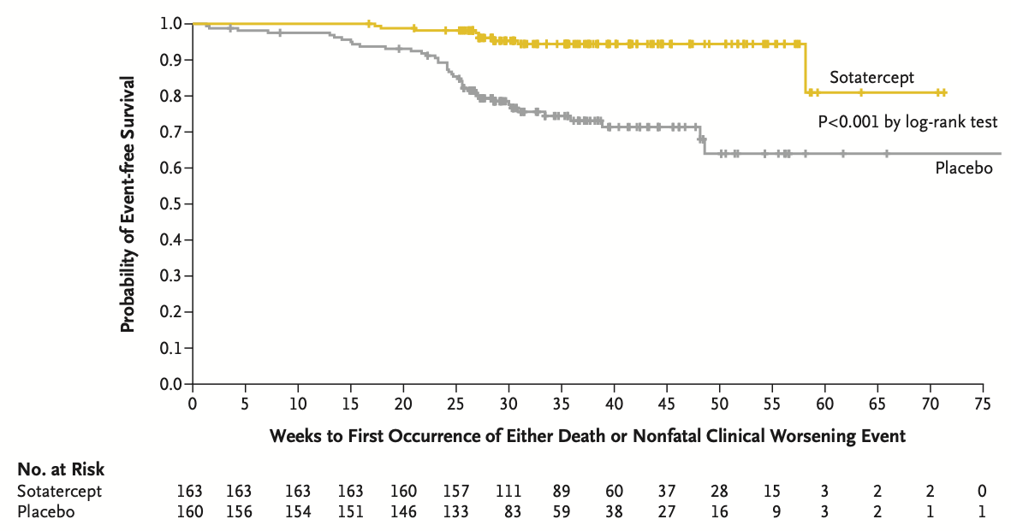
Time to death or clinical worsening
Hoeper MM, et al. N Engl J Med 2023; Apr 20;388(16):1478-1490.
Notes:
This improvement in the sotatercept group appeared to be driven by decreased death, less worsening of PAH, and less need for rescue therapy with prostacyclins

Slide 43
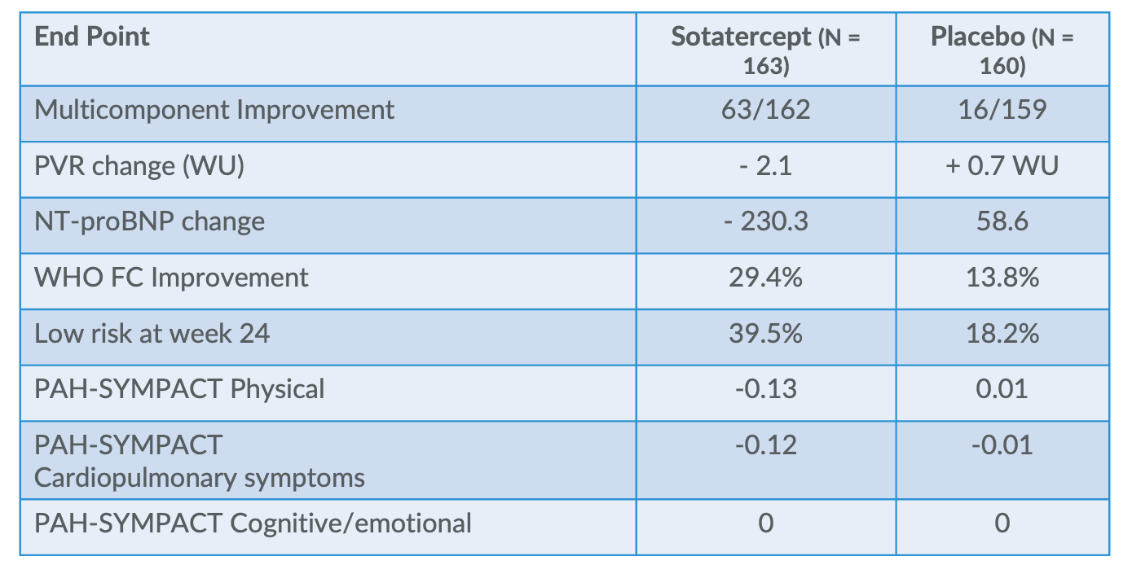
STELLAR: Secondary outcomes
Hoeper MM, et al. N Engl J Med 2023; Apr 20;388(16):1478-1490.

Slide 44
STELLAR: Adverse Events
Adverse event | Sotatercept (N = 163) | Placebo (N = 160)
Increased Hct | 9 (5.5) | 0
Thrombocytopenia | 10 (6.1) | 4 (2.5)
Bleeding events | 35 (21.5) | 20 (12.5)
Increased SBP | 6 (3.7) | 1 (0.6)
Telangiectasia | 17 (10.4) | 5 (3.1)
Hoeper MM, et al. N Engl J Med 2023; Apr 20;388(16):1478-1490.
Notes:
Based off this study, sotatercept is currently under review at the FDA for approval, which is anticipated shortly.

Slide 45
Where to go from here…
Earlier Diagnosis
Community education
Improve screening efforts
Enhance screening techniques
Enhancing risk assessment
Inclusion of cardiac imaging
Characterize the ‘false’ low risk patients
Therapeutics
Expansion of targets
Proliferation, inflammation
Role for combining new therapies?
Clarifying timing of treatment introduction
Identification of biomarkers to guide patient selection
Assessment of patient response to therapy

Slide 46
Takeaways:
Screen your at-risk patients – diagnosis of PAH is often late
  If there’s one good thing about systemic sclerosis, it’s that we can catch the complications early and TREAT early
The pulmonary vascular phenotype can be complex in CTD – careful assessment with RHC hemodynamics with provocative maneuvers should guide classification and treatment
Risk stratification during frequent follow up visits will guide escalation of therapy
Refer to a facility with experience and expertise in the treatment of PAH so that therapies can be escalated and optimized as needed.

Slide 47
Thank You
robinjef@ohsu.edu
503-803-1407
PACT Clinical Research Team:
Samantha Ruimy
Allyson Knapper
Lorenzo Redmond
Clinical Team:
Kellee Larson, RN
Ka Wan Chiang, PharmD
Amy Ashley, MA
Jaden Kaufman, MA
Ally Moore, MA
Pulmonary and Cardiology Divisions
MICU and CVICU teams
OHSU School of Pharmacy
PH Attendings:
Nalini Colaco, MD PhD
Morgan Bailey, MD
Jeff Robinson, MD

Slide 48
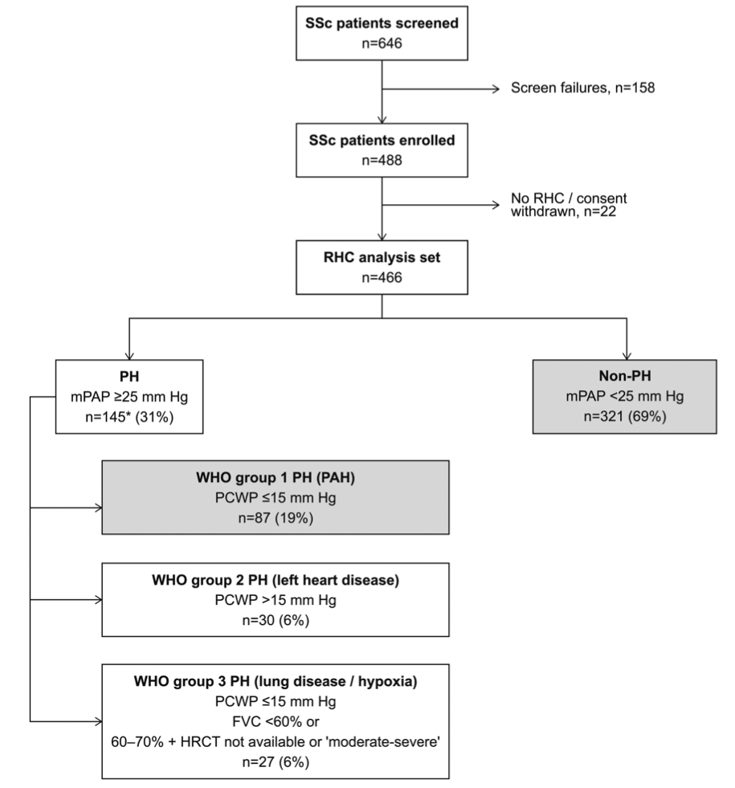
DETECT Study: Predicting PAH in SSc
Coghlan JG, et al. Annals of the Rheumatic Diseases 2014;73:1340-1349.

Slide 49
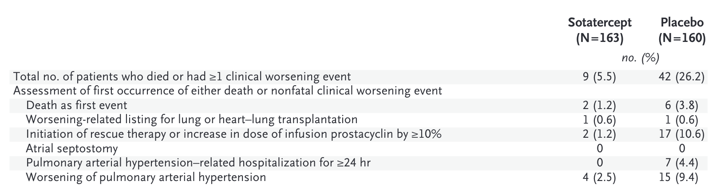
Sotatercept: Time to death or worsening

Slide 50
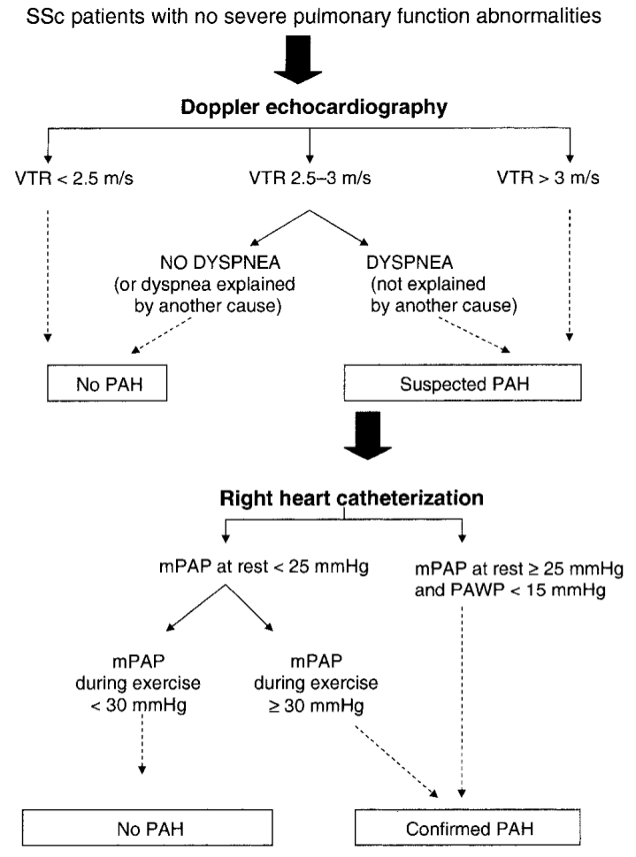
French Study: Yearly Echocardiogram
Results:
Of 599 patients, 33 patients underwent RHC
18 found to have new diagnosis of PAH
Of these patients, disease was generally mild severity with mean PAP = 30 mmHg
Hachulla E, et al. ARTHRITIS & RHEUMATISM. Vol. 52, No. 12, December 2005, pp 3792–3800
Notes:
Yes, resource intensive, but more likely to catch early disease that we can intervene on.
It’s my belief that there is no single screening tool- each patient must be assessed with a pulmonary focused history, yearly PFTs and Echo, and low threshold if any concern to perform not just RHC, but consider augmenting with exercise RHC or CPET in an effort to find earlier disease and we can intervene on.

Slide 51
PAH
SSc
SLE
MCTD
SS
PM/DM
LV Disease
SSc
SLE
RA
I
II
PH
Lung Disease
SSc
SLE
RA
SS
PM/DM
Thrombotic
SLE
SSc
IV
III
Adapted from: Mathai SC. Cardiol Clin 40 (2022) 29–43

Slide 52
CTD and Left Heart Disease (Group II)
1. PAH
1.1 Idiopathic PAH
1.2 Heritable PAH
1.3 Drug- and toxin-induced PAH
1.4 PAH associated with:
    1.4.1 Connective tissue disease
    1.4.2 HIV infection
    1.4.3 Portal hypertension
    1.4.4 Congenital heart disease
    1.4.5 Schistosomiasis
    1.5 PAH long-term responders to calcium channel blockers
    1.6 PAH with overt features of venous/ capillaries (PVOD/PCH) involvement
    1.7 Persistent PH of the newborn
    syndrome
2. PH due to left heart disease
2.1 PH due to heart failure with preserved LVEF
2.2 PH due to heart failure with reduced LVEF
2.3 Valvular heart disease
2.4 Congenital/acquired cardiovascular conditions leading to post-capillary PH
4. PH due to pulmonary artery obstructions
4.1 Chronic thromboembolic PH
4.2 Other pulmonary artery obstructions
5. PH with unclear and/or multifactorial mechanisms
5.1 Haematological disorders
5.2 Systemic and metabolic disorders
5.3 Others
5.4 Complex congenital heart disease
3. PH due to lung diseases and/or hypoxia
3.1 Obstructive lung disease
3.2 Restrictive lung disease
3.3 Other lung disease with mixed restrictive/obstructive pattern
3.4 Hypoxia without lung disease
3.5 Developmental lung disorders
HIV=human immunodeficiency virus; LVEF=left ventricular ejection fraction; PCH=pulmonary capillary haemangiomatosis; PVOD=pulmonary veno-occlusive disease.
Simonneau G, et al. Eur Respir J. 2019;24:53(1). doi:10.1183/13993003.01913-2018.

Slide 53
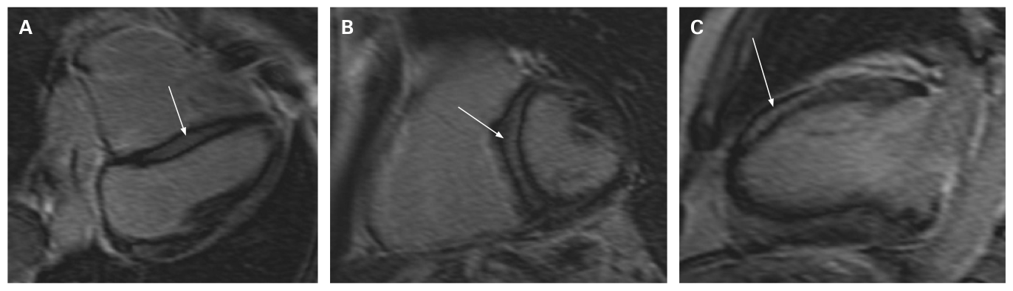
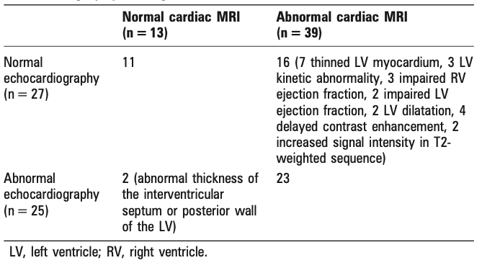
SSc and left heart disease
Hachulla AL, et al. Ann Rheum Dis 2009;68:1878–1884.

Slide 54
Rates of Group 2 PH in SSc?
Fox et al. Study
54% Group I PAH
45% Group II PH
21% Group III PH
PHAROS Study
69% Group I PAH
10% Group II PH
21% Group III PD
Fluid Challenge
*1/3 of patients labeled as PAH
had occult diastolic dysfunction*

Slide 55
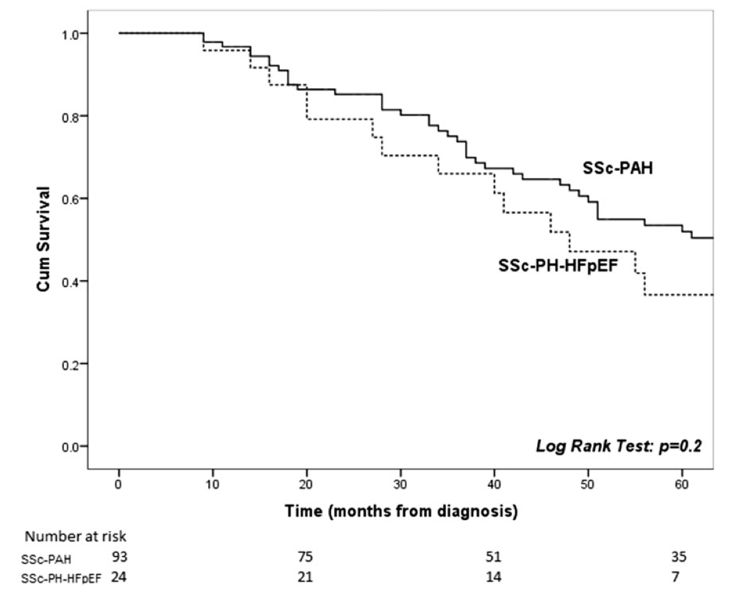
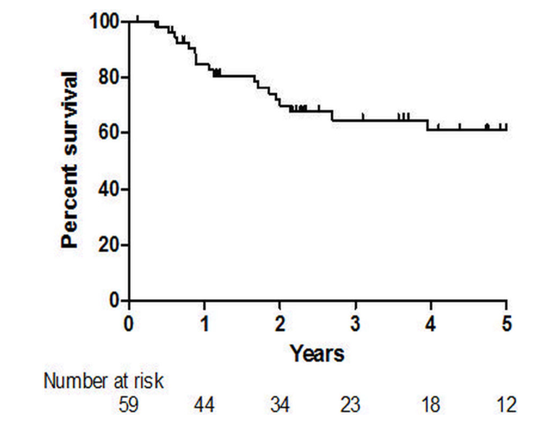
SSc-HFpEF Mortality
HOPKINS COHORT
PHAROS

Slide 56
Trials of pulmonary vasodilators in group 2 PH
FIRST trial (1997): poprostenol)for HFrEF, functional class IIIb/IV: stopped early due to increased signal for mortality
5 trials with ERAs (only 1 with evidence of PHTN on echo): No clear benefit, 2 trials stopped early due to increased risk of HF decompensation
SIOVAC: Post-valve surgery with residual group 2 PH → Worsened mortality with sildenafil
This is an area of active clinical investigation

Slide 57
PAH
SSc
SLE
MCTD
SS
PM/DM
LV Disease
SSc
SLE
RA
I
II
PH
Lung Disease
SSc
SLE
RA
SS
PM/DM
Thrombotic
SLE
SSc
IV
III
Adapted from: Mathai SC. Cardiol Clin 40 (2022) 29–43

Slide 58
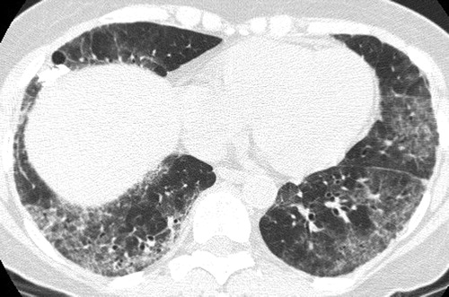
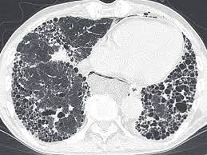
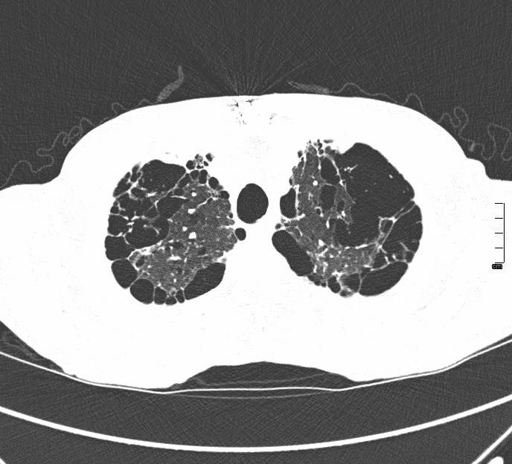
CTD and Group III Disease
3. PH due to lung diseases and/or hypoxia
3.1 Obstructive lung disease
3.2 Restrictive lung disease
3.3 Other lung disease with mixed restrictive/obstructive pattern
3.4 Hypoxia without lung disease
3.5 Developmental lung disorders
Simonneau G, et al. Eur Respir J. 2019;24:53(1).

Slide 59
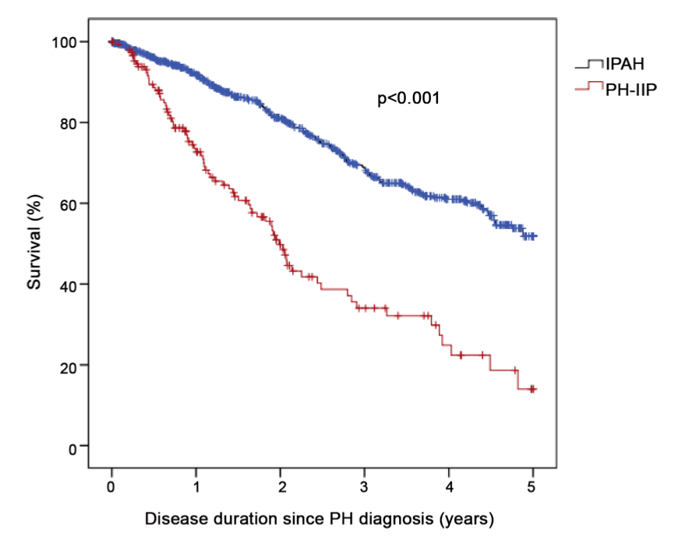
Outcomes in PH-IIP vs. IPAH
Hoeper MM, et al. (2015) Pulmonary Hypertension in Patients with Chronic Fibrosing Idiopathic Interstitial Pneumonias. PLoS ONE 10(12): e0141911.
Notes:
Group 3 PH is a very big deal with big consequences for the patient. We often think of idiopathic pulmonary hypertension as having a dismal prognosis, but outcomes in group 3 PH are often worse. This, for instance, is a Kaplan meyer curve of PH associated with idiopathic interstitial pneumonia WITH PH in red vs. IPAH in blue. 50% mortality by year 2 for those with PH-IIP. This is likely due to a number of factors – the PH-IIP group is older, and has severe fibrotic disease in addition to PH. Also, as you’ll see, treatment options are limited.

Slide 60
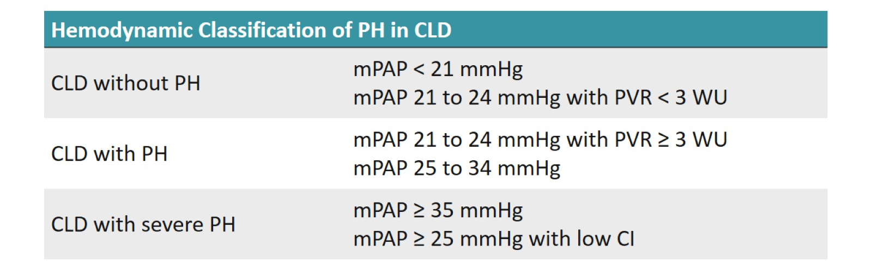
Group 3 PH: Classifying severity
PH severity is associated with severity of underlying lung disease
Presence of PH often leads to more severe dyspnea
Nathan SD, Barbera JA, Gaine SP, et al. Pulmonary hypertension in chronic lung disease and hypoxia. Eur Respir J 2019; 53: 1801914
Notes:
At the 6th world symposium, efforts were made to classify severity of group 3 PH. PVR must be 3 or greater, and have a mPAP > 21 mmHg.
More severe group 3 disease is indicated by mPAP >35 or any elevation in mPAP with low cardiac index, which is indicating significant RV dysfunction.

Slide 61
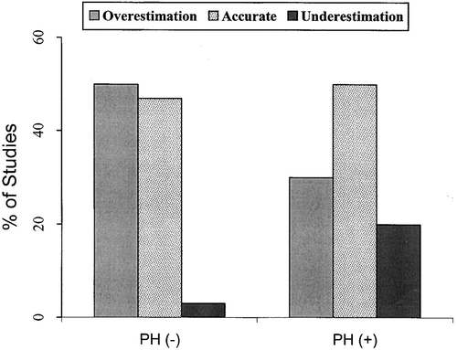
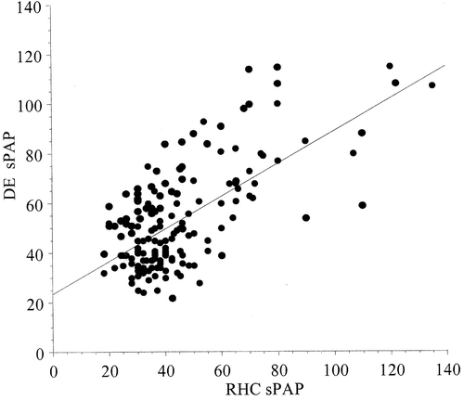
Diagnosing group 3 PH
Diagnosis is difficult – signs and symptoms of PH are common in CLD
Echocardiogram has limited utility
  48% with RVSP > 45mmHg by echo had NO PH on RHC
Similar to other forms of PH, RHC is necessary to properly diagnose
Arcasoy AM, et al. J Respir Crit Care Med. 2003 Mar 1;167(5):735-40.

Slide 62
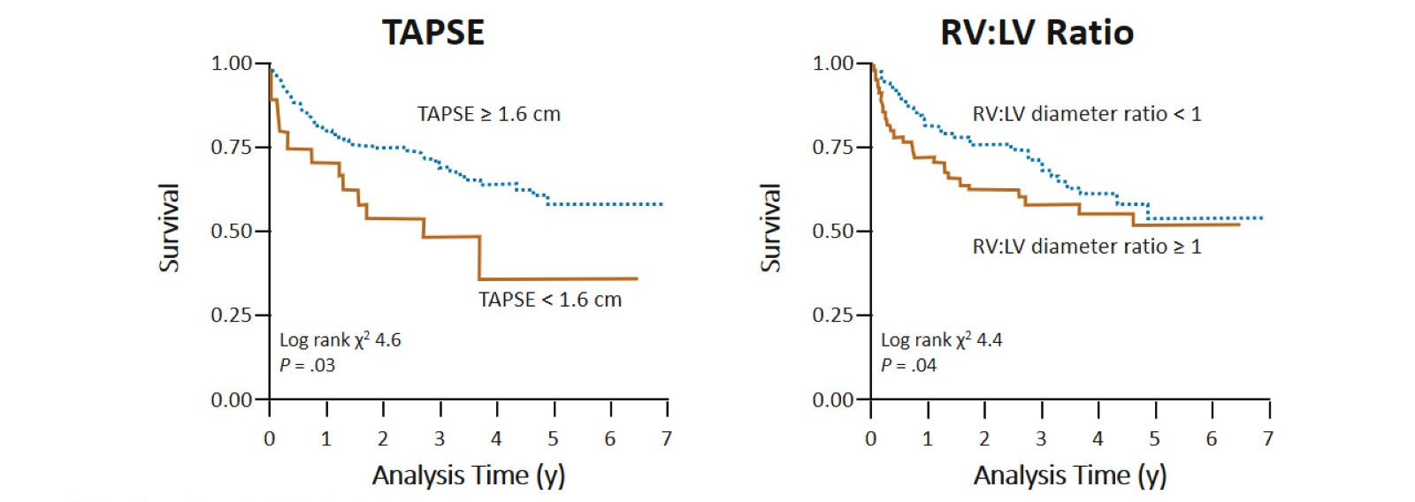
RV dysfunction impacts outcomes in CLD
In patients with IPF, RV dysfunction predicts poor prognosis
Rivera-Lebron BN, et al. Chest. 2013;144:564-570

Slide 63

ILD-PH RCTs
Notes:
STEP IPF: Took patients with more severe IPF (DLCO<35%) and randomized to sildenafil – thinking that this may improve gas exchange via increased blood flow to ventilated areas. 2/3 of these folks had an echocardiogram available, and those with MORE RV dysfunction had less functional decline with pulmonary vasodilators
ARETEMIS-IPF looked primarily at ambrisentan in treating IPF, with the main trial showing worsened outcomes and MORE disease progression with ERA therapy. They did a subset analysis looking at those with RHC-confirmed group 3 PH, and they saw no difference in hemodynamics between ambrisentan and placebo. Overall, patients showed slow progression of their PH regardless
RISE-IIP: this looked at riociguat, a sGC stimulator in those with IIP and hemodynamically confirmed gropu 3 PH. This is really one of the better designed and larger trials in group 3 disease. 147 patients were randomized, and the study was stopped early due to serious adverse events and increased mortality with riociguat.

Slide 64

Systemic vs. inhaled pulmonary vasodilators

Slide 65

INCREASE Trial…
Inhaled Treprostinil vs. Placebo for patients with ILD-PH
Strengths
  326 subjects
  RHC-proven disease
  Similar discontinuation between tre and placebo
  Significant improvements in plasma NT-proBNP with tre
  Less clinical worsening with tre (driven by hospitalization or drop in 6MWD
Weaknesses:
  16-week trial
  No change in QOL

Slide 66
My approach for Group 3 PH
Mild PH is common in CLD, first treat underlying disease
  Ensure hypoxemia and/or sleep disordered breathing is treated
  Follow up echocardiogram at 6 mo – 1 year
For those with RV dysfunction or persistent RVSP > 40 mmHg despite management of CLD, refer to PH clinic and move to RHC
If ILD, consider inhaled Treprostinil
Enrollment in clinical trials

Slide 67
PAH
SSc
SLE
MCTD
SS
PM/DM
LV Disease
SSc
SLE
RA
I
II
PH
Lung Disease
SSc
SLE
RA
SS
PM/DM
Thrombotic
SLE
SSc
IV
III
Adapted from: Mathai SC. Cardiol Clin 40 (2022) 29–43

Slide 68

Diagnosis
Perfusion:
Ventilation:
Notes:
Detected with a VQ scan

Slide 69
Diagnosis
Perfusion:
Ventilation:
Notes:
Patients are particularly at risk for this if they are antiphospholipid ab positive.

Slide 70


Treatment
Notes:
And everyone with a new diagnosis of PH gets a VQ scan – because the treatment is completely different.

