Slide 1
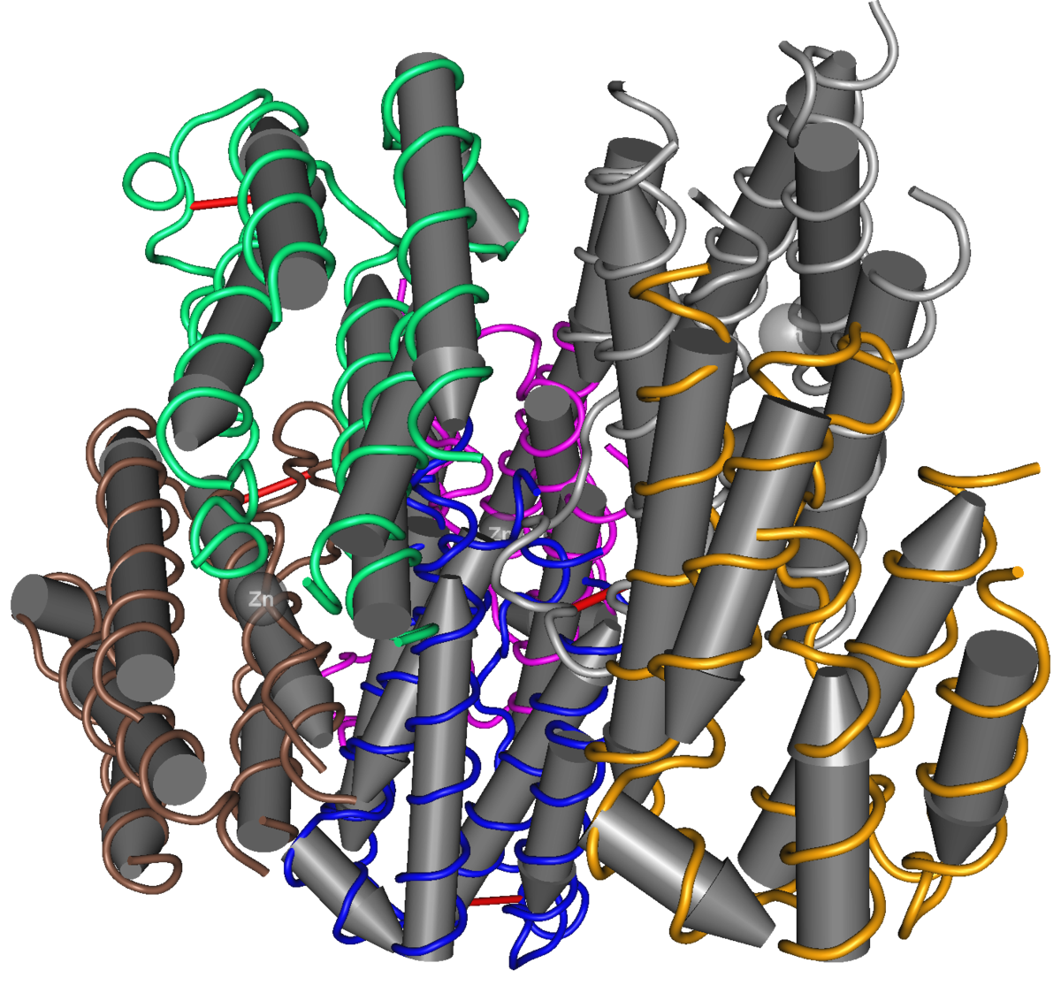
Interferonopathies
2025 Northwest Rheumatism Society Meeting
Andreas Reiff, MD
Neutrolis Chief Medical Officer
1

Slide 2
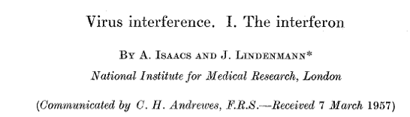
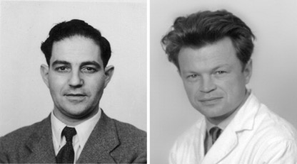
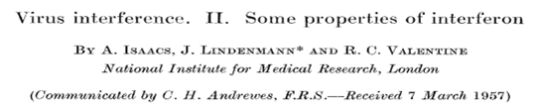

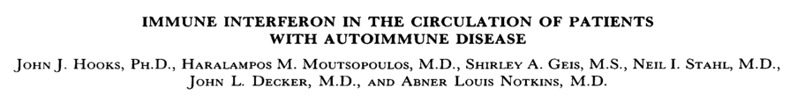
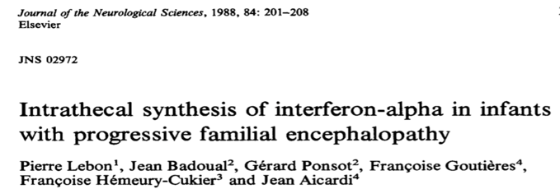
Interferon History
--- 1957 Discovery of IFN
Proc. Royal Soc. London 147:258-267, 1957
Alick Isaacs 1921-1967
Jean Lindemann 1924-2015
Proc. Royal Soc. London 147:268-273, 1957
---
1979 Discovery of IFN in SLE patients
---
1988 Discovery of IFN blood and CSF in AGS

Slide 3
What are Interferons
Interferons (IFNs), are cytokines, signaling proteins made and released by host cells in response to the presence of several viruses
IFNs are named for their ability to "interfere" with viral replication by protecting cells from virus infections
Virtually all human cells are able to synthesize IFNα/β
More than 20 distinct IFN genes and proteins have been identified in humans: Type I IFN, Type II IFN, and Type III IFN

Slide 4
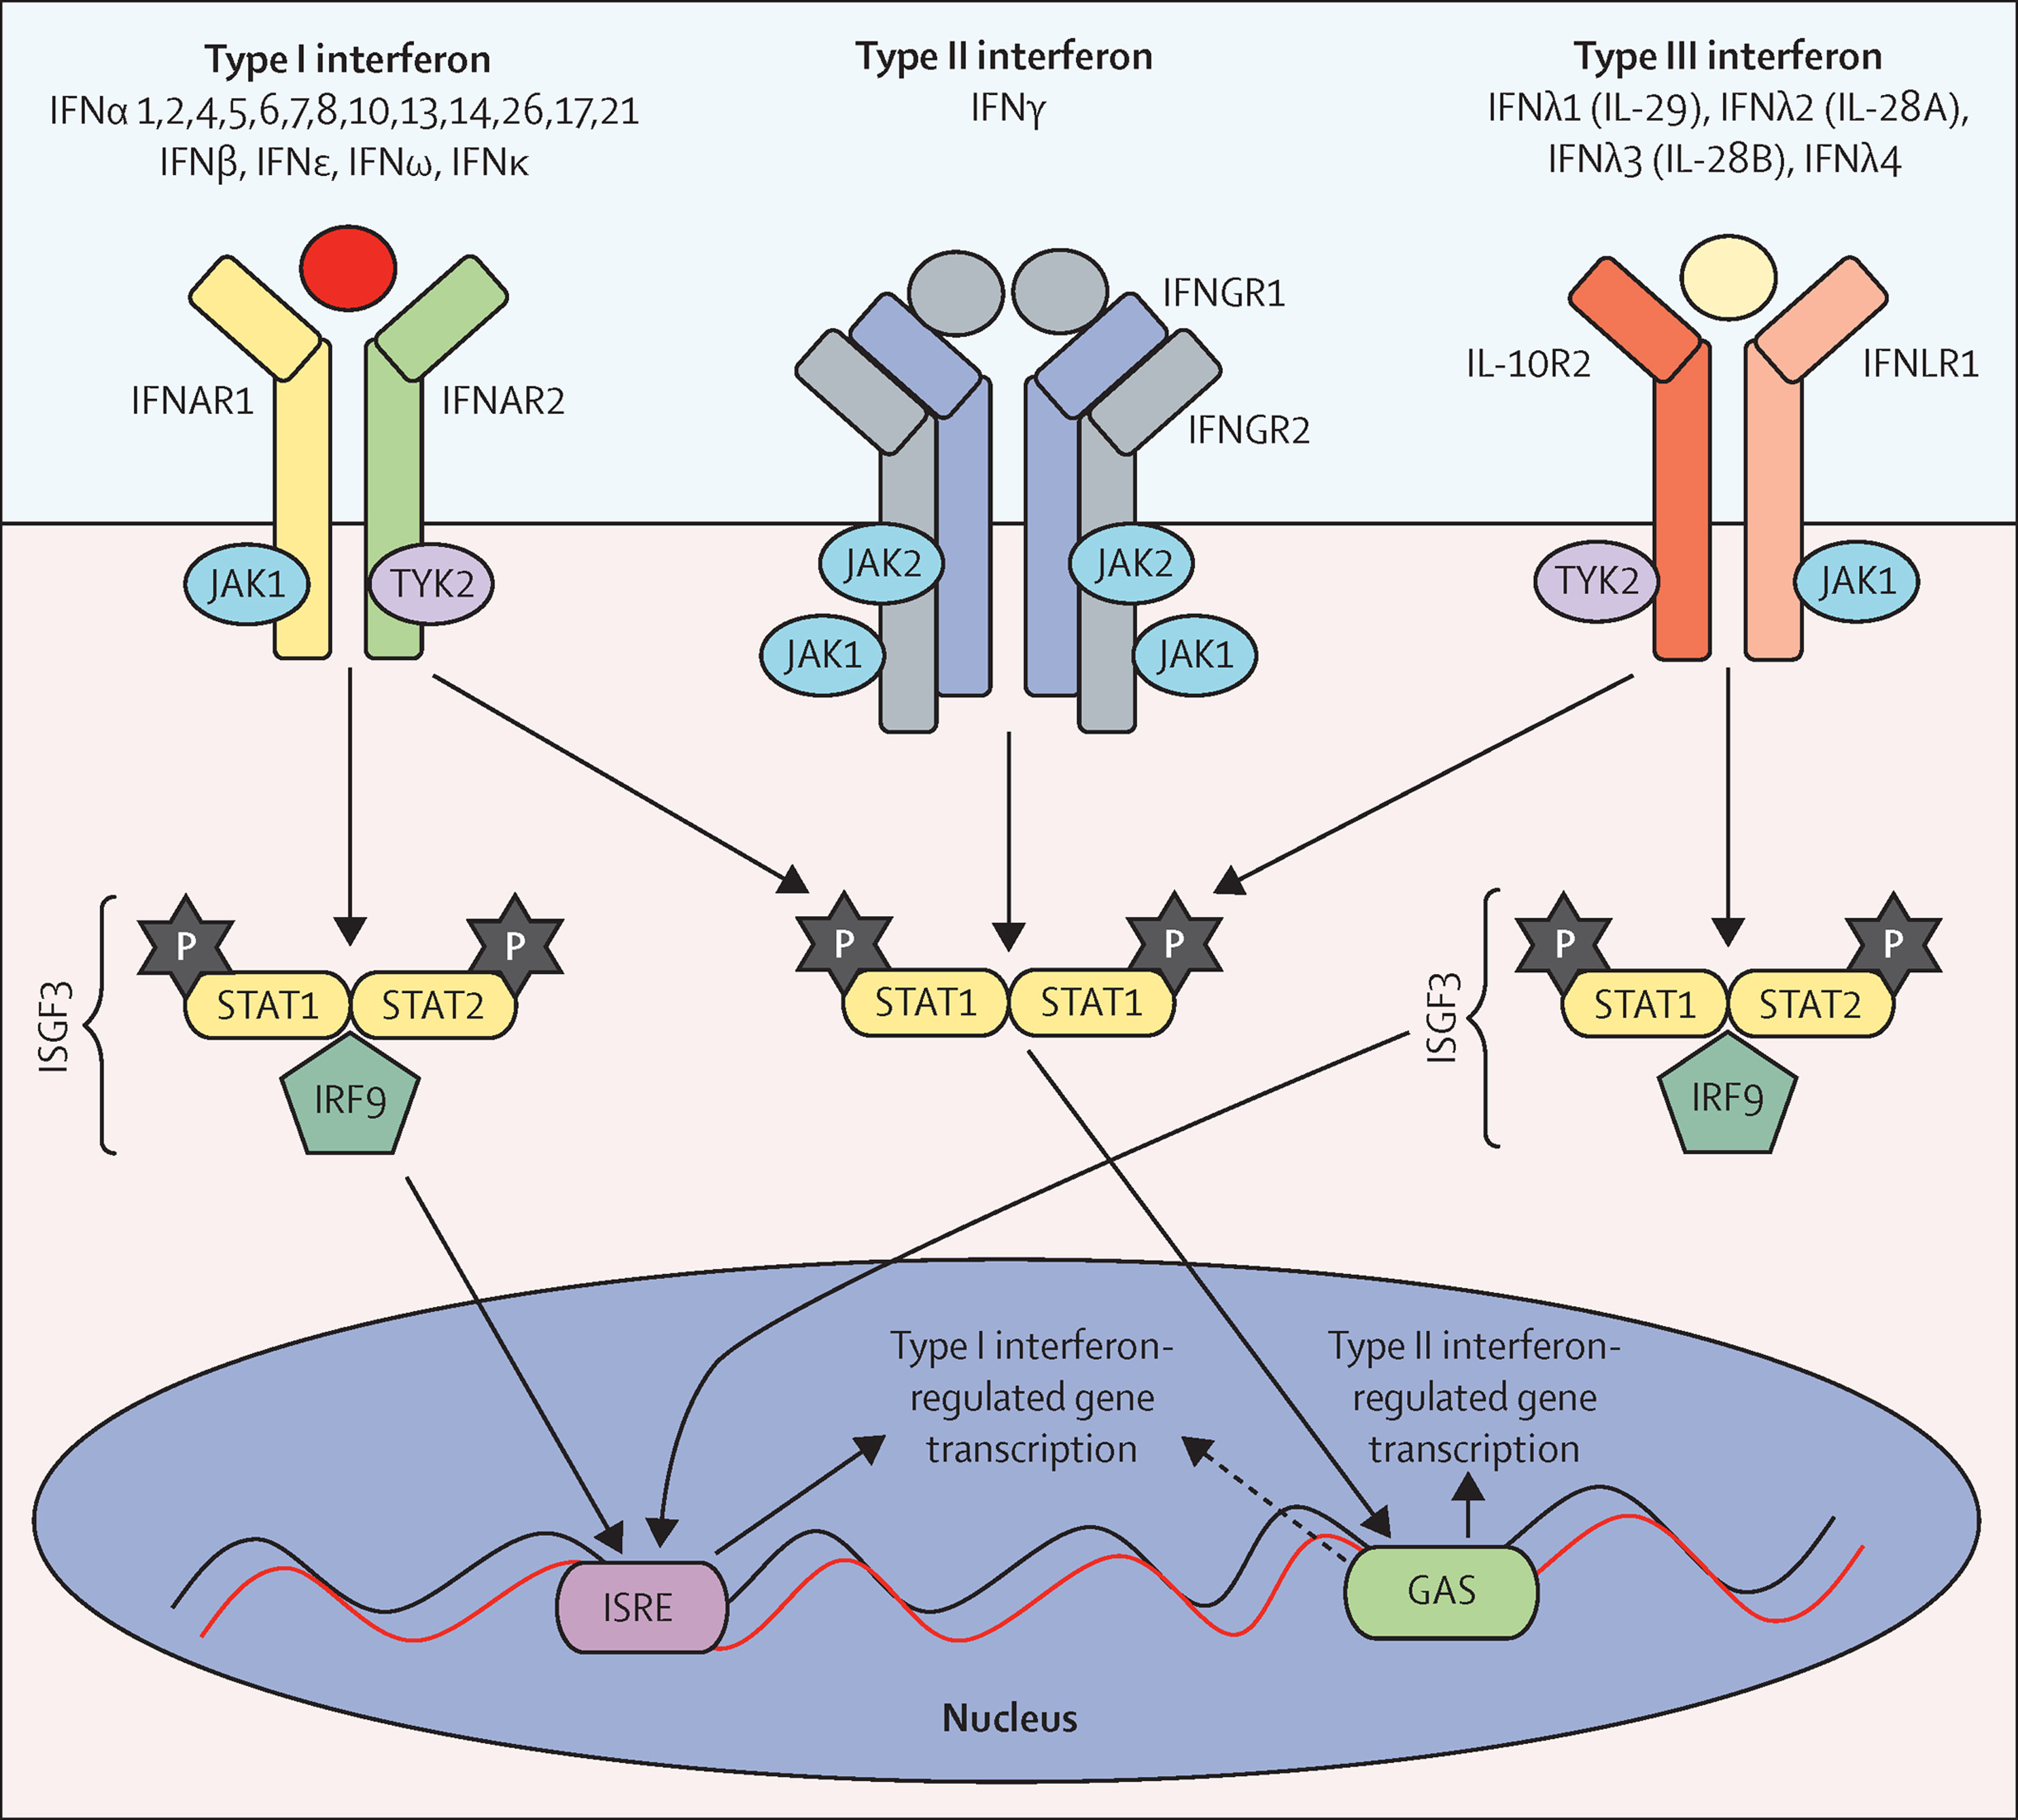
Interferon Signaling Pathways

Slide 5
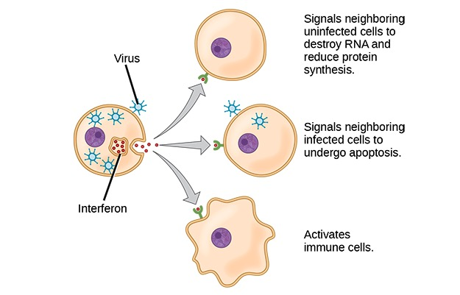
Immunologic Function of Interferons
IFNs activate key components of the innate and adaptive immune systems via production of cytokines involved in activation of T, B,NK cells and macrophages
IFNs increase host defenses by upregulating MHC I and II antigens
IFNs increase immunoproteasome activity
“Interferons” by OpenStax. License: CC BY 4.0

Slide 6
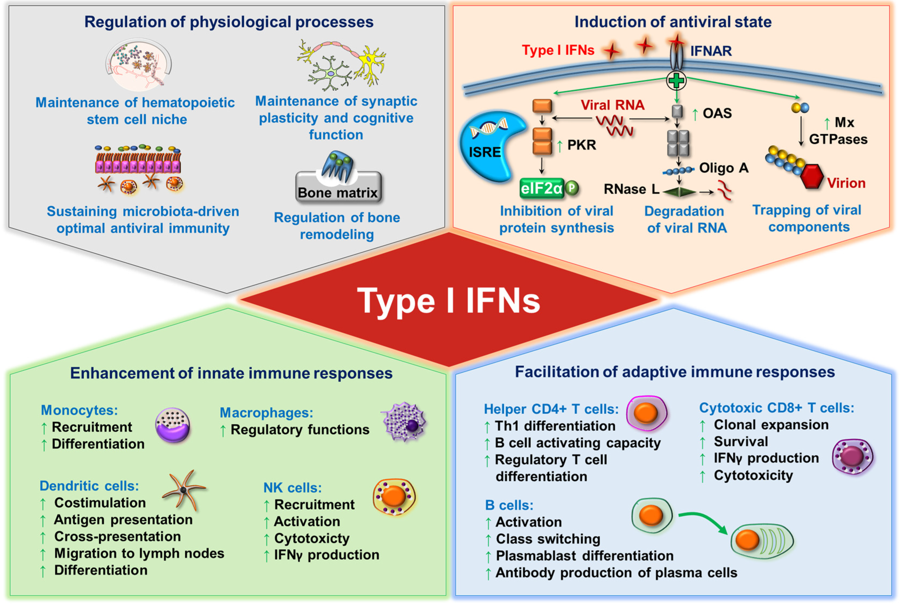
Function of Interferons
Int.J.Mol.Sci.. 2021, 22(8), 4190;

Slide 7
Interferons in Autoinflammatory Diseases

Slide 8

Discovery of genes that cause auto-inflammatory diseases (INFEVERS database)
n=73
~28% de novo
DDX58
IFIH1*
LACC1
NCSTN
POMP
PSMA3
PSMB4
PSMB9
RNF31
TNFAIP3
IL-1 mediated autoinflammatory diseases (n=8)
IL-18 mediated autoinflammatory diseases (n=3)
Interferonopathies (n=27)
NFkB and ubiquitylation disorders (n=9)
Modifiers of innate immune signals (n=8)
Other/unknown (n=18)
F12
IKBKG
LSM11*
PSMB10
RIPK1
RNU7-1*
SAMD9L
SOCS1*
UBA1
CARD14
IL36RN
PLCG2
SLC29A3
ACP5*
ISG15*
NCSTN
ALPK1
CDC42
CEBPE
PSMG2
STAT2
TRAP1
IL10
IL10RA
IL10RB
IL1RN
SAMHD1*
ADA2
APIS3
NLRC4
STING1
TRNT1
ADAM17
ATAD3A*
C2ORF69
ELF4
TBK1
1999 Dan Kastner:
Concept of Autoinflammatory Diseases
TREX1*
RNASEH2A*
RNASEH2B*
RNASEH2C*
OTULIN
WDR1
COPA
USP18*
ADAR*
NLRP12
RBCK1
JAK1
NLRP1
RELA
IFNAR1*
LYN*
HCK*
MVK
TNFRSF1A
NOD2
SH3BP2
MEFV
NLRP3
PSTPIP1
LPIN2
PSMB8
https://infevers.umai-montpellier.fr/web/detail_mutation.php
* Not in INFEVERS database
Notes:
The now 25 year history of autoinflammatory diseases started in 1997 with the discovery of the gene that caused FMF and TNFSF1A cause TNF receptor associated periodic syndrome (TRAP). With Hal Hoffman’s discovery of NLRP3 as cause of familial FCAS, and Jorg Tschopp and John Bertin’s discovery that NLRP3 activation actives caspase-1 that cleaves IL-1, that tied autoinflammatory diseases to innate genetically hard wired immune sensors and Pyrin and cryopyrin were thus the first intracellular sensors that were found by disease caused discovery. However to date genes that lead to high IFN signatures are the most common genes causing an autoinflammatory disease (blue color).

Slide 9
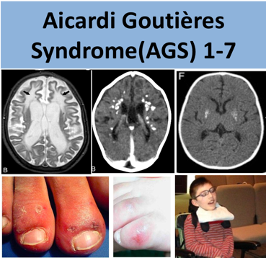
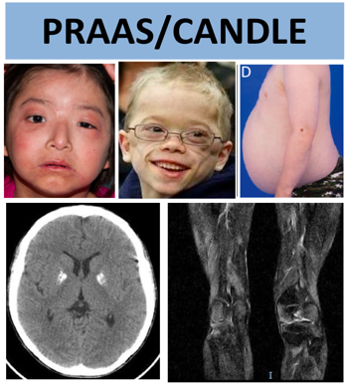
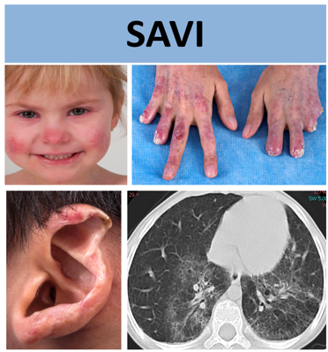
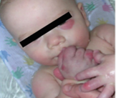
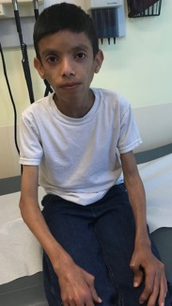
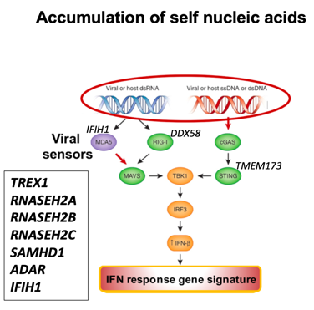
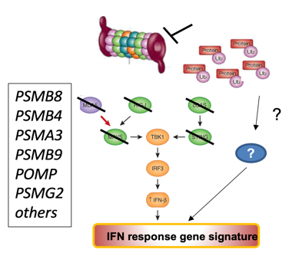
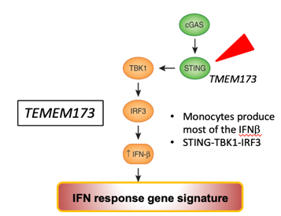
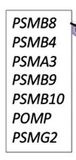
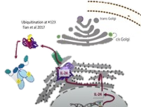


Monogenic Autoinflammatory Interferonopathies
n>300
n>70
n~100
2006
TREX1 and RNASEH2A-C causes AGS1-4
2011
PSMB8
CANDLE/
PRAAS
Proteotoxic stress
STING autoactivation
*
NFκB??
STING1
2014
STING1
causes SAVI
*
STING1
*
*
PKR
IFNα/β
Agarwal et al AJHG 2010, Arima et al PNAS 2011,
Kitamura A JCI et al 2011
Liu Y et al. Arthritis Rheum 2011,
Brehm et al. JCI 2015, Sanchez et. al. JCI 2018
Crow, YJ et al. Nat Genet 2006
Crow, YJ et al. Nat Genet 2006
Liu Y et al. NEJM 2014,
Jeremiah N et al. JCI 2014
Notes:
With the discovery of the genetic caused of three major interferonopathies the pathogenesis of accumulation of self nucleic acids that trigger intracellular viral sensors, accumulation of proteotoxic stress that triggers IL-24 mediated PFR activation and Gain of Function mutations in STING that allow for oligomerization and continued activation of downstream pathways.

Slide 10
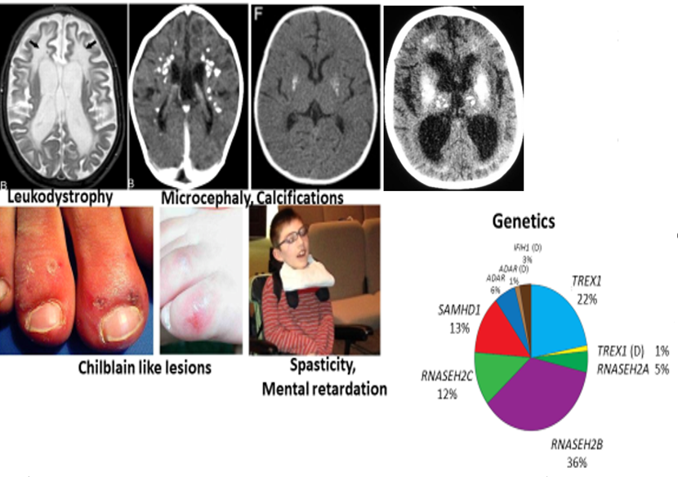
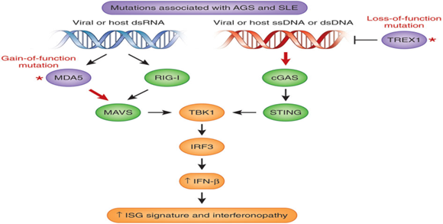
Aicardi-Goutières syndrome

Slide 11
Aicardi-Goutières syndrome (AGS 1-9)
Autosomal dominant mutations in IFIH1, encoding MDA5
Autosomal recessive mutations in TREX1, RNASEH2A/B/C, AMHD1,ADAR1
Typical onset neonatal or between 6 and 24 months of age
Clinical Presentation:
  Calcifying leukoencephalopathy/CNS white matter disease, Microcephaly
  Varying severity of spasticity, quadriplegia
  Severe developmental delay
  Rashes, cytopenia, pneumonitis, AIH and arthritis
  Chilblain like skin lesions
Childhood mortality ~25%

Slide 12
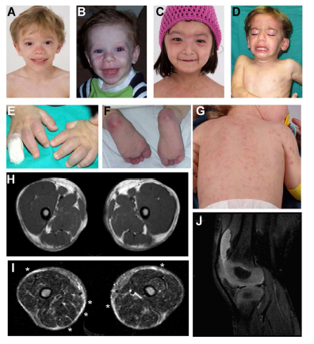
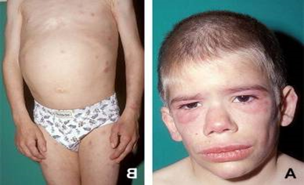
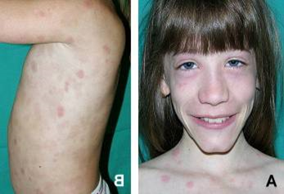
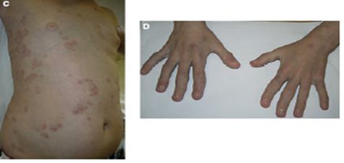
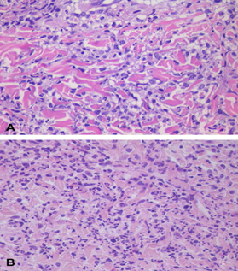
Chronic atypical neutrophilic dermatosis with lipodystrophy and elevated temperature: CANDLE/PRAAS Syndrome
CANDLE Syndrome Symptoms
Joint pain
Developmental delays
Recurrent fevers
Purpura
Swollen eyelids
Slow and progressive fat loss in the face, neck, chest, arms, and abdomen
Muscle contractures and stiffness
Seizures
Dermal infiltrates composed of atypical mononuclear cells, with large, vesicular, elongated or kidney-shaped nuclei, and scant eosinophilic cytoplasm.

Slide 13
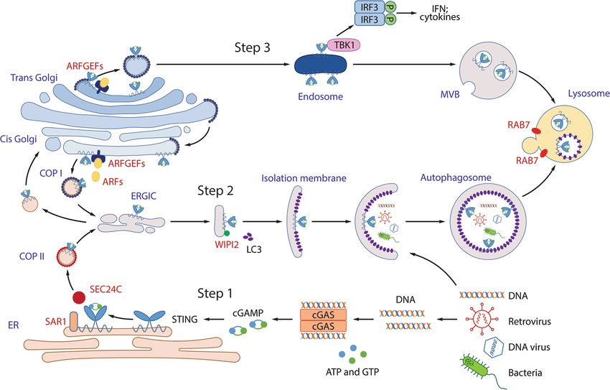
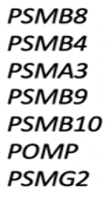
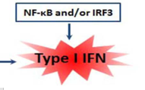
Pathogenies of CANDLE Syndrome
Cells 2022, 11(3), 318; https://doi.org/10.3390/cells11030318

Slide 14
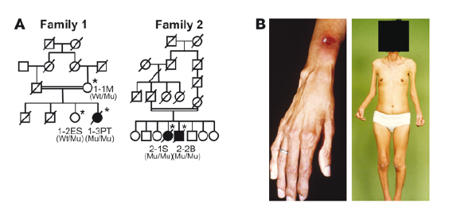
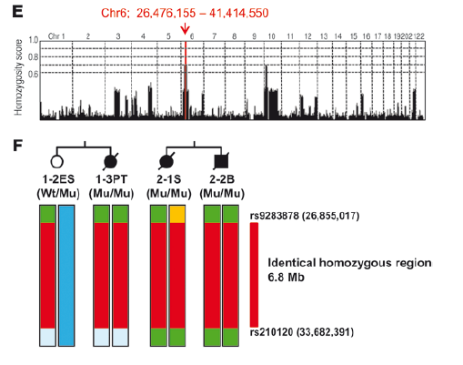
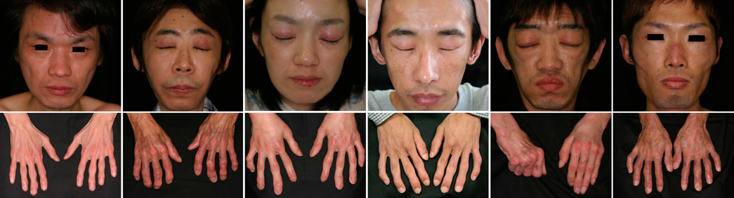
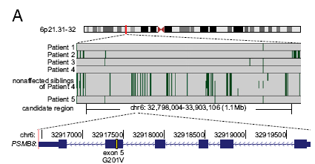
Mutation of PSMB8 (proteasome subunit beta type 8) Nakajo-Nishimura Syndrome
Kitamura et al., JCI 2011
Arima et al, PNAS 2011

Slide 15
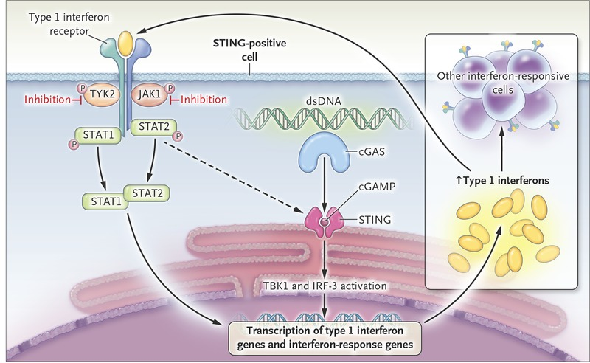
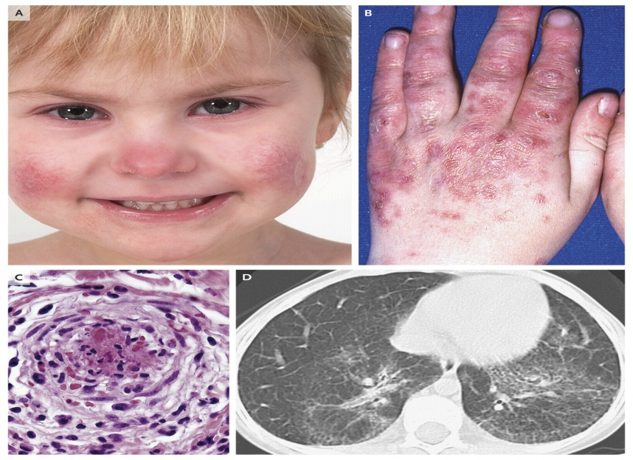
Systemic Inflammation CutAneous Vasculopathy and Lung Inflammation (SAVI)
Clinical Presentation:
Early-onset systemic inflammation
Cutaneous vasculopathy
Lung inflammation and fibrosis
cGAS independent
STING autoactivation
N Engl J Med 2014;371:507-518

Slide 16
Stimulator of Interferon Genes (STING)
Also known as transmembrane protein 173 (TMEM173)
Works as direct cytosolic DNA sensor and adaptor protein in type I interferon signaling
Induces type I interferon production when cells are infected with intracellular pathogens, such as viruses, mycobacteria and parasites
STING is expressed in peripheral lymphoid tissues, including T lymphocytes, NK cells, myeloid cells and monocytes
De novo mutations in TMEM173 gene cause SAVI

Slide 17
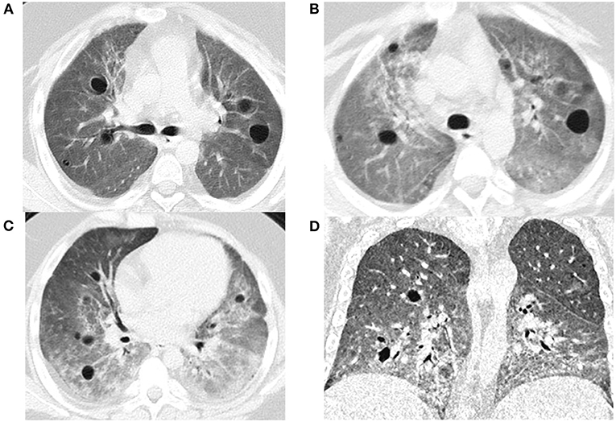
COPA Syndrome
76 % of patients develop symptoms of disease <5 years of age
ILD/pulmonary hemorrhage
Non-erosive arthritis
High-titer autoantibodies (ANA, ANCA,RF)
Immune complex-mediated renal disease

Slide 18
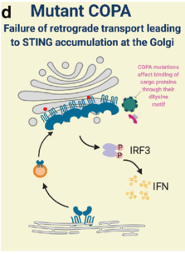
Pathogenesis of COPA Syndrome
AD, missense mutations in the alpha subunit of the coatomer complex-I that is devoted to transiting molecular cargo from the Golgi complex to the endoplasmic reticulum, (30 mutations)
Enhanced production of cytokines that promote the expansion of Th17 cells (IL-23 p19, IL-12 p40, IL-12 p35, IL-1β and IL-6)
The link between COPA mutations and IFN signaling is unknown

Slide 19
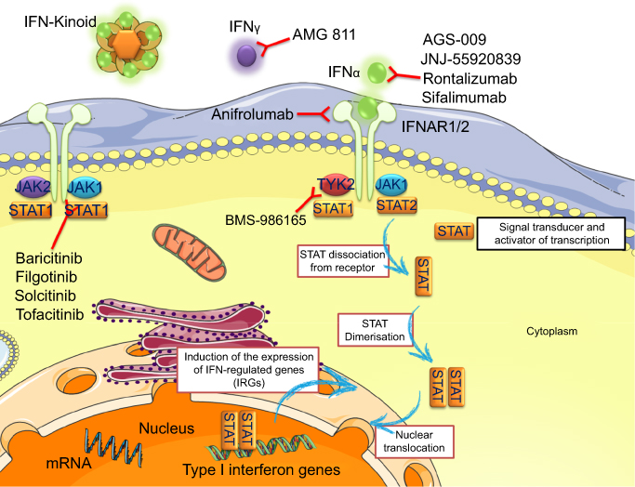
Drug Design, Development and Therapy Volume 13, 2019
Treatment of Interferonopathies

Slide 20
Treatment of Interferonopathies
No Drug approved for any Interferonopathy
GCs
Traditional DMARDs as GC sparing agents
Anti-IL-1 agents (ineffective)
JAKi (Bari, Tofa, Ruxo.) but
  Incomplete responses in SAVI, and in CANDLE (50%)
  Safety concerns on high dose JAKi even in responders
Anifrolumab
Allogeneic BMT

Slide 21
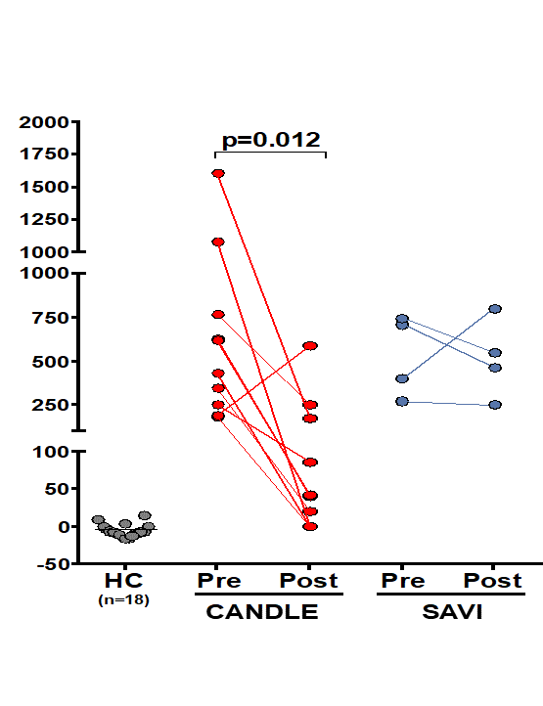
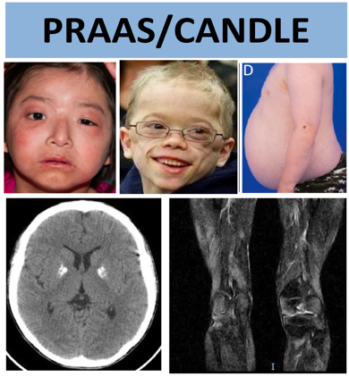

Treatment of Interferonopathies - JAKi
CANDLE n=10
SAVI n=4
Other n=4
Remission in 50% of patients
Improvement
Growth parameters (height and DEXA scan)
Cytopenias
Daily diary score
Lung function
Safety
Drug Exposure:~1.8 fold higher than RA at 4mg/d
Reactivation of (BK, HZV)
Kim H et al. 2018
Sanchez et al. JCI 2019

Slide 22
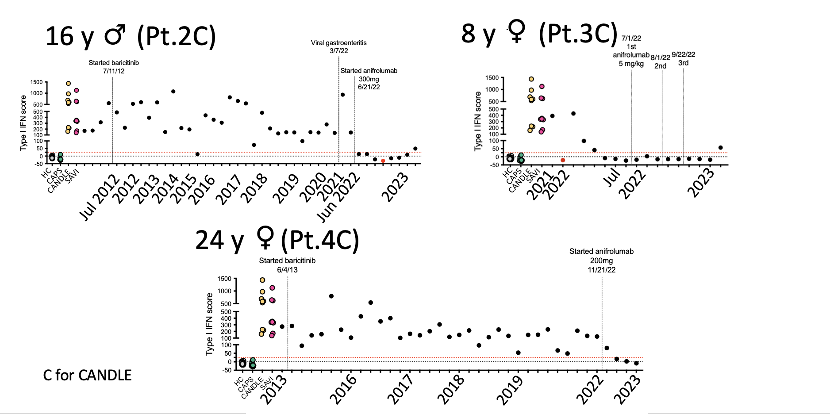
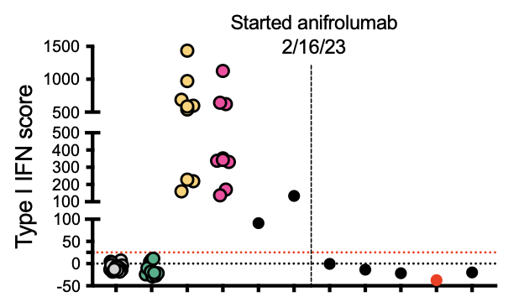
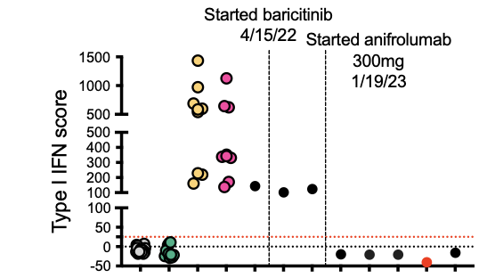
Anifrolumab suppresses IFN score in CANDLE and SAVI
17 y M SAVI
27 y M SAVI

Slide 23
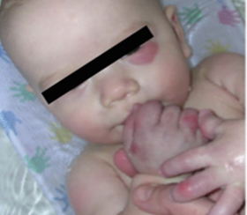
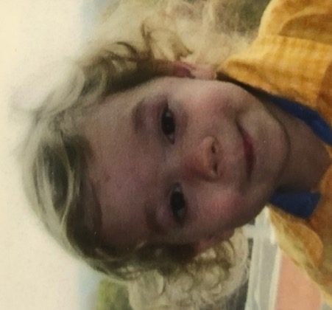
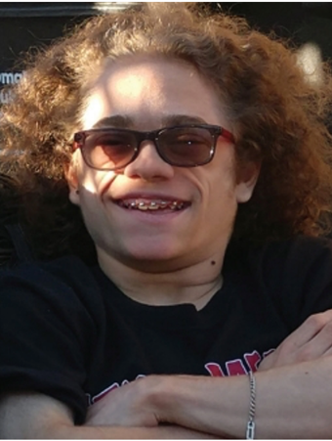
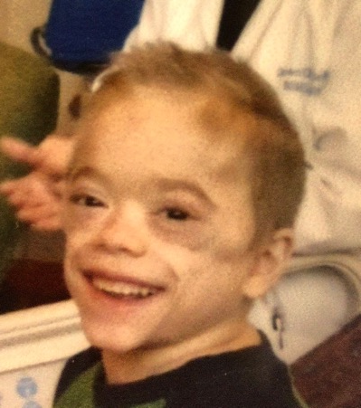
Unmet need CANDLE: Panniculitis and Lipoatrophy
Age 2 weeks
Age 2 years
Age 7 years
Age 18 years
Other: short statute, metabolic syndrome, cognitive delay

Slide 24
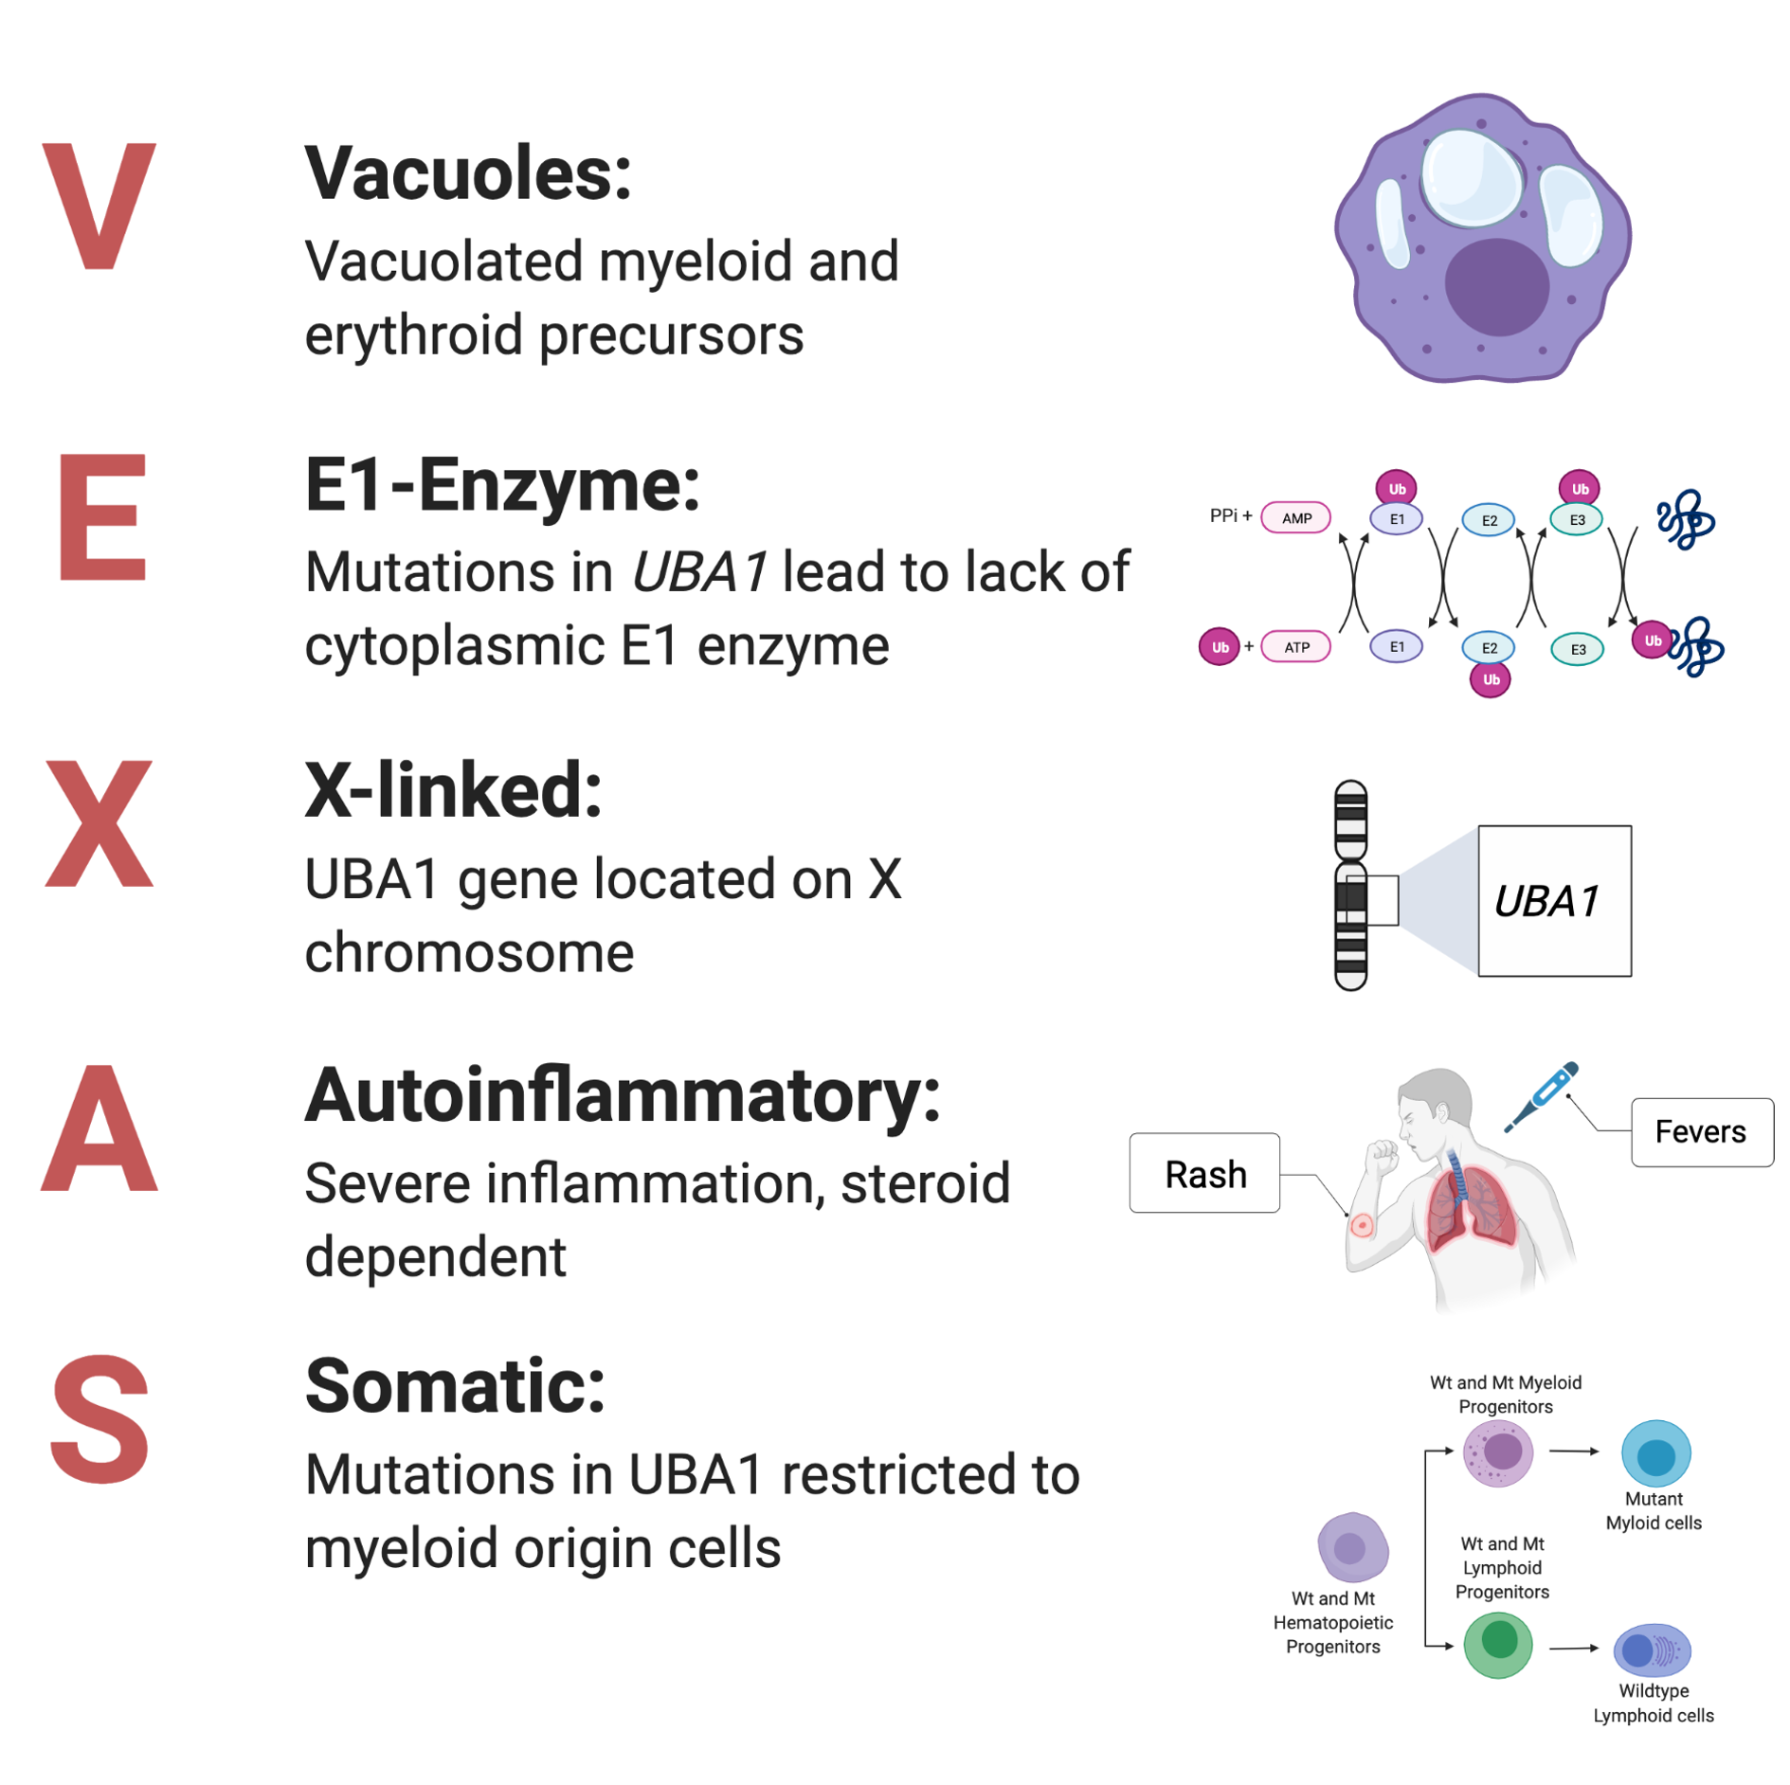
VEXAS Syndrome
Ubiquitination is an important process of:
Protein degradation & recycling
Protein processing
Cell signaling
Cell homeostasis
Apoptosis
Immune response
DNA repair
Mutations are somatic, meaning they are acquired at some point in life and not inherited, with a penetrance close to 100%

Slide 25
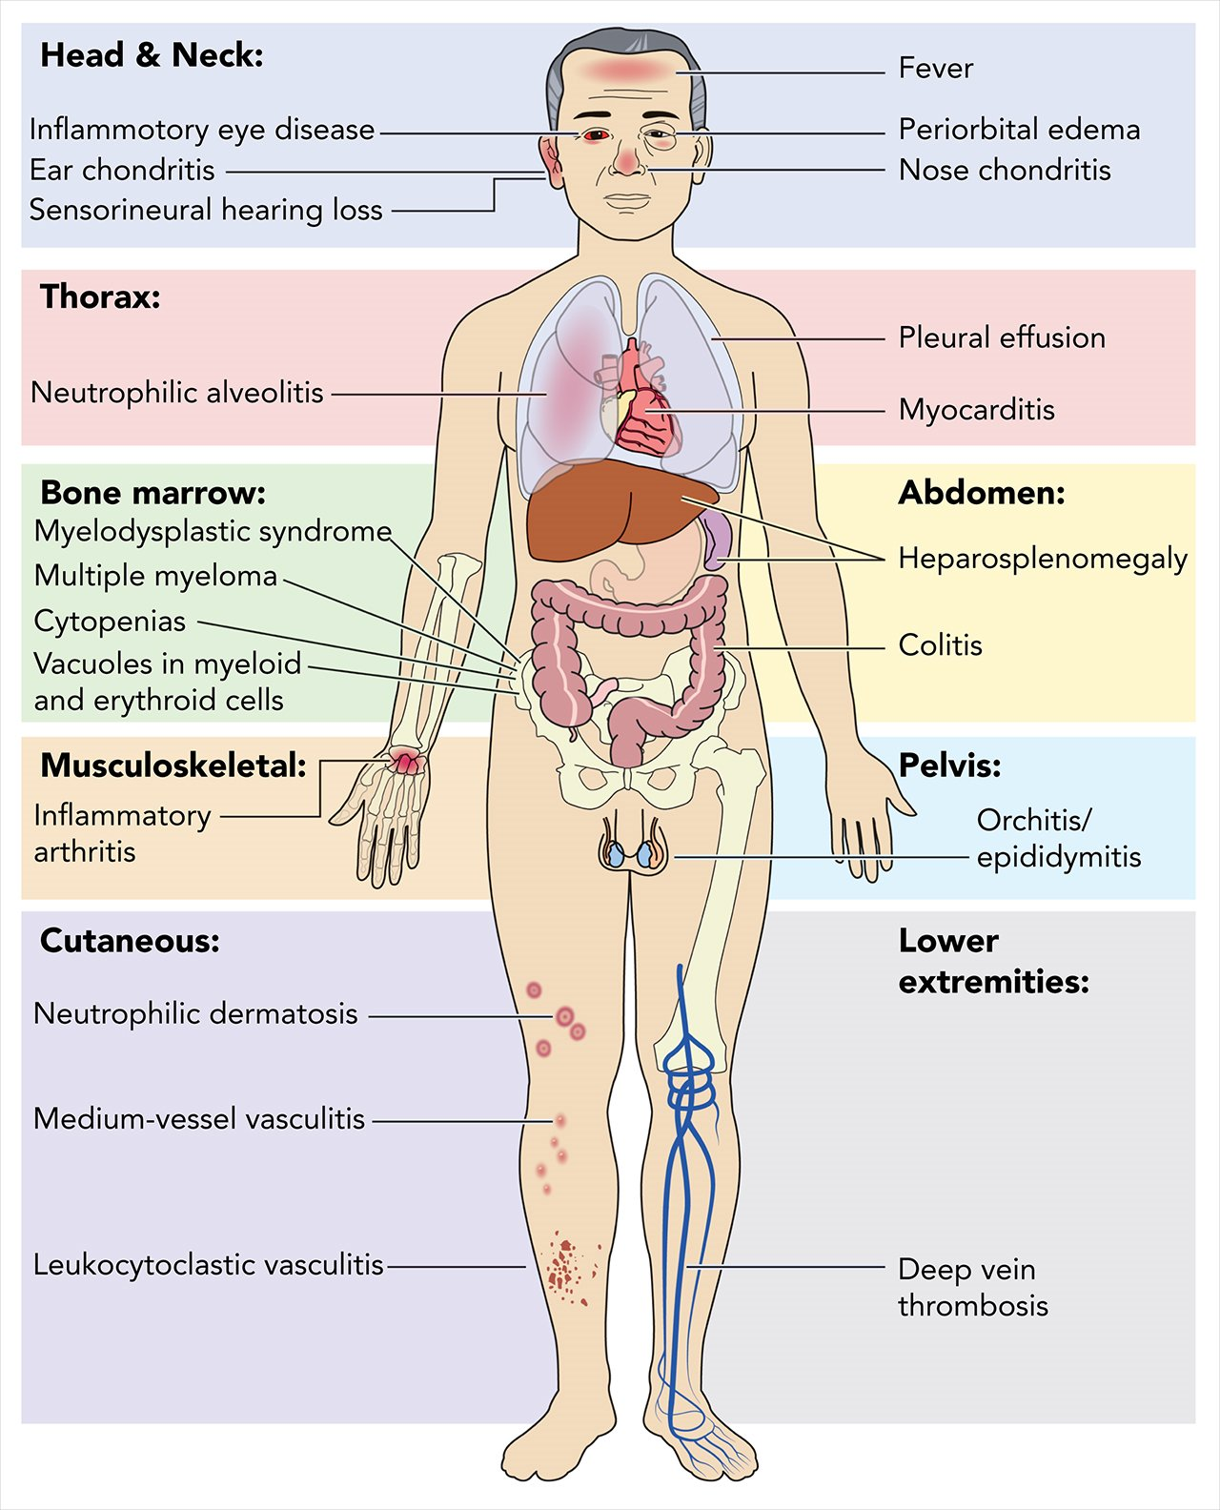
VEXAS Syndrome
Considered to be an Interferonopathy
Identified in 2020 through whole exome sequencing in 3/2,560 patients (mainly Caucasian)
Prevalence: 1 in every 13,591 adults
The disease usually starts in late adulthood (typically males after the age of 50) and causes both auto-inflammatory and hematologic symptoms
Patients with VEXAS have overexpression of interferon gamma IFNγ, interleukin IL-8 and INF-inducible protein 10
Typically severe and progressive disease course
Therapy with GC, anti-IL1,6 JAKi (Rux.), BMT

Slide 26
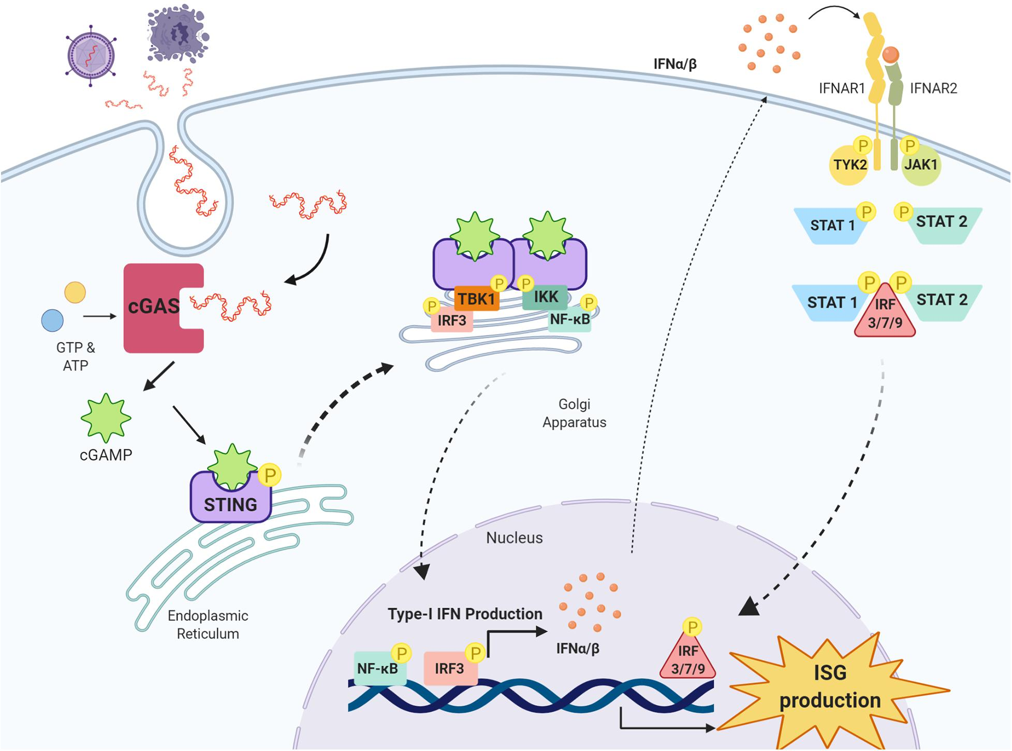
Future drug targets in Interferonopathies
JAKi (Baricitinib trial ongoing)
JAK1TYK2 inhibitors
cGAS inhibitors
NALP3 inhibitors
Front. Neurosci. Sec. Neuropharmacology February 2021 Volume 15 - 2021

Slide 27
Summary
Interferon signatures pay an important role in autoimmunity and autoinflammation
Interferonopathies are an expanding group of inherited monogenic auto-inflammatory diseases characterized by a dysregulation of the interferon pathway, leading to constitutive upregulation of its activation mechanisms or down-regulation of negative regulatory systems
Interferonopathies are clinically heterogeneous and difficult to treat
The QOL of patients can be severely impacted and depending on disease mortality is high (2nd decade)
There are no approved drugs in any Interferonopathy

Slide 28

Thank you

Slide 29
EXTRAS

Slide 30

Interferonopathies are STINGopathies

Slide 31
Types of Interferons
Interferon type I (IFN-α, IFN-β, IFN-ε, IFN-κ and IFN-ω):
  Bind to the IFN-α/β receptor (IFNAR) consisting of IFNAR1 and IFNAR2 chains
  Produced by fibroblasts and monocytes
  Production of type I IFN-α is inhibited by IL-10
  IFN-α used to treat Hepatitis B and C infections, while IFN-β used to treat MS
Interferon type II (IFN-γ):
  Binds to the IFNGR, receptor consisting of IFNGR1 and IFNGR2 chains.
  Produced by cytotoxic T cells and TH1 helper cells. Block Th2 helper cells
  Activated by IL-12
Interferon type III (IFN-λ1, IFN-λ2, IFN-λ3):
  Bind to the IL10R2 (CRF2-4) and IFNLR1 (CRF2-12) receptor complex
  Produced by endothelial and dendritic cells
  Importance for certain virus or fungal infections

Slide 32







Unmet needs SAVI: Peripheral Vasculitis
Unmet needs SAVI: Non-healing ulcers
Tissue loss and amputation
of hands and feet
2014
Start JAKi
2013
2015
2021 age 32
Frequent
new vasculitic lesions

Slide 33








Unmet needs SAVI: Lung disease progression
2005
Age 10
2017
Age 22
2021
Age 26
2023
Age 28
Patient 1
Mutation: STING1, p.R281Q
2020
Age 5
Age 6
2022
Age 7
Age 7.5
Patient 2
Mutation: STING1, p.V155M
SARS-Cov2 infection
Aspergillus fumigatus infection
Aspergillus calidoustus infection

Slide 34
Interferons in Autoimmune Diseases

Slide 35
Interferon signature in autoimmune diseases
An increased expression of type I IFNs regulated genes (IFN signature) has been reported in blood and tissue cells from patients with RA, SLE, Sjögren's syndrome, SSc, DMS and often correlate with either active disease or a certain disease subtype
Besides type I IFN, type III IFN (IFN-λ) may contribute to the IFN signature
INF signatures may predict response to certain types of treatment
Mechanism: Autoantigens from dying cells trigger plasmacytoid dendritic cells to a continuous synthesis of type I IFN, which activate NK and B cells

Slide 36





IFN signature as diagnostic and/or theragnostic Biomarker
Microarray/RNAseq
qPCR
Nanostring
28 IFN-response
genes score
*
*
*
Standardized 28 gene IFN score
*
*
*
Bennett L.. Pascual V JEM 2003
Rice GI …Crow Y JCI 2017
Kim H et al. J Interferon Cytokine Res. 2018

Slide 37

Interferon signature in SLE

Slide 38

Interferon signature in SLE The Anifrolumab Experience
In the subpopulation with a high interferon gene signature (301 of 362 patients, 83.1% of patients overall), the percentage of patients with a BICLA response at week 52 was 48.0% in the anifrolumab group and 30.7% in the plc group
In the subpopulation with a low interferon gene signature (61 of 362 patients, 16.9%), the percentage of patients with a BICLA response was 46.7% and 35.5%, respectively

Slide 39
Designing Clinical Trials in Interferonopathies

Slide 40
Clinical Trials in Interferonopathies
Are very complex due to disease heterogeneity
Need to be individualized based on the disease subtype
Are complex and expensive
Are difficult to recruit
Not all disease manifestations may respond to treatment
Early treatment intervention is critical
Require Centers of Expertise with special multidisciplinary teams
Most trials are initiated by NIH or Academic Institutions
Small market

