Slide 1
AI in Medicine
AI roots and the path traversed and the engines propelling it
How will AI influence Health & Medicine? How can you influence and use it?
Gans Srinivasa

Slide 2
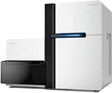
Let me introduce myself
My job at Intel was to create server chips that delivered
“system performance” that doubled year over year in the same “power envelope”.
  By 2013, my focus shifted to Big Data, Collaborating with Biomedical Community
“Collaborative Precision Medicine Platform” , “Collaborative Cancer Cloud” and Big data Analytics to Guide personalized disease management.
Disease genes pathways and phenotypes identified
Precision
Healthcare

Slide 3
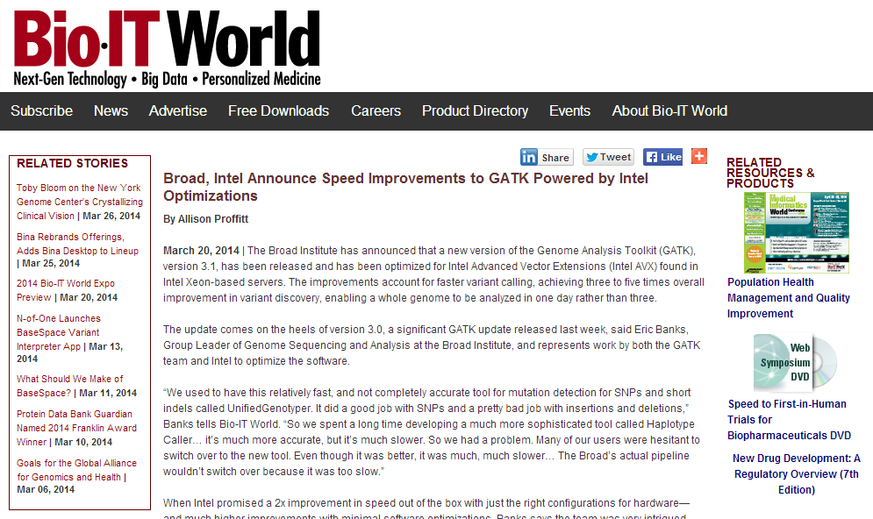
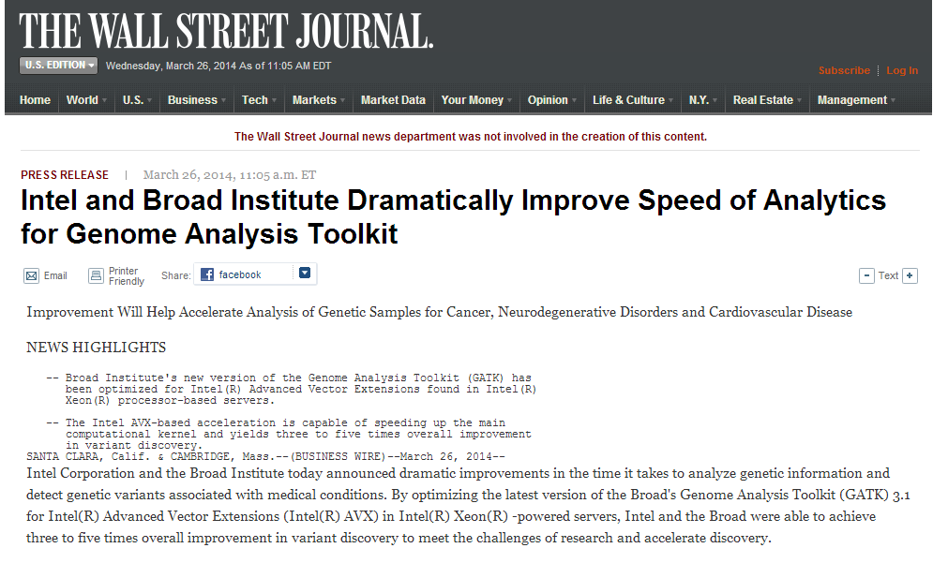
Intel – Broad Institute- My first collaborative work with Bio world

Slide 4
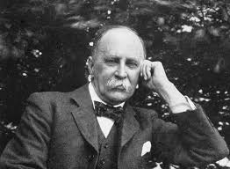
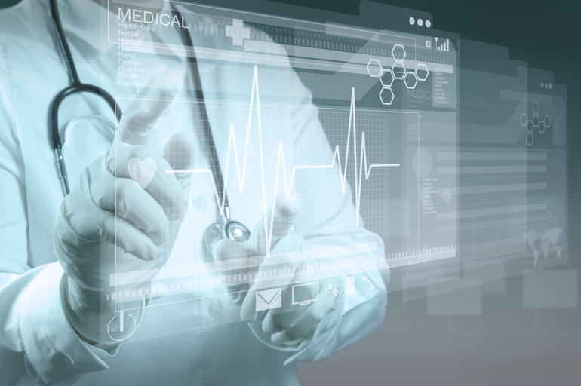
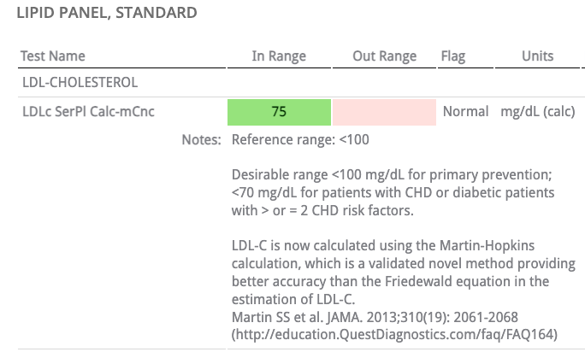
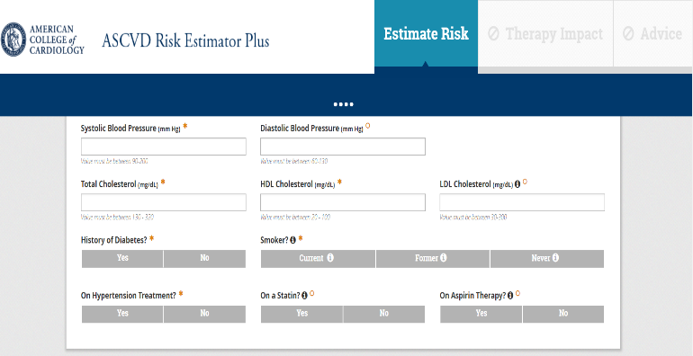
Oslerian Ideal
Willam Osler
Oslerian Ideal - Still dominates today
    DX : By Taxonomy of Symptoms;
    RX : Class of disease by Algorithms
Advances in Testing, use of Algorithms, DNA, Molecular networks are changing Medicine.
    DX : Individual “Data Cloud” ;
    RX : Medicine enabled by Big Data
1849-1919
CARDIOLOGY
RISK ESTIMATOR
Notes:
Let us focus on Healthcare.
Oslerian principles are the staple of any Academic Medical Center that train doctors, and they are continuously learning health care systems.
It is Dx (diagnosis), Rx as prescription based on a set of algorithms. This was established in the early part of last century.
We are now witnessing a data deluge and need to update the techniques to deal with voluminous individual data and this has heavy ramifications on the treatment. Essentially, we need Causal AI to deal with and reason with.
I would like to mention about the Institute Of Medicine* report that highlight these issues.

Slide 5
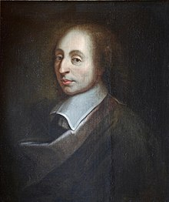
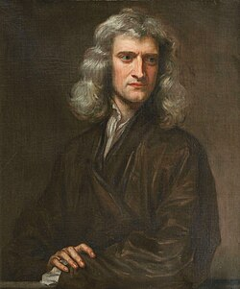
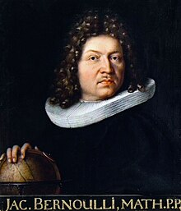
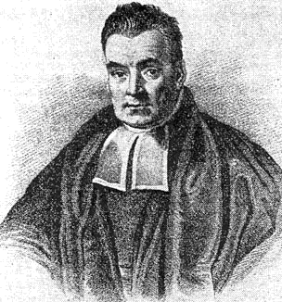
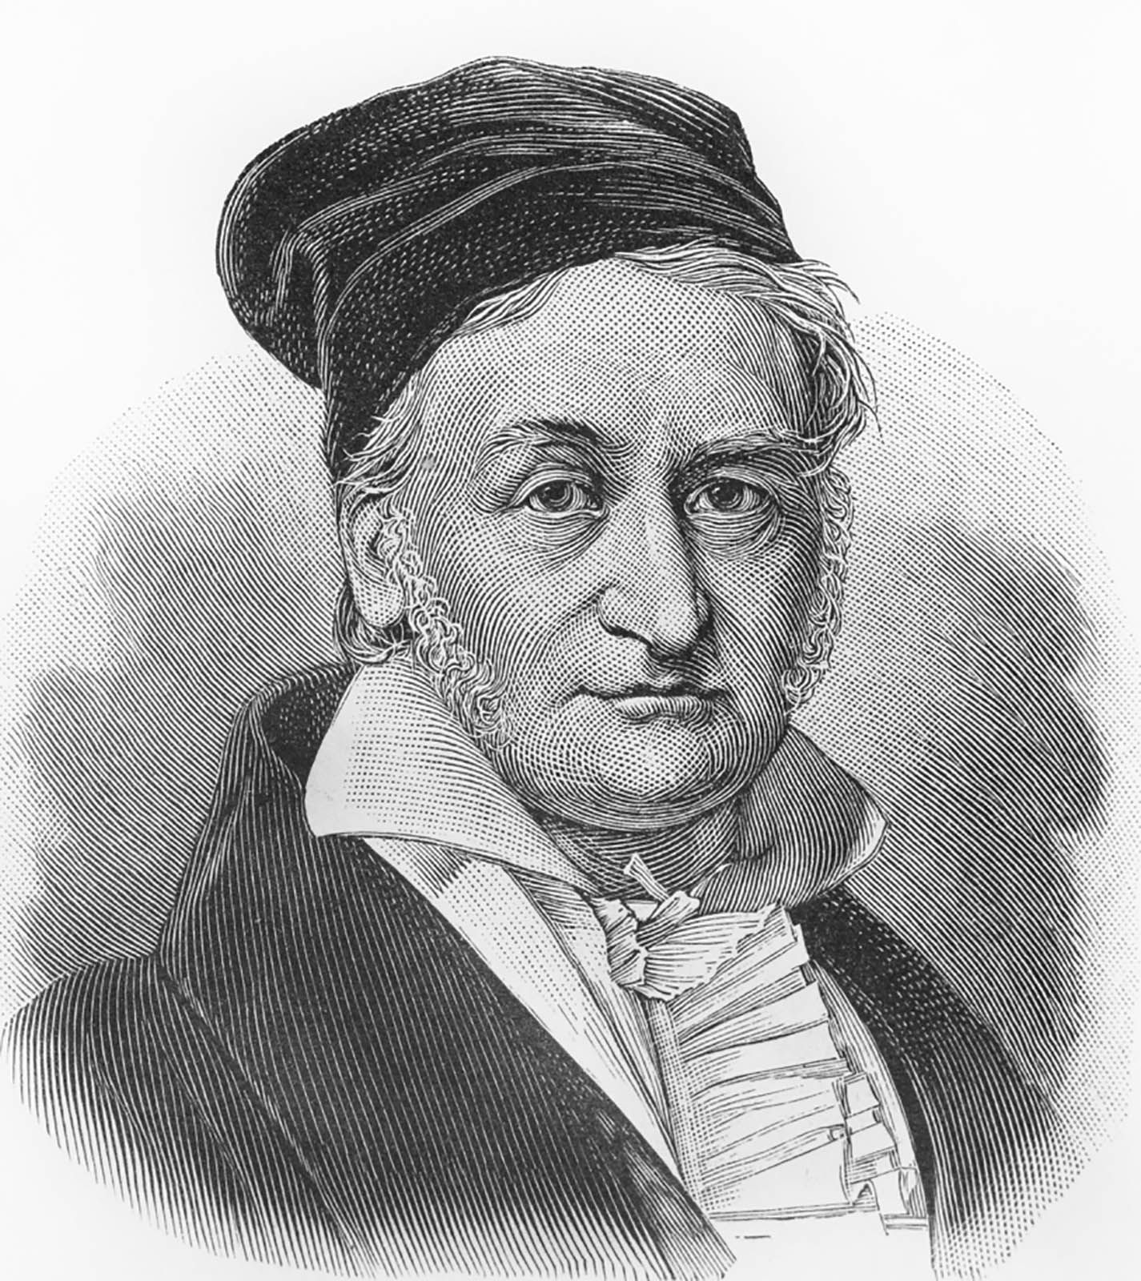
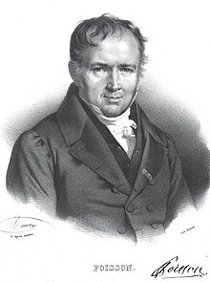

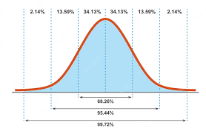
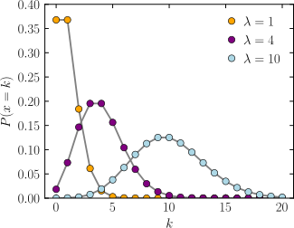
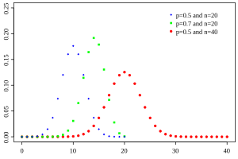
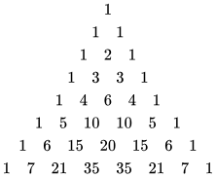

Pascal
Newton
Bernoulli
Bayes
Gauss
Poisson
1623-1662
1643-1727
1655-1705
1701-1761
1777-1855
1781-1840
Posterior = Likelihood × Prior ÷ Evidence
Mathematical Machinery was well established. What was missing then?... Two big items!
Computing power at scale for large amounts of data needed…… Solving it was 20th Century problem!

Slide 6
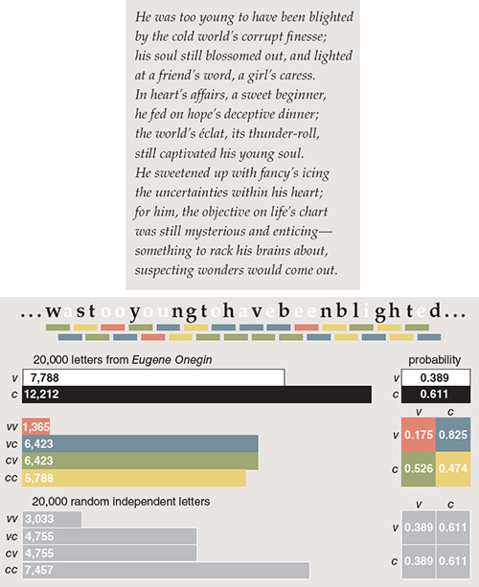
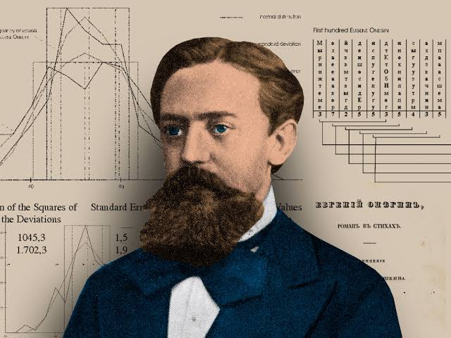
1906
Andrey Markov
1856-1922
Markov first addressed the issue of dependent variables and the law of large numbers in 1906.
In the 100 years since 1913, Markov chains have become a major mathematical industry

Slide 7
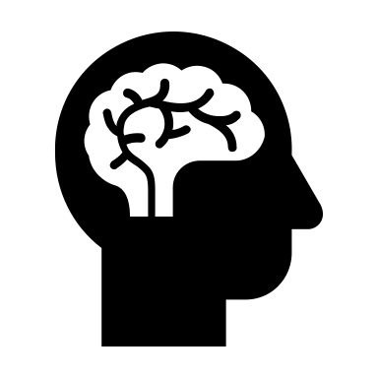
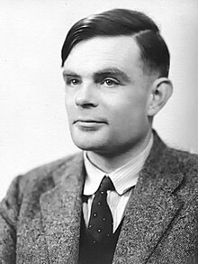

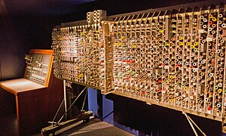
1949: Turing Test
Biological/Human Behavior
Alan Turing
Answer_{H}
Imitation
Game
Question
Answer_{C}
Programmed Behavior
1912-1954
  Are the Answer_{H} and Answer_{C} indistinguishable?
Notes:
How do you make meaning out of this data?
Need a Model. Model can convey information that pure data is unable to provide. Age is a confounder - lurking variable of Cholesterol and Exercise.
How do you express this model?
Through a Causal Graph, Like this Exercise ← Age → Cholesterol. Age is the confounder! And not in the data!
Let us reflect this Causal model on the data !

Slide 8
The mathematics that were invented couple of centuries back
PLUS
Technology, Automation and Interdisciplinary innovations!
AI is models and algorithms executed in split fractions of a second!
What is AI?

Slide 9
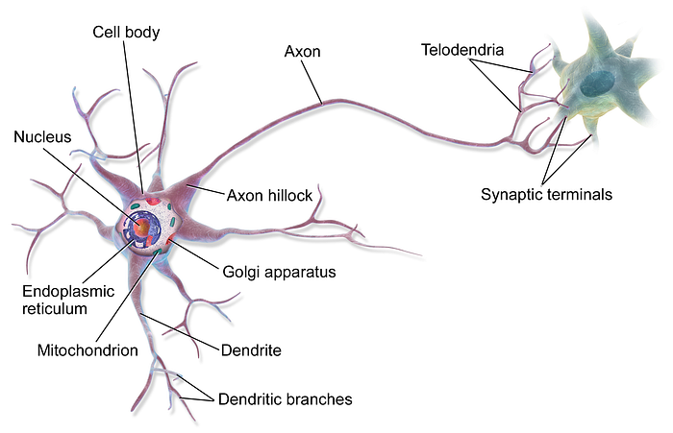
Hebb’s Rule [1949]: Changes in the strength of synaptic connections are proportional to the correlation in the firing of the two connections....If they fire together the connections will become stronger.
The story of grandmother: Always gives you a chocolate bar when she comes to visit….
Now even the sight of your grandmother , even in photo will be enough to make you think of chocolate.

Slide 10
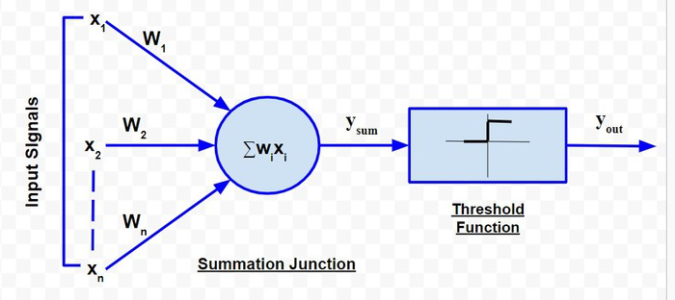
1940s, Warren McCulloch, a neurophysiologist, and Walter Pitts, a logician, proposed a groundbreaking model of the biological neuron. Their simple yet powerful concept laid the foundation for what we now call artificial neurons, the building blocks of
Artificial Neural Networks (ANNs).
Hodgkin and Huxley did study neurons in 1952, using neurons from giant squids, it earned them a Nobel Prize.

Slide 11
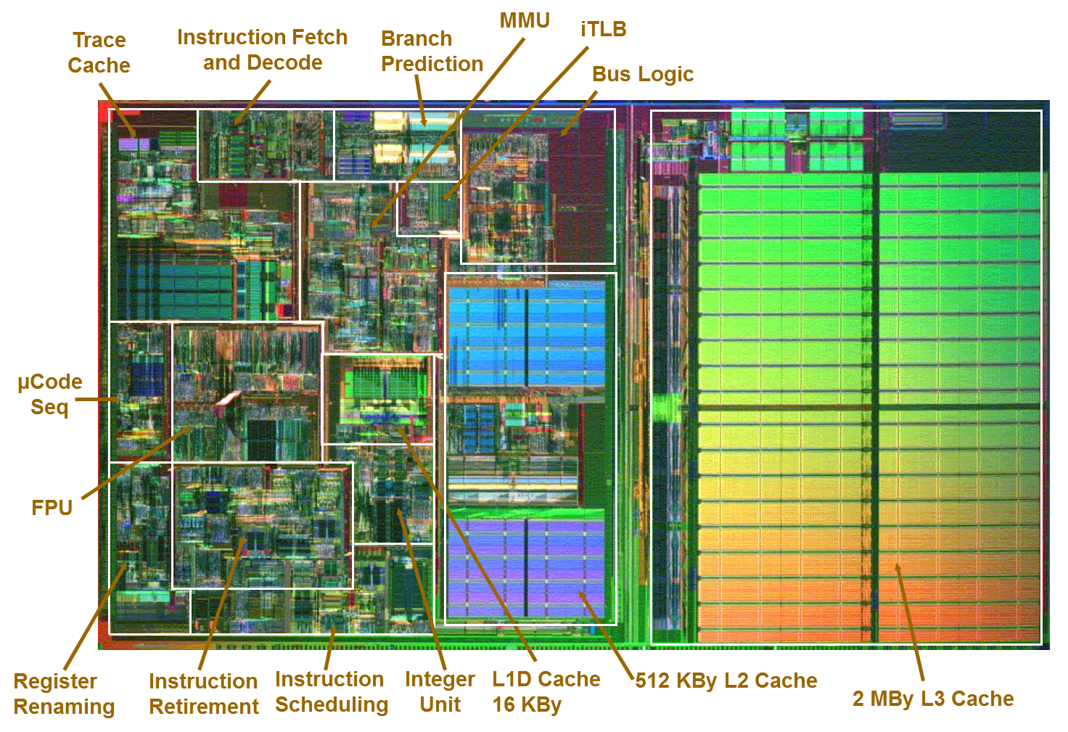
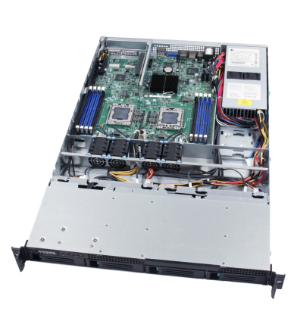
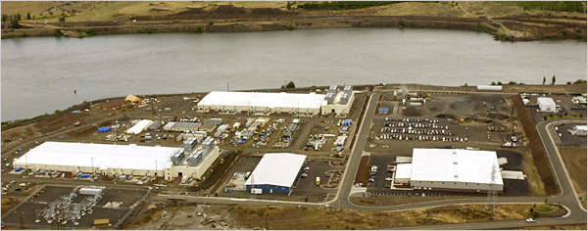
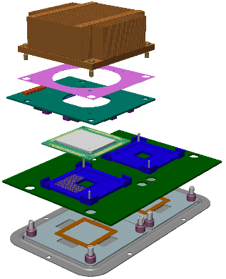
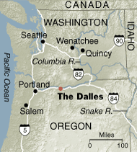
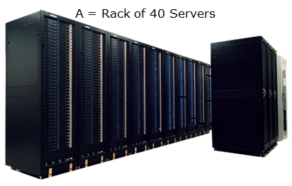
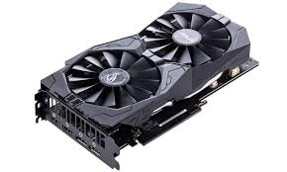
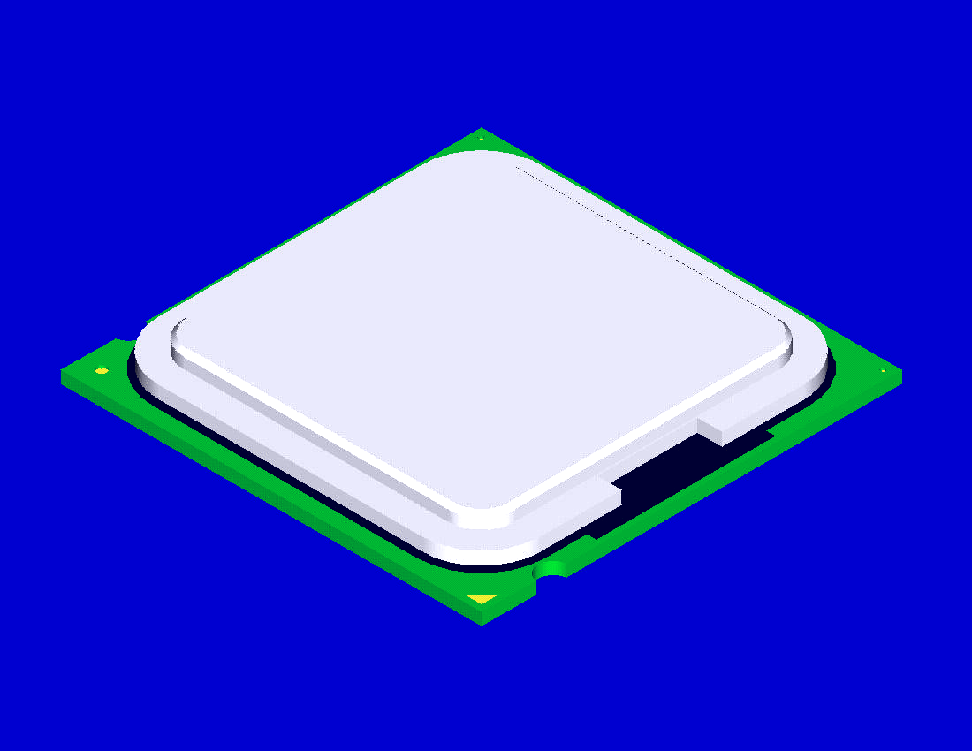
Technology
Silicon
Packaging; Platform; Server with GPUs
Data Center and Cloud computing
Source – NY Times, 06.14.2006

Slide 12
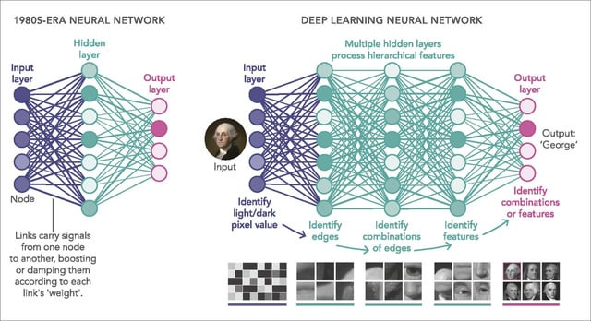

Slide 13
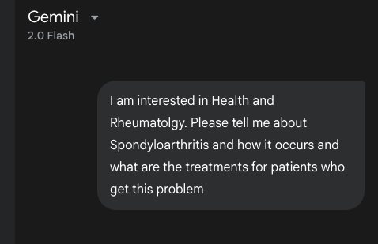
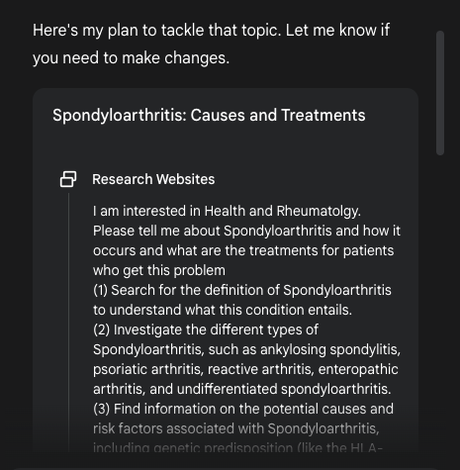
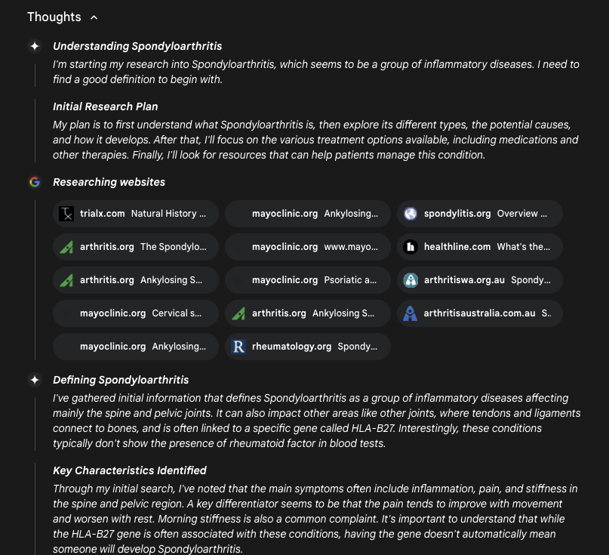
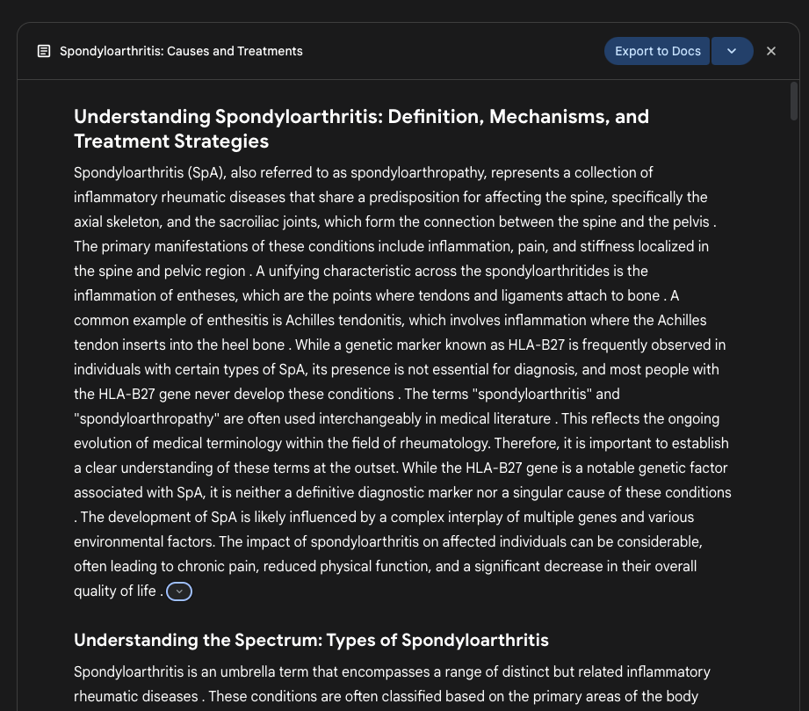
2025
Takeaway:
We know how to recognize the patterns. We are doing this with computers.
They are extremely good at dealing with high dimensional data.
Remember Correlation is not Causation!
The big question: Can we abstract and reason with these tools?

Slide 14
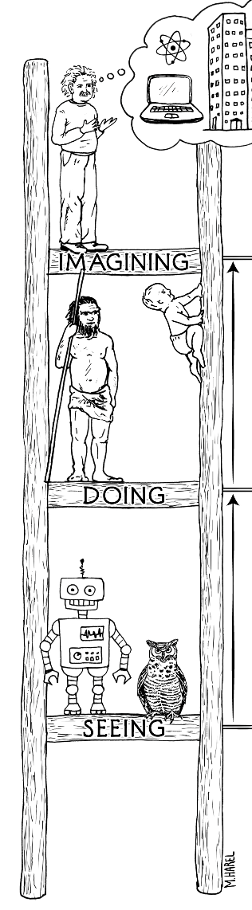
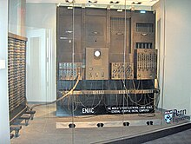
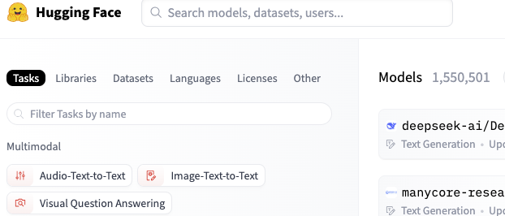
REASONING , LOGICAL DEDUCTION
Symbolic Processing
Can Humans think of more than 3 D?
It is easy for computers to imagine say 10 or 100+ Dimensions!
1945
1950
GENERALISING the OBSERVED DATA
i.e. PERCEIVE and LEARN from the DATA
Sub symbolic Processing: Statistical processing and learning
Large Language Models
(LLMs, LLVMs, LLMMs)
Learn from large amount of data through Attention networks; Answer & Prediction through Transformers

Slide 15
How will AI influence Health & Medicine?
How can you influence it?

Slide 16
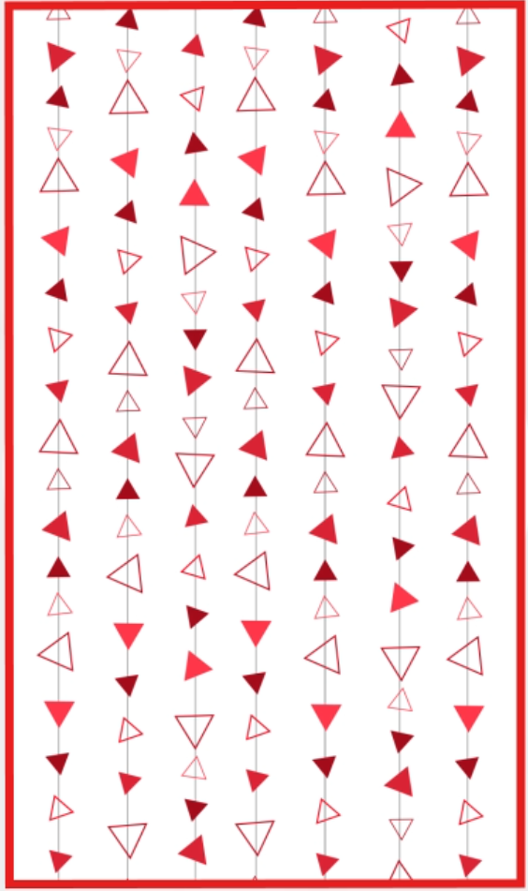
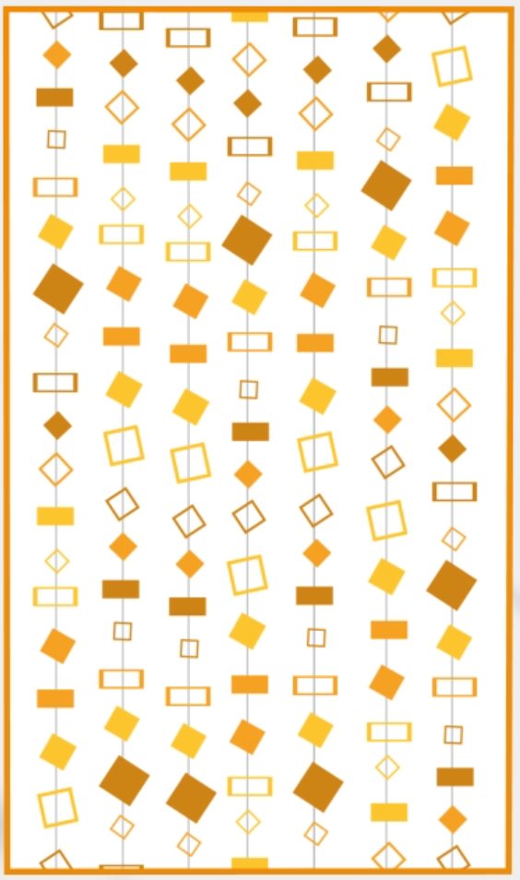
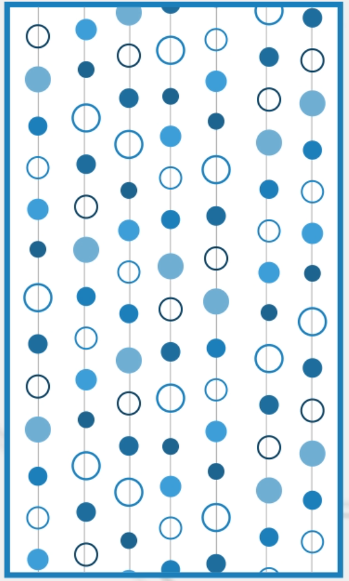
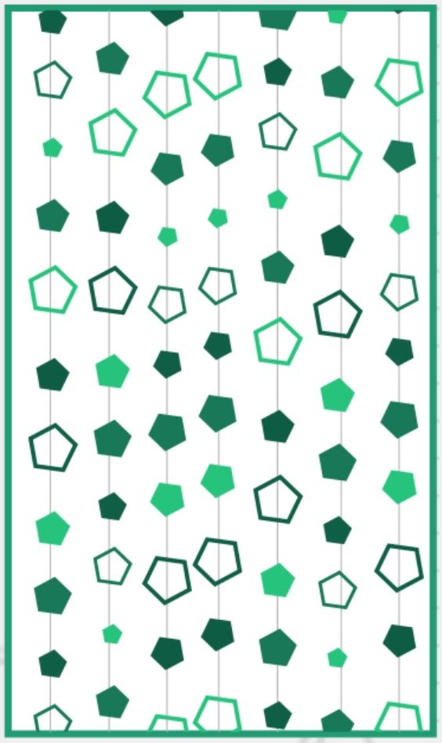



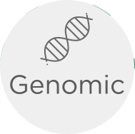

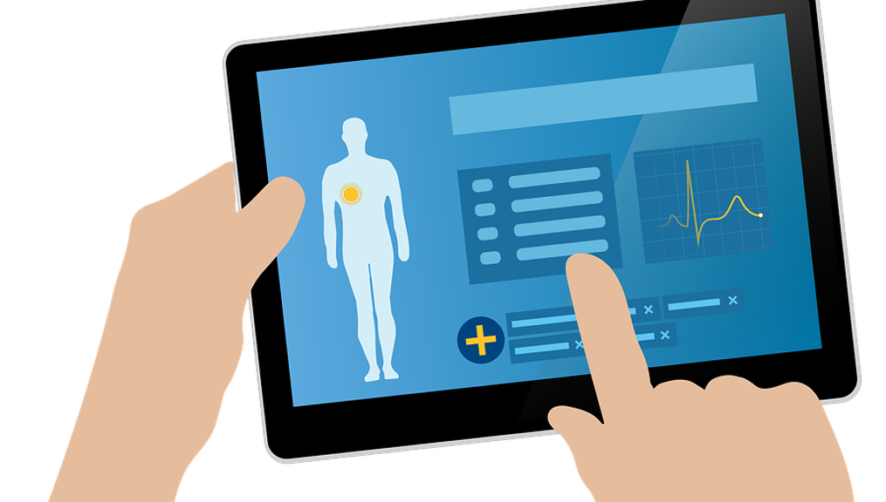

Issue
MBs-1GB
MBs-10GB
MBs-100GB
MBs-10TB
Medical Data is Big, Siloed, Disparate & Growing
Big Data Producers
Projection
Exabytes (1 EB = 1M TB)
*Stephens ZD, Lee SY, Faghri F, et al. Big Data: Astronomical or Genomical?. PLoS Biol. 2015;13(7):e1002195.
Notes:
The issue is that medical data is # BIG # Disparate # Siloed # and growing #
The medical data industry needed innovation to be able to #
Efficiently store,# Quickly query# and analyze very large amounts of disparate data. #

Slide 17
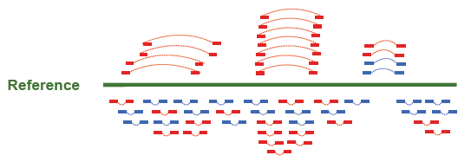
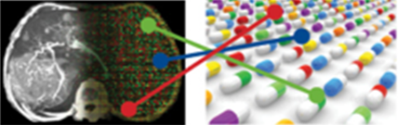
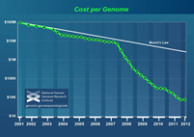
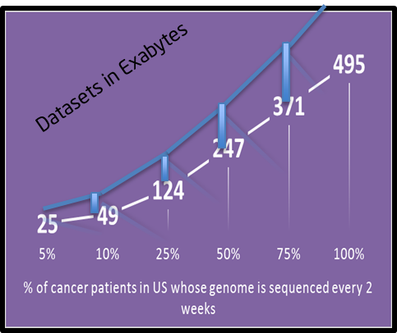

“All in a Day” [2013-16]: Collaboration
1
2
3
4
PRIMARY ANALYSIS
SECONDARY ANALYSIS, DNA/RNA PIPELINE + MORE
PRECISION MEDICINE
HC
Multiple sample compute starts here
Predicted Actionable Variants
Data Driven Association
HC
HC
Variant
store
HC
HC
Joint
genotyping
HC
HC
Pop/Dis
study
Clinically Actionable Variants
Individual
Multiple individual
HC
Clinical trial groups
Data curation
Knowledge Database
HC
HC
Illumina
Broad Collaboration
UCLA , ISTC/MIT
OHSU : Collaboration in an Immersive Environment
1-4 days under a day
Week 1 day
Weeks Under a Week
Months & in research
$1000 to $100
$100-$500: Compute and storage for 10+ years
Notes:
TCO- Total Cost of Operation

Slide 18



: Prior to 2019, What Problems Were They Trying To Solve?
1. Collaboration on genomic medicine, across our network,
was virtually non-existent.
Providence has facilities in seven states spanning four time zones.
Centralized Molecular Genomics Laboratory in Portland since 2013.
2. Data for genomic medicine was siloed.
Clinical decision support was wanting.
3. Finding and reviewing relevant patient data,
in the proper context, was challenging.
Clinical history, imaging, pathology, genomics, and clinical trials
data were in different locations.
EMR
Radiology
Pathology
Genomics

Slide 19

Multimodal Data Aggregation: What Is It?
Definition:
Multimodal data aggregation combines multiple types, or modes, of data to create complimentary views of information to describe a phenomenon
(e.g., a patient with cancer).
Multimodal data may be in modes that span different contexts and file formats (e.g., text, imaging, histopathology, clinical pathology, and genomics).
Adapted from Boehm, K.M., Khosravi, P., Vanguri, R. et al. Harnessing multimodal data integration to advance precision oncology. Nat Rev Cancer 22, 114–126 (2022). https://doi.org/10.1038/s41568-021-00408-3

Slide 20


Slide 21

Clinical Impact: Did Multimodal Data Aggregation Address Our Initial Problems?
Short answer.. Yes!
Relevant siloed data was integrated
Patient data is displayed in a logical way which facilitates clinical decision support in the context of a molecular tumor board.
It was a collaborative effort – Data Science/ML folks collaborating with Clinicians!!!
Clinical

Slide 22
Where will we be with AI in the future?

Slide 23
Causal Artificial Intelligence
Causality addresses cause and effect using a new branch of Calculus.
Establishes “Causality” as a New AI Discipline
Turing Prize 2011 (“Noble Prize of Computer Science”)
23
Notes:
We want systems that have the "Ability to abstract" what is learnt and perceived and
then "reason causally" with the information. It is Causal AI – addressing cause and effect.
This is the holy grail of Turning machine – the imitation game! Some of you would have watched the movie!
This has been pioneered by Judea Peral. He was awarded the Turing Prize in 2011- 100th anniversary of Alan Turing’s Birth. I attended the award ceremony and the dinner party.
This is what we do at ODA – Causal AI. I will be sharing the details and how it works in Precision Medicine in the upcoming slides.

Slide 24


Causality
Age
Exercise
Cholesterol
Unsegregated data: Cholesterol increases by Exercise
Causal diagram (Directed Acyclic Graph - DAG Model) reflected on data would aid the decision
Segregated data by age (confounder) : Cholesterol decreases by Exercise
Judea Pearl : Causal inference in statistics,
AI & DATA SCIENCE
+
DOMAIN EXPERTISE
=
CAUSAL AI
Notes:
Let us delve into Causal AI and its mathematical basis.
On the left is data - simply correlated. The conclusions are misleading i.e. Cholesterol increases by exercise!
We need the model in the middle to make sense. Model convey information that is expressed in the language of DAG- Directed Acyclic Graph. Here Age is a confounder - lurking variable of Cholesterol and Exercise.
Mixing model and data, we get the right results shown at the right. This is Causal AI at the basic level. This is abstracted and you can reason with this. We use all of these for Precision Medicine and will show you later in this presentation.
By the way, If model does not exist, we have techniques to create one using principles of “Occam’s razor”
The process of creating Causal DAG model helps with representation learning – reusable and transportable to other domains.
We can reason with this abstraction, and a form of “Artificial Intelligence” that involves thinking.

Slide 25


Climbing the Ladder : CausalAI
REASONING , LOGICAL DEDUCTION
Symbolic Processing
Large Language Models
(LLMs, LLVMs, LLMMs)
Learn from large amount of data through Attention networks; Answer & Prediction through Transformers

Slide 26

Technology-AI-DOMAIN Expertise
Mutlicore Parts
Data
SCIENCE
&
TECHNOLOGY
What is
next?
Transition to Multicore Era
Medical
&
HEALTH
DOMAIN
EXPERTISE
1950
Pre 90’s
Power Constrained Era
Prior Wave
Rigidly pre programmed
Curr Wave
Statistical
Learning

Slide 27








Evolution of AI
Next Wave
Contextual
Adaptation
Perceive
Abstract
Ability to reason causally.
Systems construct contextual explanatory models for classes of real-world phenomena
DOMAIN
EXPERTISE
DATA
learn
Reason
Curr Wave
Statistical
Learning
Engineers create statistical models for specific problem domains and train them on big data.
No Contextual and reasoning ability
The structure of the knowledge is defined by humans. The specifics are explored by the machine.
NOT SCALABLE
Prior Wave
Handcrafted
Knowledge
CARDIOLOGY
RISK ESTIMATOR
CARDIOLOGY
RISK ESTIMATOR
Risk estimator: http://tools.acc.org/ASCVD-Risk-Estimator-Plus/#!/calculate/estimate/

Slide 28
Would AI be answer to all? No.
How can you influence AI?

Slide 29

Clinical Decision Making
is Entirely Dependent on
Data Aggregation, Analysis and Causal Interpretation

Slide 30





Causality
Causal Analysis,
Counterfactual Analysis, Intervention Questions
Aggregation and harmonization.
Real-World Evidence through multimodal cohorts.
CLINICAL & MEDICAL
DOMAIN EXPERTISE
AI & DATA SCIENCE
+
=
CAUSAL AI
Notes:
Let us delve into Causal AI and its mathematical basis.
On the left is data - simply correlated. The conclusions are misleading i.e. Cholesterol increases by exercise!
We need the model in the middle to make sense. Model convey information that is expressed in the language of DAG- Directed Acyclic Graph. Here Age is a confounder - lurking variable of Cholesterol and Exercise.
Mixing model and data, we get the right results shown at the right. This is Causal AI at the basic level. This is abstracted and you can reason with this. We use all of these for Precision Medicine and will show you later in this presentation.
By the way, If model does not exist, we have techniques to create one using principles of “Occam’s razor”
The process of creating Causal DAG model helps with representation learning – reusable and transportable to other domains.
We can reason with this abstraction, and a form of “Artificial Intelligence” that involves thinking.

Slide 31











Call to Action: Collaborate
MyPatient360-ObGyn
MyPatient360-Breast
MyPatient360-Lung
MyPatient360-Ovarian
MyPatient360-Cardiology
MyPatient360-Neurology
Notes:
Here are the various apps we are focused in the clinical area.
We are working with Providence on the Virtual Molecular Board, and it is in Clinical use. The future enhancements are going deeper into each specialty.
We are working with UCSF on pre-term pregnancy and ODA framework powers the HOPE consortium along with 3D visualization.
The cardiology use case is being developed and we foresee the market developing for other diseases where multiple specialties, subject matter experts need to come together for better patient management and outcome. This is the principle behind MyPatient360.

Slide 32



Thank you
SRINIVASA RAMANUJAN
1887-1920
ganapati.srinivasa@gmail.com

