Slide 1
Beyond Bisphosphonates
Eric Orwoll
Professor of Medicine
Oregon Health & Science University

Slide 2
Disclosures
Consulting:
Amgen, Angitia, Biocon, Radius, Ultragenyx

Slide 3
Osteoporosis drugs
Antiresorptives
Bisphosphonates (alendronate, risedronate, ibandronate, zoledronate)
Denosumab
Anabolics*
Teriparatide
Abaloparatide
Romosozumab
* Anabolics are used for 1-2 years, followed by an antiresorptive
Newer strategies for optimally utilizing these options

Slide 4
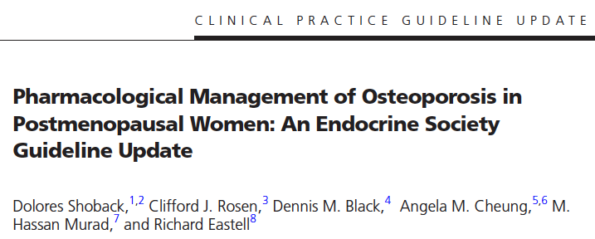
Update JCEM March 2020
Essential points
Treat high risk individuals - particularly those with previous fracture.
Consider bisphosphonates as the first line therapeutic choice for postmenopausal women at high risk of fracture.
Reassess fracture risk after patient has been on bisphosphonates for 3-5 years.
Following reassessment, prescribe a “bisphosphonate holiday” for women who are on bisphosphonates and are low-to-moderate risk of fracture.
In postmenopausal women with osteoporosis who are at high risk for osteoporotic fractures, we recommend using denosumab as an alternative initial treatment.
administration of denosumab should not be delayed or stopped without subsequent antiresorptive

Slide 5
Update JCEM March 2020
Essential points
Consider anabolic therapy (teriparatide or abaloparatide) for women at very high risk of fractures, such as those with severe or multiple vertebral fractures.
In postmenopausal women with osteoporosis at very high risk of fracture, such as those with severe osteoporosis (i.e., low T-score < −2.5 and fractures) or multiple vertebral fractures, we recommend romosozumab.
Anabolic therapies should be followed by an antiresorptive.
All women undergoing treatment with osteoporosis therapies other than anabolic therapy should consume calcium and vitamin D in their diet or via supplements.
Monitor the BMD of high-risk individuals with a low BMD every 1 to 3 years.

Slide 6
Choosing initial osteoporosis therapy – make treatment decisions based on fracture risk
alendronate
risedronate
zoledronate
denosumab
abaloparatide
romosozumab
teriparatide
Fracture risk
Moderate High
Low BMD Low BMD
Healthy Risk factors
Hx fracture
Very High
Very low BMD (T score <-3.0)
Very high FRAX score
>30% MOF
>4.5% hip
Recent fracture
Multiple or severe vertebral fx
Fx on therapy
McClung MR et al. Menopause 2021:28:973-97

Slide 7
Initial therapy with osteoanabolic drug provides a more rapid and robust response
Key Points:
Osteoanabolic drugs increase BMD more and more quickly than do anti-remodeling drugs
Teriparatide and romosozumab reduce fracture risk more effectively than do bisphosphonates
The fracture risk reduction achieved with osteoanabolic therapy persists for at least 2 years after transition to an anti-remodeling drug
Lumbar spine BMD
Romozosumab
Mean Percentage Change from Baseline
Teriparatide
Denosumab
Alendronate
Months

Slide 8
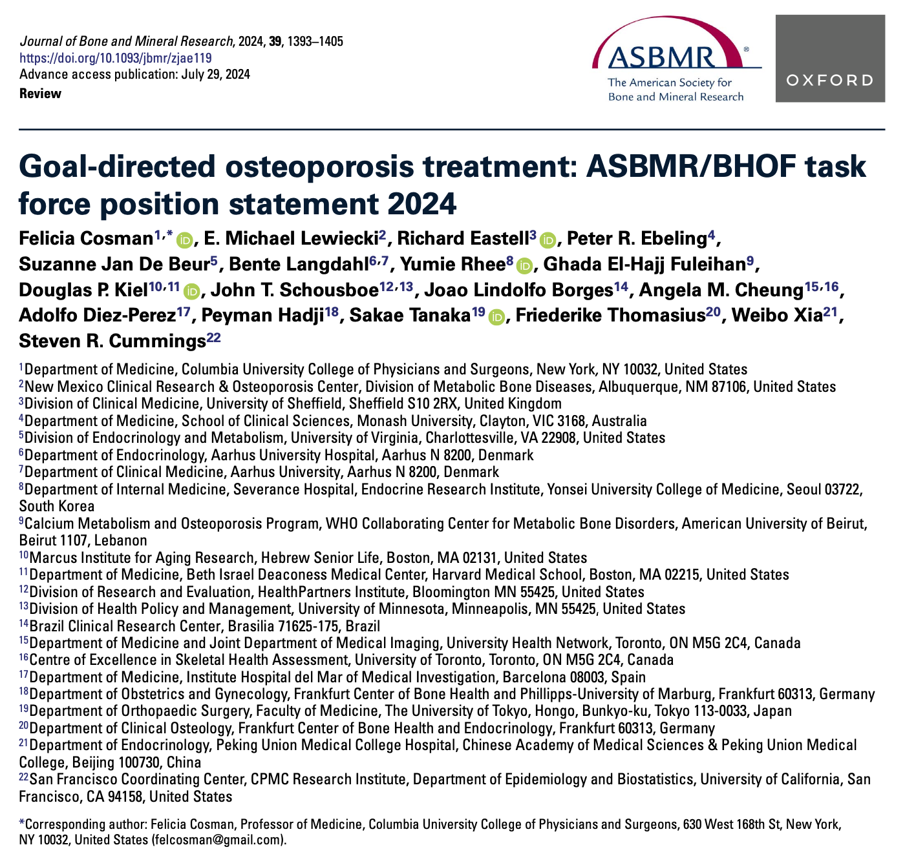

Slide 9
Goal-directed osteoporosis treatment: ASBMR/BHOF task force position statement 2024
Recent guidelines have included a new very high fracture risk category, and a subset are at imminent risk of fracture for 2 yr following an incident fracture or after multiple prior fractures.
Since the last task force report in 2017, there has been the emergence of new medical evidence and development of new therapeutic agents
Two new osteoanabolic agents, abaloparatide and romosozumab, have been approved, and head-to-head studies in high or very high-risk patients demonstrate that osteoanabolic agents are more effective in preventing osteoporotic fractures than bisphosphonates and denosumab.
FNIH/SABRE showed a strong relationship between BMD increases with treatment and the magnitude of anti-fracture efficacy – particularly increase in total hip and femoral neck BMD

Slide 10
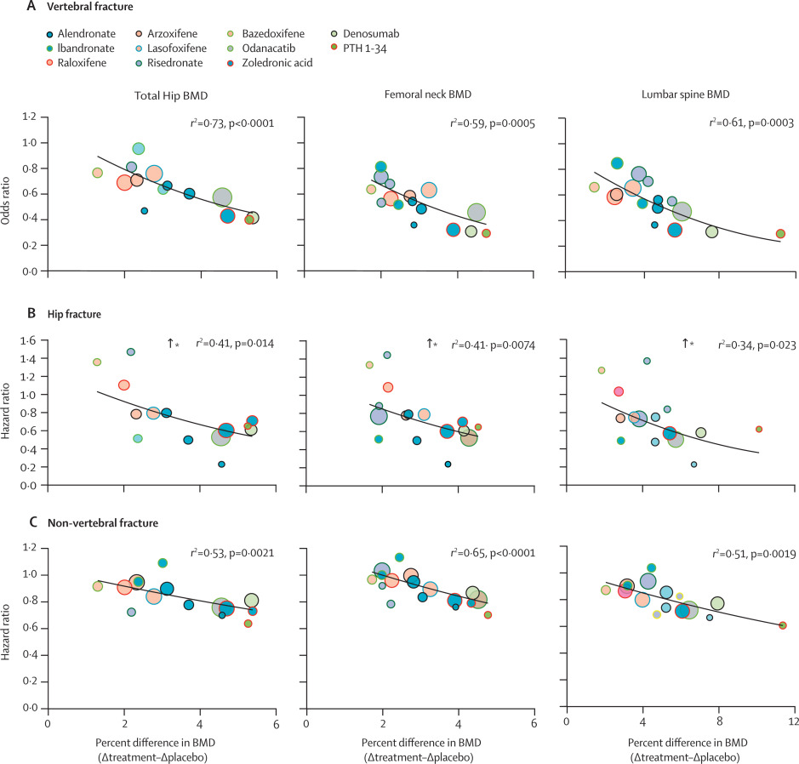
Treatment-related changes in bone mineral density as a surrogate biomarker for fracture risk reduction (SABRE)
- Vertebral Fx
Total hip BMD
Fem neck BMD
Spine BMD
Black et al.
Lancet Diabetes and Endocrinology
2020
91,779 patients from 23 randomized, placebo-controlled trials
- Hip Fx
- Non-vertebral Fx
% difference in BMD
treatment vs placebo
% difference in BMD
treatment vs placebo
% difference in BMD
treatment vs placebo

Slide 11
Treatment goals 1. Patients at imminent risk of fracture 2. Other patients at increased risk of fracture (with T scores < -2.5)

Slide 12
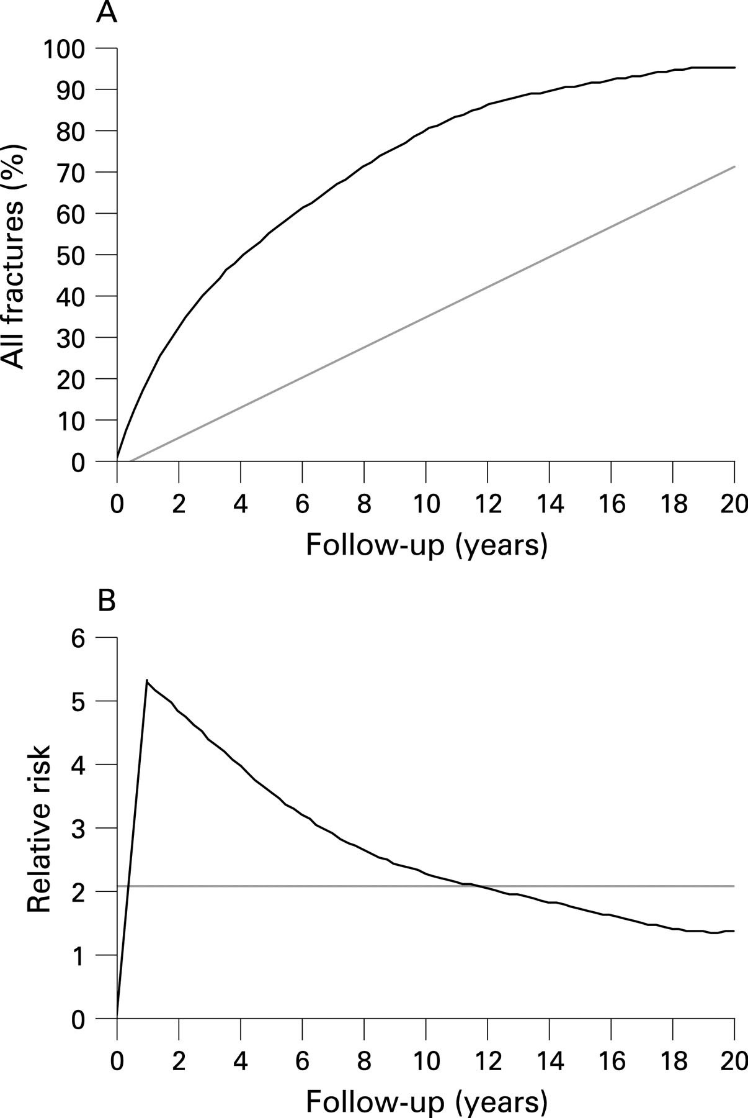
Clinical fractures cluster in time
After an osteoporotic fracture there is a period of heightened risk of additional fractures
Relative risk of all subsequent fractures calculated as a mean from the first fracture (grey line) and per separate year of follow-up (black line)
Van Geel et al. Annals of the Rheumatic Diseases 2009

Slide 13
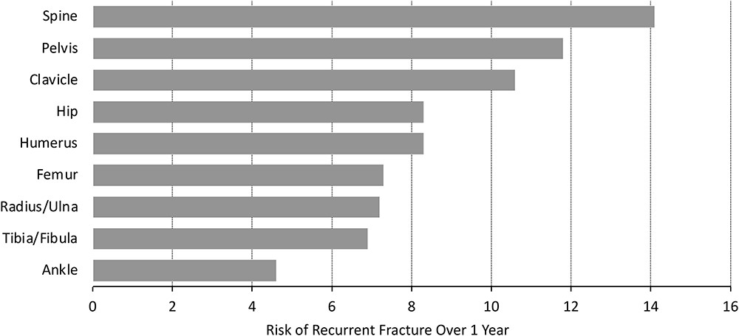
Risk of subsequent fracture after prior fracture among older women
One-year risk of recurrent fracture in women > 65 years of age, based on site of initial fracture, from Medicare database of 377,561 women with first fracture
Average risk of subsequent fracture was 10% in the very next year and 18% in the 2 yr following the first fracture.
Balasubramanian et al. Osteoporosis Int 2018

Slide 14
1. Patients at imminent risk of fracture
Patients with recent fracture
Patients with multiple previous fractures
Goal: to maximally increase BMD as quickly as possible. First choice - an anabolic agent.

Slide 15
2. Other patients at increased risk of fracture (with T scores < -2.5)
Target goal - achieve a lower risk BMD

Slide 16
Using BMD to set and monitor treatment goals
Use total hip BMD to set and monitor treatment goals
Total hip is the best BMD measurement site
Most precise
Increases in hip BMD are strongly associated with fracture reduction
BMD T score > -2.5 should be the minimum goal
In patients with other risk factors for fracture the T score goal may be higher (e.g. -2.0 or -1.5)
Higher age
Previous fracture
Fall risk
Diabetes, glucocorticoids
If TH is > -2.5 but LS or FN is below, use those sites to set goals and monitor progress

Slide 17
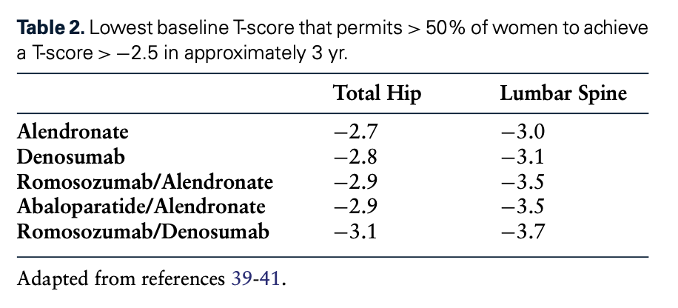
Selecting initial treatment in order to achieve target BMD within 3 years
In patients with TH T-score−2.5 to−2.8 and LS T-score−2.5 to−3.0:
Bisphosphonates, denosumab, anabolics all likely to achieve goal in >50%
Individual patient factors and local/regional guidance should be considered
Previous fracture or other risks may prompt more aggressive therapy to increase speed or likelihood of achieving goal
In patients with very low BMD (TH T-scores <−2.8 or LS T-scores <−3.0):
Anabolic agent more likely to succeed

Slide 18
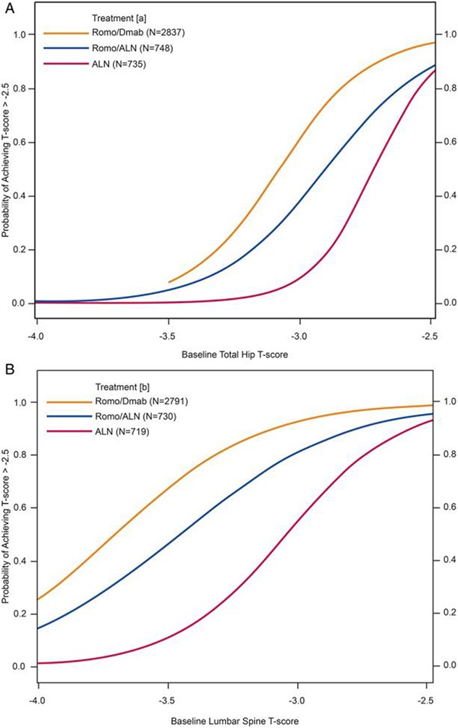
Selecting initial treatment to achieve target BMD within 3 years
Probability of attaining T-score above −2.5 for Total Hip (A) and Lumbar Spine (B) over 3 yr during treatment with romo/demab, romo/alendronate or alendronate
Baseline total hip T-score
Baseline lumbar spine T-score

Slide 19
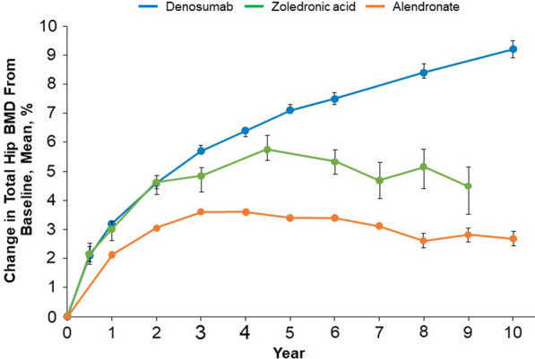
Effects of antiresorptive osteoporosis treatments on hip BMD
Data derived from long-term follow-up studies of the FLEX trial (alendronate, 5–10 mg peroral per day), the HORIZON trial (zoledronic acid, 5 mg intravenous infusion per year), and the FREEDOM trial (denosumab, 60 mg subcutaneous injection every 6 months)
Denosumab
Zoledronate
Alendronate
As data are derived from separate studies, formal comparisons between changes in BMD have not been made. Error bars indicate 95% confidence intervals.
Kendler et al.
Adv Ther 2021

Slide 20
When treatment targets have not been met
If BMD goal is not met – options:
On bisphosphonate → switch to denosumab or anabolic
On denosumab - continue
After 1 course of anabolic + antiresorptive → another course of an anabolic?
Fracture on therapy
May not mean treatment failure but probably indicates higher future fracture risk
Reconsider risk factors, optimize non-pharm approaches, consider more aggressive therapies
Anabolic, or another course of an anabolic

Slide 21
When treatment targets have been achieved
Bisphosphonates → holiday, followed by intermittent zol or low dose oral bisphosphonate
Denosumab – intensive bisphosphonates, then intermittent zol or low dose oral bisphosphonate
Anabolic/bisphosphonate – intermittent zol or low dose oral bisphosphonate
Anabolic/denosumab – intensive zol followed by intermittent zol or low dose oral bisphosphonate

Slide 22
Initial and subsequent therapy - example
For patients at very high risk of fracture
Very high
An anabolic followed by denosumab to achieve goal
Followed by 2-3 years of zoledronate and then intermittent therapy
High
Anabolic
Fracture risk
Denosumab
Moderate
Zoledronate
No therapy
Modest
65 70 75 80 85 90
Age (yrs)
M McClung

Slide 23
Major conclusions
Rapid fracture risk reduction should be the predominant treatment goal for patients at very high and imminent risk of fracture.
Initial treatment decisions and specific BMD targets should be tailored to each patient’s clinical risk profile and BMD.
Use BMD goals to guide clinical decisions for initiating and continuing treatment.

