Slide 1
Drug Development in Rheumatology
2025 Northwest Rheumatism Society Meeting
Andreas Reiff, MD
Chief Medical Officer, Neutrolis

Slide 2
The Challenges with Rheumatology Clinical Trials
Immunology drugs represent a significant portion of global medicine sales (valued at $127 billion in 2021) and had the highest historic growth rate of all large therapy areas, with a five-year compound annual growth rate (CAGR) of 16%
Currently ~ 4,100 trials in autoimmune diseases (AIDs)
Annual funds raised in the Biotech sector in 2023 hit the lowest mark in four years, at a projected $24 billion across 840 transactions* compared to $38.1 billion in 2020, $53.9 billion in 2021 and $36.9 billion for 2022
Despite the growing partnerships and networks between rheumatologists, the public sector, and the healthcare industry to optimize research funding allocations, industry-sponsored research funding in Rheumatology has decreased by more than 20% from 2014 to 2022**
Recruitment challenges:
Academic burn out
Trial fatigue
Trials lack ethnic diversity and often do not address the patient populations with the highest unmet medical need (AA, Hispanic, Asian)
* PitchBook 2023
** The Journal of Rheumatology August 2023, jrheum.2023-0417

Slide 3
What We Will NOT Talk about Today
G-Protein Coupled Receptor (GPCR) Antagonists (OSE-230 et al.)
RIP Kinase (RIPK1/2) Inhibitors (SAR443122 et al.)
PIM Kinase Inhibitors (KIC-0101, AZD1208 et al.)
Neonatal IgG Fc receptor (FcRn) antagonists (Efgartigimod et al.)
Sphingosine-1 Phosphate Receptor Modulators (Ozanimod et al.)
Protein tyrosine phosphatases (PTPs) antagonists (Daxdilimab, Litifilimab et al.)
IRAK-4 Inhibitors (Edecesertib et al.)

Slide 4
Cellular Therapies

Slide 5
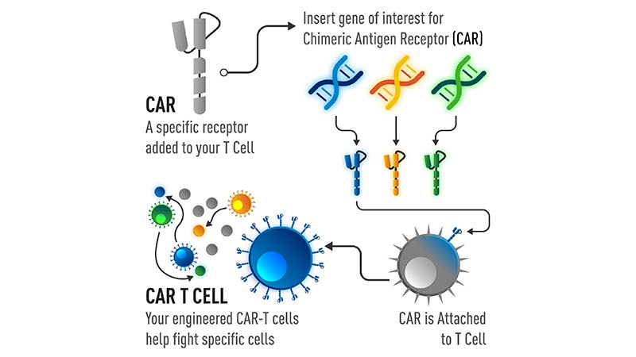
CAR T cell therapy for refractory AID
J Leukoc Biol. 100(6):1255-1264
twitter.com/Lupusreference

Slide 6
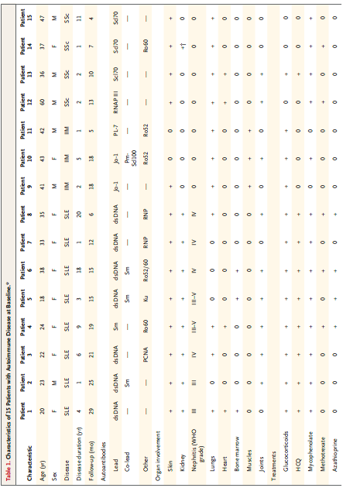
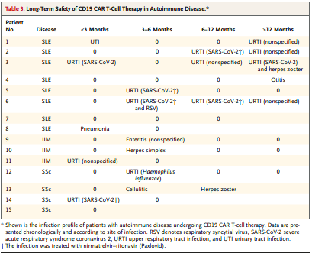
CAR T cell therapy for refractory AID
Median follow-up: 15 months (range, 4 to 29)
Median SLEDAI score 13
Mean (±SD) duration of B-cell aplasia was 112±47 days
All SLE patients achieved DORIS remission
All IIM patients had a major ACR–EULAR clinical response
All SSc patients had a decrease in the score on the EUSTAR activity index
Immunosuppressive therapy was completely stopped in all patients
Grade 1 CRS occurred in 10 patients
One patient each had grade 2 CRS, grade 1 ICANS, and pneumonia that resulted in hospitalization
N Engl JMed 390;8 nejm.org February 22, 2024

Slide 7
CAR T cell Therapies
Drug Candidates | Indications | Manufacturer | Development Status
CD19 | AA, AAV, AIH, IIM, ITP, IgG4RD, MS, MG, Nephritis, NMSO, SLE, LN, pSLE, SSc, SS | Multiple Universities and Medical Centers in China, Germany, David Porter, University of Pennsylvania Autolus, Cabaletta Bio, Juno Therapeutics, Kyverna, Miltenyi, Novartis, PersonGen BioTherapeutics (Suzhou) Co., Sana Biotechnology | Phases I-II
CD19/CD20 | SLE | ImPACT Bio | Phase I-II
CD19/BCMA | AAV, AIH, IIM, ITP, IgG4RD, MS, MG, Nephritis, NMSO, SLE | Zhejiang University, China | Phases I-II
BCMA* | MG | Cartesian Therapeutics | Phase II
CD7 | CD, UC, DMS Stills, | Shanghai University, China | Phases I
BAFF | SLE, DMS, SSc, NMSO | Luminary Therapeutics, Multiple Universities in China | Phases I
DSG3-CAART MuSK-CAART | Pemphigus, MG | Cabaletta Bio | Phases I
In total:
>40 studies in SLE/LN/pSLE
11 studies in IIM
9 studies in SSc
* B-cell maturation antigen, also known as tumor necrosis factor receptor superfamily member 17
9 studies in AAV
6 studies in Sjogren's
5 studies in MG

Slide 8
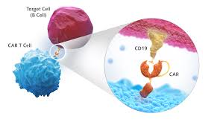
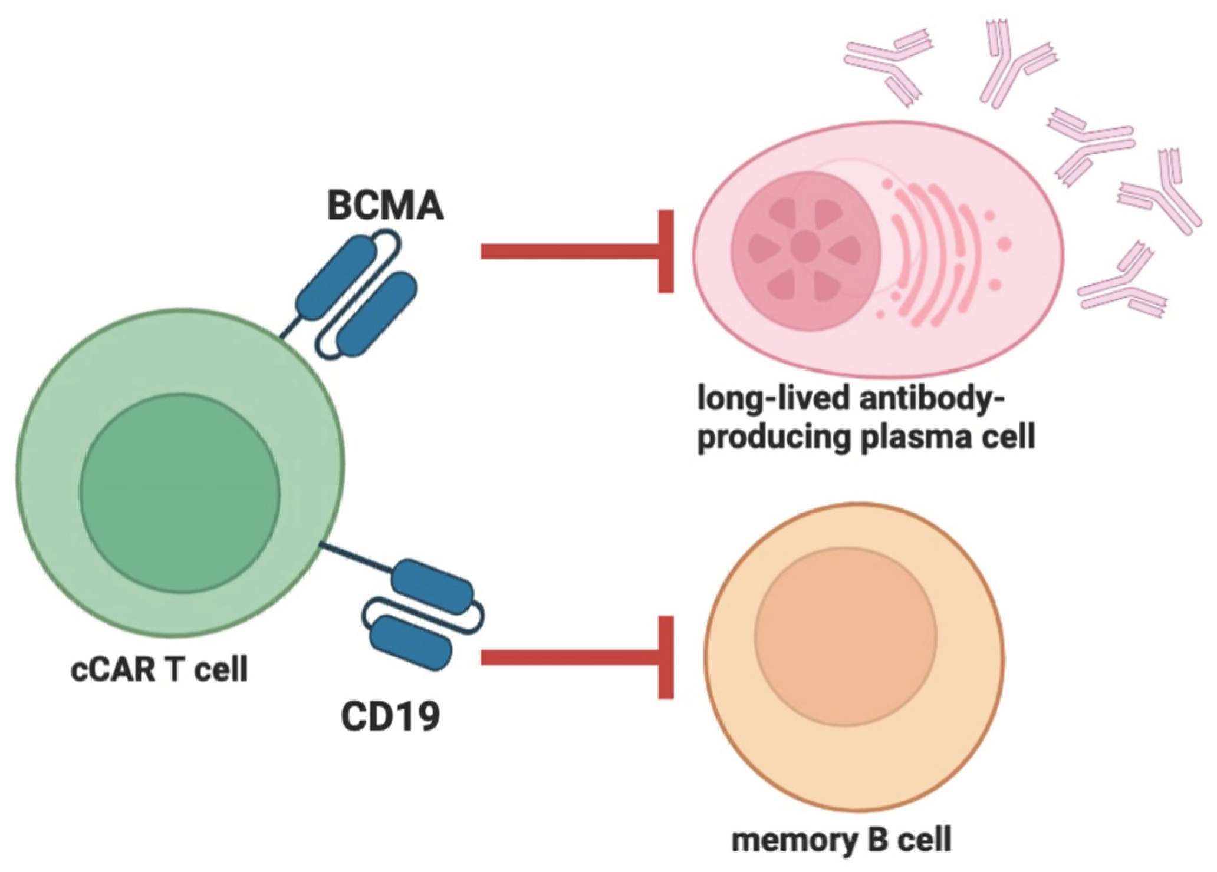
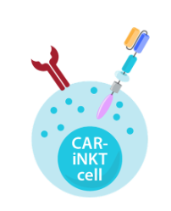
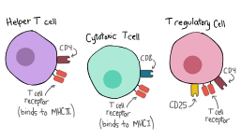
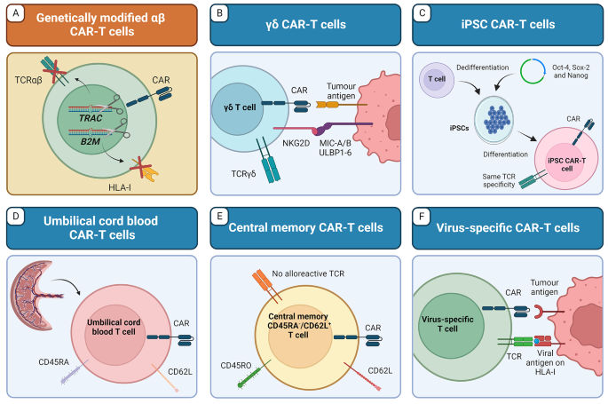
The Future of CAR T cell therapy for refractory AID
https://www.bmsscience.com
CART cell type
Bispecific CAR T
Autologous
Require Apheresis
Delay in treatment
Allogeneic
No apheresis required
Off the shelf
Readily available
No treatment delay
Cheaper
Cells 2023, 12(11), 1534
T cell source
https://www.arovella.com
https://www.khanacademy.org/science
iNK CART
Minimal expansion
Requires more frequent administration
Lesser risk of CRS and ICANS
Might not require repeat conditioning
Traditional CART
Rapid expansion
Risk of CRS/ICANS
Experimental Hematology & Oncology volume 12, Article number: 73 (2023)

Slide 9
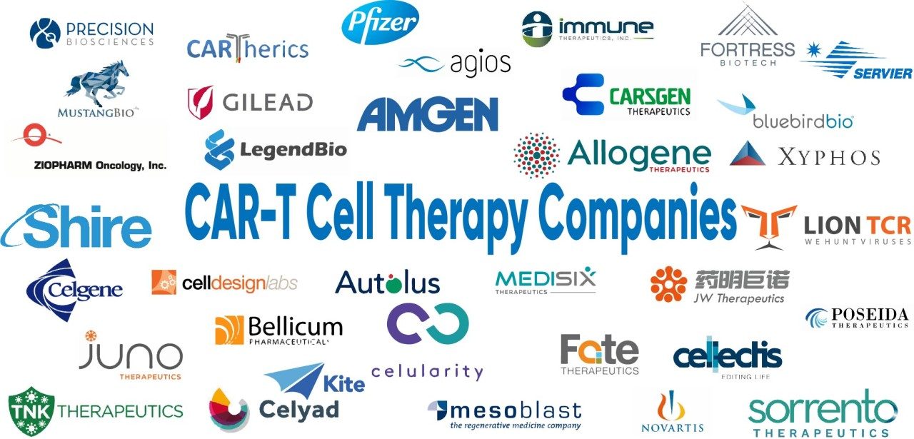
Cellular therapies for refractory AID - Summary
Highly competitive space
Many companies originate from Oncology and lack experience in AID
Large Pharma entering this space will acquire or outspend Biotech
24+ CART companies currently competing for few diseases (SLE, SSc, IIM, SS)
Allogeneic products may prevail if they show efficacy and safety
Alternatives to traditional CARTs including Treg therapies, iNKs, CAR INKs or Type 1 regulatory T cells will impact this landscape and increase competition

Slide 10
B-Cell Targeting Therapies

Slide 11
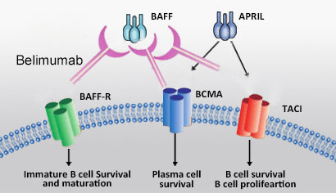
Interference with B-cell survival
BlyS (also called B cell activating factor, BAFF)
B-cell survival factor
Inhibits B cell apoptosis
Favors B-cell proliferation and maturation
Mediates antibody production and IgG class switching
APRIL
Binds to TACI and BCMA
Mediates effects that are similar to those of BLyS
Mediates Plasma cell survival
BLyS and APRIL are produced by monocytes, macrophages, dendritic cells, neutrophils, activated T cells, some B cells and non-hematopoietic cells
biomedicalresearch.29-18-841

Slide 12
Interference with B-Cell Survival
Belimumab (anti-BLyS antibody)
Well established in the SLE market despite initial rather disappointing performance in clinical trials. Since approval in 2011, sales increased to ~ 1.6B USD in 2023
Blisibimod (anti-BLyS antibody)
Failed in several SLE, LN trials, but was associated with successful steroid reduction, decreased proteinuria and biomarker responses
Also failed in trials in ANCA-Associated Small Vessel Vasculitis, ITP and IgAN
Tabalumab (anti-BLyS antibody)
Failed in several trials in SLE, RA and MS
Ianalumab (anti-BLyS receptor antibody)
Ianalumab is administered subcutaneously once a month
Currently investigated in several Phase II/III trials for RA, SS, SLE/LN, Cytopenias, and Pemphigus
Sibeprenlimab and BION-1301 (anti-APRIL antibodies)
Currently investigated in 2 Phase II/III trials for IgAN

Slide 13
Dual BLyS-April Inhibition The next generation of interfering with B cell survival
Drug Candidates | Indications | Manufacturer | Development Status
Atacicept | SLE, RA, MS, IgAN, Optic Neuritis | Merck/Vera Therapeutics | All studies terminated due to lack of efficacy or toxicity except 1 Phase III study recruiting in IgAN
Telitacicept | SLE, LN, pSLE, SS, RA, IgAN, MS, MG AAV (RTX combo), APS, Thrombocytopenia, Steroid Dependent Nephrotic Syndrome, | RemeGen | Conditional marketing approval by the Chinese National Medical Products Administration (NMPA) for adult SLE in March 2021 Fast track designation by the FDA for adult SLE in April 2020 All indications in Phase II-III
Povetacicept | ANCA pos. vasculitis, IgAN, LN, Membranous Nephropathy, Cold Agglutinin Disease, ITP, immune Thrombocytopenia, warm autoimmune hemolytic anemia | Alpine Sciences (Vertex Pharmaceuticals) | Currently recruiting into 2 Phase I/II basket studies

Slide 14
B-cell Depleting Therapies - T cell engagers
T-cell engagers have shown promising results in the treatment of a variety of hematological malignancies and solid tumors
These drugs work by recruiting and activating T-cells to recognize and attack cancer or autoimmune cells by bringing them into close proximity, leading to T-cell activation and the release of cytokines and cytotoxic molecules that kill the target cell
T-cell engagers can cause side effects like cytokine release syndrome and neurotoxicity
Cancers (Basel). 2023 May; 15(10): 2824.

Slide 15
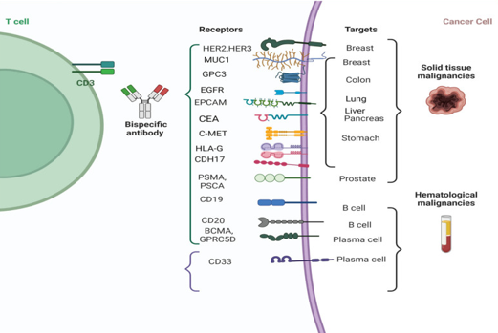
T cell engagers in Cancer Therapy
Blinatumomab
Glofitamab
Mosunetuzumab
Solitomab
Talquetamab
Tarlatamab
Tebentafusp
Targets in AID
Cancers (Basel). 2023 May; 15(10): 2824

Slide 16
T cell engagers in Autoimmunity
Drug Candidates | Indications | Manufacturer | Development Status
Mosunetuzumab | SLE | Genentech | Currently recruiting into a Phase Ib
Imvotamab | SLE, RA | IGM Biosciences | Currently recruiting into a Phase Ib
CLN-978 | SLE | Cullinan | SLE studies are planned
Undisclosed | SLE, Dermatomyositis, Polymyositis, Sjogren’s syndrome | Undisclosed | Phase Ib study is anticipated to start at the end of the year

Slide 17
Therapies Targeting B-T Cell Interactions
Small Molecules and Signaling Inhibitors

Slide 18
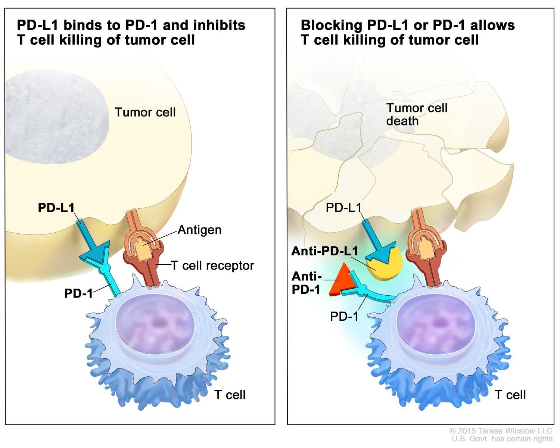
Immune Checkpoint Inhibitors (ICIs)
Immunotherapy using ICIs has shown remarkable efficacy in Oncology
ICIs don’t kill cancer cells directly but rather unblock checkpoints to allow the immune cell to eliminate them
3. Ipilimumab blocking the cytotoxic T-lymphocyte associated antigen (CTLA-4) became the first approved Mab in 2011
This was followed by the approval of:
MAbs targeting programed cell death 1 (PD1): pembrolizumab and nivolumab
MAbs against programmed death ligand 1 (PDL1): atezolizumab and durvalumab

Slide 19
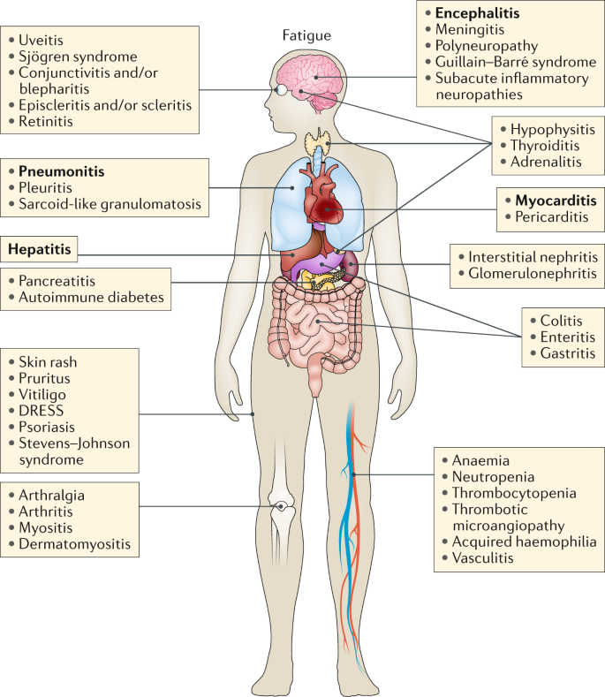
Immune Checkpoint Inhibitors (ICIs) and Autoimmunity
Due to their disinhibitory effects on the adaptive immune system, ICIs have been known to cause multiple rheumatic and non rheumatic immune related adverse events (irAEs)
These AEs are seen in ~90% of patients treated with CTLA-4 MAbs and 70% of patients treated with PD1/PDL-1 MAbs
30-50% of patients with AID experience a flare while being treated with ICI
25-50% of patients with AID experience a new irAE while being treated with ICI
Nature Reviews Clinical Oncology
volume 16, pages 563–580 (2019)

Slide 20
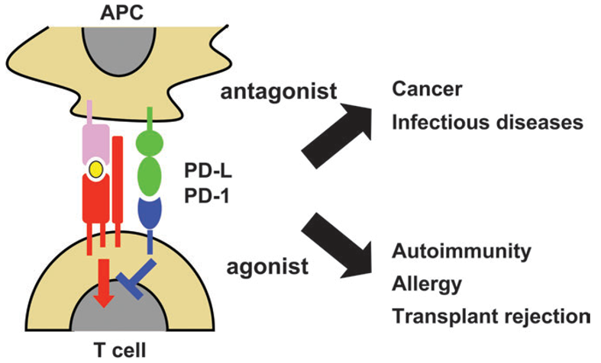
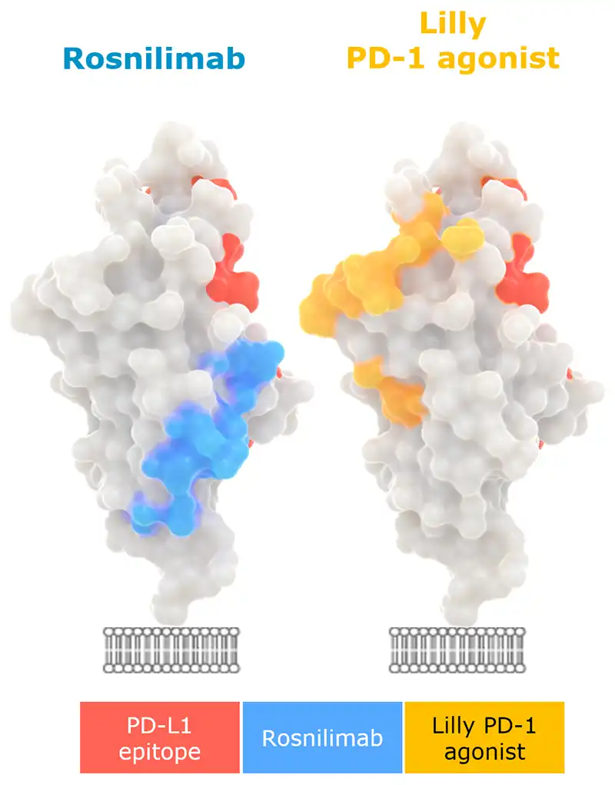
Immune Checkpoint Inhibitors (ICIs) for the treatment of AIDs
AnaptysBio, Inc.
Eli Lilly
Peresolimab
International Immunology 1 July 2007
PD-1 agonists exist within the group of PD-1 antagonists only differentiated by the fact that they bind to the membrane-proximal extracellular region in contrast to the membrane-distal region blocked by PD-1 antagonists
www.anaptysbio.com

Slide 21
PD1 Agonists in Autoimmunity
Drug Candidates | Indications | Manufacturer | Development Status
Peresolimab | RA | Eli Lilly | Discontinued after Phase II
Rosnilimab | RA, UC, Alopecia | AnaptysBio, Inc. | Currently recruiting Phase III after successful Phase II
S-4321 Bi-directional PD-1/FcyRIIb | Undisclosed | Seismic | Phase Ib study is anticipated to start
Drug Candidates | Indications | Manufacturer | Development Status
Peresolimab | RA | Eli Lilly | Completed Phase II, awaiting Phase III
Rosnilimab | RA, UC, Alopecia | AnaptysBio, Inc. | Currently recruiting Phase II
Undisclosed | SLE, Dermatomyositis, Polymyositis, Sjogren’s syndrome | Undisclosed | Phase Ib study is anticipated to start at the end of the year

Slide 22
Novel MOAs for the Treatment of RA and SLE
Upstream Interference with the Innate Immune System

Slide 23
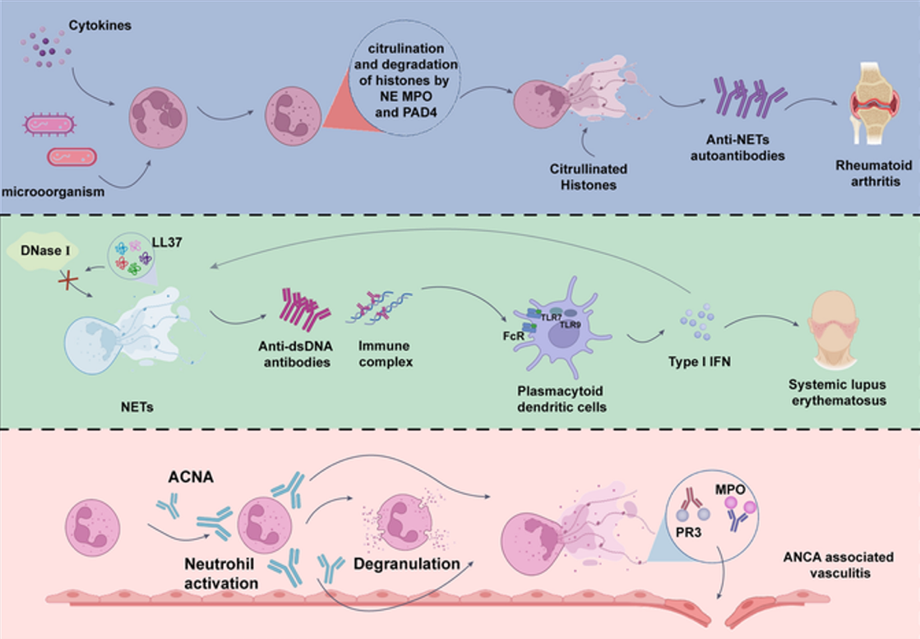
NETOSIS inhibitors
NETs are web-like structures composed of thick and filamentous strands of DNA released by neutrophils during inflammation
NETs provide a catalytic surface by binding pro-inflammatory proteins, blood and tissue fluids (e.g., neutrophil elastase, clotting factors, antibodies, complements)
RA
(ACPA)
SLE
(anti-ds DNA)
Vasculitis
(anti-PR3, MPO, anti-C1q)
Adapted from Zhang et al. Apoptosis 28(9-10):1-26July 2023

Slide 24
NETOSIS inhibitors
NETs are found in the skin and glomeruli of SLE patients
The overproduction or insufficient clearance of NETs initiate and maintain the inflammatory response in SLE
NETs correlate with disease activity in SLE patients
NETs can activate the inflammasome and drive pDCs to produce Type I INF in SLE
Genetic mutations in the DNASE1L3 gene lead to:
Familial form of SLE with a high frequency of lupus nephritis in children (loss-of-function mutation)
Hypocomplementemic urticarial vasculitis syndrome (HUVS) (frame shift mutation)
The timely removal of NETs by the intrinsic serum DNase1 is crucial to control disease by avoiding presentation of self-antigens

Slide 25
NETOSIS Inhibitors
Drug Candidates | Indications | Manufacturer | Development Status
CIT-013 (monoclonal antibody against citrullinated histones H2A and H4) | RA | Citryll | Phase I in 73 healthy volunteers showed near complete inhibition of circulating NET components. Dose limiting toxicity when given intravenously which was markedly reduced by subcutaneous administration
NTR-1011 ( recombinant DNASe1L3) | SLE, RA | Neutrolis | Recruiting in Phase Ib

Slide 26
Summary
Industry funding in Rheumatology has decreased
Drug development in Rheumatology is a rapidly developing area
High competition for patients among drug makers
Bias towards targeting MOAs of the adaptive immune system
Cellular Therapies may offer effective treatment options but at this point can only be regarded as niche products and long-term safety remains unknown
Novel biomarkers and cytokine profiling will guide future drug development and aid not only in identifying specific patient profiles but also in predicting treatment response in SLE

Slide 27
Science will continue to challenge us to find new, better and safer ways to treat our patients and provide them with a better quality of life

Slide 28
EXTRAS

Slide 29
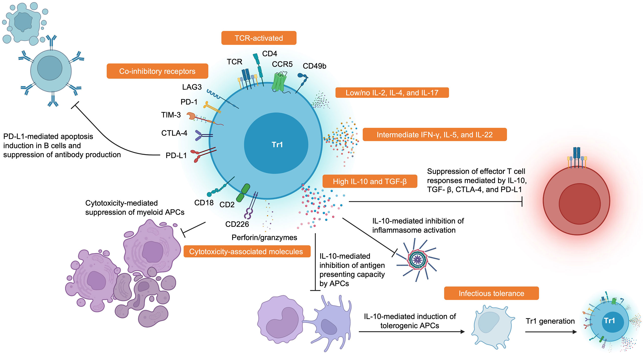
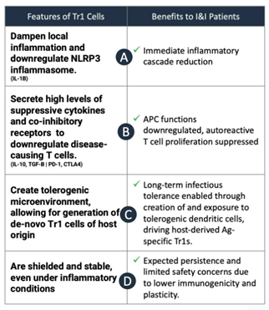
CART Alternatives - Type 1 regulatory T cell-mediated tolerance in AID
Front. Immunol., 27 October 2022

Slide 30
PD-1 Agonists - Science
The PD-1 pathway is a key immune checkpoint that plays an important role in maintaining peripheral T cell tolerance and regulating adaptive immune responses
PD-1 agonist antibodies trigger immunosuppressive signaling by cross-linking PD-1 molecules and down-regulating T cell receptor (TCR) signaling resulting in the suppression of T cell activities
PD-1, PD-L1, and PD-L2 gene polymorphisms are associated with several AIDs
Although PD-1 agonists can suppress T cell activities, they will not directly inhibit immune effectors lacking PD-1 expression such as granulocytes and macrophages
Increased expression of PD-1 in the synovium of patients with RA, correlates with disease activity
Combination of PD-1 agonist antibody with other treatments may be beneficial

