Slide 1

Puzzling palpable purpura - a case report and review of the literature
Allison Schue, DO
OHSU Rheumatology Fellow, PGY-4

Slide 2
Disclosures
I have no financial or other disclosures to disclose.
The patient I will present gave verbal permission for her case to be shared.

Slide 3
Key Objectives
MONTH 20XX
Case Presentation
HIV and IgA vasculitis
HIV Screening in Rheumatology Practice
Takeaways/Questions

Slide 4
HPI
51 y.o. female presents to the rheumatology office as a new patient with CC of 8 month history of rash across her arms, legs and torso that is painful and worsening
Previous workup at the ED has shown diffuse LAD on CT AP of unclear etiology
She also has arthralgias and mild swelling in the lower extremities

Slide 5
ROS
Gen: + night sweats and LAD
HEENT: + h/o sinusitis, no dysphagia
Resp: + h/o asthma, no current dyspnea, cough or hemoptysis
CV: No syncope or chest pain
GI: +generalized abdominal pain, diarrhea and nausea, no blood in stool
Neuro: No previous TIA symptoms, numbness, foot/wrist drop
MSK: +h/o knee swelling in setting of trauma and arthralgias
Skin: no facial rashes, hair loss or PsO, +diffuse painful rash across torso, and extremities sparing back
Psych: no mood changes or cognition problems

Slide 6
PMHx/PSHx
DVT - ?provoked in setting of being an Uber driver
Asthma
3x 1st trimester miscarriages
S/p partial hysterectomy

Slide 7
Allergies/Medications
No known drug allergies
Not currently on medications

Slide 8
FMHx/Social Hx
No FHx of autoimmune or rheumatologic disease
Never smoked, significant second hand smoke exposure
Denies h/o IVDU or current drug use
EtOH: rarely drinks
No recent travel internationally or outside the PNW
Married, has a son

Slide 9
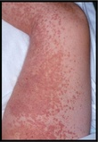
Exam
VSS
Gen: WDWN, NAD
HEENT: NCAT, normal oropharynx
Neck: L supraclavicular LAD
Resp: CTAB
CV: RRR, no murmurs
Abd: Diffuse tenderness without guarding, no masses
MSK: Tenderness of shoulders, elbows, knees, ankles, MCPs, PIPs, no joint effusions
Skin: See photo
Neuro: A&Ox4, +5/5 strength in all limbs, sensation intact throughout
Image courtesy of ACR Image bank: https://cdn2.webdamdb.com/220th_sm_1FqA4HqMr0.jpg?1589975935

Slide 10
Data

Slide 11
What’s on your differential?

Slide 12
Clinical course
Referred for urgent skin bx with Dermatology - added HIV test to infectious work up → HIV+
Skin bx findings showed LCV
Urgent referral to ID made → encountered many difficulties with insurance coverage for ID, but eventually established with ID outside our system and started HAART

Slide 13
Clinical Course
Was referred to Nephrology for ongoing hematuria and proteinuria >2 g/day despite HIV treatment
Rash persistent
Underwent renal bx that showed 1 of 8 glomeruli affected with crescent formation, found to have +IgA staining on bx →given stable renal function, supportive care with RAAS blockade for IgA vasculitis per Renal team
Underwent colonoscopy with bx that was completely negative for abnormalities →dx’d with IBS by GI and improved GI sxs with duloxetine

Slide 14
Clinical course
At followed up with Rheumatology, continued to have diffuse purpuric rash and severe arthralgias → opted to treat with 10 mg prednisone with taper
Patient to follow up with Dermatology with plans to start Dapsone for skin and possible joint DMARD effects

Slide 15


Slide 16
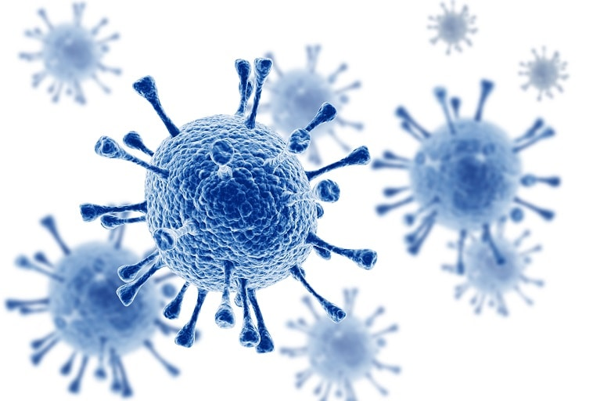
HIV infection and IgA Vasculitis
Image credit: https://www.nfid.org/wp-content/uploads/2023/03/HIV-virus.jpeg
Notes:
-Who do you screen in your practice?

Slide 17
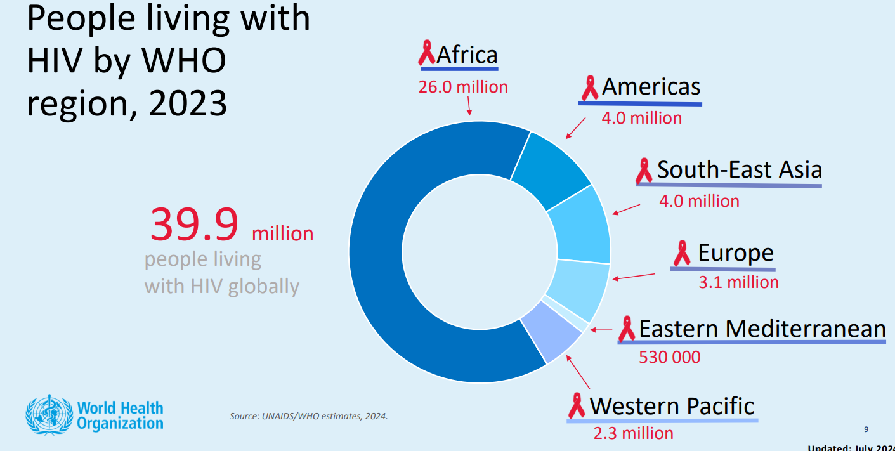

Slide 18
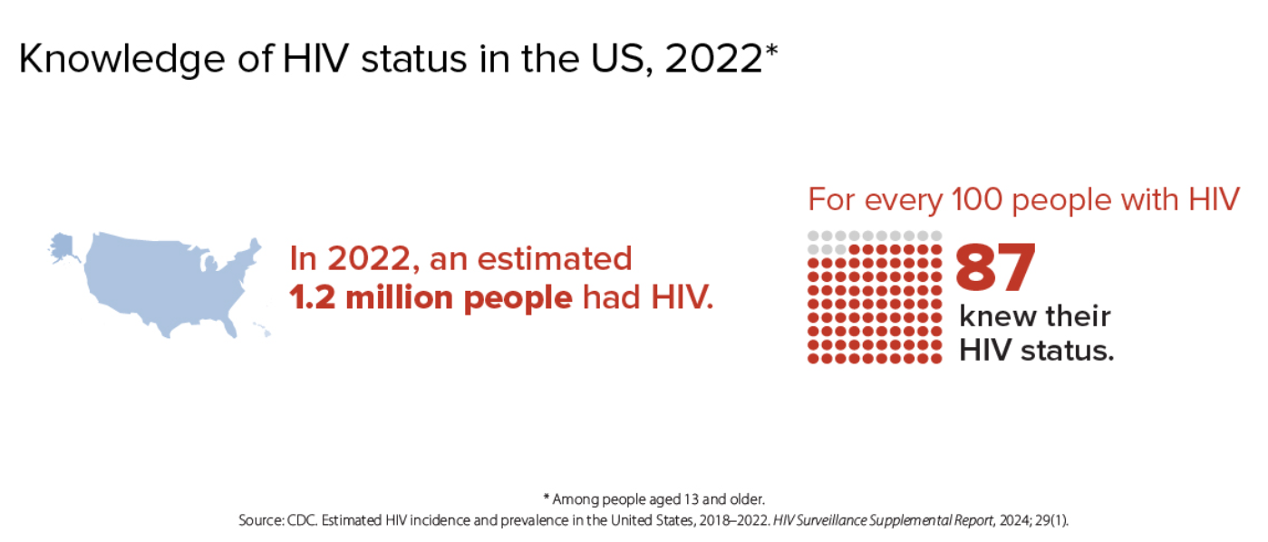
Notes:
This means that for every 100 people with HIV in the US, 13 don’t know they’re infected

Slide 19
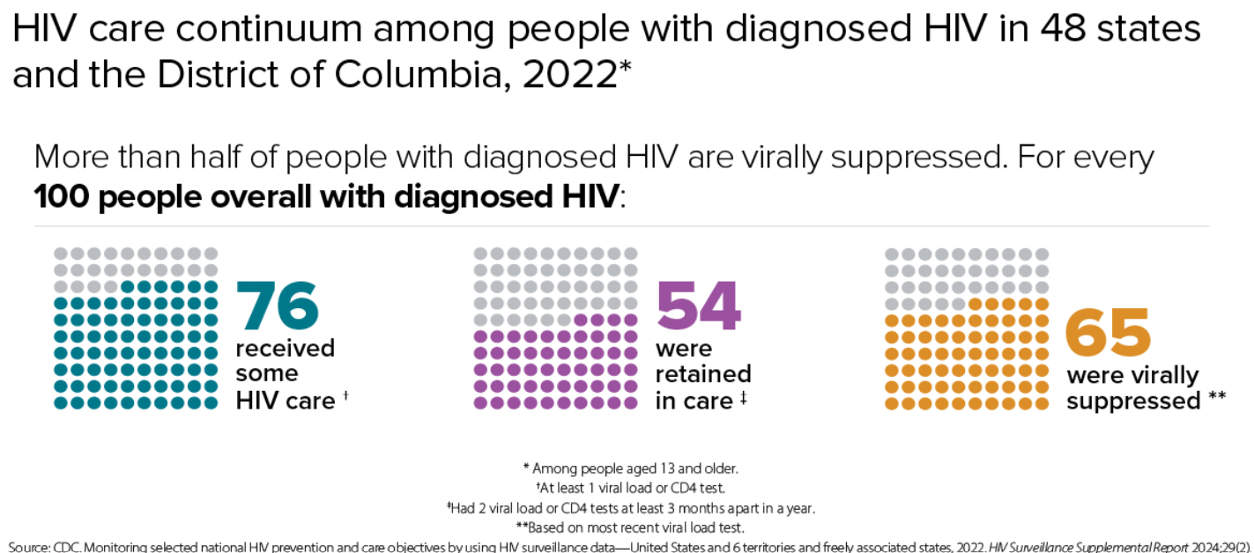
Notes:
Viral suppression refers to the percentage of people with diagnosed HIV who have less than 200 copies of HIV per milliliter of blood.

Slide 20
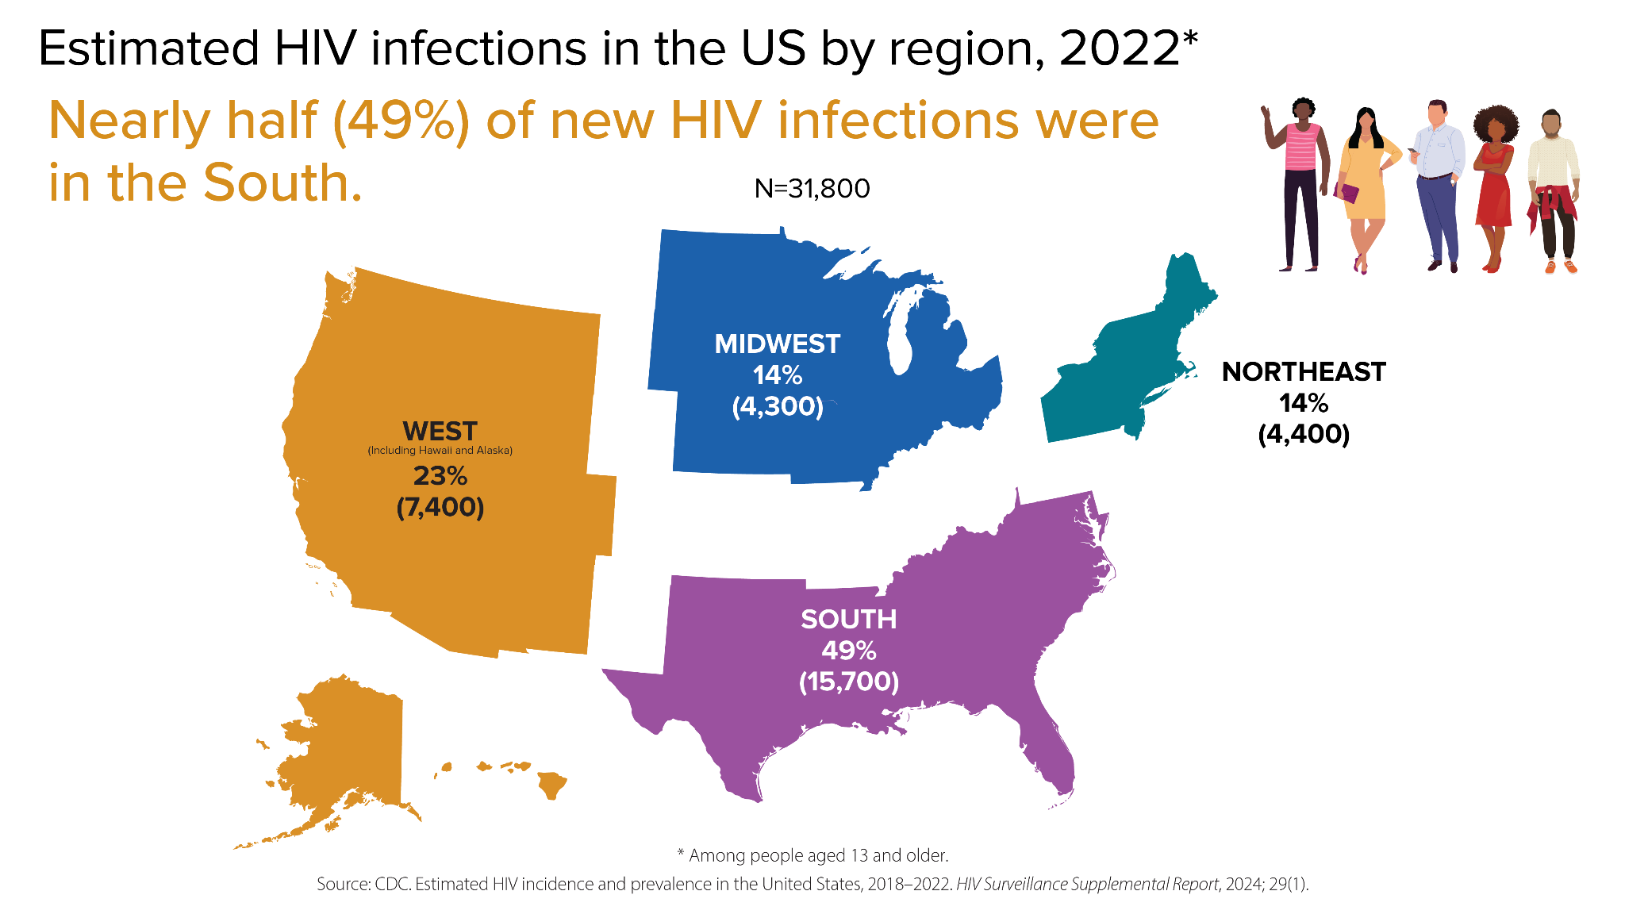
Notes:
*Data is for those 13 yo and older
*Note our region (West) accounts for 23% of new infections in US

Slide 21
Vasculitis is a rare but major consequence of HIV infection
  Incidence <1% (excluding drug reactions)
IgA vasculitis (Henoch Schoenlein Purpura) is rarely seen in adults
  ~90% of cases seen in pediatrics
Many theories exist as to pathogenesis of inflammation
  Cell mediated
  Immune complex mediated
  Autoantibody mediated
Types range from small to large vessel involvement

Slide 22
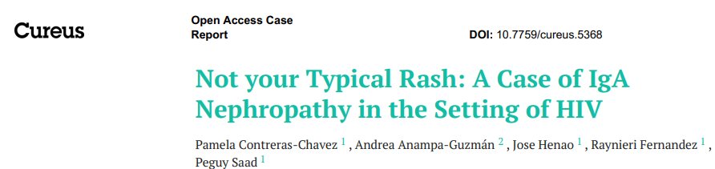
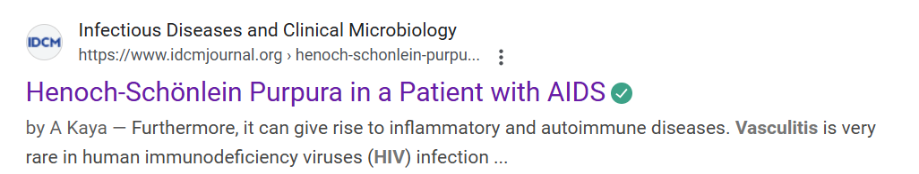
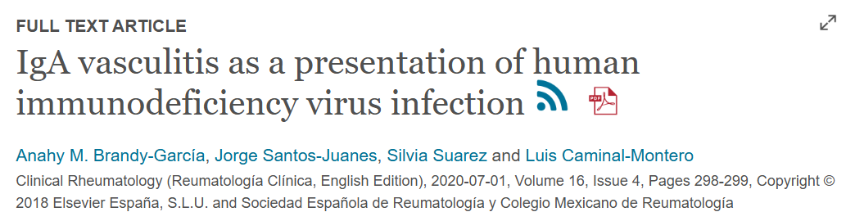
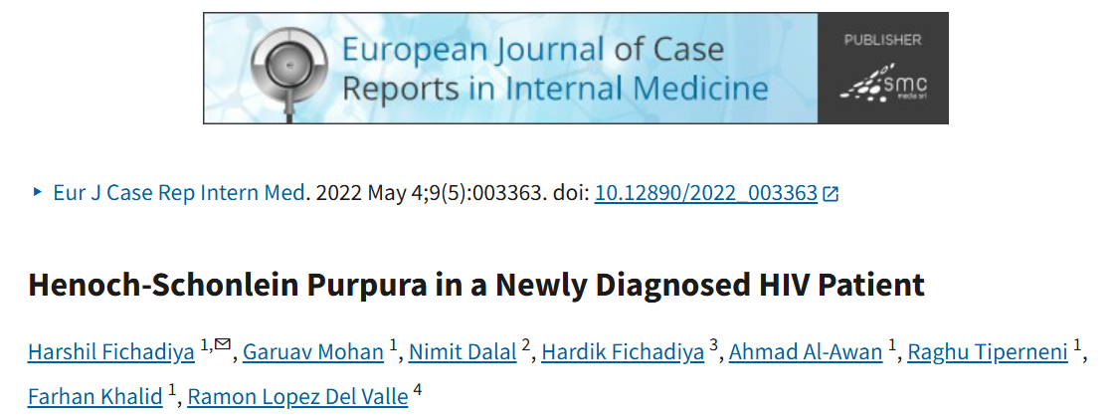
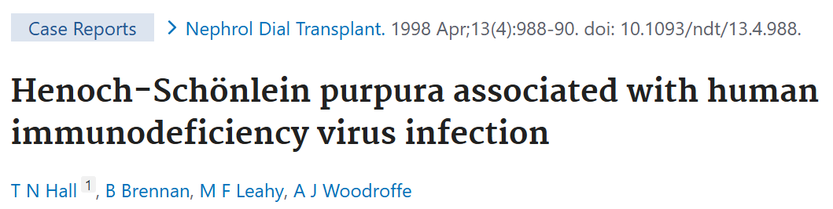
IgA vasculitis is rarely seen in HIV infection, but there are case reports going back to 1989

Slide 23
Data is sparse
  No RCTs of treatment regimens for this population of IgA vasculitis
  Treatment is extrapolated from preexistant treatment recommendations for IgA vasculitis
Common themes amongst articles:
  Often found in conjunction with new HIV diagnosis
  Treatment with corticosteroids common, particularly for renal involvement
One recent case report (Kaya et al 2024) with review of high quality HIV-associated IgA case reports showed 2/7 cases resulted in fatality, though not due to IgA vasculitis alone

Slide 24
Who should I test for HIV?
The American College of Rheumatology supports the USPSTF guidelines
  No clear guidance on how or when we should screen
Notes:
-ACR includes this in their patient facing materials as well
-No concrete guideline in place from ACR for how/when to screen

Slide 25
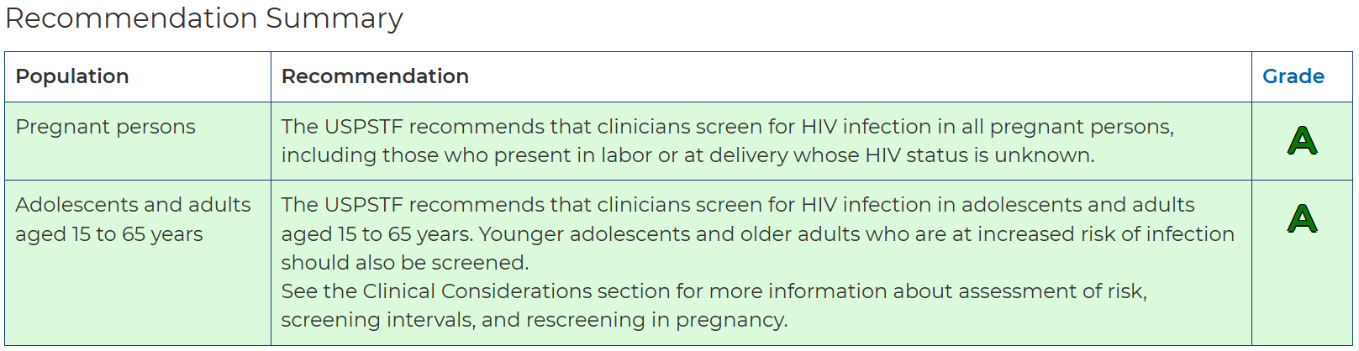
Screening Guidelines
US Preventive Services Task Force:
Notes:
-All pregnant persons
-Adolescens and adults 15-65
-Canadian Task Force on Preventive Health Care acknowleges this guideline, but given lower prevalence of ~0.2% of the population living with HIV in Canada, they do not feel this guideline applies to their population and recommends clinicians screen based on risk factors (MSM, injection drug use, ppl from endemic countries) and screen all pregnant people

Slide 26
Canadian Task Force on Preventive Health Care Screening Guidelines
Acknowledges USPSTF guidelines
However, given lower prevalence of ~0.2% of the population living with HIV in Canada, they do not feel this guideline applies to their population
Recommends clinicians screen based on risk factors (MSM, injection drug use, ppl from endemic countries) and screen all pregnant people

Slide 27
TNF alpha inhibitor use in HIV infected patients
Limited data on the use of TNFi in HIV+ patients
Notes:
However, it seems that TNF alpha inhibition is considered safe in patients with HIV that is controlled well

Slide 28
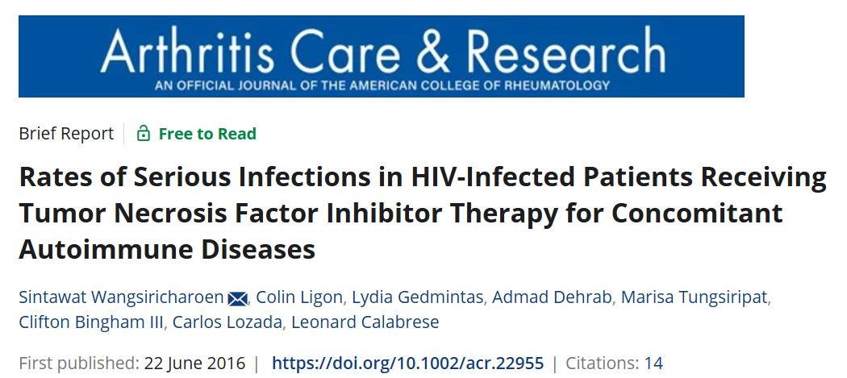

Slide 29
4 centers included
Population: patients HIV+ prior to TNF alpha inhibitor start
Dates: January 1999- March 2015
Rates of serious infections in patients with HIV diagnosis and on TNF alpha inhibitor therapy appears to be equivalent to rates in general registry studies
  Limited population studied - 23 patients with 26 instances of TNF alpha inhibition use
  Incidence was estimated to be 2.55 serious infections per 100 person years in the HIV infected population
Notes:
2016 study of serious infection rates

Slide 30
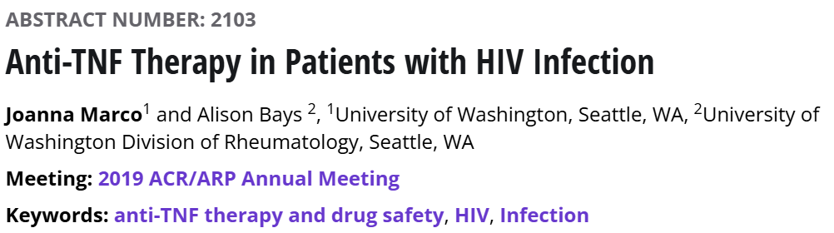

Slide 31
All pts at an academic medical center between 1/1/2014-5/1/2019 w/ HIV and TNF prescribed were identified → 11 total pts
  Mean age 48.4, 90.9% male
  Diseases represented: IBD (45.4%), RA (27.2%), PsA (27.2%), PsO (9.1%), hidradenitis suppurativa (9.1%)
  All on ART at time of TNFi start
Key findings:
  No major infections found in 47.9 person years on TNFi
  Two significant cancer cases identified →one leiomyoma (IBD), one cholangiocarcinoma (RA)
  TNFi use did not affect CD4 count or HIV viral loads
Conclusions:
  With appropriate monitoring and ART, HIV infected patients can safely use TNFi therapy

Slide 32
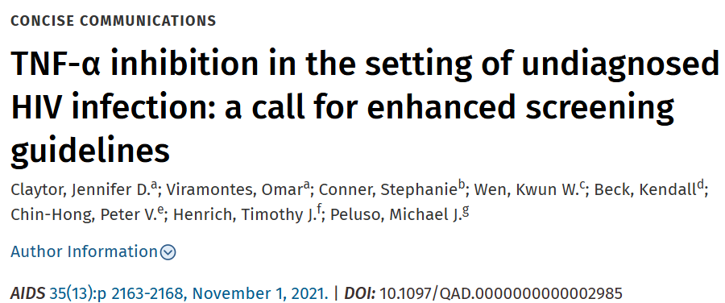

Slide 33
Small case series of 3 undiagnosed HIV cases who were treated with TNF alpha inhibitors
Two ended up having been inappropriately diagnosed with a rheumatologic or autoimmune disease when they had HIV-associated disease instead and were inappropriately immunosuppressed
  Kaposi sarcoma (thought to be IBD)
  HIV-associated arthropathy (thought to be RA)
Authors conclude that HIV screening prior to TNF alpha inhibition should be included in screening guidelines

Slide 34
Reflections
New HIV infection rates are declining, but undiagnosed cases still occur in the USA
IgA vasculitis is a rare but potentially serious consequence of HIV infection and the association between HIV and IgA vasculitis may be overlooked
Screening guidelines for HIV infection in Rheumatology are not fully outlined
TNF alpha inhibition may be a good “trigger” for screening, particularly in patients who have not met USPSTF Guidelines for screening and/or who are at heightened risk

Slide 35

Questions?

Slide 36
References
https://www.cdc.gov/hiv-data/nhss/estimated-hiv-incidence-and-prevalence.html
https://canadiantaskforce.ca/guidelines/appraised-guidelines/hiv/
https://cdn.who.int/media/docs/default-source/hq-hiv-hepatitis-and-stis-library/hiv-epi-fact-sheet-march-2025.pdf?sfvrsn=61d39578_12
Marco J, Bays A. Anti-TNF Therapy in Patients with HIV Infection [abstract]. Arthritis Rheumatol. 2019; 71 (suppl 10). https://acrabstracts.org/abstract/anti-tnf-therapy-in-patients-with-hiv-infection/. Accessed April 7, 2025.
Contreras-Chavez P, Anampa-Guzmán A, Henao J, Fernandez R, Saad P. Not your Typical Rash: A Case of IgA Nephropathy in the Setting of HIV. Cureus. 2019;11(8):e5368-e5368. doi:10.7759/cureus.5368
Anahy M. Brandy-García, Jorge Santos-Juanes, Silvia Suarez and Luis Caminal-Montero
Clinical Rheumatology (Reumatología Clínica, English Edition), 2020-07-01, Volume 16, Issue 4, Pages 298-299, Copyright © 2018 Elsevier España, S.L.U. and Sociedad Española de Reumatología y Colegio Mexicano de Reumatología
Guillevin, Loic. Vasculitides in the context of HIV infection. AIDS 22():p S27-S33, September 2008. | DOI: 10.1097/01.aids.0000327513.53255.17
Wangsiricharoen, S., Ligon, C., Gedmintas, L., Dehrab, A., Tungsiripat, M., Bingham, C., III, Lozada, C. and Calabrese, L. (2017), Rates of Serious Infections in HIV-Infected Patients Receiving Tumor Necrosis Factor Inhibitor Therapy for Concomitant Autoimmune Diseases. Arthritis Care & Research, 69: 449-452. https://doi.org/10.1002/acr.22955
https://www.uspreventiveservicestaskforce.org/uspstf/recommendation/human-immunodeficiency-virus-hiv-infection-screening
Fichadiya H, Mohan G, Dalal N, Fichadiya H, Al-Awan A, Tiperneni R, Khalid F, Del Valle RL. Henoch-Schonlein Purpura in a Newly Diagnosed HIV Patient. Eur J Case Rep Intern Med. 2022 May 4;9(5):003363. doi: 10.12890/2022_003363. PMID: 35774739; PMCID: PMC9239019.

Slide 37

Thank you!

