Slide 1
Clinical Case: PMR Masquerade
Elizabeth Anderson, MD
OHSU Junior Rheumatology Fellow
April 2024
Notes:
Thank you for the introduction. It's a privilege to share a case with this group today. My co-fellow, Dr. Cubberley, and I chose two different cases united by a common theme which we are calling the PMR Masquerade.

Slide 2
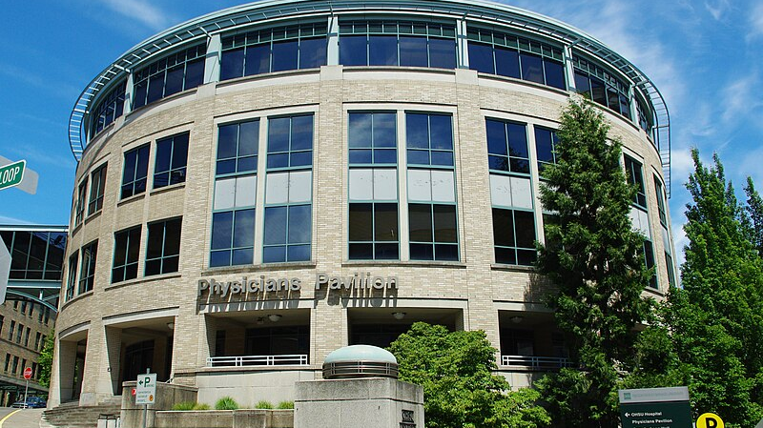
Clinical Case
Notes:
I was struck by the case I am going to present today in part because it underscores a core part of the experience of being a first year fellow: the transfer of care. Though truly every day we are all picking up the care of patients who have started their diagnostic and treatment journeys before meeting us, whether with their PCPs or rheumatologists from out of state or out of network. These transitions can be challenging for a few reasons, including that the patient before us today is not the same as they were before; perhaps he or she is now on treatment, or the disease has continued to evolve, or both.

Slide 3
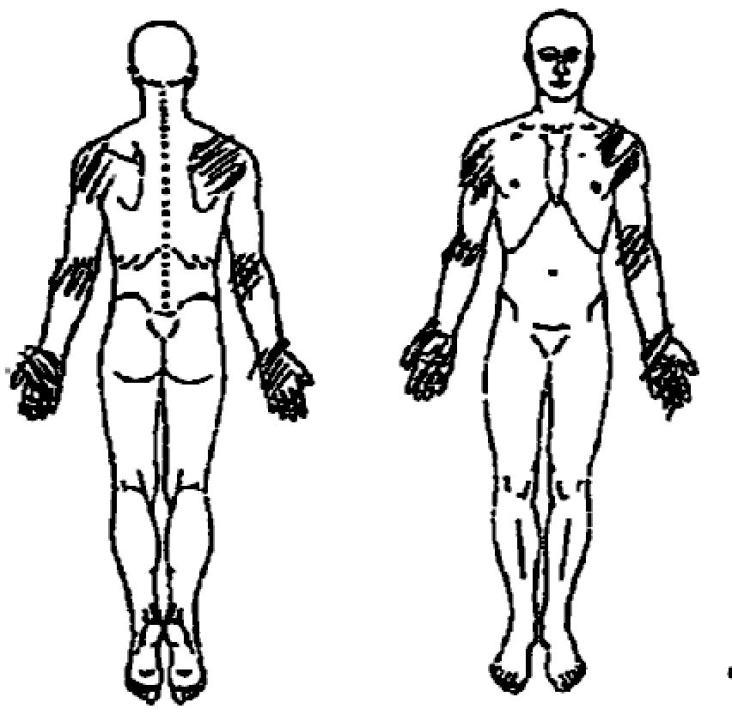
Part 1: Initial Presentation
59 year old female referred to Rheumatology for acute upper extremity pain (shoulders, elbows, wrists, hands)
Prednisone 20mg daily for the last 2 weeks
PMH: COVID 3 mo prior, otherwise healthy
SH: Retired RN, no tobacco, 1 alcoholic drink per day, very physically active
FH: Mother had polymyalgia rheumatica (PMR), thyroid disease, and glioblastoma. Had never been able to come off 1mg daily prednisone.
Notes:
At her initial presentation to Rheumatology, a couple years before I met her, my patient was a 59 year old woman who had been referred for 2 months of acute onset upper extremity pain and stiffness that had raised concern for PMR. The pain had woken her from sleep one night. By morning she had bilateral shoulder, elbow, wrist, and hand pain. She noted 1 hour of morning stiffness, particularly in the hands, and some swelling in the fingers. She had recalled two similar episodes that self-resolved within 1-2 w but which were less severe and involved hip pain as well. She was previously healthy and active, a retired RN who enjoys camping and hiking. Her ROS was otherwise unimpressive.
She initially went to her PCP who documented pain with shoulder abduction, reduced ROM in the wrists. She was prescribed prednisone 20mg in primary care, which had quickly and dramatically helped her symptoms. She had ultimately had normal inflammatory markers but had rebounded when her PCP tried to taper prednisone, so she remained on 20mg until she established with Rheumatology.

Slide 4
Part 1: Initial Presentation
BP 132/82 | Pulse 68 | Temp 98.8 °F | BMI 20.99 kg/m²
Lungs: clear to auscultation bilaterally
Ext: no clubbing, cyanosis or edema
M/S: no synovitis or joint tenderness, full ROM throughout joints of upper and lower extremities
Able to raise arms above head
Able to stand from sitting 3x in a row without pain
Skin: no abnormalities
Neuro: sensory normal; strength full in upper extremities and bilateral quadriceps
WBC 8
HB 11
PLT 301
Normal differential
Normal CMP
Normal ESR, CRP
Negative ANA, RF, CCP
Diagnosis: PMR
Treatment: Prednisone
Notes:
The documented exam from that initial presentation to Rheum notes a lack of synovitis, normal ROM, and normal strength.
Her referral lab work was largely negative, including ANA, RF, and CCP
Her presentation was felt overall to be consistent with probable PMR due to that sudden onset of upper extremity pain without swelling, and marked steroid-responsiveness.
So a standard prednisone taper for PMR was continued.

Slide 5
Part 2: Difficulty Tapering Prednisone
5 months
Prednisone 7mg
Mild morning stiffness and limited PIP synovitis
7 months
Prednisone 5mg
Worsening hand pain, swelling, and stiffness
7.5 months
Prednisone 6mg
Knee and foot pain + prior symptoms
Methotrexate 15mg weekly was started
Slowed taper to decrease by 0.5mg each month
ESR and CRP normal
https://www.mychart.org/About
Notes:
5 months into the taper she returned to clinic doing well then on 7mg of prednisone but did report ongoing morning stiffness in the hands. On exam she had mild synovitis of two PIPs, but otherwise normal joints and no issue with raising her arms overhead or standing from sitting x3.
Then 7 months into the taper she wrote in over MyChart reporting worsening hand pain swelling, stiffness. She went back to the last effective dose of prednisone, which helped, and resumed the taper.
But within 2 weeks she developed knee and foot pain in addition to recurrence of the prior symptoms, which didn't improve until prednisone was increased back to 7mg. Her rheumatolgist then started methotrexate 15mg weekly. Inflammatory markers remained normal.

Slide 6
Part 3: Liver Enzyme Elevation
8.5 Months
Cr 0.57
ALK Phos 24
AST 80
ALT 79
Methotrexate was decreased to 10mg weekly and patient abstains from alcohol
AST 47
ALT 52
She is evaluated by a hepatologist
10 months
Prednisone 7g
Symptomatically well. Liver enzymes normal. Escalate methotrexate back to 15mg.
Notes:
Then routine monitoring labs reveal newly elevated liver enzymes. So methotrexate was reduced, the patient abstained from alcohol, and numbers improve. Further hepatologic workup was reasonably reassuring and so when I met her after some discussion we returned her 10 month follow up visit. She was otherwise well symptomatically at that point.
(Fibrosis workup:
Fribrosis panel – AST 93, ALT 78, fibrosis metavir classification F1 = portal fibrosis without septa
antimitochondrial Ab eventually normal too
ASMA - neg Ferritin – 47)
______
fibrosis workup reveals mild (F1) fibrosis
______
(But she develops a sustained lymphopenia
WBC 5.7
Lymphocyte # 0.49, 0.58 K/cu mm
Methotrexate deceased to 7.5mg weekly and number remains stable)

Slide 7
Part 4: Hip Flexor Weakness
16 months
Prednisone 4mg
Age 61
1h morning stiffness
Walking 1h 3 times per week, lifting weights twice weekly
Hip and knee "stiffness" making it difficult to lift her leg into the car
Newly endorses Raynaud's
Denies shortness of breath or cough
Not on a statin
Markus Spiske
Notes:
At her 16 month follow up the patient is now on 4mg of prednisone, still quite physically active despite 1h of morning stiffness, but she is reporting 1 month of stiffness getting in and out of the car. On further discussion, it comes out that she is actually having trouble lifting her leg enough to step into the car, having to use her hands to pick up her leg! On ROS she also newly endorses Raynaud's. She's not having other symptoms, including SOB.

Slide 8
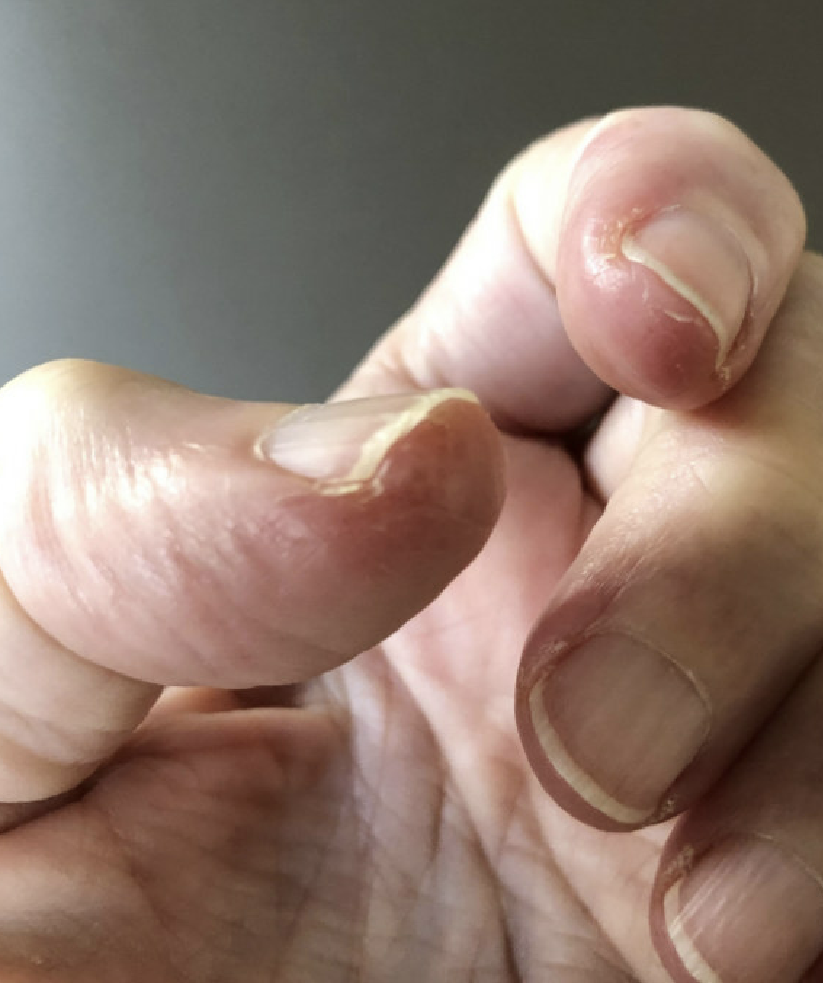
Part 4: Hip Flexor Weakness
Positive empty can test
No pain with passive ROM
No synovitis or joint tenderness. Able to stand from sitting with arms crossed without increased effort or pain, able to raise arms above head.
Peeling, nonerythematous skin at bilateral first and second digits
Strength: 4/5 bilateral hip flexors, 4/5 bilateral elbow extension, otherwise 5/5 throughout
Notes:
Pertinant exam findings include … This is a photograph of her fingers.
M/S: some right anterior shoulder tenderness to palpation over right corocoid process; positive empty can test, positive cross body, but no pain with passive ROM; otherwise no synovitis or joint tenderness of b/l DIPs, PIPs, MCPs, wrists, elbows, shoulders, knees, ankles, and MTPs. Full ROM throughout joints of upper and lower extremities. Able to stand from sitting with arms crossed without increased effort or pain, able to raise arms above head.
Skin: peeling, nonerythematous skin at several fingertips (bilateral first and second digits), no ulcerations or discoloration, otherwise no abnormal nodules, rashes, plaques, or ulcerations
Neuro: 4/5 bilateral hip flexors, 4/5 elbow extension, otherwise 5/5 throughout upper and lower extremities

Slide 9
Part 4: Hip Flexor Weakness
CK 3,848
Aldolase 48.4
AST 121
ALT 114
RF and CCP again negative
EMG:
There is evidence for a moderate, proximal more than distal irritable myopathy affecting more severely the deltoid, finger extensors and iliopsoas muscles. Given the patient's examination and history, those findings would be consistent with an inflammatory myopathy such as can been seen in anti-synthetase syndrome.
Anti-Jo-1 Ab 171

Slide 10
MRI Femurs
T2 FS AX
Myositis in the bilateral lower extremities, most notable in the quadriceps musculature (and most pronounced in the left rectus femoris muscle). No muscle architectural distortion or fatty atrophy. ​
Myofascial edema adjacent to the right distal semitendinosus muscle.
Notes:
FINDINGS:
Muscles and soft tissues: Mild edema in the bilateral iliopsoas musculature, bilateral gluteal musculature, bilateral short adductor musculature, and bilateral quadriceps. This is most marked in the left rectus femoris muscle. No muscle architectural distortion or fatty atrophy. Minimal myofascial edema adjacent to the distal right semitendinosus muscle; otherwise the fascial tissues are normal. No subcutaneous edema or drainable fluid collections. No incidental findings in the visualized pelvis.
Bones and joints: No fracture or marrow replacing lesion. Small left knee joint effusion.
IMPRESSION:
1. Myositis in the bilateral lower extremities, most notable in the quadriceps musculature (and most pronounced in the left rectus femoris muscle). No muscle architectural distortion or fatty atrophy.
2. Myofascial edema adjacent to the right distal semitendinosus muscle. Otherwise, normal intermuscular fascia. No subcutaneous edema or soft tissue fluid collection.
3. No bone marrow edema.

Slide 11
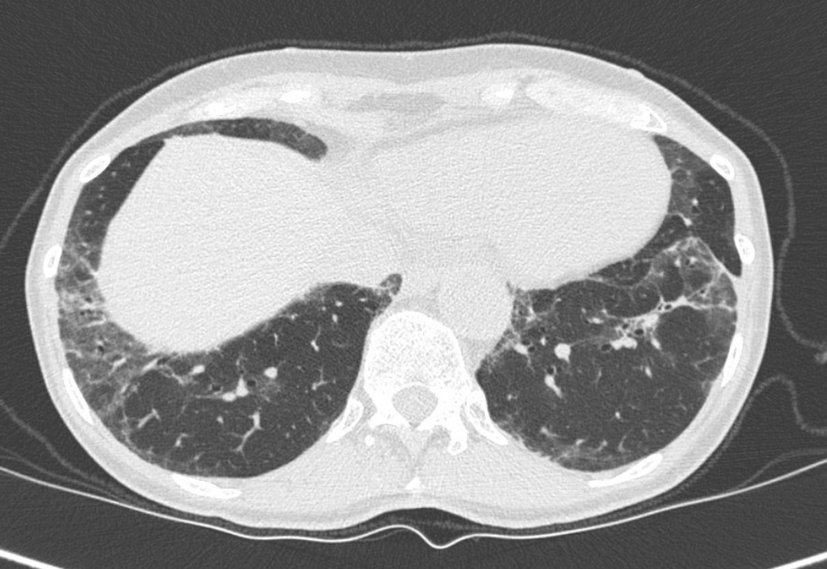
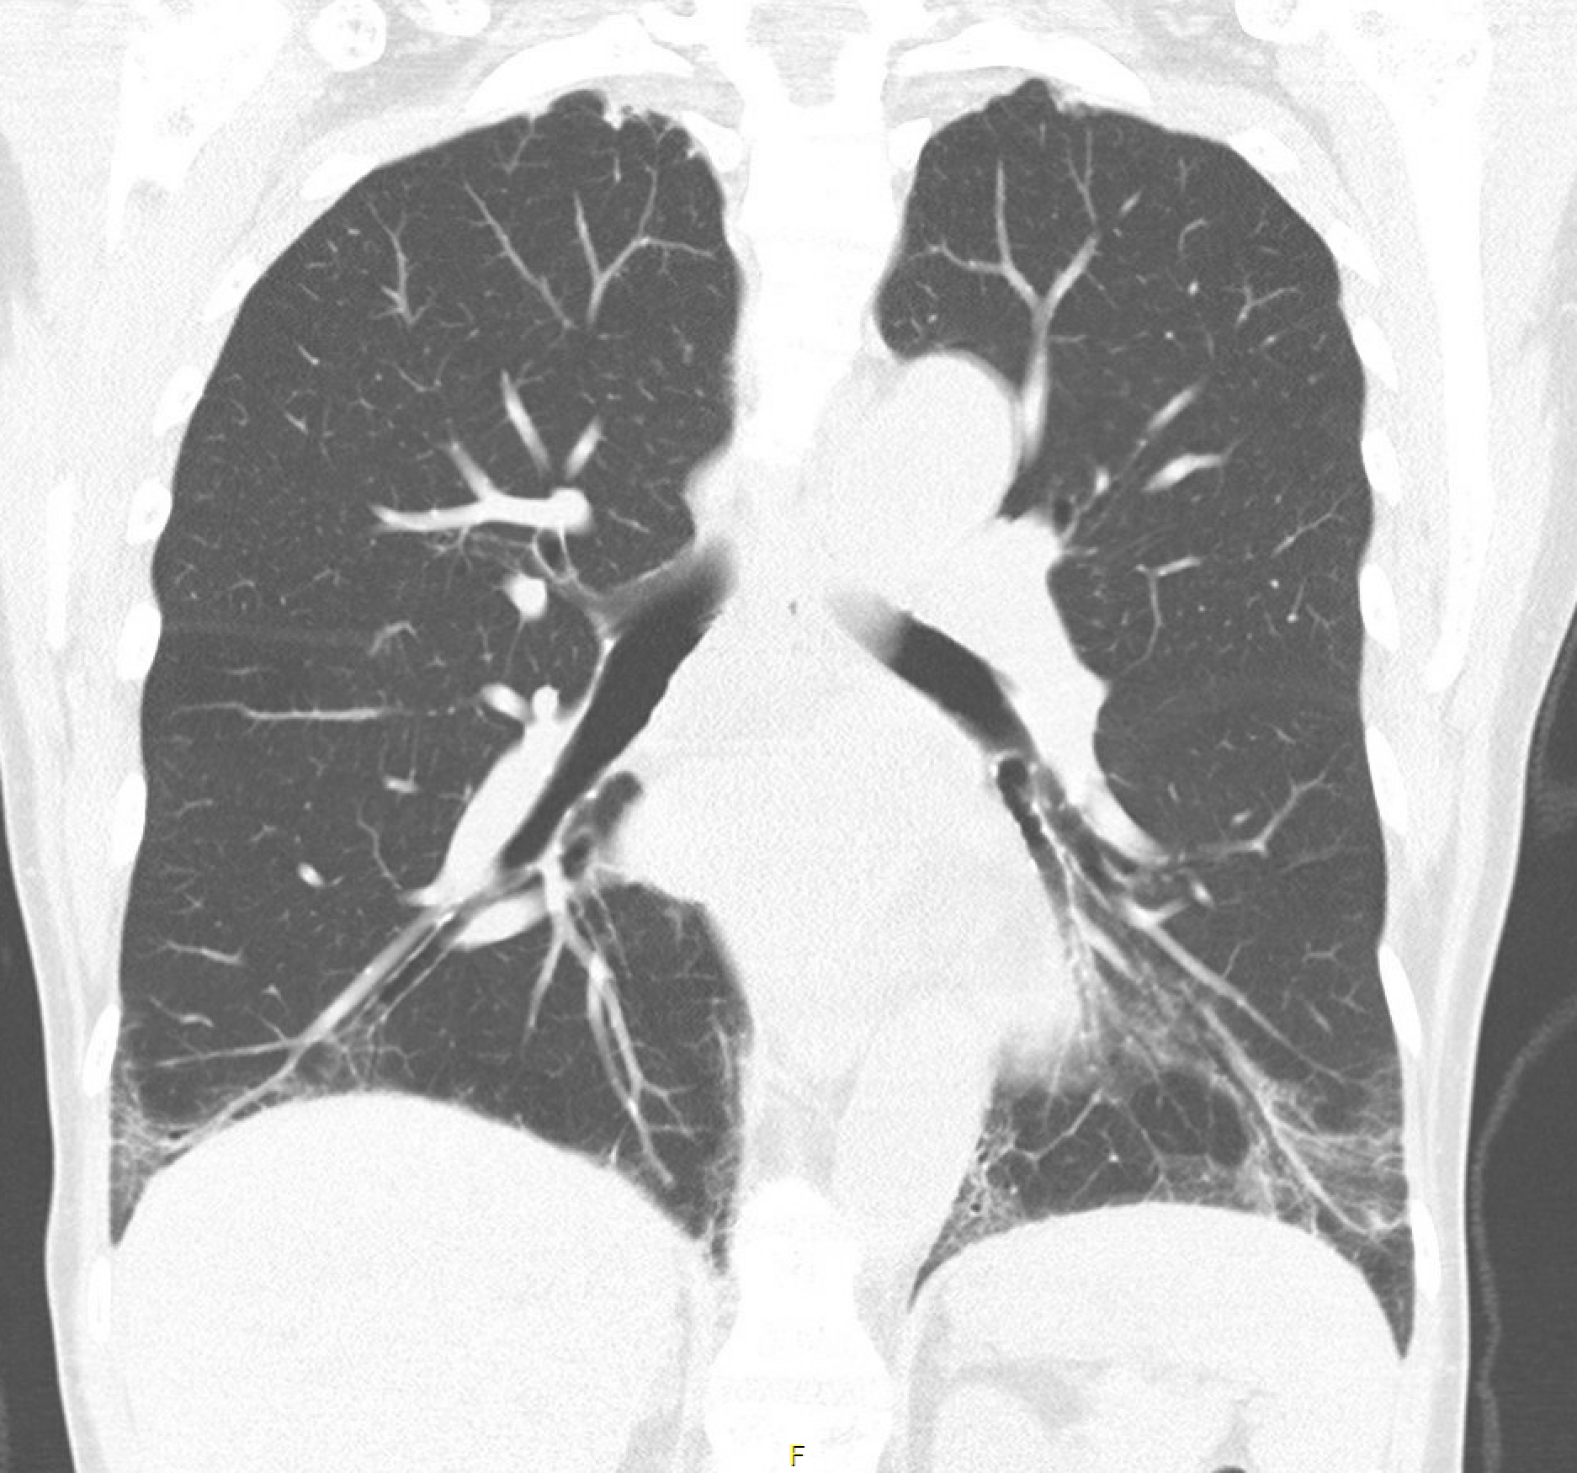
CT Chest
Normal spirometry, DLCO 79% predicted
Peripheral & basilar predominant groundglass opacities and reticular densities with regions of subpleural sparing suggestive of interstitial lung disease in an NSIP pattern
Notes:
We obtained a CXR to screen for asymptomatic pulmonary involvement, which showed mild bibasilar ggo (persistent compared with 2 years prior). A non-contrast CT chest then revealed peripheral & basilar predominant groundglass opacities and reticular densities with regions of subpleural sparing suggestive of interstitial lung disease in an NSIP pattern. (Ceullar subtype* is favored given lack of significant fibrotic change.)
Spirometry was fortunately normal though TLC was 79% predicted.
_____________
FINDINGS:
MEDIASTINUM/NODES/SOFT TISSUES: Visualized portions of the thyroid gland are unremarkable. There is no thoracic adenopathy.
HEART AND GREAT VESSELS: The heart is normal in size. There is no pericardial effusion. No significant calcified coronary artery disease. Great vessels are of normal caliber & configuration.
LUNGS/PLEURA: Large central airways are patent. Mild biapical scarring. Peripheral & basilar predominant patchy groundglass opacities are noted within the bilateral lungs. There is subpleural sparing within the posterior lower lobes bilaterally. Mild lower lobe predominant reticular densities are also noted. Probable minimal cylindrical bronchiectasis/bronchiolectasis in the distal right lower lobe airways (sagittal 67). No macrocystic honeycombing.
On expiratory phase imaging, there is no evidence of tracheobronchomalacia. Minimal lower lobe predominant air trapping manifest by hyperlucent lobules, most evident in the left lung base.
VISUALIZED ABDOMEN: No concerning findings in the visualized upper abdominal structures. Scattered subcentimeter hepatic hypodensities, probable benign hepatic cysts and/or hemangiomas.
BONES AND SOFT TISSUES: No acute or suspicious osseous or soft tissue abnormality.
IMPRESSION:
1. Peripheral & basilar predominant groundglass opacities and reticular densities with regions of subpleural sparing. Given clinical history and likely presence / persistence when compared to radiographs 6/26/2022, findings favored to reflect interstitial lung disease in an NSIP pattern. Ceullar subtype is favored given lack of significant fibrotic change. Recommend continued attention on follow-up imaging.
2. Faint upper lobe groundglass opacities, possibly related to the above, although could also reflect residua of recent COVID infection.
3. Minimal lower lobe predominant air trapping, possibly within physiologic normal limits, or could reflect minor component small airways disease.
4. No evidence of tracheobronchomalacia.
_____________
CXR
FINDINGS:
Normal cardiomediastinal silhouette and pulmonary vascularity. Trachea is midline. Similar bibasilar groundglass opacities. No new consolidation. No significant pleural fluid. No pleural air. Bones demonstrate stable mild scoliosis. Otherwise normal. Visualized upper abdomen is grossly normal. Soft tissues normal.
IMPRESSION:
Similar bibasilar mild groundglass opacities could reflect atelectasis, but chronic interstitial process is not excluded. Consider noncontrast chest CT to further evaluate if of continued clinical concern.
References a CXR from about 1.5y prior which showed bibasilar subsegmental atelectasis. It had been ordered during an ED visit for an episode of acute chest pressure and palpitations. She had had atrial flutter which self-resolved.

Slide 12
Diagnosis: Anti-synthetase Syndrome
Management
Started prednisone taper and MMF 1000mg BID
Stopped MTX
ILD Pulmonary Clinic referral
18 mo 17 mo
Notes:
Muscle biopsy was not felt diagnostically necessary.
Prednisone 20mg daily x30 days, then 15mg daily x30 days, then 10mg until follow up (traveling)
In a follow up call her strength was improving and flaking skin on fingertips cleared up, while CK came down quite quickly.
Her liver enzymes also improved, suggesting that at least to some degree, the elevated liver enzymes may not have been solely due to methotrexate or wine with dinner, and that rather myocyte damage was a contributor.
We have not pursued additional malignancy screening given that Jo-1 Antibodies fall under a low risk category.

Slide 13
Literature
Notes:
This case became a jumping off point for an interesting journey through myositis and PMR literature trying to understand why and how often Antisynthetase syndrome might masquerade as PMR.

Slide 14
Literature
Antisynthetase Syndrome

Slide 15
Antisynthetase Syndrome: Clinical Manifestations and Diagnosis
ILD, myositis, arthritis
Raynaud's syndrome, fever, rashes
Several tRNA synthetase autoantibodies, most commonly anti-Jo-1
When ILD present, most often NSIP pattern
A subset (25%) may lack myopathy on initial presentation (hypomyopathic or amyopathic)
Those with arthritis often receive a delayed diagnosis (mean time to diagnosis is 27 months)
Both ILD and antisynthetase antibodies are considered protective against malignancy
Marco, 2020
Notes:
To review, Antisynthetase syndrome can present with ...
_________
Marco JL, Collins BF. Clinical manifestations and treatment of antisynthetase syndrome. Best Pract Res Clin Rheumatol. 2020;34(4):101503. doi:10.1016/j.berh.2020.101503
"Antisynthetase syndrome (ASyS) is an autoimmune disease clinically manifested most often by interstitial lung disease, myositis, and arthritis. Raynaud's syndrome, fever, and rashes are also commonly seen. This syndrome is characterized by the highly specific presence of antibodies against various aminoacyl transfer RNA synthetases, including Jo-1 and others."
"There is a different aminoacyl tRNA synthetase for each amino acid, and the autoantibodies seen in ASyS each target a unique synthetase [1]. For example, anti-Jo-1 antibody targets histidyl-tRNA synthetase, which incorporates histidine into proteins, and anti-PL12 antibody targets alanyl-tRNA synthetase, which incorporates alanine into proteins [1]….Notably, a direct pathogenic role of the antisynthetase antibodies themselves has not been identified [2]."
"In the original Bohan and Peter classification criteria for idiopathic inflammatory myopathy (IIM) [9], as well as the modern ACR/EULAR classification criteria [10], ASyS is generally categorized by clinical manifestations as either dermatomyositis (DM) or polymyositis (PM). Other authors suggest that although clinically ASyS may share features with DM and PM, it has unique serological and pathological features that indicate it represents its own separate disease entity within the IIMs [[11], [12], [13]]. We favor this approach."
"High-resolution computed tomography (HRCT) is critical in diagnosis and follow-up of patients with ASyS. It was found that 78–100% of patients with ASyS-ILD have a non-specific interstitial pneumonia (NSIP) or organizing pneumonia (OP) pattern on HRCT; fibrosis and honeycombing are uncommon at disease onset but may became more common with the duration of ILD and some patients have a usual interstitial pneumonia (UIP) pattern [20,[24], [25], [26]]."
"The IIM of ASyS is typically symptomatic, with significant weakness and myalgias. Proximal muscle groups are primarily affected, and the legs are often more affected than the arms or neck [11]. Creatine kinase (CK) is typically elevated. The mean peak CK was over 4000 in one ASyS study [11].
A subset of ASyS patients may lack significant signs or symptoms of myopathy, while still having abnormal CK and/or electromyography (EMG). These patients are termed hypomyopathic or amyopathic. This finding is seen in about 25% of anti-Jo-1 ASyS patients [16]."
"Polyarthralgia and polyarthritis are the most common articular manifestations of ASyS, seen in 58–70% of ASyS patients [16,22,38]. Arthritis is more common among ASyS patients with anti-Jo-1 Ab than with the other antisynthetase antibodies, but the characteristics of arthritis tend to be similar regardless of the underlying antisynthetase antibody [39]. About 70% of ASyS patients with arthritis have a symmetric polyarticular arthritis; the remaining 30% have an oligoarticular or asymmetric arthritis [16,38]. Erosions develop in 15–20% of patients with arthritis; they are more common in patients with rheumatoid factor (RF) or anti-citrullinated peptide antibody (ACPA) and more common in patients who first presented with arthritis (rather than those who developed arthritis later in their disease course) [16,38,40].
Many ASyS patients who have arthritis as their presenting symptom are first diagnosed with rheumatoid arthritis (RA) rather than with ASyS. Among ASyS patients with arthritis, RF and ACPA are relatively common, seen in 27–31.5% and 11–13.5% of patients with active arthritis, respectively [16,38]."
"Unfortunately, patients with ASyS-associated arthritis often receive a delayed diagnosis: the mean time to diagnosis is 27 months in ASyS-associated arthritis compared to a typical 3-month time to diagnosis in RA [43,44]. One study reports a series of six ASyS patients who had been diagnosed with RA after presenting with a symmetric small joint polyarthritis; ASyS was discovered years later after myositis and/or ILD developed [45].
It is unclear whether these similarities represent a true overlap between ASyS and RA, or whether ASyS is merely a mimic of RA in some cases. Regardless, we recommend checking RF and ACPA in all patients with ASyS as this may predict development of arthritis and more severe articular disease. Additionally, we recommend rheumatologists consider ASyS in the differential for both seronegative and seropositive inflammatory arthritis, particularly when features such as lung or muscle disease, Raynaud's, or positive ANA (particularly with cytoplasmic staining) are present [43]."
Malignancy
Links between other IIMs and malignancy raise the question of whether ASyS may be associated with malignancy. In general, both ILD and antisynthetase antibodies are considered protective factors within the IIMs and are associated with fewer malignancies than seen in DM [55,56].
Anti-Jo-1 is the most common antisynthetase antibody, accounting for 60.3% of antisynthetase antibodies in one large study [17]. In that study, anti-PL12 was seen in 17.3%, anti-PL7 in 12.3%, anti-EJ in 4.5%, anti-KS in 3%, and anti-OJ in 2.5%.

Slide 16
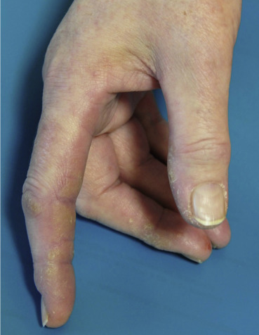
Mechanics hands in patients with antisynthetase syndrome: 25 cases.
Linear keratotic papules and plaques on the lateral and palmar surfaces of the first fingers on each hand, with pulpitis and fissures
Associated with lower cancer risk
Gusdorf, 2019
Notes:
Mechanics hands, as in my patient, are most frequently associated with antisynthetase syndrome and anti-Jo-1 positivity though not exclusively this Ab as you see in this table. The finding is also not unique to this disease (contact dermatitis, DM, SLE, other inflammatory myopathies, & SSc). The condition is characterized by linear keratotic papules and plaques on the lateral and palmar surfaces of the first fingers on each hand, together with pulpitis and fissures. Mechanics hands have been reported to be associated with a lower cancer risk.
___________
Gusdorf L, Morruzzi C, Goetz J, Lipsker D, Sibilia J, Cribier B. Mechanics hands in patients with antisynthetase syndrome: 25 cases. Ann Dermatol Venereol. 2019;146(1):19-25. doi:10.1016/j.annder.2018.11.010
"highly specific semiology consisting of linear keratotic papules and plaques on the lateral and palmar surfaces of the first fingers on each hand, together with pulpitis and fissures."
"Importance of mechanic's hands
This condition is found primarily in ASS [32], but also in dermatomyositis [8], [33], lupus erythematosus [8] and in other inflammatory myopathies and connectivitis [30], [34], particularly in scleroderma/polymyositis with anti-PM-Scl antibodies in the absence of ASA [35]. The description of mechanic's hands does not appear to vary according to the different associated diseases. In dermatomyositis, the presence of mechanic's hands appears to be associated with increased risk of diffuse interstitial lung disease [36], but also with a better prognosis [37], less severe muscular environment and a lower prevalence of cancer."
"The risk of cancer in the case of dermatomyositis has been clearly established [40] and the presence of mechanic's hands appears to be associated with lower risk [37]. The risk of cancer during ASS is not well known. The role of anti-Jo1 antibodies has not been elucidated: depending on different studies, anti-Jo1 antibodies have been found to be associated variously with reduced risk of cancer [41] or with increased risk [42], or else to be devoid of any predictive value [5]."

Slide 17
Incomplete Antisynthetase Syndrome
225 Jo-1 +
181 Incomplete
110 Single
71 Double
44 Triple
54 Arthritis (24%)
28 Myositis (12%)
28 ILD (12%)
Cavagna et al, 2015
Notes:
The next question this case raised for me was that of how common it is for antisynthetase syndrome to present without the complete triad of arthritis, myositis, and interstitial lung disease (ILD). One international, multicenter, retrospective study explored this which was the largest of its kind for this disease at the time of publication. They looked at 225 Jo-1 positive patients with a mean follow up of 80 months. They found that at the onset, 181 of the patients had incomplete antisynthetase syndrome, 110 of those had just one problem from the triad (isolated arthritis in 54 cases, isolated myositis in 28 cases, and isolated ILD in 28 cases).
(As a sidenote, the authors make an interesting case for Jo-1 Ab testing in isolated arthritis, including in patients with RF and CCP autoantibodies and erosions on XR, which is a topic for another day.)
______
Cavagna L, Nuño L, Scirè CA, et al. Clinical Spectrum Time Course in Anti Jo-1 Positive Antisynthetase Syndrome: Results From an International Retrospective Multicenter Study. Medicine (Baltimore). 2015;94(32):e1144. doi:10.1097/MD.0000000000001144
Bartoloni E, Gonzalez-Gay MA, Scirè C, et al. Clinical follow-up predictors of disease pattern change in anti-Jo1 positive anti-synthetase syndrome: Results from a multicenter, international and retrospective study. Autoimmun Rev. 2017;16(3):253-257. doi:10.1016/j.autrev.2017.01.008
Tang HS, Tang IYK, Ho RTC, et al. Clinical heterogeneity and prognostic factors of anti-synthetase syndrome: a multi-centered retrospective cohort study. Rheumatology (Oxford). Published online December 14, 2023. doi:10.1093/rheumatology/kead671

Slide 18
Literature
Polymyalgia Rheumatica

Slide 19
Interstitial Lung Disease in Patients with Polymyalgia Rheumatica: A Case Series
Sambataro G, Sambataro D, Pignataro F, et al. Respir Med Case Rep. 2018;26:126-130
Retrospective
Patients referred to a rare lung disease center in Italy over the course of one year
Preexisting diagnosis of PMR at the time of referral, as well as respiratory symptoms including subjective weakness, shortness of breath, dry cough unresponsive to low doses of corticosteroids
Berthold Werner
Sumbataro et al., 2018
Notes:
Turning to the PMR literature, I also looked for reports of the incidence of ILD in patients previously diagnosed with PMR. Sambataro and colleagues published on this subject in in 2018.
___________
Sambataro G, Sambataro D, Pignataro F, et al. Interstitial Lung Disease in patients with Polymyalgia Rheumatica: A case series. Respir Med Case Rep. 2018;26:126-130. Published 2018 Dec 21. doi:10.1016/j.rmcr.2018.12.014
Picture is University of Catania

Slide 20
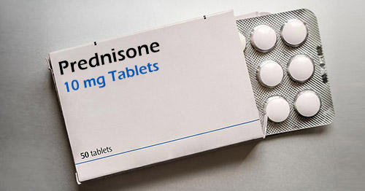
Interstitial Lung Disease in Patients with Polymyalgia Rheumatica: A Case Series
15 patients
12 did not have good control of PMR symptoms on low doses of prednisone (10mg or less)
Reconsidered original diagnosis:
3 RA
1 SJS
1 high titer positive PL7 and Mi2 classified as antisynthetase syndrome
7 confirmed diagnosis of PMR
Sumbataro et al., 2018
Notes:
While true muscle weakness is what had prompted us to reconsider the diagnosis of PMR, had someone incidentally discovered her NSIP, that could itself has easily prompted the re-broadened differential.
_______
Sambataro G, Sambataro D, Pignataro F, et al. Interstitial Lung Disease in patients with Polymyalgia Rheumatica: A case series. Respir Med Case Rep. 2018;26:126-130. Published 2018 Dec 21. doi:10.1016/j.rmcr.2018.12.014
Symptom timeline
2 had had stiffness before respiratory symptoms (RA and SjS)
Image: https://www.hss.edu/conditions_steroid-side-effects-how-to-reduce-corticosteroid-side-effects.asp

Slide 21
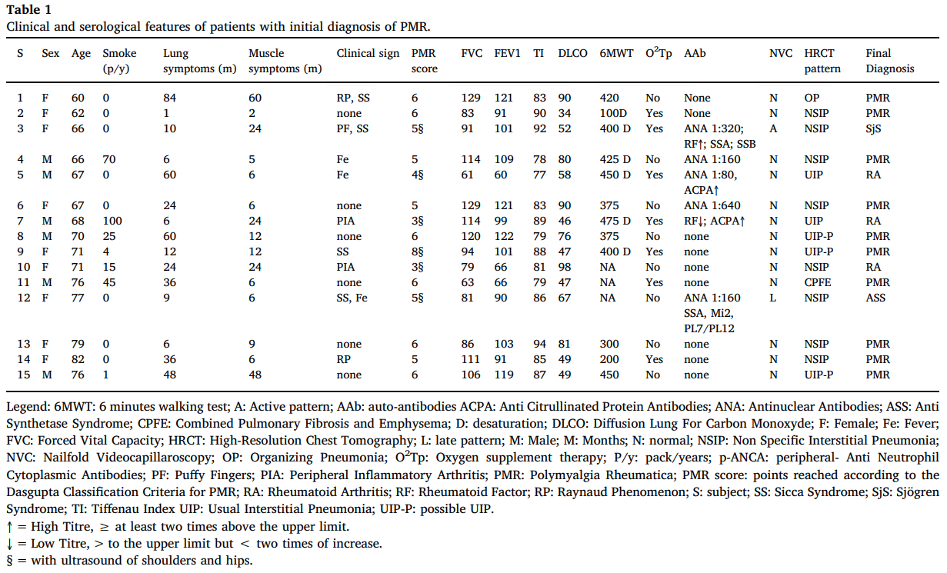
Sumbataro et al., 2018​
Notes:
This patient differed from mine in several ways, including that she had Mi2 antibodies

Slide 22
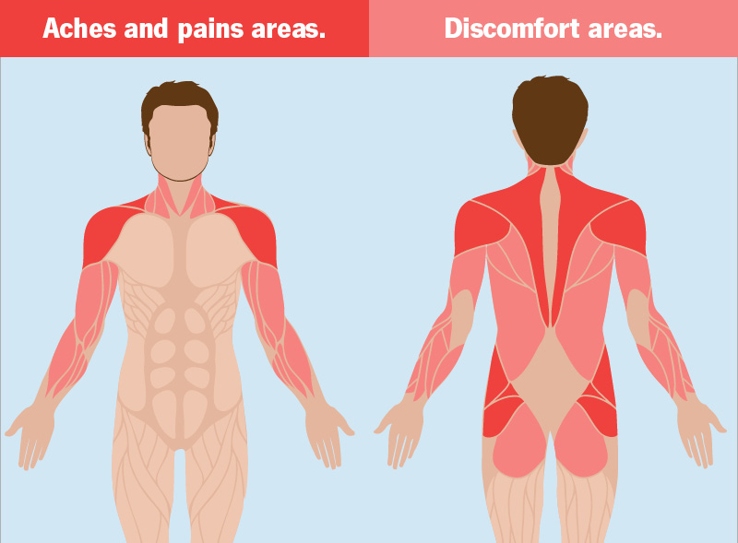
Polymyalgia Rheumatica
8–28% of patients are re-classified with another disease during follow-up
Camellino et al., 2019
https://my.clevelandclinic.org/health/diseases/25215-polymyalgia-rheumatica
Notes:
A key takeaway is the reminder that PMR, which feels like a straightforward clinical diagnosis which can be made in primary care, is actually not always straightforward. In fact, 8-28% of patients are reclassified... even as in this case when they presented with the typical clinical syndrome: abrupt onset of pain in the shoulders and hips, which can spread down the limbs, sometimes with peripheral arthritis of the wrists or knees and prolonged morning stiffness and elevated inflammatory markers. (Though in a small number of cases (<5%) inflammatory markers can be normal.)
_________
Camellino D, Giusti A, Girasole G, Bianchi G, Dejaco C. Pathogenesis, Diagnosis and Management of Polymyalgia Rheumatica. Drugs Aging. 2019;36(11):1015-1026. doi:10.1007/s40266-019-00705-5
"The diagnosis of polymyalgia rheumatica is usually based on clinical presentation and increase of inflammatory markers. There are no pathognomonic findings that can confirm the diagnosis. "
"The typical presentation of PMR consists of pain in the shoulders and in the hips, often spreading to the arms and limbs [1]. Pain can develop abruptly or progressively during the course of weeks. It is typically more intense during the night and in the first part of the day, and is associated with prolonged morning stiffness. Patients often report malaise, fever and weight loss. Peripheral arthritis, especially at the level of the wrist and the knee, can be present [9, 10]. "
"The diagnosis of PMR is usually based on clinical presentation, namely pain and stiffness in the neck, shoulder and pelvic girdles, associated with prolonged morning stiffness and increased ESR and CRP."
"There are no laboratory tests that confirm the diagnosis of PMR and, even in specialised centres, 8–28% of patients have to be re-classified with another disease during follow-up [51, 52]. The primary differential diagnosis of PMR consists of elderly-onset RA, which might present with girdle pain and, if rheumatoid factor (RF) and anti-citrullinated peptide antibodies (ACPA) are absent, the correct diagnosis is often made only during follow-up."
&Matteson EL, Dejaco C. Polymyalgia Rheumatica. Ann Intern Med. 2017;166(9):ITC65-ITC80. doi:10.7326/AITC201705020

Slide 23
Polymyalgia Rheumatica Differential Diagnosis
Inflammatory arthritis
Vasculitis
Elderly-onset rheumatoid arthritis
Spondyloarthropathy
Vasculitis (giant cell arteritis; antineutrophil cytoplasmic antibody–associated vasculitis, including microscopic polyangiitis and granulomatous polyangiitis)
Inflammatory myopathies
Crystalline arthritis
Noninflammatory musculoskeletal disorders
Rotator cuff disease
Adhesive capsulitis
Degenerative joint disease
Fibromyalgia
Endocrinopathies
Thyroid diseases
Disorders of the parathyroid gland
Infection
Viral syndromes, such as parvovirus B19, hepatitis B, HIV
Bacterial infections, such as endocarditis or disk space infection
Mycobacterial
Cancer
Parkinsonism
Depression
Vitamin D deficiency
Drug-induced myopathy, such as from statins
Notes:
This is just one published compilation of the PMR ddx. Elderly-onset RA, which if RF and ACPA are negative, is typically only diagnosed in follow up. But there are quite a few other conditions to be considered in the appropriate contexts, including the inflammatory myopathies.
_________
Matteson EL, Dejaco C. Polymyalgia Rheumatica. Ann Intern Med. 2017;166(9):ITC65-ITC80. doi:10.7326/AITC201705020

Slide 24
ACR 2015 PMR Management Guidelines
Initial Workup
Additional workup to consider
RF, ACPA
CRP and/or ESR
CBC, CMP, dipstick urinalysis
SPEP
TSH
CK
Vitamin D
Notes:
Accordingly, the 2015 EULAR/ACR guidelines for PMR management recommend an additional workup which would capture common alternate diagnoses. And among the additional workup to consider is CK, which I find myself reaching for more often.
_______________
https://rheumatology.org/polymyalgia-rheumatica-guideline Dejaco C, Singh YP, Perel P, Hutchings A, Camellino D, Mackie S, Abril A, Bachta A, Balint P, Barraclough K, Bianconi L, Buttgereit F, Carsons S, Ching D, Cid M, Cimmino M, Diamantopoulos A, Docken W, Duftner C, Fashanu B, Gilbert K, Hildreth P, Hollywood J, Jayne D, Lima M, Maharaj A, Mallen C, Martinez-Taboada V, Maz M, Merry S, Miller J, Mori S, Neill L, Nordborg E, Nott J, Padbury H, Pease C, Salvarani C, Schirmer M, Schmidt W, Spiera R, Tronnier D, Wagner A, Whitlock M, Matteson EL, Dasgupta B; European League Against Rheumatism; American College of Rheumatology. 2015 recommendations for the management of polymyalgia rheumatica: a European League Against Rheumatism/American College of Rheumatology collaborative initiative. Arthritis Rheumatol. 2015 Oct;67(10):2569-80. doi: 10.1002/art.39333. PMID: 26352874.
Box 1. Summary of the 2015 European League Against Rheumatism (EULAR)/American College of Rheumatology (ACR) recommendations
for the management of polymyalgia rheumatica (PMR)
Target population:
Patients with PMR based on clinician diagnosis which may be supported by currently available diagnostic or classification criteria (3,4,7–11).
Overarching principles for the management of PMR:
A. Adoption of a safe and specific approach to ascertain the PMR case definition. The clinical evaluation should be directed toward exclusion of rele-
vant mimicking (eg, non-inflammatory, inflammatory (such as giant cell arteritis or rheumatoid arthritis), drug-induced, endocrine, infective and neo-
plastic) conditions.
B. Every case of PMR should have the following assessments prior to the prescription of therapy (primary or secondary care):
" Documentation of a basic laboratory dataset. This will help to exclude mimicking conditions and establish a baseline for monitoring of therapy.
This should include rheumatoid factor and/or anti–cyclic citrullinated peptide antibodies (ACPA), C-reactive protein and/or erythrocyte sedi-
mentation rate (ESR), blood count, glucose, creatinine, liver function tests, bone profile (including calcium, alkaline phosphatase) and dipstick
urinalysis. Additional investigations to consider are protein electrophoresis, thyroid stimulating hormone (TSH), creatine kinase and vitamin D

Slide 25
Summary
We reviewed a case of Jo-1 Ab positive antisynthetase syndrome which was an amended diagnosis from PMR.
We reviewed common features of antisynthetase syndrome.
Patients with arthritis in the setting of antisynthetase syndrome can often have a long delay in diagnosis.
PMR has a broad differential. Making the correct clinical diagnosis is complicated by transitions in care and initial rheumatology evaluations taking place after glucocorticoids have understandably been started.

Slide 26
References
Camellino D, Giusti A, Girasole G, Bianchi G, Dejaco C. Pathogenesis, Diagnosis and Management of Polymyalgia Rheumatica. Drugs Aging. 2019;36(11):1015-1026. doi:10.1007/s40266-019-00705-5
Cavagna L, Nuño L, Scirè CA, et al. Clinical Spectrum Time Course in Anti Jo-1 Positive Antisynthetase Syndrome: Results From an International Retrospective Multicenter Study. Medicine (Baltimore). 2015;94(32):e1144. doi:10.1097/MD.0000000000001144
Dejaco C, et al. European League Against Rheumatism; American College of Rheumatology. 2015 recommendations for the management of polymyalgia rheumatica: a European League Against Rheumatism/American College of Rheumatology collaborative initiative. Arthritis Rheumatol. 2015 Oct;67(10):2569-80. doi: 10.1002/art.39333. PMID: 26352874.
Gusdorf L, Morruzzi C, Goetz J, Lipsker D, Sibilia J, Cribier B. Mechanics hands in patients with antisynthetase syndrome: 25 cases. Ann Dermatol Venereol. 2019;146(1):19-25. doi:10.1016/j.annder.2018.11.010
Marco JL, Collins BF. Clinical manifestations and treatment of antisynthetase syndrome. Best Pract Res Clin Rheumatol. 2020;34(4):101503. doi:10.1016/j.berh.2020.101503
Matteson EL, Dejaco C. Polymyalgia Rheumatica. Ann Intern Med. 2017;166(9):ITC65-ITC80. doi:10.7326/AITC201705020
Sambataro G, Sambataro D, Pignataro F, et al. Interstitial Lung Disease in patients with Polymyalgia Rheumatica: A case series. Respir Med Case Rep. 2018;26:126-130. Published 2018 Dec 21. doi:10.1016/j.rmcr.2018.12.014
Notes:
https://www.rawpixel.com/image/5947564/free-public-domain-cc0-photo

Slide 27
Objectives
Attendees will have a refreshed differential diagnosis for suspected PMR.
Attendees will recognize and evaluate for extra-articular manifestations of the disease ultimately diagnosed in the following case.

Slide 28
Interstitial Lung Disease in Patients with Polymyalgia Rheumatica: A Case Series
Takeaways:
Isolated ILD in the setting of PMR may go unnoticed if it is steroid responsive
ILD should be suspected in PMR patients when subjective weakness is not resolved by low doses of corticosteroids
A new diagnosis of ILD should prompt reconsideration of the original PMR diagnosis
Reminder that PMR criteria have a high sensitivity and low specificity
RA is not the only PMR look-alike
Notes:
Sambataro G, Sambataro D, Pignataro F, et al. Interstitial Lung Disease in patients with Polymyalgia Rheumatica: A case series. Respir Med Case Rep. 2018;26:126-130. Published 2018 Dec 21. doi:10.1016/j.rmcr.2018.12.014

Slide 29
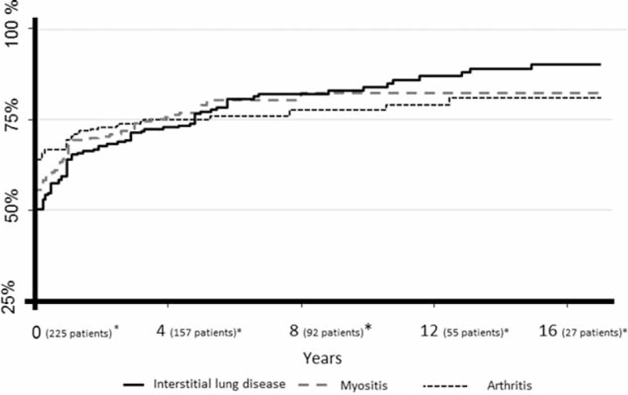
Incomplete Antisynthetase Syndrome
Cavagna et al, 2015
Notes:
This graph shows the development of additional manifestations over time, with the solid black line displaying the development of ILD. This complication we fear, ILD, is also the most common condition to develop later on in those who have incomplete disease at onset, eventually affecting 67% of patients who did not have ILD at baseline within the timeframe of the study. 60% of patients with incomplete forms at onset develop additional manifestations within the first year of disease (steep part of curve).
_____
Cavagna L, Nuño L, Scirè CA, et al. Clinical Spectrum Time Course in Anti Jo-1 Positive Antisynthetase Syndrome: Results From an International Retrospective Multicenter Study. Medicine (Baltimore). 2015;94(32):e1144. doi:10.1097/MD.0000000000001144
____
Bartoloni E, Gonzalez-Gay MA, Scirè C, et al. Clinical follow-up predictors of disease pattern change in anti-Jo1 positive anti-synthetase syndrome: Results from a multicenter, international and retrospective study. Autoimmun Rev. 2017;16(3):253-257. doi:10.1016/j.autrev.2017.01.008
Tang HS, Tang IYK, Ho RTC, et al. Clinical heterogeneity and prognostic factors of anti-synthetase syndrome: a multi-centered retrospective cohort study. Rheumatology (Oxford). Published online December 14, 2023. doi:10.1093/rheumatology/kead671

